Slide 1


Audacious Android Application Programming Workshop
This work is licensed under a Creative Commons Attribution 3.0 Unported License
Dr. Frank McCown
Computer Science Dept.
Harding University
Searcy, Arkansas, USA
March 9, 2011

Slide 2
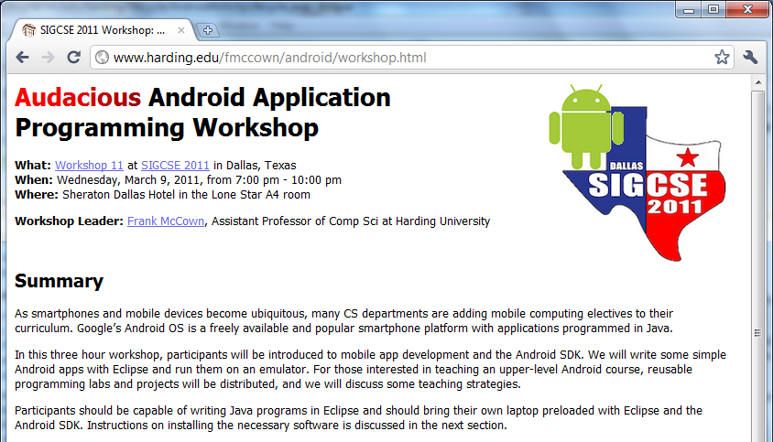
Workshop Website
http://www.harding.edu/fmccown/android/workshop.html

Slide 3
Setup Development Environment
Install JDK 6
Install Eclipse IDE for Java EE Developers (version 3.5 or 3.6)
Download and unpack the Android SDK
Install Android Development Tools (ADT) plugin for Eclipse
Using the Android SDK and AVD Manager, add the SDK Platform Android 2.2, API 8 package
Detailed install instructions available on Android site
http://developer.android.com/sdk/installing.html

Slide 4
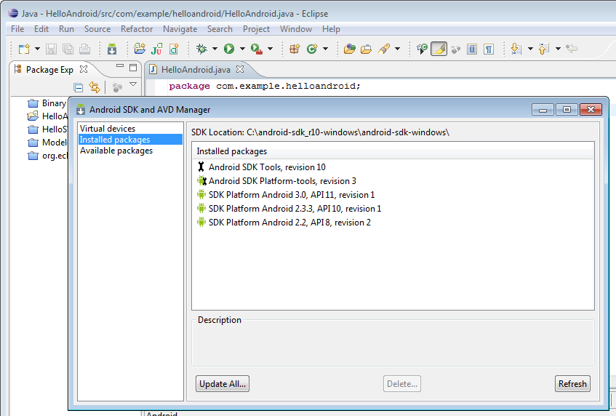

Slide 5
Agenda
Introduction to Android
Android emulator basics
Mobile devices and applications
Simple Android app
10 minute break
Android activities and intents
Tic-tac-toe example
User interface issues
Wrap-up

Slide 6
Why Mobile App Development?
Mobile platform is the platform of the future
  Double-digit growth in world-wide smartphone ownership³
Job market is hot
  Market for mobile software surges from $4.1 billion in 2009 to $17.5 billion by 2012¹
  2010 Dice.com survey: 72% of recruiters looking for iPhone app developers, 60% for Android¹
  Dice.com: mobile app developers made $85,000 in 2010 and salaries expected to rise²
Students are naturally interested!
¹ http://www.businessweek.com/technology/content/oct2010/tc20101020_639668.htm
² http://it-jobs.fins.com/Articles/SB129606993144879991/Mobile-App-Developers-Wanted-at-Ad-Agencies
³http://www.gartner.com/it/page.jsp?id=1466313

Slide 7
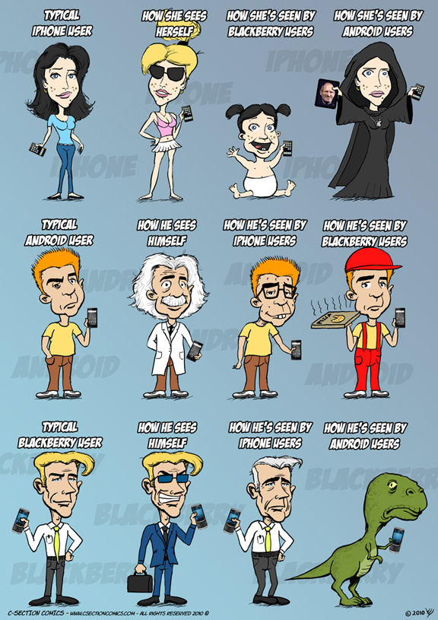
http://www.csectioncomics.com/2010/11/iphone-vs-android-vs-blackberry.html

Slide 8
Why Android?
A lot of students have them
  2010 survey by Univ of CO¹: 22% of college students have Android phone (26% Blackberry, 40% iPhone)
  Gartner survey²: Android used on 22.7% of smartphones sold world-wide in 2010 (37.6% Symbian, 15.7% iOS)
Students already know Java and Eclipse
  Low learning curve
  CS0 students can use App Inventor for Android
¹http://testkitchen.colorado.edu/projects/reports/smartphone/smartphone-appendix1/
²http://www.gartner.com/it/page.jsp?id=1543014

Slide 9

Why Android?
Transferring app to phone is trivial
  Can distribute by putting it on the web
  Android Market for wider distribution
It’s not 1984
Image: http://www.youtube.com/watch?v=Pm8iTUI-MvU

Slide 10
Types of
Android Devices

Slide 11
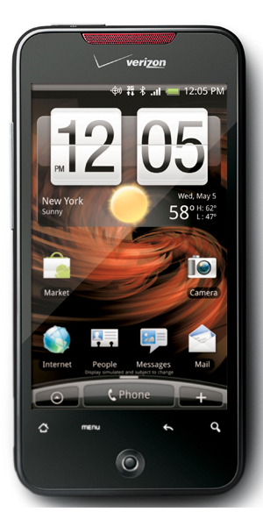
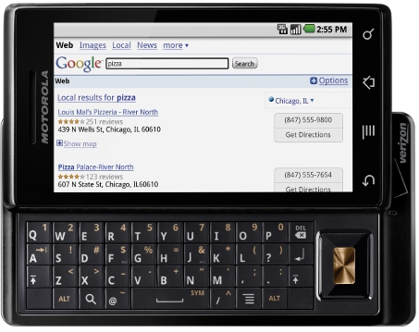
HTC Droid Incredible
Motorola Droid
http://www.androidcentral.com/droid-incredible
http://homebiss.blogspot.com/2009/11/motorola-droid-iphone-3gs.html

Slide 12
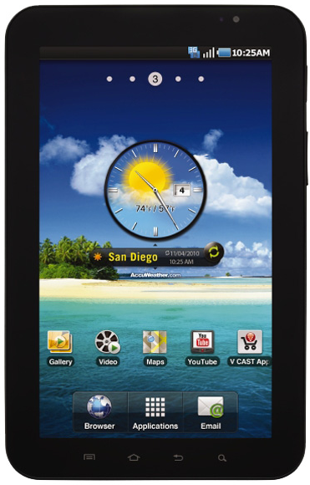
Galaxy Tablet
Retail: $250 with 2 year contract
7-inch 1024 x 600-pixel LCD screen
0.84 pounds
7.48 x 4.74 x 0.47 inches
1 GHz Coretx A8 processor
512 MB RAM
16 or 32 GB internal storage
Front and rear cameras
http://www.samsung.com/us/mobile/galaxy-tab/SCH-I800BKAVZW

Slide 13
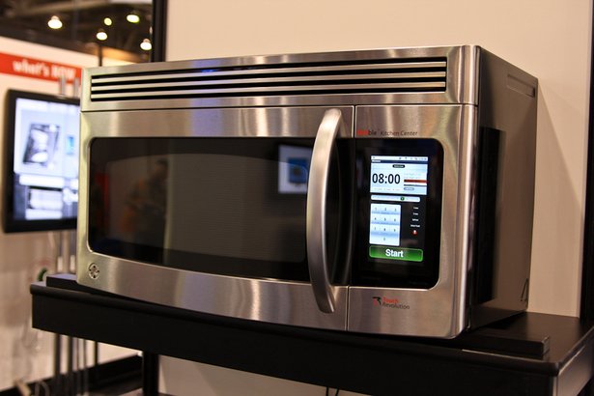
Android-Powered Microwave
By Touch Revolution – at CES 2010
http://www.pocket-lint.com/news/30712/android-powered-microwave-cooking-google

Slide 14
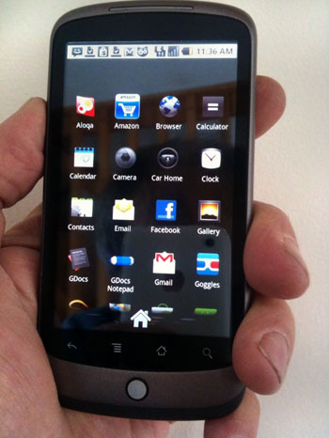
Google Nexus One
Retail: $530
Not tied to single provider
3.7-inch 800 x 400-pixel OLED screen
No support for multitouch
512 MB of built-in flash memory
Preloaded 4 GB SD card
Ubiquitous voice recognition
5-megapixel camera with zoom and flash
Navigation system using Google Maps and GPS
http://www.wired.com/reviews/product/pr_nexus_one
Notes:
named after a robot in Bladerunner

Slide 15
Brief History
2005
  Google acquires startup Android Inc. to start Android platform
  Work on Dalvik VM begins
2007
  Open Handset Alliance announced
  Early look at SDK
2008
  Google sponsors 1st Android Developer Challenge
  T-Mobile G1 announced
  SDK 1.0 released
  Android released open source (Apache License)
  Android Dev Phone 1 released
Pro Android by Hashimi & Komatineni (2009)
Notes:
Open Handset Alliance, a consortium of 47 hardware, software, and telecom companies devoted to advancing open standards for mobile devices. Includes Texas Instruments, Broadcom Corporation, Google, HTC, Intel, LG, Marvell Technology Group, Motorola, Nvidia, Qualcomm, Samsung Electronics, Sprint Nextel and T-Mobile

Slide 16
Brief History cont.
2009
  SDK 1.5 (Cupcake)
    New soft keyboard with “autocomplete” feature
  SDK 1.6 (Donut)
    Support Wide VGA
  SDK 2.0/2.0.1/2.1 (Eclair)
    Revamped UI, browser
2010
  Nexus One released to the public
  SDK 2.2 (Froyo)
    Flash support, tethering
  SDK 2.3 (Gingerbread)
    UI update, system-wide copy-paste

Slide 17
Brief History cont.
2011
  SDK 3.0 (Honeycomb) for tablets only
    New UI for tablets, support multi-core processors

Slide 18
What is Google Android?
A software stack for mobile devices that includes
  An operating system
  Middleware
  Key Applications
Uses Linux to provide core system services
  Security
  Memory management
  Process management
  Power management
  Hardware drivers

Slide 19
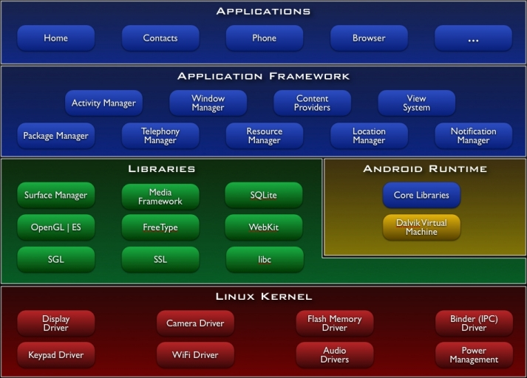
http://developer.android.com/guide/basics/what-is-android.html

Slide 20
Android Emulator or AVD
Emulator is essential to testing app but is not a substitute for a real device
Emulators are called Android Virtual Devices (AVDs)
Android SDK and AVD Manager allows you to create AVDs that target any Android API level
AVD have configurable resolutions, RAM, SD cards, skins, and other hardware

Slide 21
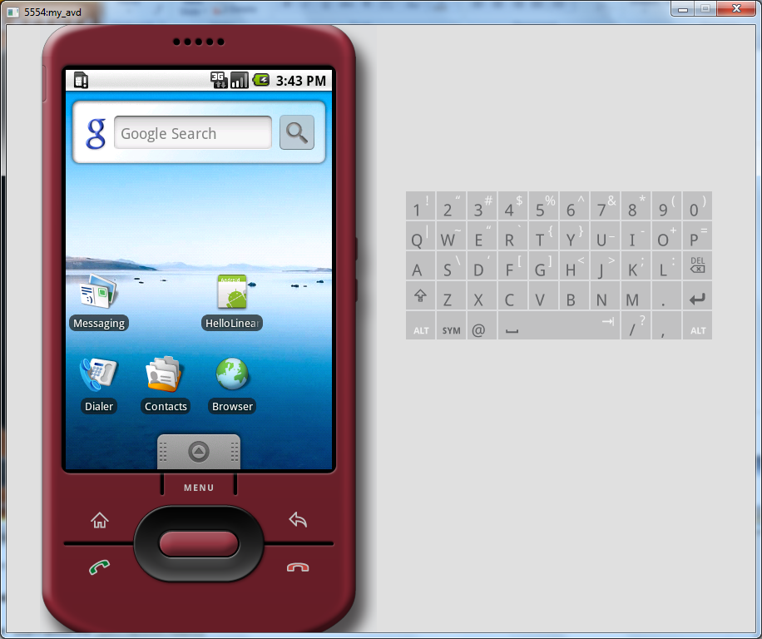
Android Emulator: 1.6 Device

Slide 22
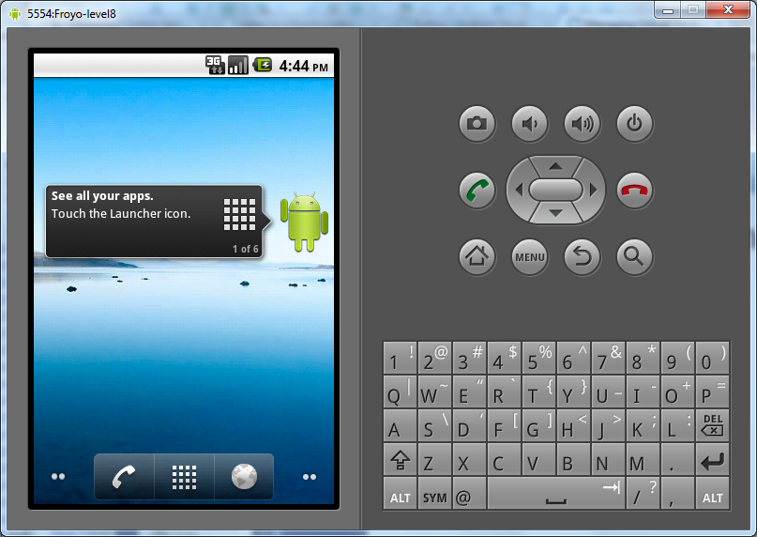
Android Emulator: 2.2 Device

Slide 23
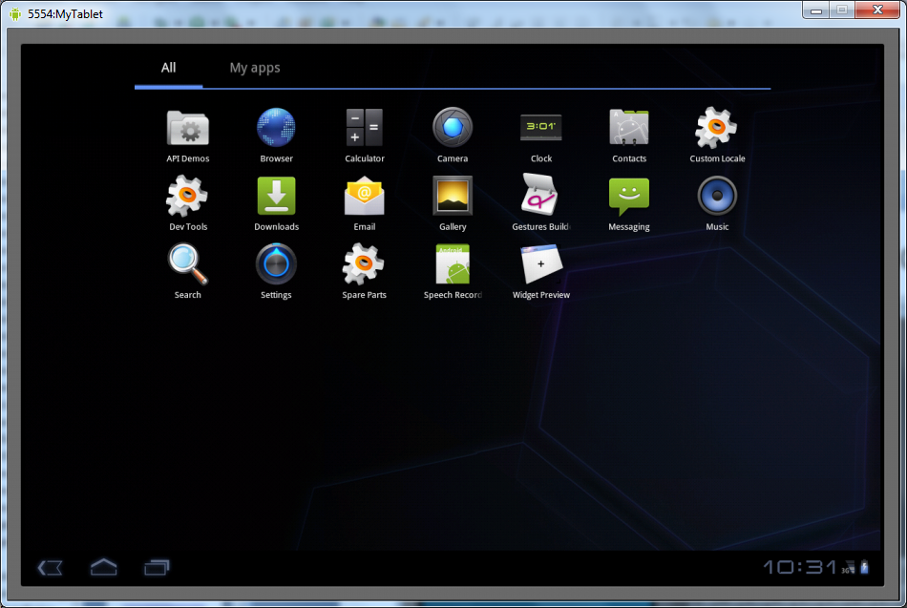
Android Emulator: 3.0 Device

Slide 24
Emulator Basics
Host computer’s keyboard works
Host’s mouse works like finger
Uses host’s Internet connection
Side buttons work: Home, Menu, Back, Search, volume up and down, etc.
Ctrl-F11 toggle landscape → portrait
Alt-Enter toggle full-screen mode
More info at http://developer.android.com/guide/developing/devices/emulator.html

Slide 25
Emulator Limitations
No support for placing or receiving actual phone calls
  Simulate phone calls (placed and received) through the emulator console
No support for USB connections
No support for camera/video capture (input)
No support for device-attached headphones
No support for determining connected state
No support for determining battery charge level and AC charging state
No support for determining SD card insert/eject
No support for Bluetooth
No support for simulating the accelerometer
  Use OpenIntents’s Sensor Simulator

Slide 26
In other words, test your app on an actual device!

Slide 27
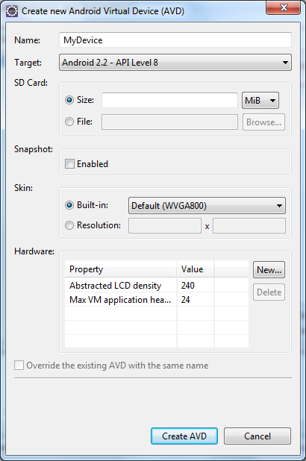
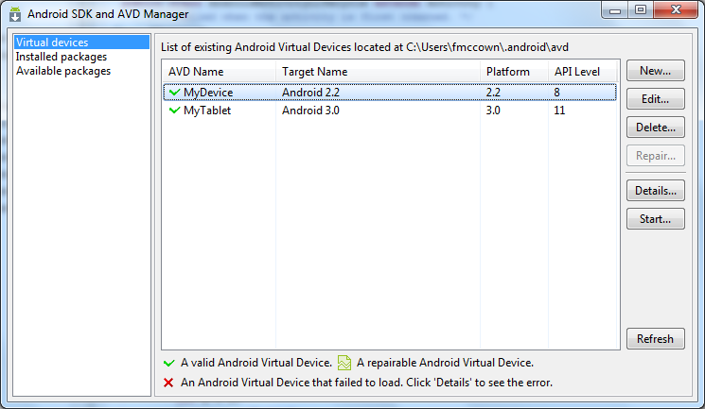
Create an AVD using
Android SDK and AVD Manager

Slide 28
Or From the Command Line
C:\android-sdk-windows\tools>android create avd -n MyDevice -t android-8
Android 2.2 is a basic Android platform.
Do you wish to create a custom hardware profile [no]
Created AVD 'MyDevice2' based on Android 2.2,
with the following hardware config:
hw.lcd.density=240
vm.heapSize=24
C:\android-sdk-windows\tools>emulator -avd MyDevice
Device name
Target platform
Launch device
More info:
http://developer.android.com/guide/developing/devices/managing-avds-cmdline.html

Slide 29
Play Time:
Get to know your Emulator

Slide 30
Mobile Devices: Advantages
Always with the user
Typically have Internet access
Typically GPS enabled
Typically have accelerometer & compass
Many have cameras & microphones
Many apps are free or low-cost

Slide 31
Mobile Devices: Disadvantages
Limited screen size
Limited battery life
Limited processor speed
Limited and sometimes slow network access
Limited or awkward input: soft keyboard, phone keypad, touch screen, or stylus
Limited web browser functionality
Range of platforms & configurations across devices

Slide 32
Mobile Applications
What are they?
  Any application that runs on a mobile device
Types
  Web apps: run in a web browser
    HTML, JavaScript, Flash, server-side components, etc.
  Native: compiled binaries for the device
    Often make use of web services

Slide 33
Android Apps
Built using Java and new SDK libraries
  No support for some Java libraries like Swing & AWT
  Oracle currently suing Google over use
Java code compiled into Dalvik byte code (.dex)
  Optimized for mobile devices (better memory management, battery utilization, etc.)
Dalvik VM runs .dex files

Slide 34
Applications Are Boxed
By default, each app is run in its own Linux process
  Process started when app’s code needs to be executed
  Threads can be started to handle time-consuming operations
Each process has its own Dalvik VM
By default, each app is assigned unique Linux ID
  Permissions are set so app’s files are only visible to that app

Slide 35

Producing an Android App
Java code
javac
Byte code
Dalvik exe
dx
.java
.class
classes.dex
aapt
Byte code
<xml>
Other .class files
AndroidManifest.xml
.apk
<str>
Resources
Notes:
Every application must have an AndroidManifest.xml file (with precisely that name) in its root directory. The manifest presents essential information about the application to the Android system, information the system must have before it can run any of the application's code. Among other things, the manifest does the following:
It names the Java package for the application. The package name serves as a unique identifier for the application.
It describes the components of the application — the activities, services, broadcast receivers, and content providers that the application is composed of. It names the classes that implement each of the components and publishes their capabilities (for example, which Intent messages they can handle). These declarations let the Android system know what the components are and under what conditions they can be launched.
It determines which processes will host application components.
It declares which permissions the application must have in order to access protected parts of the API and interact with other applications.
It also declares the permissions that others are required to have in order to interact with the application's components.
It lists the Instrumentation classes that provide profiling and other information as the application is running. These declarations are present in the manifest only while the application is being developed and tested; they're removed before the application is published.
It declares the minimum level of the Android API that the application requires.
It lists the libraries that the application must be linked against.

Slide 36
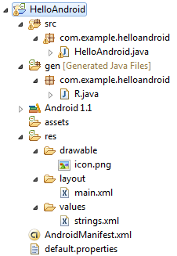
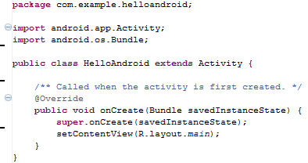
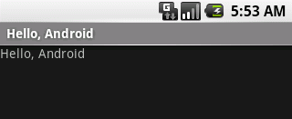
Hello Android Tutorial
http://developer.android.com/resources/tutorials/hello-world.html

Slide 37
Important Files
src/HelloAndroid.java
  Activity which is started when app executes
res/layout/main.xml
  Defines & lays out widgets for the activity
res/values/strings.xml
  String constants used by app
gen/R.java (Don’t touch!)
  Auto-generated file with identifiers from main.xml, strings.xml, and elsewhere
AndroidManifest.xml
  Declares all the app’s components
  Names libraries app needs to be linked against
  Identifies permissions the app expects to be granted

Slide 38
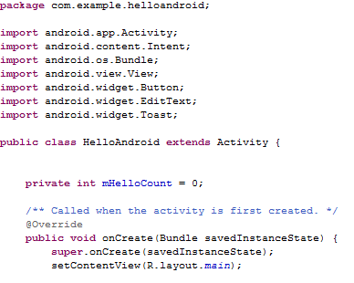
src/HelloAndroid.java
Activity which is started when app executes

Slide 39
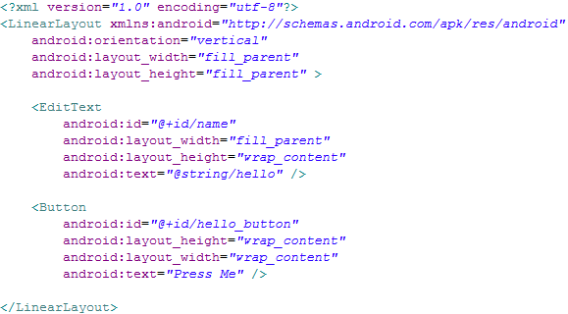
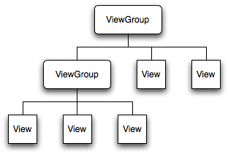
res/layout/main.xml
Declares layouts & widgets for the activity
Tree from: http://developer.android.com/guide/topics/ui/index.html
Notes:
A ViewGroup is a special view that can contain other views (called children.) The view group is the base class for layouts and views containers. The ViewGroup subclass is the base class for layouts, which are invisible containers that hold other Views (or other ViewGroups) and define their layout properties. LinearLayout is a subclass of ViewGroup.
The View class represents the basic building block for user interface components. A View occupies a rectangular area on the screen and is responsible for drawing and event handling. View is the base class for widgets, which are used to create interactive UI components (buttons, text fields, etc.).

Slide 40
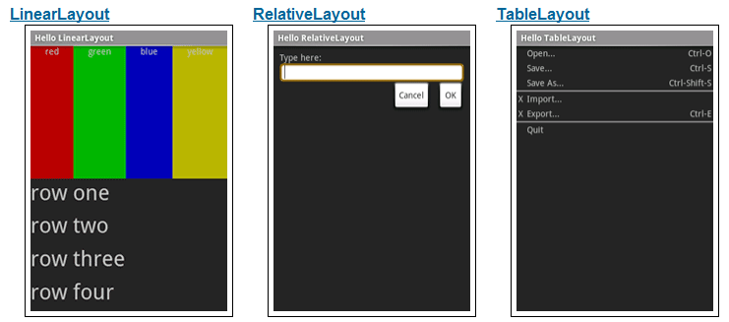
Various Layouts
http://developer.android.com/resources/tutorials/views/index.html

Slide 41
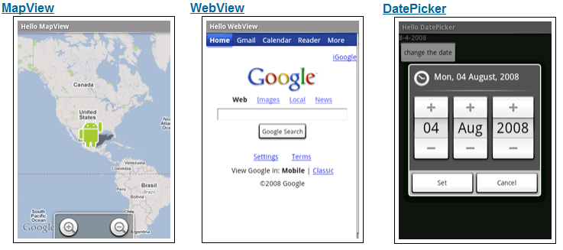
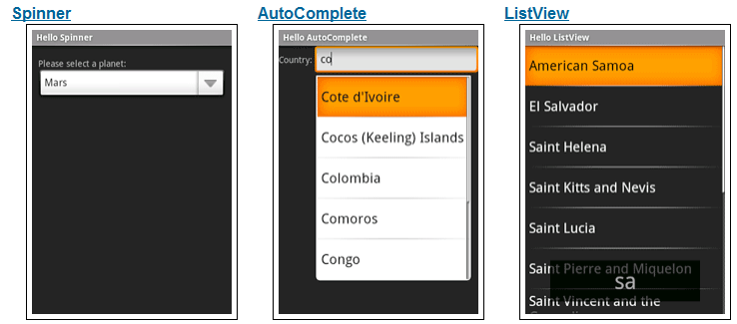
Various Widgets
http://developer.android.com/resources/tutorials/views/index.html

Slide 42

res/values/strings.xml
String constants used by app
Used for supporting Localization
  res/values-es/values/strings.xml to support Spanish
  res/values-fr/values/strings.xml to support French
  Etc.

Slide 43
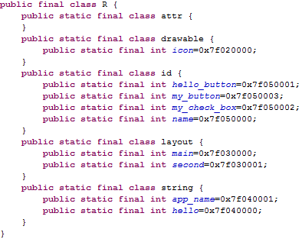
gen/R.java
Auto-generated file with identifiers from main.xml, strings.xml, and elsewhere
Do not modify!

Slide 44
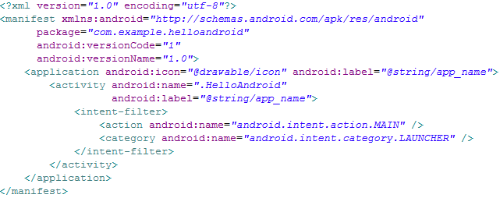
AndroidManifest.xml
Declares all the app’s components
Names libraries app needs to be linked against
Identifies permissions the app expects to be granted
Notes:
This is the most common IntentFilter seen in Android applications. The action android.intent.action.MAIN indicates that this is the first activity that should be executed when starting this app. The category android.intent.category.LAUNCHER places this Activity in
the launcher window (the window that lists all the available apps).

Slide 45
Four Application Components
Activities
  Presents a visual UI for a single endeavor
  Single app may be composed of several activities
  Examples: list of photos, buttons to start/stop a song
Services
  Performs background work (no UI)
  Examples: play background music, retrieve data over a network
Broadcast Receivers
  Receives and reacts to broadcast announcements (no UI)
  Broadcast examples: battery is low, pic is taken, lang pref changed
Content Providers
  Provides app data to other applications (no UI)
  Examples: share contact info from SQLite, image from the file system

Slide 46
Typical Game
High Scores
Activity
Splash Screen
Activity
Main Menu
Activity
Game Play
Activity
Settings
Activity
Conder & Darcey (2010), Fig 4.1, p. 74

Slide 47
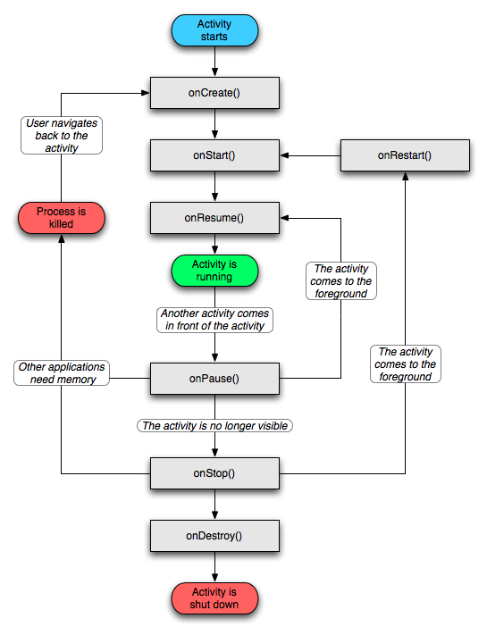
Activity Lifecycle
http://developer.android.com/reference/android/app/Activity.html

Slide 48
Lifecycle Demo

Slide 49
Intents
Activities, services, & broadcast receivers are activated by intents
  Intents are asynchronous messages
  May include data to be passed between components
  Example: A Service starts an Activity to pick a photo by using an intent. The photo is returned to the Service also using an intent.

Slide 50
Intent Demo
Hello
Android
Intent holding hello count
Second
Activity
startActivityForResult()
Intent holding
checkbox bool
setResult()

Slide 51
Data Storage
App’s data is private
  Can be shared using content providers
Four ways to store data:
  Preferences: Lightweight mechanism to store and retrieve key-value pairs of primitive data types
  Files: Store on mobile device or on a removable storage medium
  Databases: SQLite
  Network: Store/retrieve data stored elsewhere

Slide 52
Common Interface Issues
Menus
  Options menu
  Context menu
Touch gestures
  Tap/Touch
  Long press
  Double tap
  Pinch & spread
  Flick/swipe
  Drag
Responsiveness

Slide 53
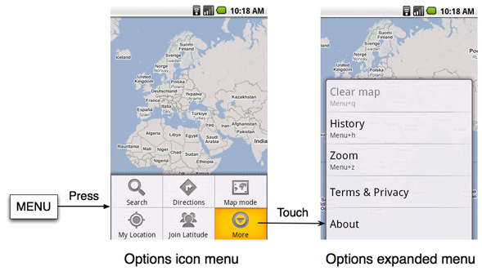
Options Menu
Activated by pressing MENU button
More than 6 items show in expanded menu

Slide 54
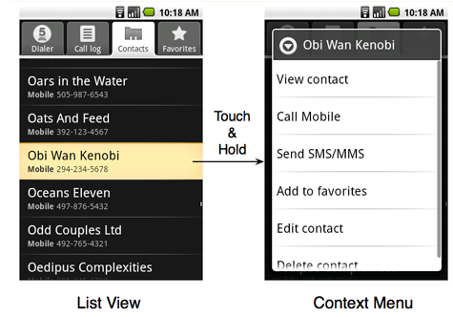
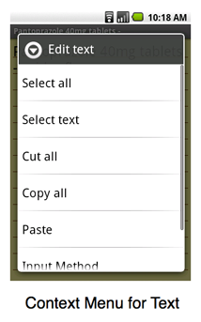
Context Menu
Activated by long touch on item
Most intuitive command should be listed first
Many users never see or use them, so items should usually be visible elsewhere
http://developer.android.com/guide/practices/ui_guidelines/menu_design.html

Slide 55
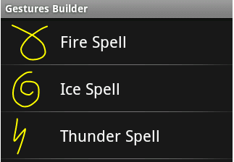
Touch Gestures
Tap or touch
  Most common action
  Used to select item
Long press
  Launch context menu or other intuitive action
Double tap
  Toggle zoom-in and zoom-out
Pinch & spread
  Zoom-in and out
Flick or swipe
  Switch between screens or scroll content
Drag
  Scroll, move items, or draw a path
Custom gestures
  android.gesture package
Image: http://developer.android.com/resources/articles/gestures.html

Slide 56
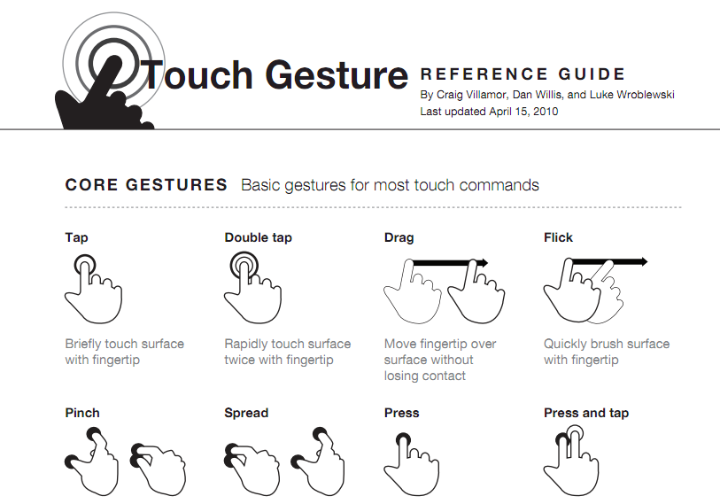
http://www.lukew.com/touch/TouchGestureGuide.pdf

Slide 57
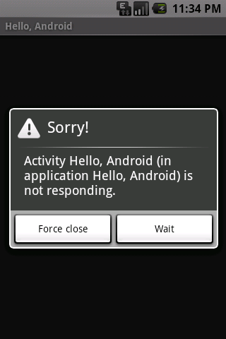
Responsiveness
Most important UI consideration is responsiveness
If app ignores input event for 5 seconds, Android displays the dreaded Application Not Responding (ANR) dialog
Often caused by performing lengthy operations like waiting for network response or AI to decide next move
Image: http://developer.android.com/guide/practices/design/responsiveness.html

Slide 58
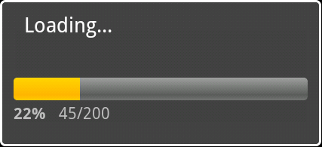

Avoiding ANR
Most apps run on a single thread
Any activity which may take a long time should be delegated to a child thread
Use progress bars to give users feedback when lengthy activities are being performed
Short wait
Long wait

Slide 59
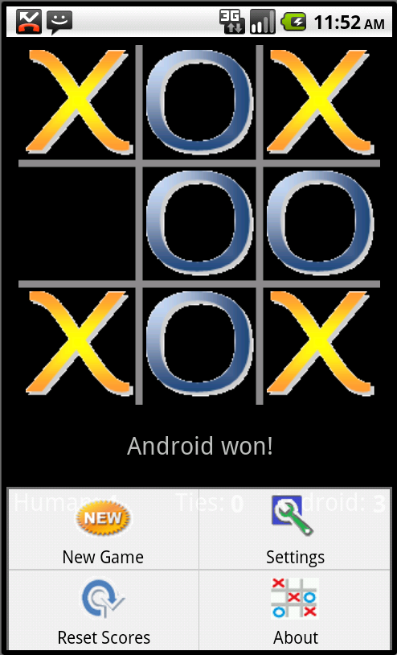
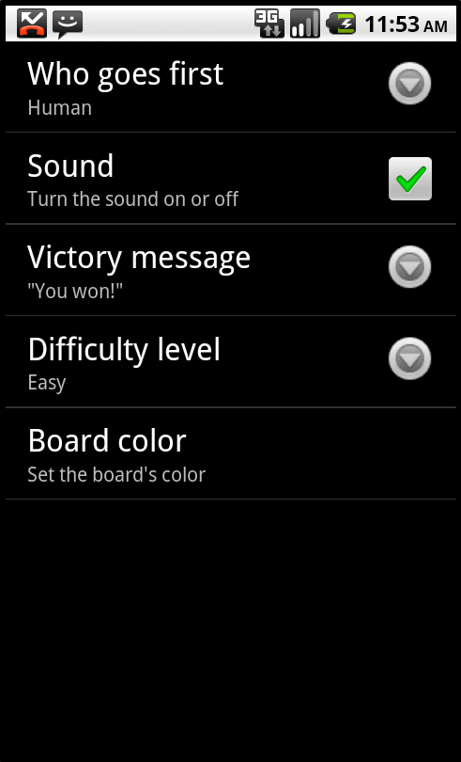
Tic-tac-toe

Slide 60
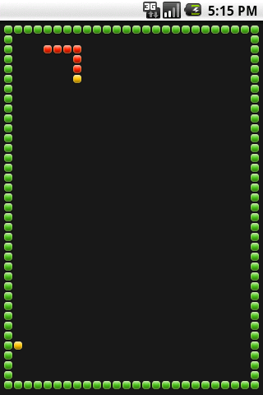
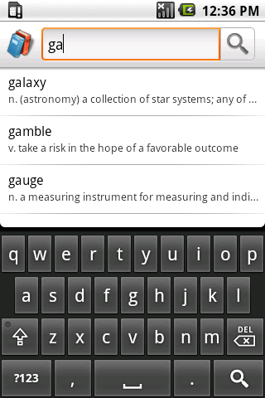
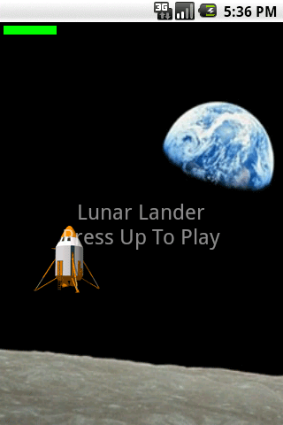
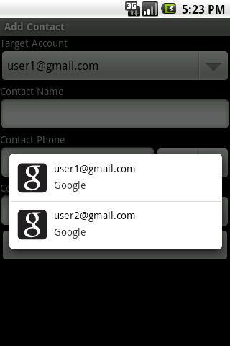
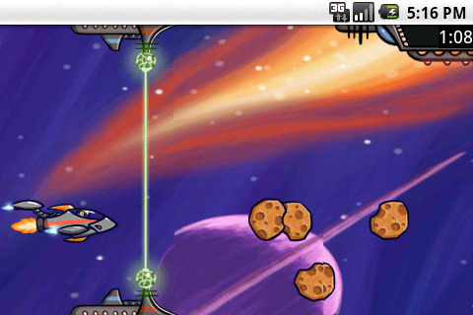
SDK Samples

