Slide 1
A Short History of the Internet and Web
Frank McCown
COMP 250 – Internet Development
Harding University

Slide 2
“God alone knows the future, but only an historian can alter the past.” -Ambrose Bierce

Slide 3
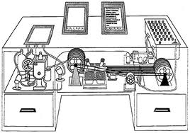
1945 – Vannevar Bush writes about “memex”, a futuristic, automatic, personal library system
1960s – Advanced Research Projects Agency (ARPA) does research on “internetwork”, connecting small and large networks
Notes:
1945 Vannevar Bush -The Atlantic Monthly article As We May Think.

Slide 4
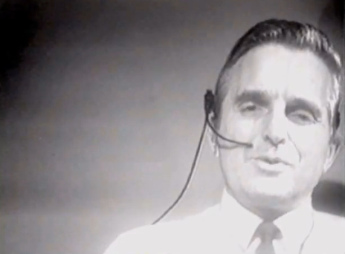
1968 – Doug Engelbart demonstrates NLS, a hypertext system that uses a “mouse”
1969 – ARPANET goes online with 4 nodes
“The Demo”
Notes:
On December 9, 1968, Douglas C. Engelbart and the group of 17 researchers working with him in the Augmentation Research Center at Stanford Research Institute in Menlo Park, CA, presented a 90-minute live public demonstration of the online system, NLS, they had been working on since 1962.

Slide 5
1971 – Ray Tomlinson sends first e-mail (sent to himself and probably read “QWERTYUIOP”)
1972 – Telnet allows user to login to a remote computer
1973 – FTP (File Transfer Protocol) allows files to be transferred between computers
1981 – ARPANET (Internet) has 200 nodes

Slide 6
1982 – ARPANET standardizes its use of TCP/IP (Transmission Control Protocol / Internet Protocol) to send data packets across the network
1984 – Over 1000 nodes on Internet
1986 – Over 10,000 nodes on Internet. Govt splits ARPANET into MILNET (military-only network) and turns over ARPANET to NSF (National Science Foundation).

Slide 7
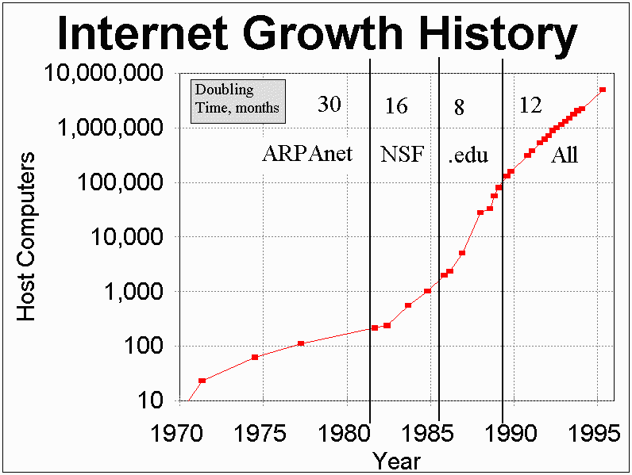
1988 – Over 100,000 nodes on Internet
1988 – First Internet worm by Robert Tappan Morris crashes 6% of servers on Internet
Figure by Roy Brander at http://www.cuug.ab.ca/~branderr/csce/Ihistory.html
Notes:
First Internet worm - Robert Tappan Morris, a 22-year-old Cornell University student, wrote and unleashed his Internet worm program which traveled the Internet and copied itself to each computer. The arrival of the worm crashed 6,000 computers, about six percent of the servers on the Internet. It did no other damage and did not modify or delete any files. Morris's software would have mapped the entire Internet, except that it had a tiny programming error which caused it to replicate repeatedly on each system. The error did have the benefit of revealing just how vulnerable the Internet was to intentional attack. Morris was punished with three years probation, 400 hours of community service, and a $10,000 fine.

Slide 8
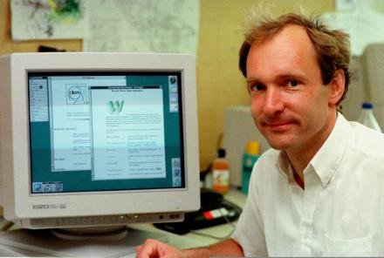
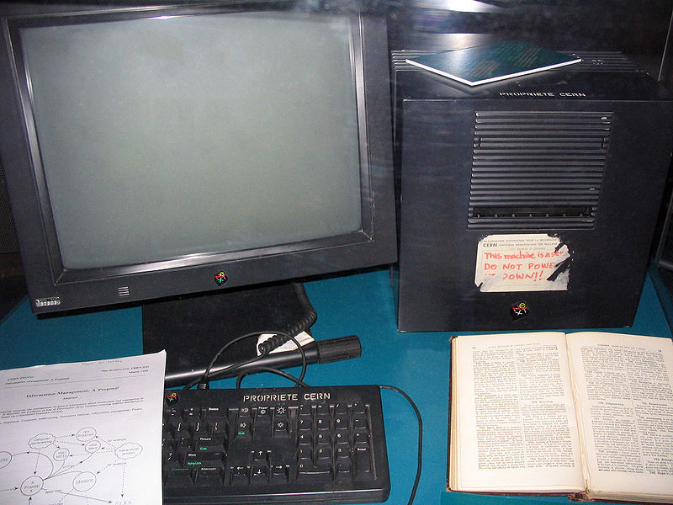
1990 – Tim Berners-Lee and researchers at CERN develop first text-only browser for accessing and viewing remote documents over “the Web”
Images: http://www.radford.edu/sjennings15/text.htm http://en.wikipedia.org/wiki/Tim_Berners-Lee
Notes:
This NeXT Computer was used by Berners-Lee at CERN and became the world's first Web server.

Slide 9
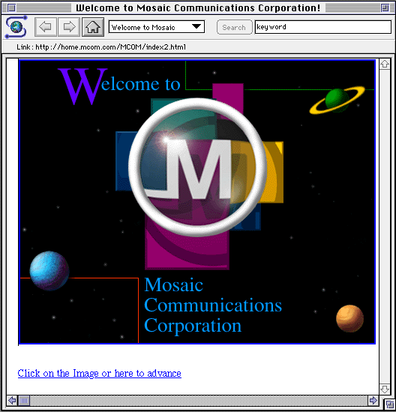
1992 – Viola browser. 50 web servers
1993 – 500 web servers Mosaic web browser – 1st browser to display graphics, written by Marc Andreesen
Image: http://en.wikipedia.org/wiki/File:NCSAMosaic1.0Mac.png

Slide 10
1994 – 2,500 web servers WWW Consortium (W3C) began Netscape 1.0 Yahoo! Web directory started by Jerry Yang and David Filo

Slide 11
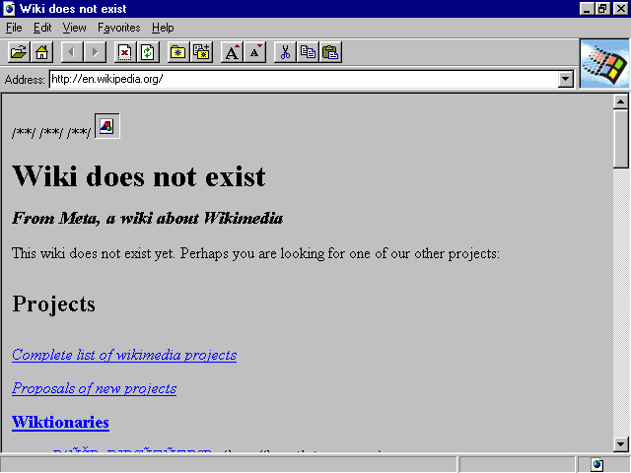
1995 – VRML (Virtual Reality Markup Language) released Netscape 2.0 – Supported plug-ins, frames, Java applets, JavaScript Internet Explorer 1.0 released by Microsoft
Image: http://en.wikipedia.org/wiki/File:Internet_Explorer_1.0.png
Notes:
IE 1 was bundled for free with Windows 95 and later 98. Kicked off the Browser Wars and United States v. Microsoft
On April 3, 2000, Judge Jackson issued his findings of fact that Microsoft had abused its monopoly position by attempting to "dissuade Netscape from developing Navigator as a platform", that it "withheld crucial technical information", and attempted to reduce Navigator's usage share by "giving Internet Explorer away and rewarding firms that helped build its usage share" and "excluding Navigator from important distribution channels"

Slide 12
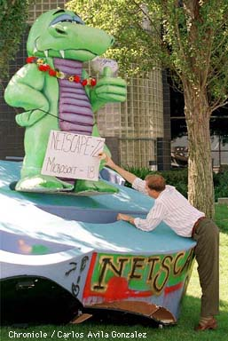
1996 – Macromedia Flash 1.0 (previously called FutureSplash Animator)
1997 – HTML 4.0 de facto standard Browser Wars I: Netscape vs. IE
Image: http://home.snafu.de/tilman/mozilla/stomps.html
Notes:
In October 1997 Internet Explorer 4.0 was released. The release party in San Francisco featured a ten-foot-tall letter "e" logo. Netscape employees showing up to work the following morning found the giant logo on their front lawn, with a sign attached that read "From the IE team ... We Love You". The Netscape employees promptly knocked it over and set a giant figure of their Mozilla dinosaur mascot atop it, holding a sign reading "Netscape 72, Microsoft 18" representing the market distribution.

Slide 13
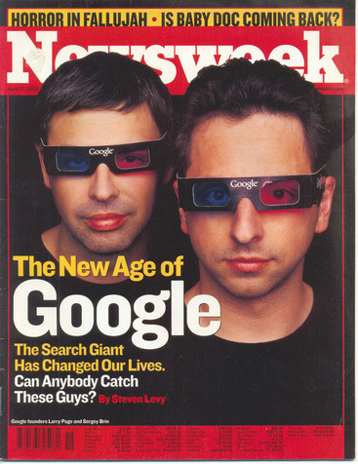
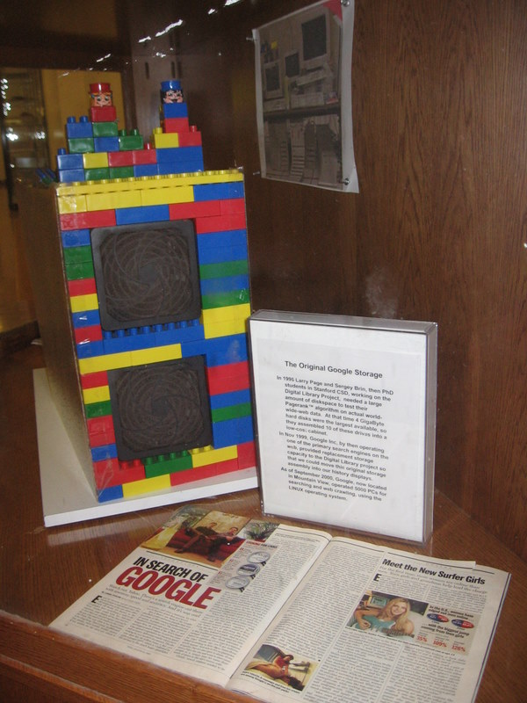
1998 – Network Solutions registers 2 millionth domain name Emergence of <XML> Google founded by Larry Page and Sergey Brin
Notes:
A photo of the first Google server “Backrub” which is encased in the comp sci building at Stanford Univ.

Slide 14
1999 – Over 5 million domain names Internet growth rate is approximately one computer added per second Internet2 (code name Abilene) debuts
2000 – Napster taken to court over ability to share digital copy of copyrighted music Web size estimates by NEC-RI and Inktomi surpass 1 billion indexable pages. XHTML 1.0 recommended by W3C

Slide 15
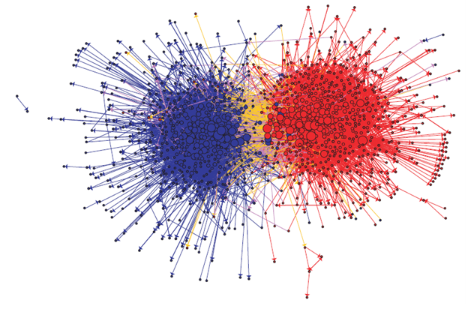
2002 – Approximately 45 million web sites Blogs become popular
The Political Blogosphere and the 2004 U.S. Election by Adamic & Glance

Slide 16
2003 – ITunes.com and other legal Internet music downloading services appear. ITunes.com registers 25th million song download in Dec (“Let It Snow! Let It Snow! Let It Snow!” by Frank Sinatra).
Image: http://www.engadget.com/2007/10/16/apple-officially-cuts-drm-free-track-prices-to-99/
Notes:
In Feb 2010, the 10 billionth song, “Guess Things Happen That Way” by Johnny Cash, was downloaded by Louie Sulcer of Woodstock, Georgia.

Slide 17
2003 – Security problems: 1) SQL Slammer worm - largest and fastest spreading distributed denial of service (DDoS) attacks ever 2) Sobig.F virus - the fastest spreading virus ever 3) Blaster (MSBlast) worm – one of the most damaging worms ever
Notes:
Difference between virus and worm?

Slide 18
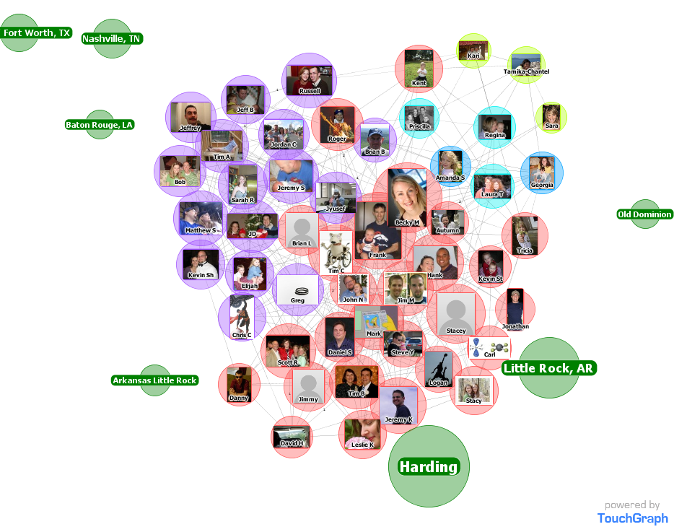
2004 – MySpace and Facebook popularize online social networking

Slide 19
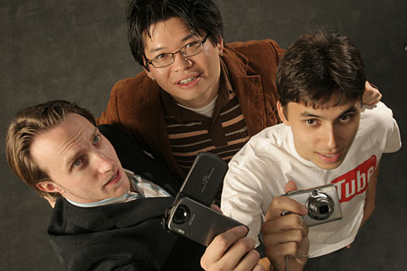
2005 – YouTube founded by three former PayPal employees. Sold to Google for $1.65B in 2006.
Image: http://www.usatoday.com/tech/news/2006-10-11-youtube-karim_x.htm
Notes:
PayPal co-founders: Chad Hurley, Steve Chen, and Jawed Karim

Slide 20
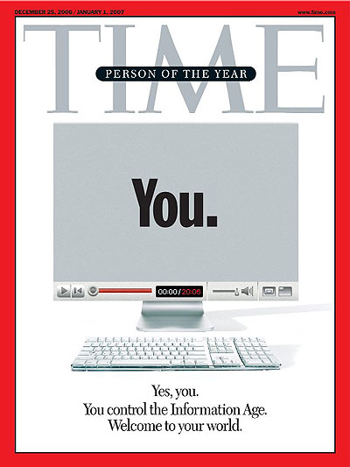
2006 – Time magazine’s person of the year: You. Acknowledges significance of user generated content (Web 2.0)

Slide 21
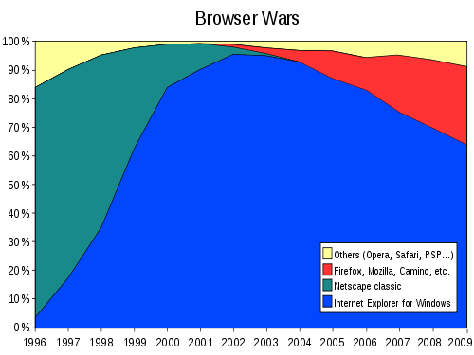
2008 – Firefox 3 sets Guinness World Record for the “largest number of software downloads in 24 hours.” (8 million downloads)
Image: http://en.wikipedia.org/wiki/File:Browser_Wars.svg

Slide 22
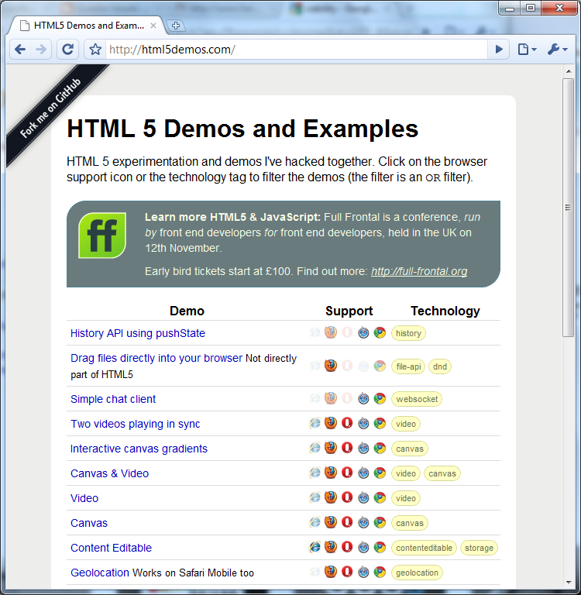
2008 – W3C releases First Public Working Draft of HTML5 spec
Try out the HTML5 demos!

