Slide 1
Developing Applications for Mobile Devices
Dr. Frank McCown
GUI Programming
Fall 2008

Slide 2
Also Known As
Handheld devices
Handheld computer
Personal Digital Assistants
Palmtop
Smartphones

Slide 3
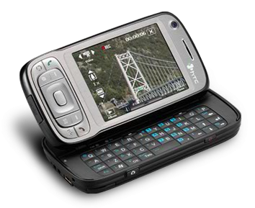
Pocket PC Phone
http://en.wikipedia.org/wiki/Windows_Mobile http://en.wikipedia.org/wiki/Image:Modern_Pocket_PC.png

Slide 4
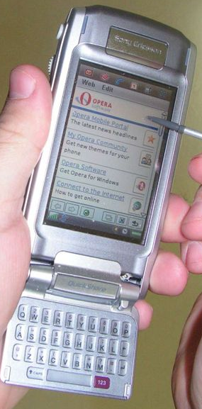
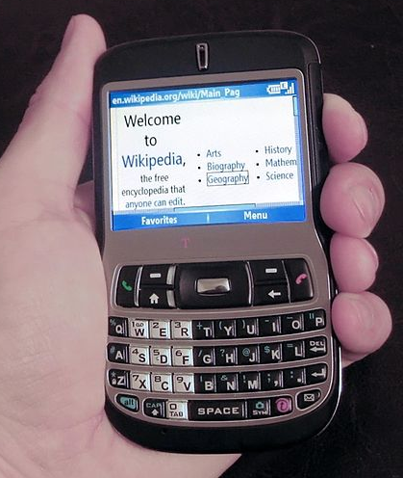
Other Smartphones
http://en.wikipedia.org/wiki/Image:SE_P910i.jpg

Slide 5
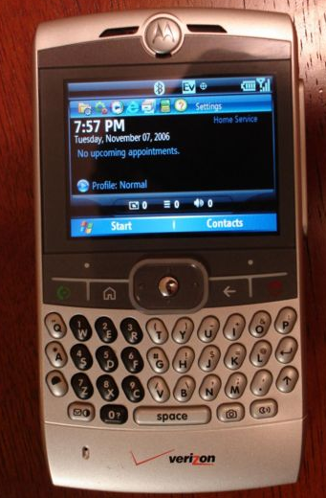
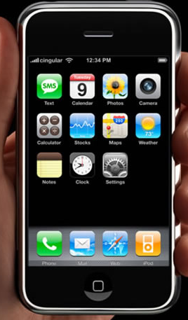
Other Smartphones
http://en.wikipedia.org/wiki/Image:Motorola_Q_1.jpg http://www.mobileafrica.net/images/apple-iphone.jpg

Slide 6
Platforms / Operating Systems
Symbian (57.1% market share)
RIM (17.4%)
Windows Mobile (12.0%)
Linux (7.3%)
iPhone OS (2.8%)
Palm OS (2.3%)
Others (1.1%)
Android (released Nov 2007 by Google)
http://www.gartner.com/it/page.jsp?id=754112
Notes:
Symbian used by Nokia which has 52.9% of the smartphone market.
RIM – Blackberry
Rather than being a platform in its own right, Linux is used as a basis for a number of different platforms developed by several vendors, including Motorola and TrollTech.
Android is based on the Linux kernel and runs programs using a modified version of Java. Android now controlled by Open Handset Alliance. Currently only running on T-Mobile G1.

Slide 7
Mobile App Considerations
Limited screen size and colors
Limited battery life
Limited and slow network access
Limited or awkward input: full keyboard, phone keypad, touch screen, or stylus
Web browser with limited plug-ins
Often inconsistent platforms across devices
Warning: Blackberry thumb

Slide 8
Windows Mobile
Compact OS based on Win32 API
History
2000 – Pocket PC 2000
2002 – Pocket PC 2002
2003 – Windows Mobile 2003 and SE
2005 – Windows Mobile 5
2007 – Windows Mobile 6

Slide 9
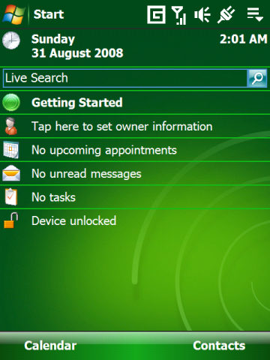
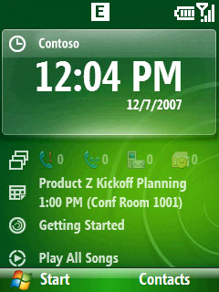
Windows Mobile 6 Screenshots
http://en.wikipedia.org/wiki/Windows_Mobile

Slide 10
.NET Compact Framework
Scaled-down version of .NET Framework
Some extra classes specific to mobile devices
VS. NET 2005 supports development in C#, VB.NET, and C++
Pocket PC 2003 emulator
Smartphone emulator

Slide 11
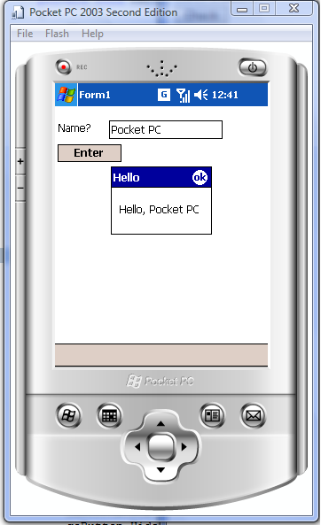
Hello World
using System;
using System.Collections.Generic;
using System.ComponentModel;
using System.Data;
using System.Drawing;
using System.Text;
using System.Windows.Forms;
namespace HelloPocketPC
{
public partial class Form1 : Form
{
public Form1()
{
InitializeComponent();
}
private void button1_Click(object sender, EventArgs e)
{
MessageBox.Show("Hello, " + textBox1.Text, "Hello");
}
}
}

