Slide 1
Introduction to Mobile Computing
An Overview of Mobile Devices and Developing Mobile Applications
Dr. Frank McCown
Harding University
Fall 2011
This work is licensed under Creative Commons Attribution-NonCommercial 3.0

Slide 2
Why Mobile Computing?
Mobile platform is the platform of the future
Double-digit growth in world-wide smartphone ownership³
Job market is hot
Market for mobile software surges from $4.1 billion in 2009 to $17.5 billion by 2012¹
2010 Dice.com survey: 72% of recruiters looking for iPhone app developers, 60% for Android¹
Dice.com: mobile app developers made $85,000 in 2010 and salaries expected to rise²
It’s a lot of fun!
¹ http://www.businessweek.com/technology/content/oct2010/tc20101020_639668.htm
² http://it-jobs.fins.com/Articles/SB129606993144879991/Mobile-App-Developers-Wanted-at-Ad-Agencies
³http://www.gartner.com/it/page.jsp?id=1466313

Slide 3
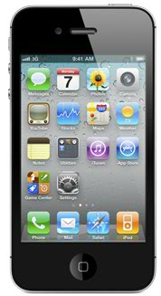
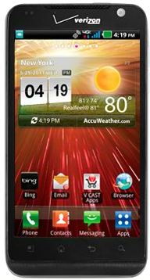
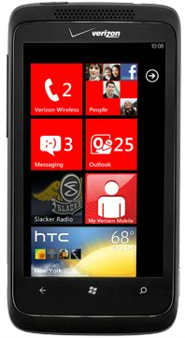
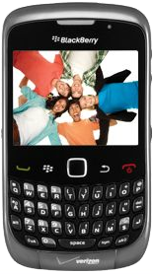
Smartphones
BlackBerry Curve
iPhone 4
LG Revolution
HTC Trophy

Slide 4
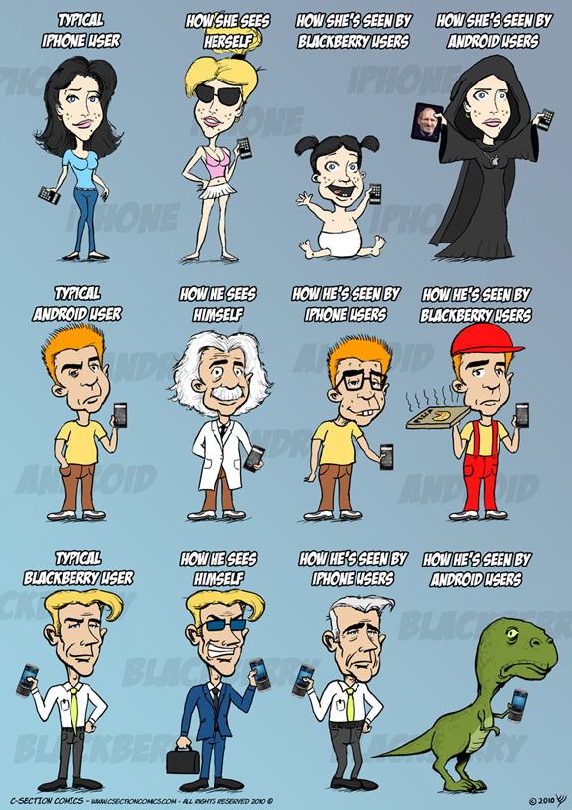
http://www.csectioncomics.com/2010/11/iphone-vs-android-vs-blackberry.html

Slide 5
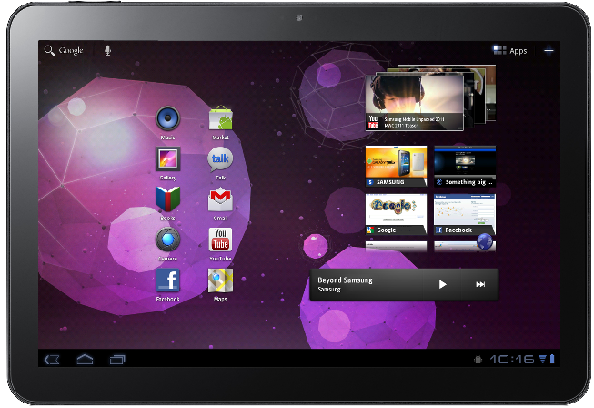
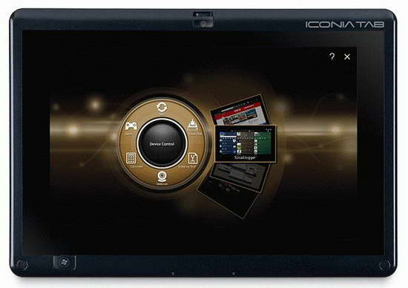
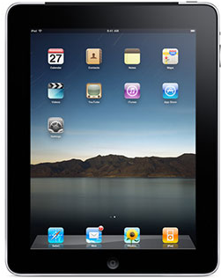
Tablets
Galaxy Tab 10.1
Acer Iconia Tab W500
iPad 2

Slide 6
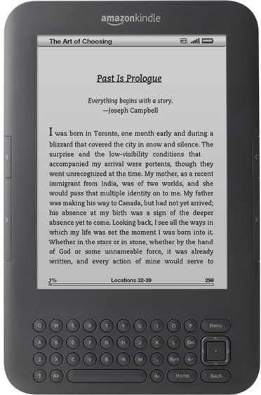
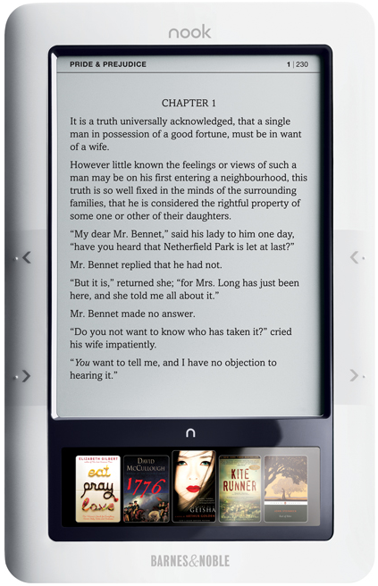
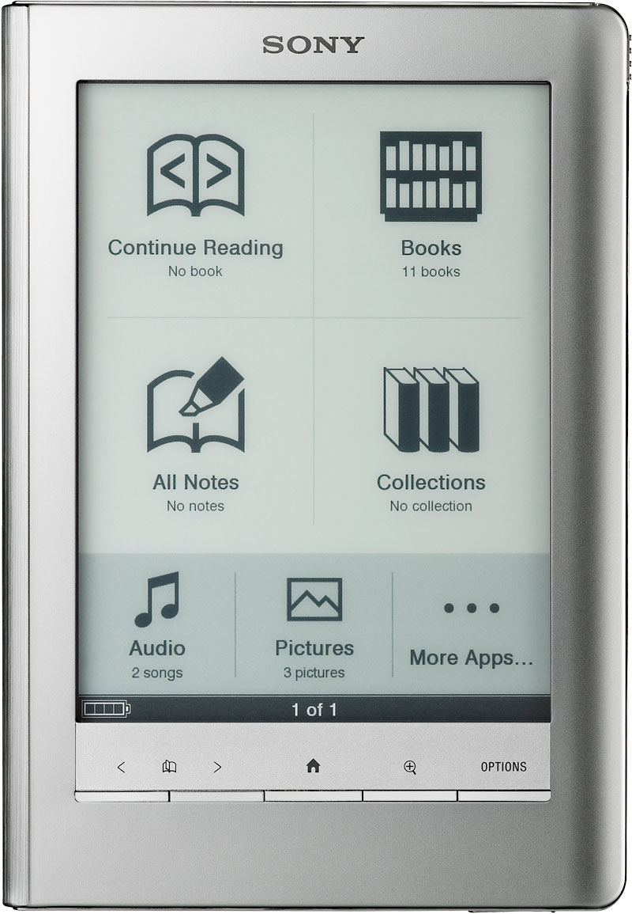
eReaders
Sony Reader Touch Edition
Kindle 3
Nook

Slide 7
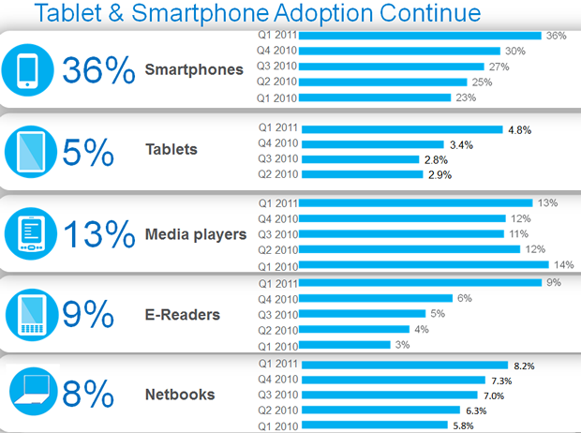
Adoption of Mobile Devices
Credit: Nielson
http://news.cnet.com/nielsen-tablets-are-hot-but-few-actually-own-one/8301-17938_105-20064626-1.html

Slide 8
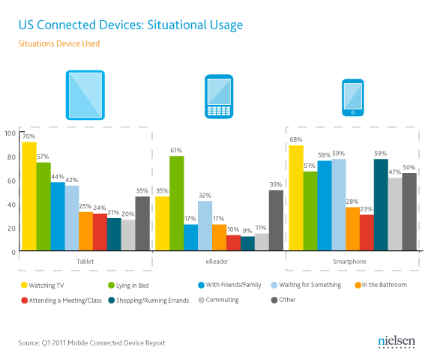
Device Usage
http://www.androidauthority.com/nielsen-report-americans-use-tablets-smartphones-as-tv-buddies-14564/

Slide 9
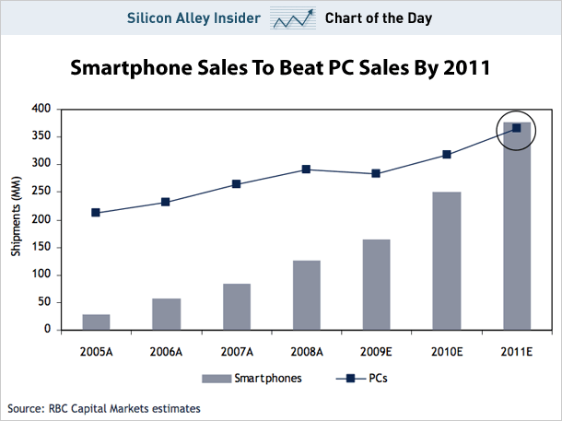
Smartphone vs. PC Sales
http://www.businessinsider.com/chart-of-the-day-smartphone-sales-to-beat-pc-sales-by-2011-2009-8
Notes:
Worldwide, Nokia still leads smartphone sales with 44.3% of the market, but that represents a significant slide over the last few years. As recently as 2006, Nokia's Symbian platform accounted for over 72% of smartphones sold; now it represents just 50.3%. Nokia has particularly lost ground among business users due to the popularity of RIM's BlackBerry, which now claims a 20.9% share of smartphones. Nokia recently announced a "partnership" with Microsoft, which largely just involves porting Pocket Office apps to Symbian in a bid to make Nokia's devices more competitive with the BlackBerry.
In October, 2009, Gartner Inc. predicted that by 2012, Android would become the world's second most popular smartphone platform, behind only the Symbian OS which powers Nokia phones very popular outside the US. Meanwhile, BlackBerry would fall from 2nd to 5th place, iPhone would remain in 3rd place, and Microsoft's Windows Mobile would remain in 4th place.

Slide 10
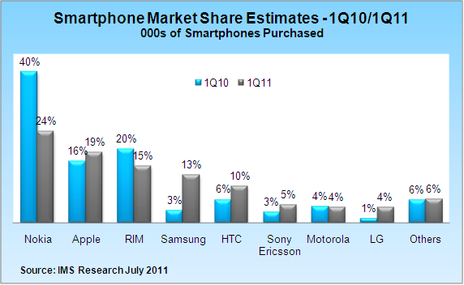
Smartphone Market Share
http://www.infogenra.com/global-smartphone-sales-for-2011-pegged-at-420-million-units-infographic.html

Slide 11
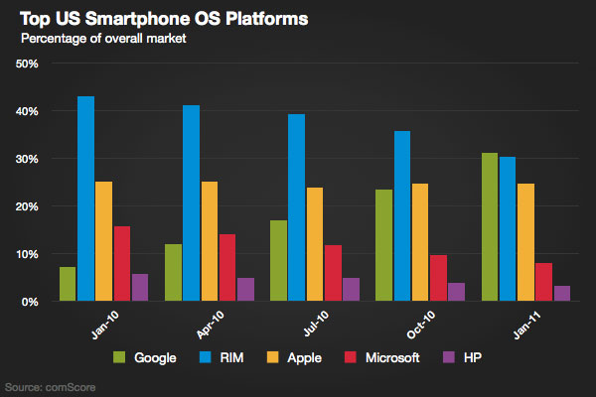
Top US Smartphone OS Platforms
http://gigaom.com/apple/iphone-flat-in-u-s-as-android-takes-market-share-lead/

Slide 12
Mobile Devices: Advantages
Always with the user
Typically have Internet access
Typically GPS enabled
Typically have accelerometer & compass
Typically have cameras & microphones
Apps are free or low-cost

Slide 13
Mobile Devices: Disadvantages
Limited screen size
Limited battery life
Limited processor speed
Limited and sometimes slow network access
Limited or awkward input: soft keyboard, phone keypad, touch screen, or stylus
Limited web browser functionality
Range of platforms & configurations across devices

Slide 14
Mobile Applications
What are they?
Any application that runs on a mobile device
Types
Web apps: run in a web browser
HTML, JavaScript, Flash, server-side components, etc.
Native: compiled binaries for the device
Economics
Free (often ad-supported) vs. paid

Slide 15
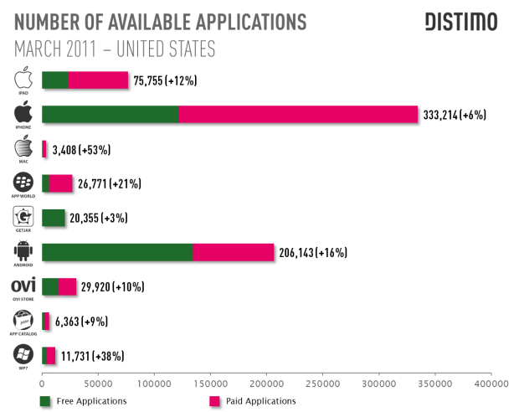
Free vs. Paid Apps
http://backtogeek.com/2011/04/27/there-are-now-more-free-apps-for-android-than-for-the-iphone-distimo/

Slide 16
Where Can I Get Apps?
iOS
Apple’s App Store
Stringent vetting process
Android
Several stores
Android Market, Amazon Appstore for Android, GetJar
On the Web

Slide 17
iPhone or Droid?
http://www.xkcd.com/662/

Slide 18
Development Environments
Most platforms have an SDK that you can download and build against
Every platform has an emulator that you can use to test your apps
Most emulators are configurable to match a variety of mobile devices
Various screen sizes, memory limitations, etc.

Slide 19
Popular Development Environments
Java ME
.NET Compact Framework (C++, C#, VB.NET) for Windows Mobile
Windows Phone 7 (Silverlight and XNA)
Qualcomm’s BREW (C or C++)
Symbian (C++)
BlackBerry (Java)
Android (Java)
iPhone (Objective-C)
Is having so many choices a good thing?
Notes:
BREW: Binary Runtime Environment Wireless
Proprietary mobile device platform developed by Qualcomm.Development
language is C with C++ interfaces.
Certification and development process is expensive.

Slide 20
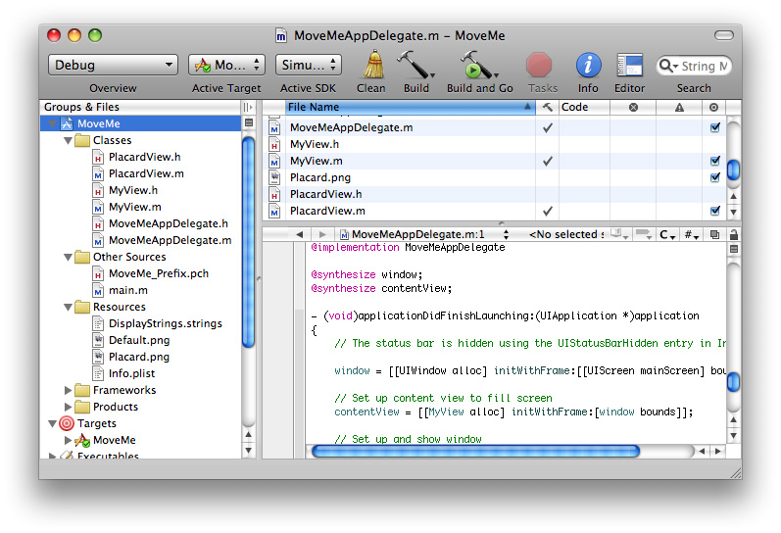
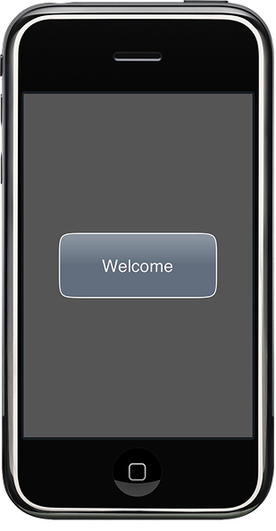
xCode IDE & iPhone Emulator
http://developer.apple.com/iphone/library/referencelibrary/GettingStarted/Creating_an_iPhone_App/index.html

Slide 21
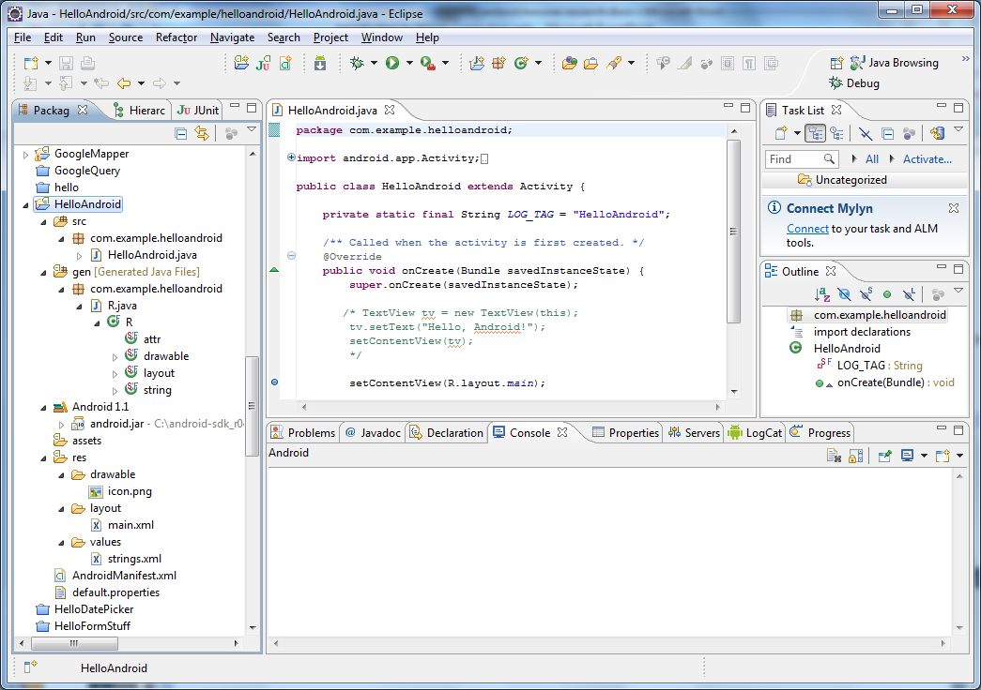
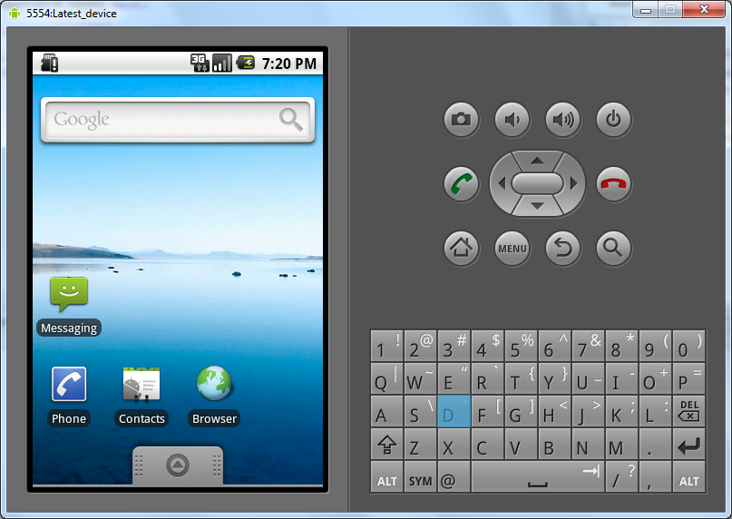
Eclipse and Android Emulator

