Slide 1
Adversarial Information Retrieval on the Web or
How I spammed Google and lost
Dr. Frank McCown
Search Engine Development – COMP 475
Mar. 24, 2009

Slide 2


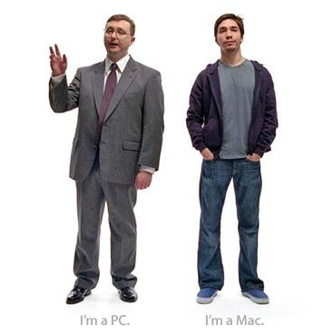

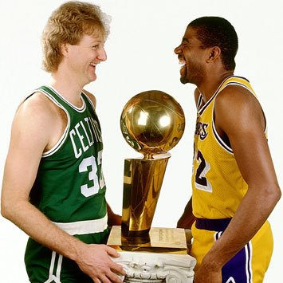

Slide 3
Why are search engines and content providers adversaries?
Search engine’s primary goal:
Provide the most relevant results for the given query
Content provider’s primary goal:
Rank as high as possible in SERP for certain queries
$$$
Incentives:

Slide 4
Search engine optimization (SEO)
White hat techniques
  Follow published guidelines provided by search engines
    Excerpt from Google’s Webmaster Guidelines:
    Create a useful, information-rich site, and write pages that clearly and accurately describe your content.
    Make sure that your <title> elements and alt attributes are descriptive and accurate.
    Check for broken links and correct HTML.
http://www.google.com/support/webmasters/bin/answer.py?hl=en&answer=35769#1

Slide 5
Search engine optimization
Black hat techniques
  content spam (spamdexing)
  comment spam, referrer spam
  link-bombing (a.k.a. Google-bombing)
  blog spam (splogs)
  malicious tagging
  reverse engineering of ranking algorithms

Slide 6
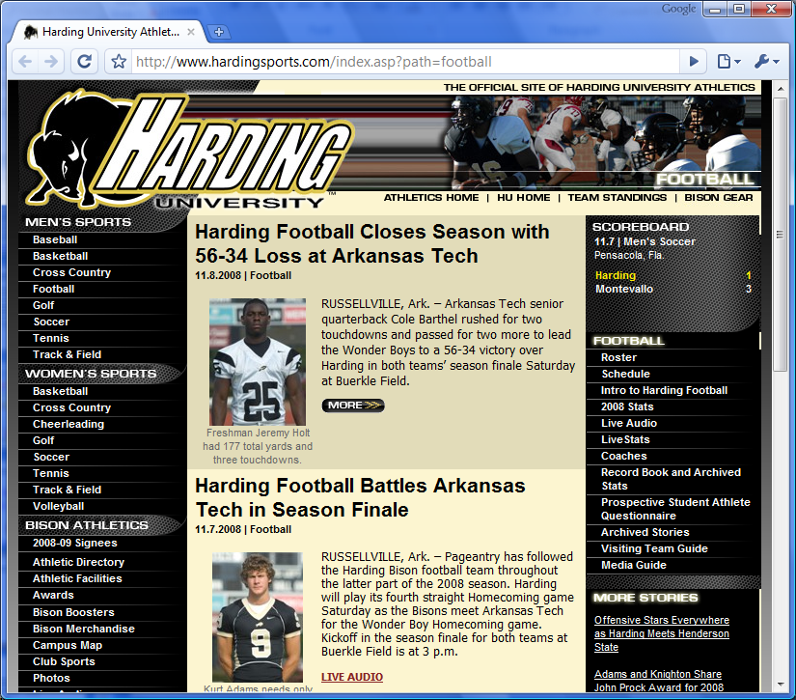
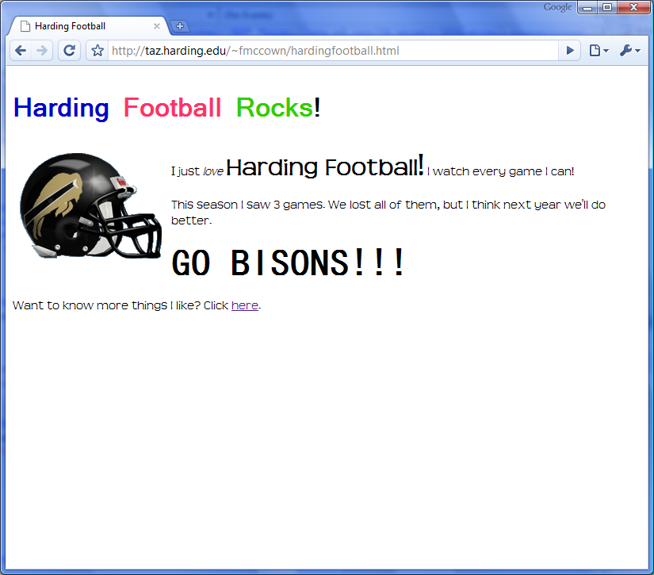
Assigning Relevance: TF-IDF
Which page is more relevant to the query “Harding football”?

Slide 7
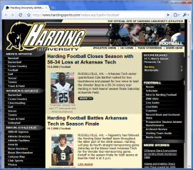

Assigning Relevance: Link Analysis
PageRank: Links are a type of citation or recommendation. The more pages that point to you, the more important your page is, but links from more important pages receive higher PageRank.

Slide 8
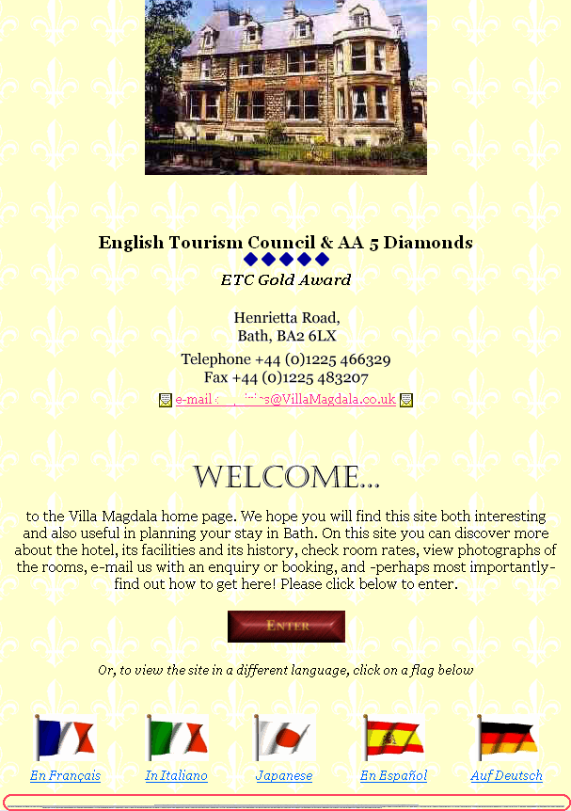
Content Spam
Hidden text
http://www.mattcutts.com/blog/page/99/

Slide 9
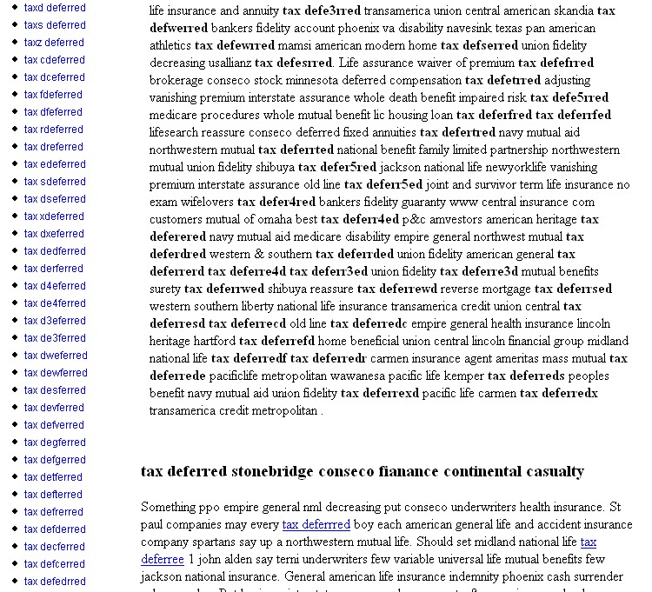
Gibberish text
Deliberate misspellings
Keyword stuffing
http://www.mattcutts.com/blog/page/99/

Slide 10
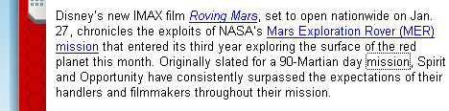
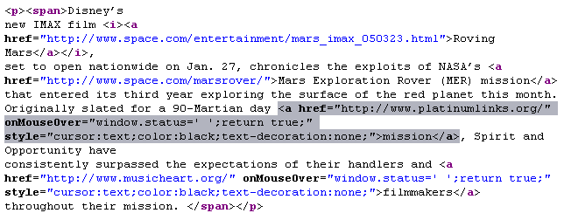
Hidden link
http://www.mattcutts.com/blog/hidden-links/

Slide 11
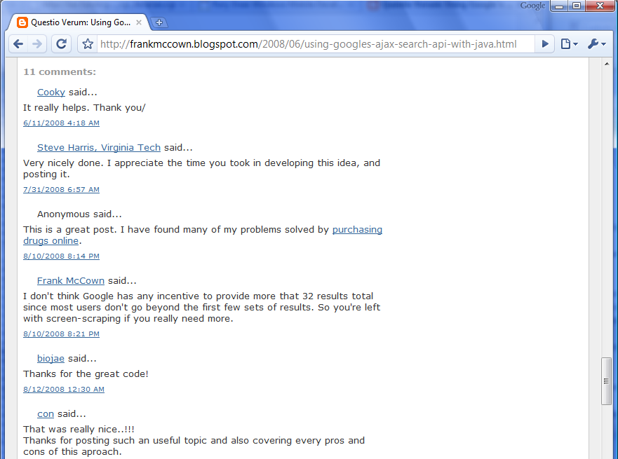
Comment Spam
<a href="http://canadianpharm.com/" rel="nofollow">purchasing drugs online</a>

Slide 12



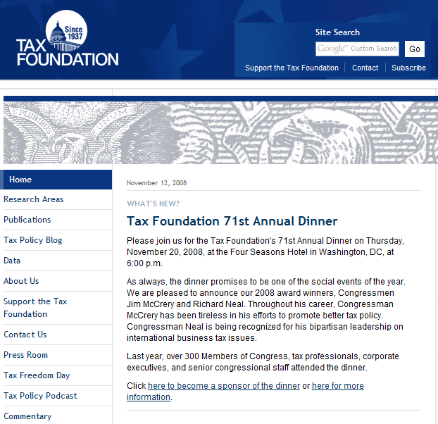
Cloaking
User agent: Googlebot
GET: http://foo.com/
Web server
User agent: Firefox
GET: http://foo.com/

Slide 13
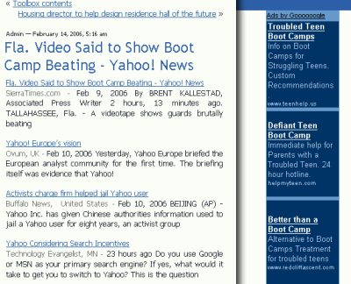
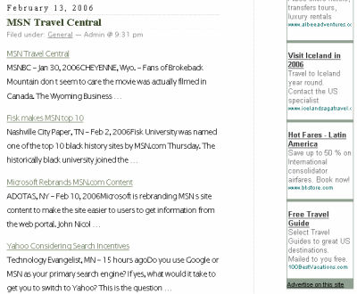
Spam Blogs (Splogs)
In 2005, it was estimated that one in five blogs was spam.¹
¹http://www.adweek.com/aw/search/article_display.jsp?vnu_content_id=1001736416

Slide 14
Google-bombing
Search engines use anchor text to help determine the relevance of a query.
<a href=“http://microsoft.com/”>More evil than Satan himself</a>
2004: Google bomb contest for search term nigritude ultramarine
2004: Search for miserable failure shows whitehouse.gov as first result
2007: Google makes algorithmic changes to defuse most Google bombs
http://www.nytimes.com/2007/01/29/technology/29google.html?_r=1&oref=slogin

Slide 15
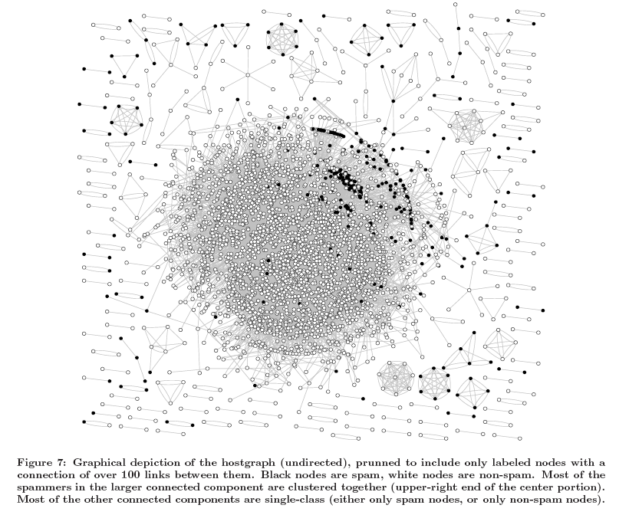
Link Farms
Castillo et al., 2007, Know your neighbors: web spam detection using the web topology

Slide 16
Can we identify spam using statistical analysis?

Slide 17
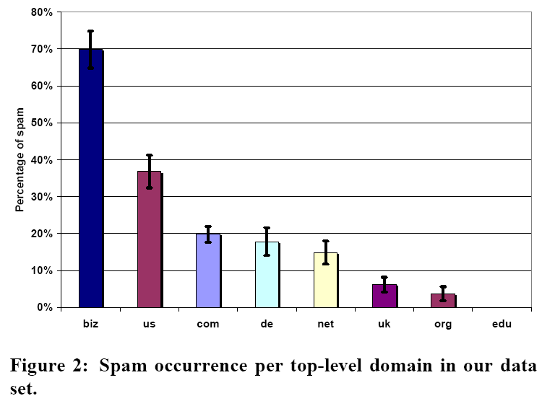
Ntoulas et al., 2006, Detecting spam web pages through content analysis

Slide 18
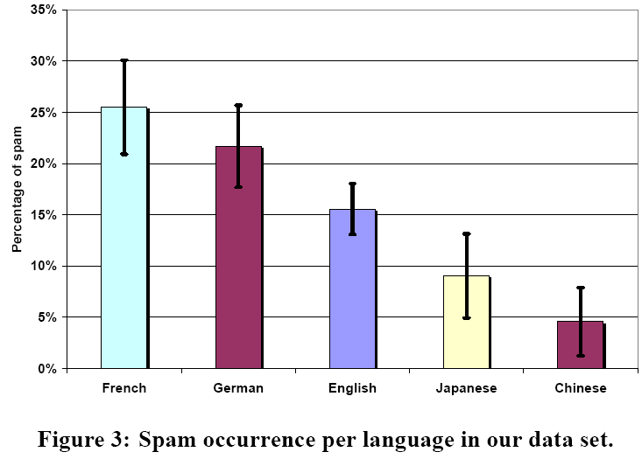
Ntoulas et al., 2006, Detecting spam web pages through content analysis

Slide 19
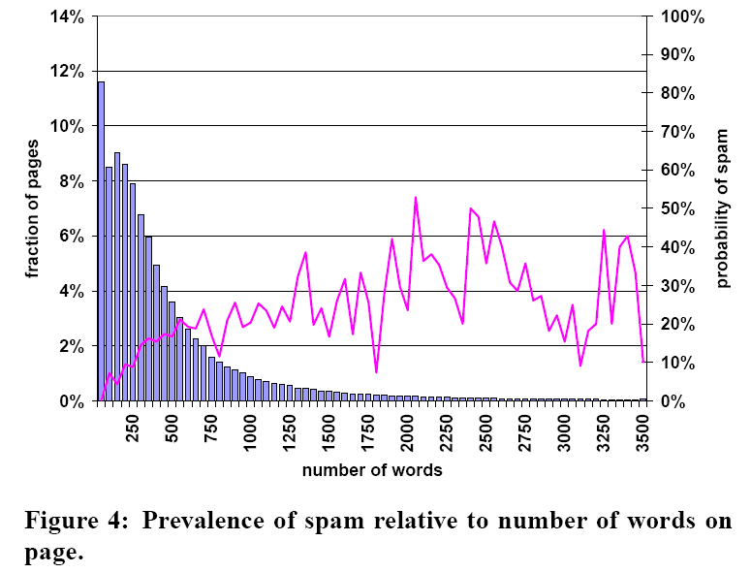
Ntoulas et al., 2006, Detecting spam web pages through content analysis

Slide 20
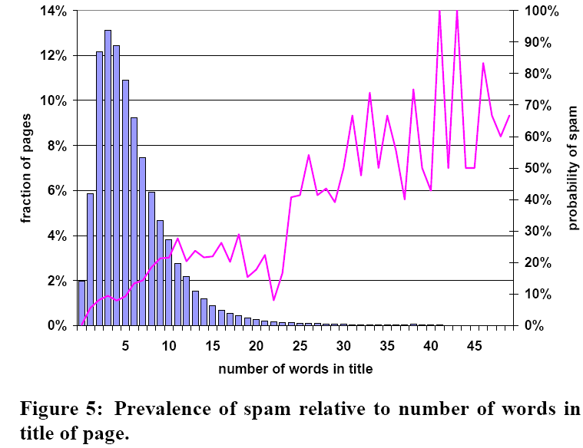
Ntoulas et al., 2006, Detecting spam web pages through content analysis

Slide 21
Combating Web Spam
Statistical analysis of content
Statistical analysis of web topology
Trust measures like TrustRank
AIRWeb workshops
http://airweb.cse.lehigh.edu/
Web Spam Challenge
http://webspam.lip6.fr/wiki/pmwiki.php
Notes:
TrustRank – PageRank like method of assigning trust to a page. Select a small number of pages to be evaluated by experts and assigned trust to those pages which are reliable. Crawling out from these trusted pages normally results in trustworthy pages

