Slide 1
Introductions
Search Engine Development COMP 475 Spring 2009
Dr. Frank McCown

Slide 2
Class objectives
Understand how the Web is organized
Understand characteristics and limitations of web search
Implement our own web crawler, indexer, and retriever
Make a significant contribution to an open source search project (Nutch)

Slide 3
Why Study Web Search?
Web searching is pervasive
91% of all Internet users have used a search engine to find information (PweInternet.org 2007)¹
70% of Internet users use search engines nearly every time they go online (iCrossing 2005)²
Web search is big business
Web search was $5.75 billion market in 2005 and is projected to be $11 billion by 2010³
If you can’t be found, you don’t exist
Some estimate that 70% of website visitors are referred from Google⁴
Some text from http://www.cse.lehigh.edu/~brian/course/2007/searchengines/notes/notes-2007-01-15.pdf
¹ http://www.pewinternet.org/trends/Internet_Activities_8.28.07.htm
² http://www.icrossing.com/articles/How%20America%20Searches.pdf
³ http://www.sempo.org/news/releases/Search_Engine_Marketers
⁴ http://www.skrenta.com/2006/12/googles_true_search_market_sha.html

Slide 4
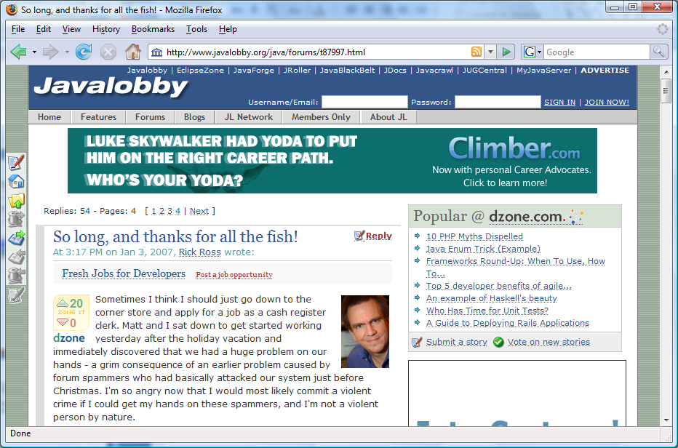
Lost 70% of traffic over Christmas when Google de-indexed them due to forum spam.

Slide 5
Why Study Web Search?
As the Web continues to grow, we will need better tools to find what we’re looking for
Indexable web is at least 11.5 billion pages¹
Demand is high for knowledgeable developers and researchers
¹http://www.cs.uiowa.edu/~asignori/web-size/

Slide 6
What is a search engine?
Type of information retrieval system
System designed to satisfy a user’s information need
Other popular IR systems:
Digital library (ACM’s DL, NSDL)
Desktop search (Google Desktop, Windows Search)
Types of search engines:
Web search engines (Google, Yahoo, Live Search)
Metasearch engines – includes Deep Web (Dogpile, WebCrawler)
Specialized (or focused) search engines (Google Scholar, MapQuest)
Web directories are not search engines! (Yahoo! Directory, Open Directory Project)

Slide 7
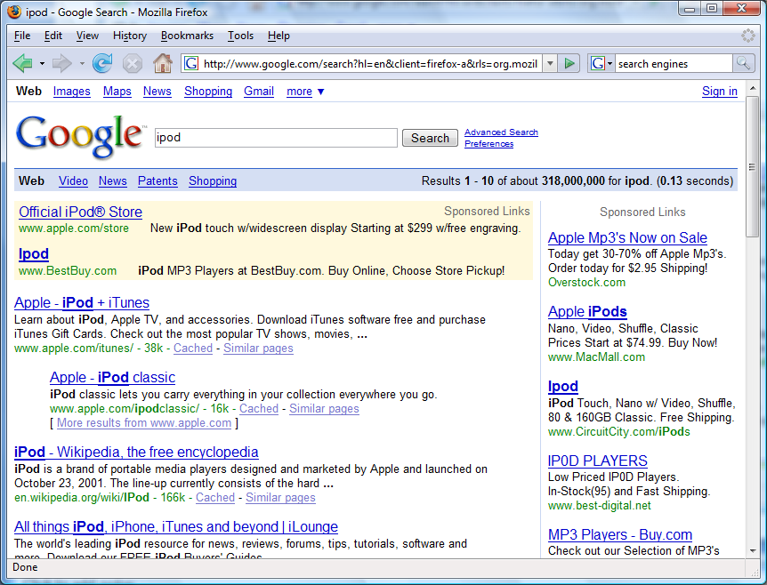
Search query
SERP
Paid results
Page title
Organic results
Text snippet
Indexed copy

Slide 8
Differences between WWW search and other IR systems
Large number of documents (more than any single search engine can possibly index)
Document corpus changes rapidly, constantly growing
Documents disappear or change location (linkrot)
Huge variation in document quality, language, subject, purpose
No central editorial control

Slide 9
Differences between WWW search and other IR systems cont.
Great amount of duplication
Docs are hyperlinked which indicates a relationship
Some docs are not hyperlinked or are hidden from web crawlers
Adversarial relationship between content producers and search engine – economic need to rank high

Slide 10
Differences between WWW search and other IR systems cont.
Query types:
Often short
2.4 words on average¹
Often popular
Google Year-end Zeitgeist
Often ambiguous
Is a search for harding trying to locate the school, the president, or the skater?
Often misspelled¹
¹Searching the web: The public and their queries by Spink et al. 2001

Slide 11
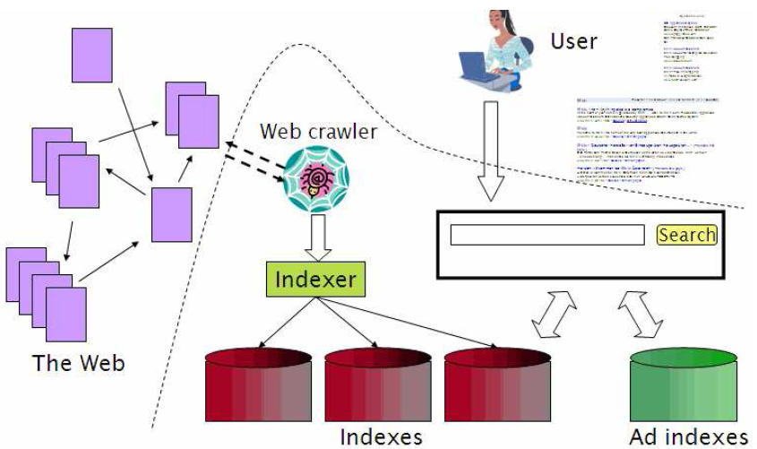
Components of a search engine
Figure from Introduction to Information Retrieval by Manning, et al., Ch 19.

Slide 12
Brief History of Web Search
1950s
Early work on IR systems at IBM
1990
Tim Berners-Lee at CERN invents the “Web”
1993
1st web crawler: Wanderer by Matthew Gray
1st search engine: Wandex (using crawls from Wanderer)
1994
WebCrawler allows search on full text
Yahoo! starts as web directory
InfoSeek becomes a popular search engine
Robots exclusion protocol developed by consensus
More detailed history can be found at http://www.searchenginehistory.com/

Slide 13
History cont.
1995
Inktomi provides search infrastructure to other providers
AltaVista initially a research project at DEC
MetaCrawler is 1st commercial metasearch engine
1996
Ask Jeeves (now Ask) was 1st natural language search engine
1997
Overture (was Goto.com, now Yahoo! Search Marketing) pioneers pay-per-click search engine advertising
1st use of term “search engine optimization” [Danny Sullivan]
1998
Google (formally BackRub) launches using PageRank to rank results: Feeling Lucky?
Notes:
Googol is the large number 10¹⁰⁰, that is, the digit 1 followed by one hundred zeros
A googolplex is 1 followed by a googol zeroes, or ten raised to the power of a googol:
10^{googol} = 10¹⁰¹⁰⁰.

Slide 14
History cont.
1999
1st Googlebomb: "more evil than satan himself" → microsoft.com
Ditto.com is 1st public image search engine
2000
Baidu, China’s largest search engine, launches
2001
Technorati becomes 1st large blog search engine
2002
Google News launches
2003
Yahoo launches own search engine (purchased Inktomi in 2002)

Slide 15
History cont.
2004
MSN Search launches own search, rebrands as Live Search in 2007
Search engine size wars (in self-reported billions of pages)
Google: 8.1, MSN: 5.0, Yahoo: 4.2, Ask: 2.5
2005
Google China controversy – Do a Little Evil?
Google Sitemap Protocol (adopted by all search engines in 2006)
Nofollow attribute created to reduce blog spam
2007
Google continues to dominate US search: Google: 65%, Yahoo: 21%, Live: 7%, Ask: 5% [Hitwise]
2008
Wikia Search – 1st attempt to apply wiki principles to web search

Slide 16
Initial projects
Learn Java servlet/JSP programming with Apache Tomcat
Develop our own search engine using the Yahoo! Search Web Service

