Slide 1
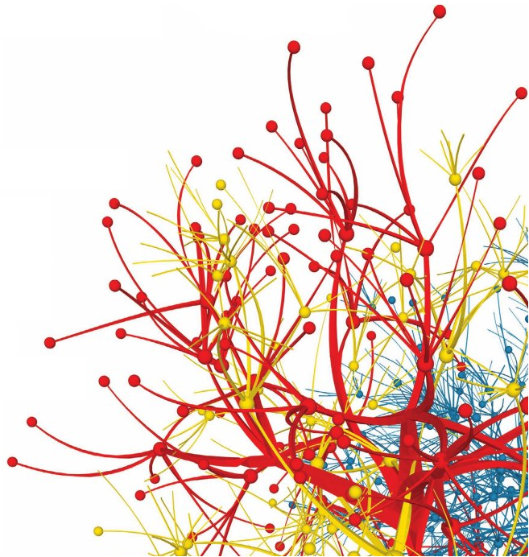
Clustering Algorithms
Dr. Frank McCown
Intro to Web Science
Harding University
This work is licensed under a Creative Commons Attribution-NonCommercial-ShareAlike 3.0 Unported License

Slide 2
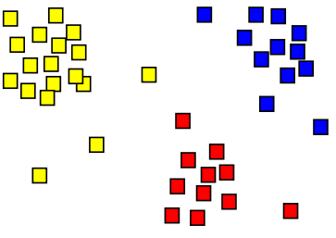
Data Clustering
Methods for discovering and visualizing groups (clusters) of things that are related
Examples:
Detecting customers with similar purchasing habits
Detecting web pages that are about the same topic
Detecting groups of genes that exhibit a similar behavior
Image: http://en.wikipedia.org/wiki/File:Cluster-2.svg

Slide 3
First Things First…
Items to be clustered need numerical scores that “describe” the items
Some examples:
Customers can be described by the amount of purchases they make each month
Movies can be described by the ratings given to them by critics
Documents can be described by the number of times they use certain words

Slide 4
Finding Similar Web Pages
Given N of the web pages, how would we cluster them?
Break each string by whitespace
Convert to lowercase
Remove HTML tags
Find frequency of each word in each document
Remove stop words and very unique words (keep words that appear in > 10% and < 50% of all pages)

Slide 5
Word Frequency Data Set
 | book | hunger | great | undo
Page 1 | 2 | 6 | 3 | 17
Page 2 | 1 | 0 | 2 | 2
Page 3 | 0 | 2 | 0 | 4

Slide 6
Calculating Distance
Euclidean distance
Pearson’s r
Cosine similarity
Jaccard coefficient
Manhattan (taxicab) distance
Other…

Slide 7
Popular Clustering Algorithms
Many different algorithms, but only two presented here
Hierarchical clustering
Build a hierarchy of groups by continuously merging the two most similar groups
K-means
Assign items to k clusters with the nearest mean

Slide 8
Hierarchical Clustering
A
B
Assign one cluster to each item
While number of clusters > 1
For each cluster c1
For each cluster c2 after c1
Calculate distance between c1 & c2
Save this pair if they have min
distance seen so far
Merge the two closest clusters
C
E
D
Example from Ch 3 of Segaran’s Programming Collective Intelligence

Slide 9
Resulting Dendrogram
Distance indicates tightness of cluster
A
B
C
D
E

Slide 10
Nice, but…
Hierarchical clustering doesn’t break items into groups without extra work
Very computationally expensive
Solution: K-means

Slide 11
K-Means Clustering
A
B
Place k centroids in random locations
Do Assign each item to nearest centroid
Move centroid to mean of assigned items
Repeat until assignments stop changing
C
E
D
Example from Ch 3 of Segaran’s Programming Collective Intelligence

Slide 12
K-Means Clustering
A
B
Place k centroids in random locations
Do Assign each item to nearest centroid
Move centroid to mean of assigned items
Repeat until assignments stop changing
C
E
D
Example from Ch 3 of Segaran’s Programming Collective Intelligence

Slide 13
K-Means Clustering
A
B
Place k centroids in random locations
Do Assign each item to nearest centroid
Move centroid to mean of assigned items
Repeat until assignments stop changing
C
E
D
Example from Ch 3 of Segaran’s Programming Collective Intelligence

Slide 14
K-Means Clustering
A
B
Place k centroids in random locations
Do Assign each item to nearest centroid
Move centroid to mean of assigned items
Repeat until assignments stop changing
C
E
D
Example from Ch 3 of Segaran’s Programming Collective Intelligence

Slide 15
Visualizing Clusters
Multidimensional scaling used to show a 2D representation of multidimensional data
Uses matrix where M_{i,j} is distance between ith and jth items
 | A | B | C | D
A | 0 | 0.2 | 0.8 | 0.7
B | 0.2 | 0 | 0.9 | 0.8
C | 0.8 | 0.9 | 0 | 0.1
D | 0.7 | 0.8 | 0.1 | 0.0
Example from Ch 3 of Segaran’s Programming Collective Intelligence

Slide 16
Multidimensional Scaling
Place n items in random locations in 2D space
Do
For each pair of items
Calculate distance between items
Move each node closer or further in
proportion of error between two items
Repeat until total error between items is
negligible
0.4
C
A
0.7
0.6
0.7
0.5
D
B
0.4
 | A | B | C | D
A | 0 | 0.2 | 0.8 | 0.7
B | 0.2 | 0 | 0.9 | 0.8
C | 0.8 | 0.9 | 0 | 0.1
D | 0.7 | 0.8 | 0.1 | 0.0

Slide 17
Multidimensional Scaling
Place n items in random locations in 2D space
Do
For each pair of items
Calculate distance between items
Move each node closer or further in
proportion of error between two items
Repeat until total error between items is
negligible
0.4
C
A
0.7
0.6
0.7
0.5
D
B
0.4
 | A | B | C | D
A | 0 | 0.2 | 0.8 | 0.7
B | 0.2 | 0 | 0.9 | 0.8
C | 0.8 | 0.9 | 0 | 0.1
D | 0.7 | 0.8 | 0.1 | 0.0
Actual distance < 0.5 so move A and B closer

Slide 18
Multidimensional Scaling
Place n items in random locations in 2D space
Do
For each pair of items
Calculate distance between items
Move each node closer or further in
proportion of error between two items
Repeat until total error between items is
negligible
0.4
C
A
0.7
0.6
0.7
D
B
0.4
 | A | B | C | D
A | 0 | 0.2 | 0.8 | 0.7
B | 0.2 | 0 | 0.9 | 0.8
C | 0.8 | 0.9 | 0 | 0.1
D | 0.7 | 0.8 | 0.1 | 0.0
Actual distance > 0.4 so move A and C farther apart

Slide 19
Multidimensional Scaling
Place n items in random locations in 2D space
Do
For each pair of items
Calculate distance between items
Move each node closer or further in
proportion of error between two items
Repeat until total error between items is
negligible
C
A
0.7
0.6
0.7
D
B
0.4
 | A | B | C | D
A | 0 | 0.2 | 0.8 | 0.7
B | 0.2 | 0 | 0.9 | 0.8
C | 0.8 | 0.9 | 0 | 0.1
D | 0.7 | 0.8 | 0.1 | 0.0

