Slide 1
Collective Intelligence
Dr. Frank McCown
Intro to Web Science
Harding University
This work is licensed under a Creative Commons Attribution-NonCommercial-ShareAlike 3.0 Unported License

Slide 2
What is Collective Intelligence?
Human Computation
Crowd- sourcing
Social Computing
Collective Intelligence
Data Mining
Quinn and Bederson, CHI 2011

Slide 3
Collective Intelligence
“groups of individuals doing things collectively that seem intelligent.” Thomas Malone, Director of MIT Center for Collective Intelligence, 2006 http://cci.mit.edu/about/MaloneLaunchRemarks.html
“when technologists use this phrase they usually mean the combining of behavior, preferences, or ideas of a group of people to create novel insights.” Toby Segaran, Programming Collective Intelligence, 2007, p. 2

Slide 4
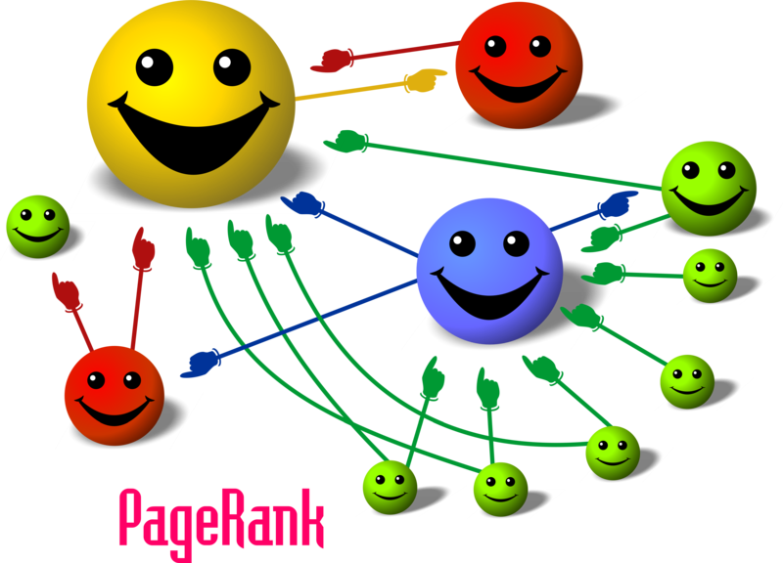
Image: http://organicseoexpert.org/wp-content/uploads/2012/03/pagerank.png

Slide 5
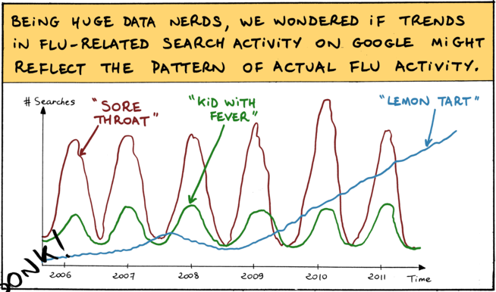
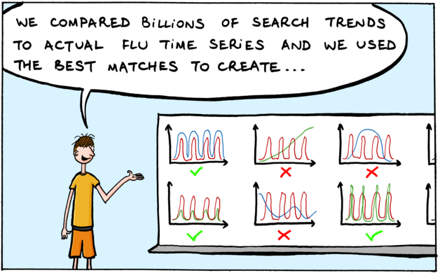
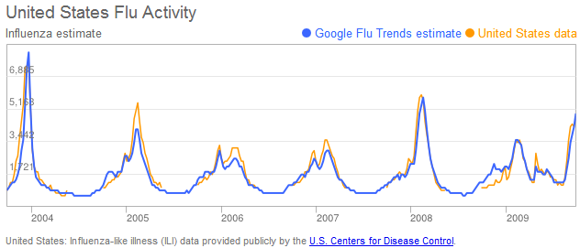
http://www.google.com/trends/correlate/comic?p=2
http://www.google.org/flutrends/about/how.html

Slide 6
Crowdsourcing
“the act of taking a job traditionally performed by a designated agent (usually an employee) and outsourcing it to an undefined, generally large group of people in the form of an open call.” Jeff Howe, “The Rise of Crowdsourcing”, Wired, Jun 2006 http://www.wired.com/wired/archive/14.06/crowds.html

Slide 7
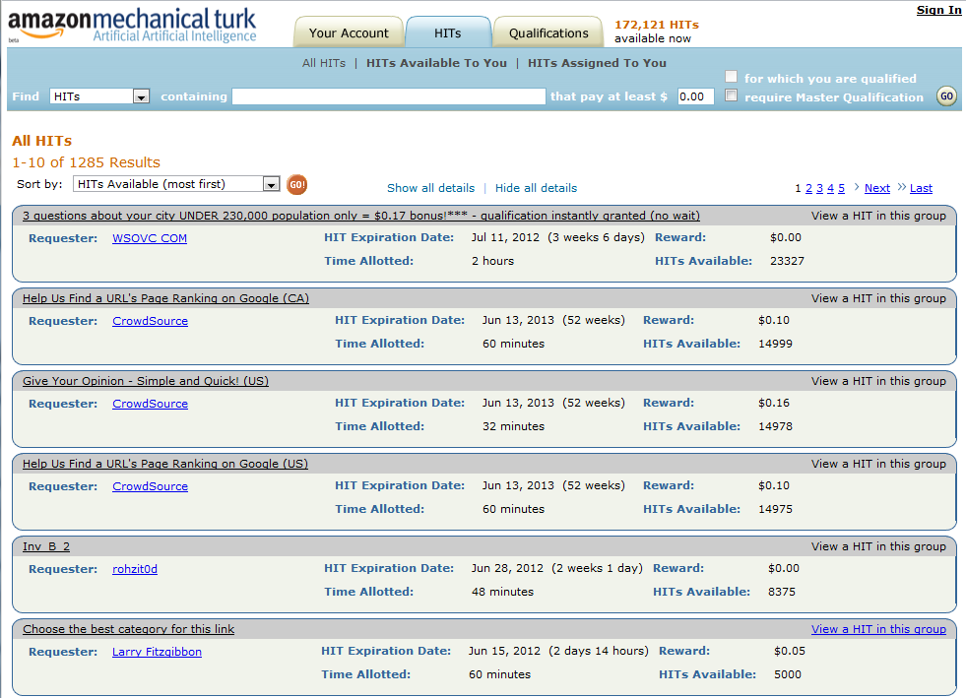

Slide 8
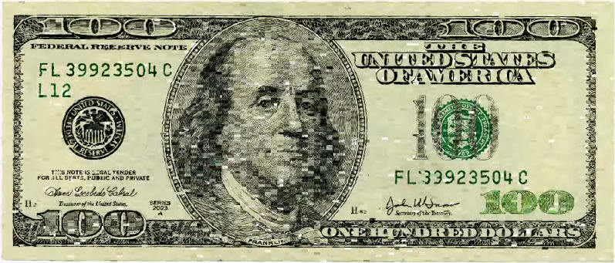
http://www.tenthousandcents.com/

Slide 9
Human Computation
“a paradigm for utilizing human processing power to solve problems that computers cannot yet solve.” Luis van Ahn, Doctoral Dissertation at Carnegie Mellon, 2005
“Human computation:
The problems fit the general paradigm of computation, and as such might someday be solvable by computers.
The human participation is directed by the computational system or process.” Quinn and Bedderson, CHI 2011

Slide 10
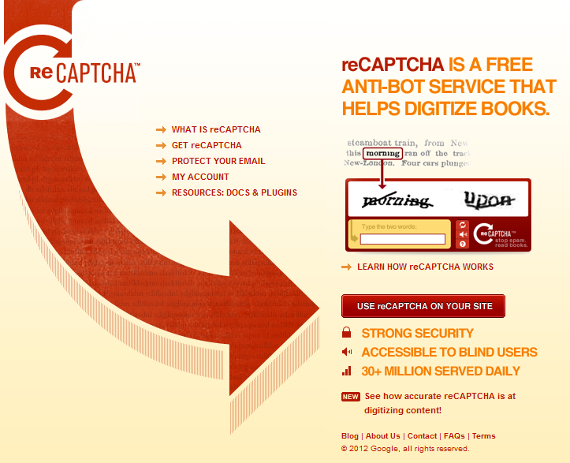

Slide 11
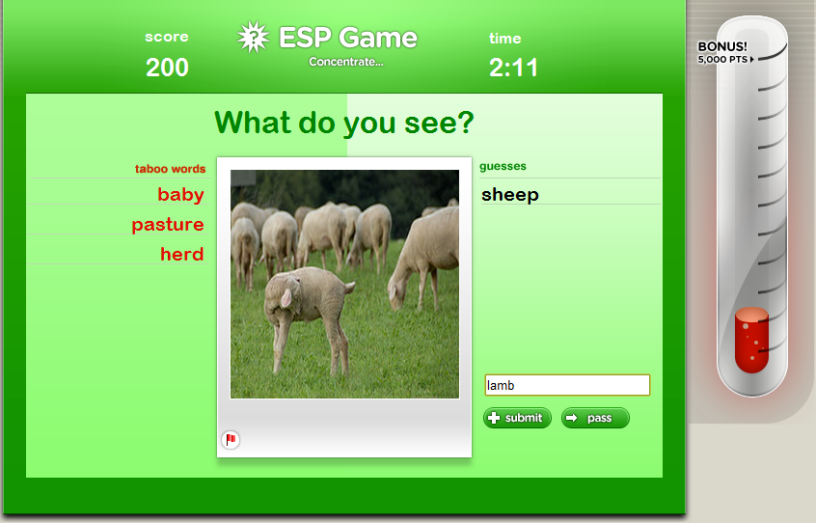

Slide 12
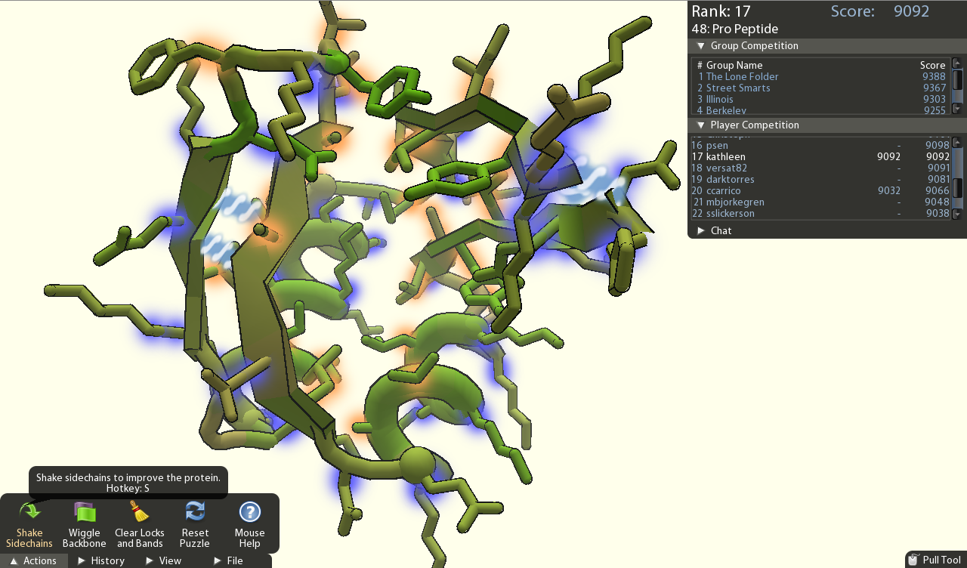
http://fold.it/portal/

Slide 13
CI not superset of HC
Human Computation
HC system could use single person working in isolation
Crowd- sourcing
Social Computing
Collective Intelligence
Data Mining

Slide 14
Crowdsourcing vs. Human Computation
Human Computation
“Whereas human computation replaces computers with humans, crowdsourcing replaces traditional human workers with members of the public.” Quinn and Bedderson, CHI 2011
Crowd- sourcing
Social Computing
Collective Intelligence
Data Mining

Slide 15
Social Computing
“applications and services that facilitate collective action and social interaction online with rich exchange of multimedia information and evolution of aggregate
knowledge.” Parameswaran and Whinston, Social Computing: An Overview, CAIS 19:37, 2007

Slide 16
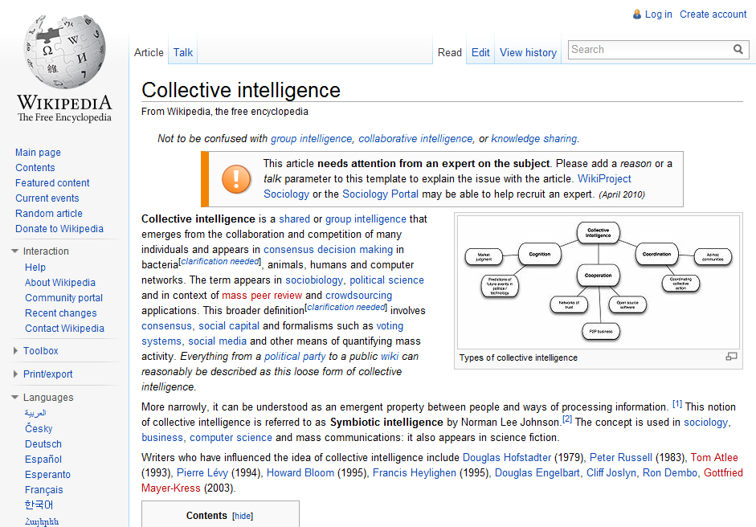

Slide 17
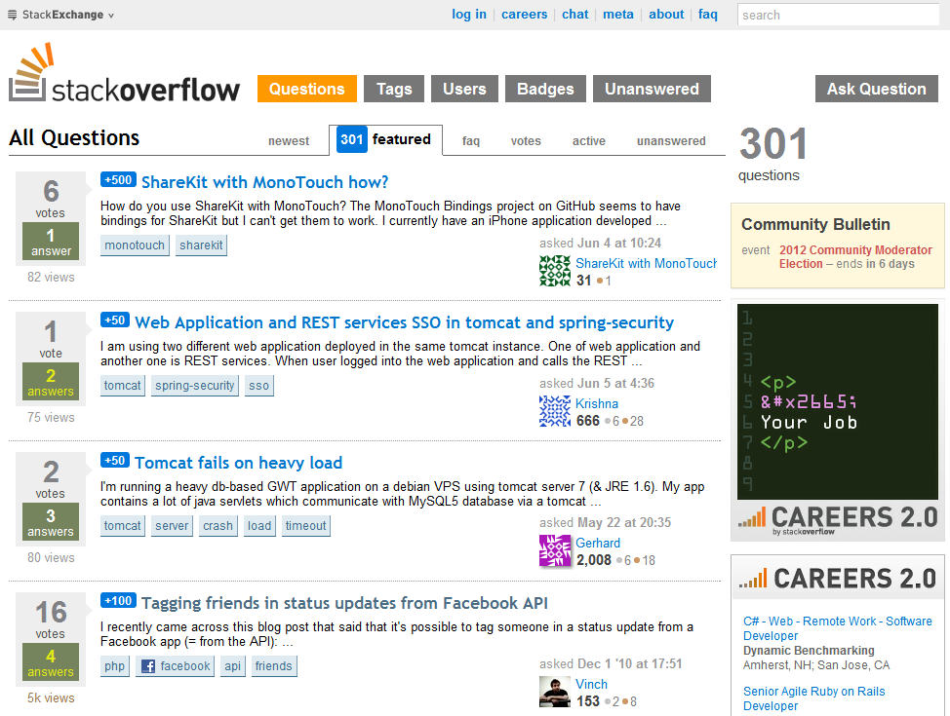

Slide 18
Data Mining
“the application of specific algorithms for extracting patterns from data.” Fayyad, Piatetsky-Shapiro, and Smyth,
Knowledge Discovery and Data Mining: Towards a
Unifying Framework, Proc. KDD, 1996

Slide 19
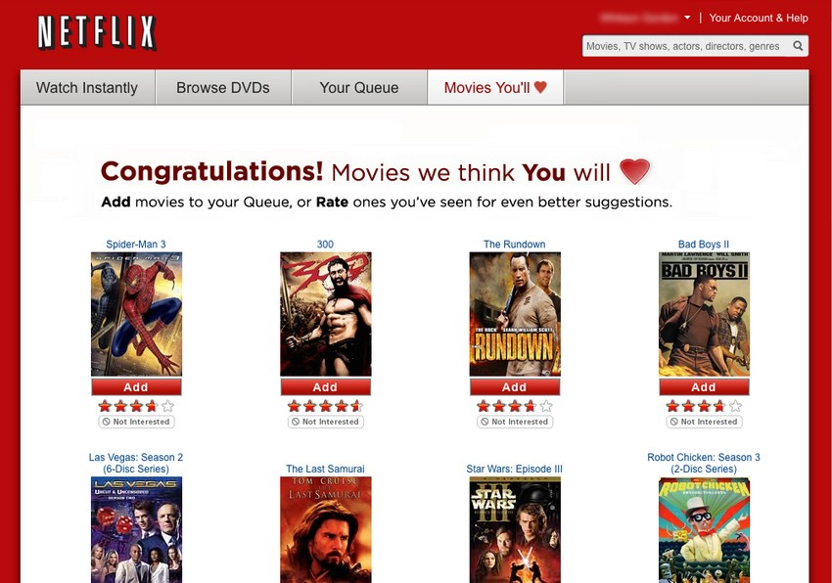
Image: http://lifehacker.com/5642050/five-best-movie-recommendation-services

Slide 20
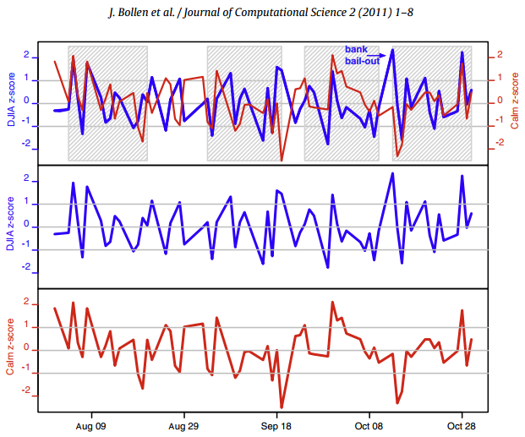
Twitter mood predicts the stock market (Bollen et al., 2011)

Slide 21
Summary
Relatively new field making use of networked world
Uses machine learning and data mining algorithms
Need for ethical standards

Slide 22
Further Reading
Howe, Crowdsourcing (2008)
Marmanis & Babenko, Algorithms of the Intelligent Web (2009)
Segaran, Programming Collective Intelligence (2007)
Shirky, Here Comes Everybody (2009)
Surowiecki, The Wisdom of Crowds (2004)
Tapscott, Wikinomics (2010)

