Slide 1
Recommender Systems
Dr. Frank McCown
Intro to Web Science
Harding University
This work is licensed under a Creative Commons Attribution-NonCommercial-ShareAlike 3.0 Unported License

Slide 2
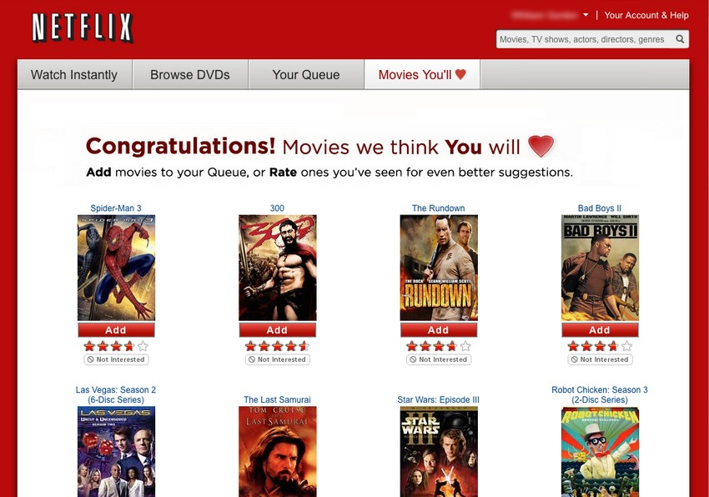
Image: http://lifehacker.com/5642050/five-best-movie-recommendation-services

Slide 3
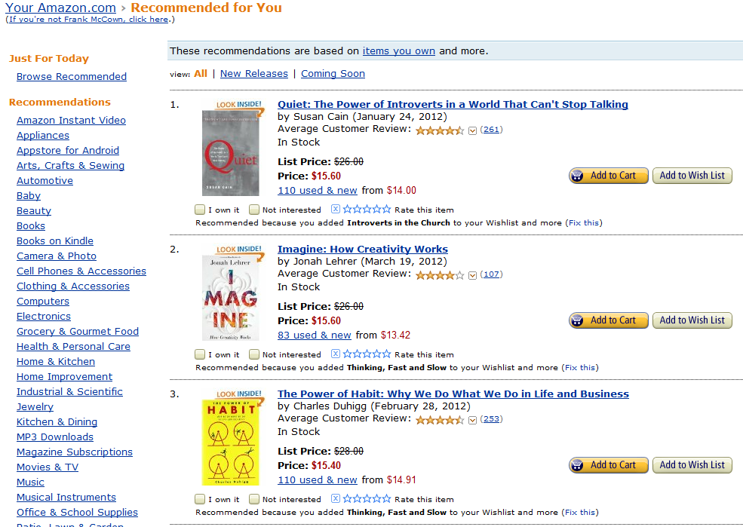

Slide 4
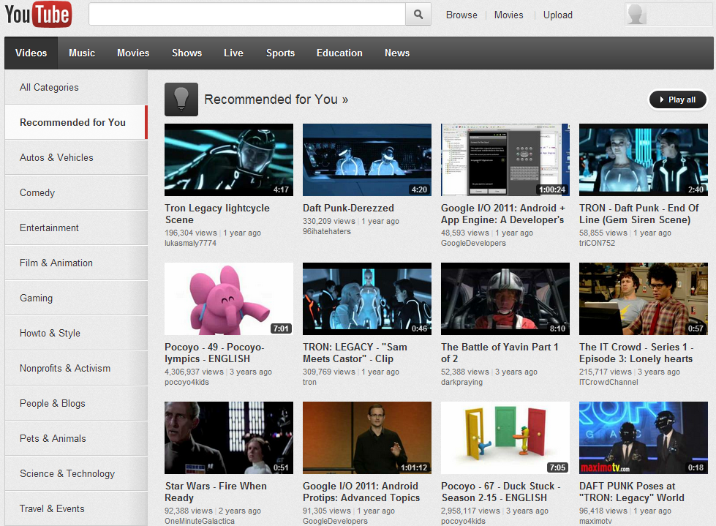

Slide 5
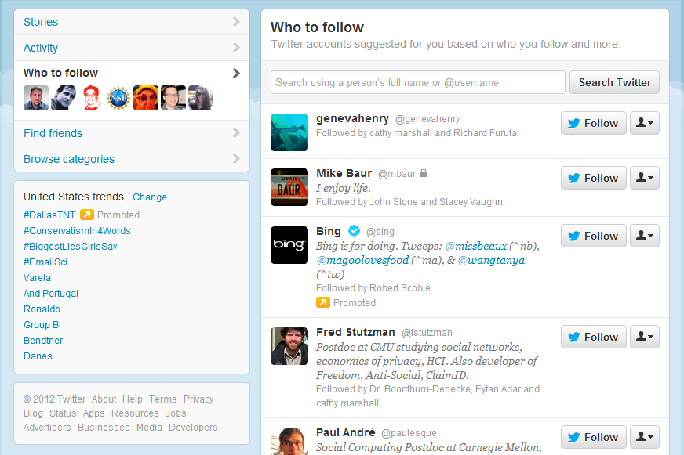

Slide 7
Recommender Systems
Recommender (recommendation) systems recommend things to people based on their preferences or past behavior
Two general approaches:
Collaborative filtering
You’ll like X because other people like you also liked X
Content-based (not covered in these slides)
You’ll like X because it is very similar to other things you like

Slide 8
Collaborative Filtering
We often seek recommendations from people we trust (family, friends, colleagues, experts)
But who to ask for a recommendation is also based on similarity in taste
I trust my sister with my life, but she doesn’t like the same movies I like
People with my tastes are likely to recommend things I will like
CF searches a large group of people for those that like the things you like, and it combines the things they like into a ranked list of suggestions

Slide 9
Example Data: Movie Ratings
Example from Ch 2 of Programming Collective Intelligence by Toby Segaran (2007)
 | Lady in the Water | Snakes on a Plane | Just My Luck | Superman Returns | You, Me and Dupree | The Night Listener
Rose | 2.5 | 3.5 | 3.0 | 3.5 | 2.5 | 3.0
Seymour | 3.0 | 3.5 | 1.5 | 5.0 | 3.5 | 3.0
Puig |  | 3.5 | 3.0 | 4.0 | 2.5 | 4.5
LaSalle | 3.0 | 4.0 | 2.0 | 3.0 | 2.0 | 3.0
Matthews | 3.0 | 4.0 |  | 5.0 | 3.5 | 3.0
Toby |  | 4.5 |  | 4.0 | 1.0
Let’s visualize the data on a scatter plot…

Slide 10
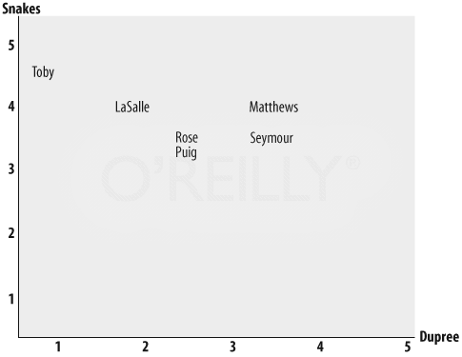
Euclidean Distance Score
$$D(x,y)= \sqrt{\sum_{i=1}^{n}{{(x_{i}−y_{i})}^{2} }}$$
2.5495
1.1180
Distance(Toby, Matthews) =
= 2.5495
$$\sqrt{(1−3.5)^{2}+(4.5−4)^{2}}$$
Distance(Toby, LaSalle) =
= 1.1180
$$\sqrt{(1−2)^{2}+(4.5−4)^{2}}$$
http://answers.oreilly.com/topic/1066-how-to-find-similar-users-with-python/

Slide 11
Modified Euclidian Distance Score
Most similarity metrics use range [0,1]
0 = no similarity
1 = exactly the same
Modify Euclidian Distance
$$D(x,y)= 1/{(1+\sqrt{\sum_{i=1}^{n}{{(x_{i}−y_{i})}^{2}}})}$$

Slide 12
Modified Euclidian Distance Score
Distance(Toby, LaSalle)
Distance(Toby, Matthews)
 | Lady in the Water | Snakes on a Plane | Just My Luck | Superman Returns | You, Me and Dupree | The Night Listener
LaSalle | 3.0 | 4.0 | 2.0 | 3.0 | 2.0 | 3.0
Matthews | 3.0 | 4.0 |  | 5.0 | 3.5 | 3.0
Toby |  | 4.5 |  | 4.0 | 1.0
$$1/(1+\sqrt{(4.5−4)^{2}+(4−3)^{2}+(1−2)^{2}})=0.4$$
$$1/(1+\sqrt{(4.5−4)^{2}+(4−5)^{2}+(1−3.5)^{2}})=0.2675$$

Slide 13
Pearson Correlation Coefficient
Problem with Euclidean distance
Ratings for A: 5, 4, 3 Ratings for B: 3, 2, 1
Although A and B seem to share roughly same opinions, distance between ratings are significant
Pearson’s r corrects for “grade inflation”
Yields values between 1 and -1 1 = perfect correlation 0 = no correlation -1 = inverse correlation

Slide 14
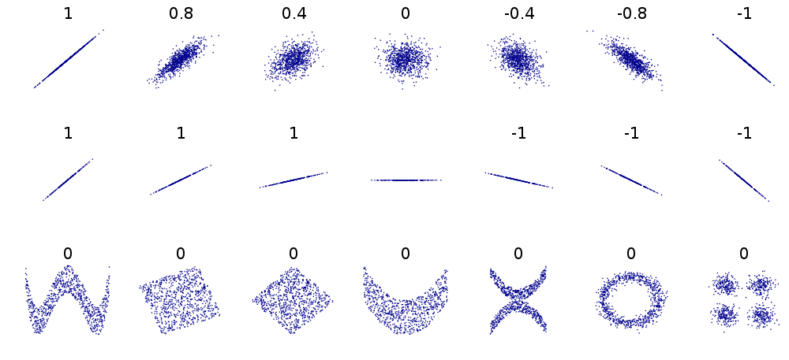
Pearson Correlation Coefficient
Perfect correlation
Inverse correlation
No correlation
http://en.wikipedia.org/wiki/File:Correlation_examples2.svg

Slide 15
Calculating Pearson’s r
x = User1’s ratings of all items rated by both users
y = User2’s ratings of all items rated by both users
$\overline{x}$ = Mean of all User1’s ratings
$\overline{y}$ = Mean of all User2’s ratings
$$r=\frac{\sum_{i=1}^{n}{(x_{i}−\overline{x})(y_{i}−\overline{y})}}{\sqrt{\sum_{i=1}^{n}{(x_{i}−\overline{x})^{2}}}\sqrt{\sum_{i=1}^{n}{(y_{i}−\overline{y})^{2}}}}$$

Slide 16
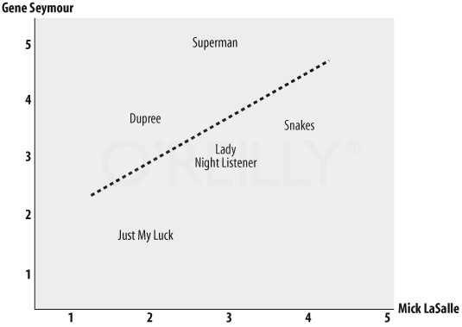
Comparing Two Critics’ Ratings
Further distance means less correlation
Best-fit line
Pearson’s r = 0.4
http://answers.oreilly.com/topic/1066-how-to-find-similar-users-with-python/

Slide 17
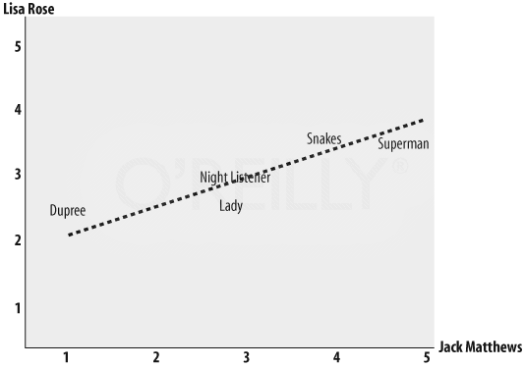
Comparing Two Critics’ Ratings
Pearson’s r = 0.75
Gives higher scores
http://answers.oreilly.com/topic/1066-how-to-find-similar-users-with-python/

Slide 18
Other Similarity Measures
Cosine similarity
Jaccard coefficient
Manhattan (taxicab) distance
Other…

Slide 19
Moving On…
 | Lady in the Water | Snakes on a Plane | Just My Luck | Superman Returns | You, Me and Dupree | The Night Listener
Rose | 2.5 | 3.5 | 3.0 | 3.5 | 2.5 | 3.0
Seymour | 3.0 | 3.5 | 1.5 | 5.0 | 3.5 | 3.0
Puig |  | 3.5 | 3.0 | 4.0 | 2.5 | 4.5
LaSalle | 3.0 | 4.0 | 2.0 | 3.0 | 2.0 | 3.0
Matthews | 3.0 | 4.0 |  | 5.0 | 3.5 | 3.0
Toby |  | 4.5 |  | 4.0 | 1.0
Should Toby see these movies?

Slide 20
Who Should We Ask?
To find recommendations for movies we have not seen, we could…
Find a single critic whose taste best matches ours
What if they haven’t rated a movie we are interested in?
Get all critics’ input but give critics with similar tastes more impact on decision
For option 2, use similarity metric to compare all ratings with ours, and compute average rating based on weighted similarity

Slide 21
Should Toby See “Lady in the Water”?
Higher values influence Weighted Ave more
All Toby’s ratings compared to other critics’
 | Similarity (Pearson’s r) | Lady in the Water | Weighted Score
Rose | 0.99 | 2.5 | 2.48
Seymour | 0.38 | 3.0 | 1.14
Puig
LaSalle | 0.92 | 3.0 | 2.77
Matthews | 0.66 | 3.0 | 1.99
Total | 2.95 |  | 8.38
0.99 × 2.5
Not included in Total since no rating
Weighted Ave = Weighted Total / Similarity Total = 8.38/2.95 = 2.83
Toby is likely to rate this movie 2.83

Slide 22
Product Recommendations
Previous example used distance metric to find critics with similar taste
What if we want to find movies that are similar to some given movie?
Solution: Use same method but swap rows and columns

Slide 23
Rows and Columns Swapped
 | Rose | Seymour | Puig | LaSalle | Matthews | Toby
Lady in the Water | 2.5 | 3.0 |  | 3.0 | 3.0
Snakes on a Plane | 3.5 | 3.5 | 3.5 | 3.5 | 4.0 | 4.0
Just My Luck | 3.0 | 1.5 | 3.0 | 2.0
Superman Returns | 3.5 | 5.0 | 4.0 | 3.0 | 5.0 | 4.0
You, Me and Dupree | 2.5 | 3.5 | 2.5 | 2.0 | 3.5 | 1.0
The Night Listener | 3.0 | 3.0 | 4.5 | 3.0 | 3.0
Find movies like Superman Returns by comparing its row with all other rows…

Slide 24
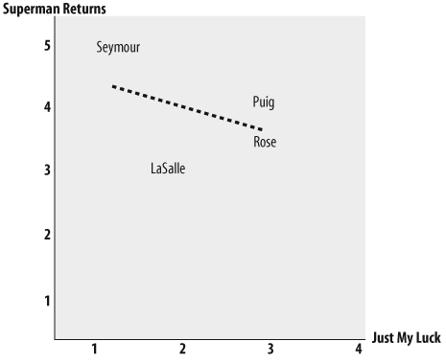
Movies Similar to Superman Returns
 | Similarity
You, Me and Dupree | 0.657
Lady in the Water | 0.487
Snakes on a Plane | 0.111
The Night Listener | -0.179
Just My Luck | -0.422
Negative correlation!
If you like Superman Returns, you probably won’t like Just My Luck (and vice versa)!
http://jampad.net/Library/collectiveintelligence/

Slide 25
Challenges for Collaborative Filtering
Ratings data is often sparse
Large data sets required
Cold start problem: new users must first rate a number of items before CF can work
Comparing all items against all users is not efficient/scalable
Compare against a sample
Use clustering algorithm to locate best neighbors

Slide 26
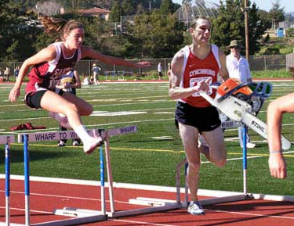
Challenges for Collaborative Filtering
Susceptible to cheating (shilling attacks)
Rate your own products higher and your competitors lower
Rate like everyone else except a select few items you want recommended to others
See Lam and Riedl, WWW 2004 Image: http://www.somethingawful.com/d/photoshop-phriday/cheating-in-sports.php

Slide 27
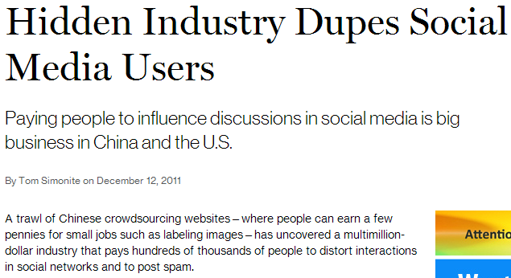
Say it isn’t true!
http://www.technologyreview.com/news/426338/hidden-industry-dupes-social-media-users/

Slide 28
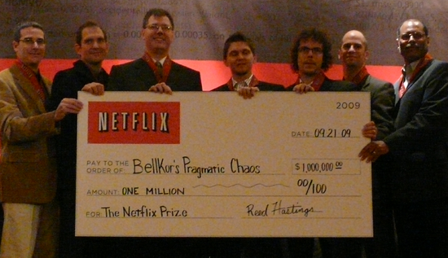
Netflix Prize
Netflix Prize (Oct 2006): $1M for beating Netflix’s collaborative filtering algorithm by 10%
Dataset: 100,480,507 ratings that 480,189 anonymized users gave to 17,770 movies
Started with 50,051 contestants
Only two teams had winning solutions by contest closing (July 2009)
Image: http://www.wired.com/images_blogs/business/2009/09/p1010915.jpg

Slide 29
How Did They Do It?
Insights that gave winning algorithms an edge:
People who rate a large number of movies at once are usually rating movies they saw a long time ago
People use different criteria when rating movies they saw a long time ago vs. recently seen
Some movies get better over time, others get worse
People rate movies differently depending on which day of the week it is
Combined hundreds of other algorithms which were precisely weighed and tuned
How the Netflix Prize Was Won by Buskirk, Wired 2009

Slide 30
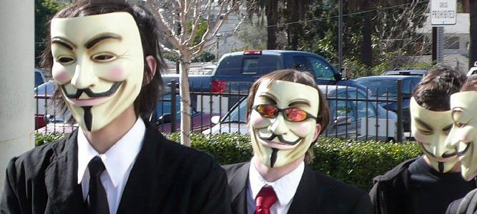
Netflix Prize 2
Second prize announced in 2009
FTC and lawsuits against Netflix about privacy
I thought the data was anonymized?
Image: http://laist.com/2008/02/10/photo_essay_ano.php

Slide 31
Anonymizing Data Is Hard To Do…
In 2007 Narayanan and Shmatikov (Univ of Texas) were able to re-identify a number of the anonymous users in Netflix dataset by correlating movie ratings with IMDb ratings (full paper)
This has happened before…
In 2006 users in anonymized AOL search data were re-identified
In 2000 Latanya Sweeney showed 87% of all Americans could be uniquely identified with only zip code, birthdate, and gender
See Why 'Anonymous' Data Sometimes Isn't by Bruce Schneier (2007)

Slide 32
Netflix gave up… no more prizes!

Slide 33
More Reading
Guy and Carmel, Social Recommender Systems (slides), Tutorial at WWW 2011 http://www.slideshare.net/idoguy/social-recommender-systems-tutorial-www-2011-7446137
Lam and Riedl, Shilling Recommender Systems for Fun and Profit, Proc WWW 2004
Jannach et al., Recommender Systems: An Introduction, 2010
Segaran, Programming Collective Intelligence, Chapter 2, 2007

