Slide 1
How Does a Search Engine Work? Part 1
Dr. Frank McCown
Intro to Web Science
Harding University
This work is licensed under a Creative Commons Attribution-NonCommercial-ShareAlike 3.0 Unported License

Slide 2
What we’ll examine
Web crawling
Building an index
Querying the index
Term frequency and inverse document frequency
Other methods to increase relevance

Slide 3
Web Crawling
Large search engines use thousands of continually running web crawlers to discover web content
Web crawlers fetch a page, place all the page’s links in a queue, fetch the next link from the queue, and repeat
Web crawlers are usually polite
Identify themselves through the http User-Agent request header (e.g., googlebot)
Throttle requests to a web server, crawl at off-peak times
Honor robots exclusion protocol (robots.txt). Example: User-agent: * Disallow: /private

Slide 4
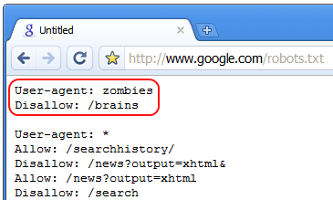
Robots.txt Humor
Halloween 2008
http://www.mattcutts.com/blog/google-protects-itself-from-zombies/

Slide 5
Web Crawler Components
Figure: McCown, Lazy Preservation: Reconstructing Websites from the Web Infrastructure, Dissertation, 2007

Slide 6
Crawling Issues
Good source for seed URLs:
Yahoo or ODP web directory
Previously crawled URLs
Search engine competing goals:
Keep index fresh (crawl often)
Comprehensive index (crawl as much as possible)
Which URLs should be visited first or more often?
Breadth-first (FIFO)
Pages which change frequently & significantly
Popular or highly-linked pages

Slide 7
Crawling Issues Part 2
Should avoid crawling duplicate content
Convert page content to compact string (fingerprint) and compare to previously crawled fingerprints
Should avoid crawling spam
Content analysis of page could make crawler ignore it while crawling or in post-crawl processing
Robot traps
Deliberate or accidental trail of infinite links (e.g., calendar)
Solution: limit depth of crawl
Deep Web
Throw search terms at interface to discover pages¹
Sitemaps allow websites to publish URLs that might not be discovered in regular web crawling
¹Madhavan et al., Google's Deep Web crawl, Proc. VLDB 2008

Slide 8
Example Sitemap
<?xml version="1.0" encoding="UTF-8"?> <urlset xmlns="http://www.sitemaps.org/schemas/sitemap/0.9"> <url> <loc>http://www.example.com/</loc> <lastmod>2009-10-22</lastmod> <changefreq>weekly</changefreq> <priority>0.8</priority> </url>
<url> <loc>http://www.example.com/specials.html</loc> <changefreq>daily</changefreq> <priority>0.9</priority> </url> <url> <loc>http://www.example.com/about.html</loc>
<lastmod>2009-11-4</lastmod> <changefreq>monthly</changefreq> </url> </urlset>

Slide 9
Focused Crawling
A vertical search engine focuses on a subset of the Web
Google Scholar – scholarly literature
ShopWiki – Internet shopping
A topical or focused web crawler attempts to download only pages about a specific topic
Has to analyze page content to determine if it’s on topic and if links should be followed
Usually analyzes anchor text as well

Slide 10
Processing Pages
After crawling, content is indexed and links stored in link database for later analysis
Text from text-based files (HTML, PDF, MS Word, PS, etc.) are converted into tokens
Stop words may be removed
Frequently occurring words like a, the, and, to, etc.
Most traditional IR systems remove them, but most search engines do not (“to be or not to be”)
Special rules to handle punctuation
e-mail → email?
Treat O’Connor like boy’s?
123-4567 as one token or two?

Slide 11
Processing Pages
Stemming may be applied to tokens
Technique to remove suffixes from words (e.g., gamer, gaming, games → gam)
Porter stemmer very popular algorithmic stemmer
Can reduce size of index and improve recall, but precision is often reduced
Google and Yahoo use partial stemming
Tokens may be converted to lowercase
Most web search engines are case insensitive

Slide 12
Inverted Index
Inverted index or inverted file is the data structure used to hold tokens and the pages they are located in
Example:
Doc 1: It is what it was.
Doc 2: What is it?
Doc 3: It is a banana.
postings
it
is
what
was
a
banana
1, 2, 3
1, 2, 3
1, 2
1
3
3
term list

Slide 13
Example Search
Search for what is it is interpreted by search engines as what AND is AND it
what: {1, 2} is: {1, 2, 3} it: {1, 2, 3}
{1, 2} ∩ {1, 2, 3} ∩ {1, 2, 3} = {1, 2}
Answer: Docs 1 and 2
What if we want phrase “what is it”?
it
is
what
was
a
banana
1, 2, 3
1, 2, 3
1, 2
1
3
3

Slide 14
Phrase Search
Phrase search requires position of words be added to inverted index
Doc 1: It is what it was.
Doc 2: What is it?
Doc 3: It is a banana.
it
is
what
was
a
banana
(1,1) (1,4) (2,3) (3,1)
(1,2) (2,2) (3,2)
(1,3) (2,1)
(1,5)
(3,3)
(3,4)

Slide 15
Example Phrase Search
Search for “what is it”
All items must be in same doc with position in increasing order
what: (1,3) (2,1) is: (1,2) (2,2) (3,2) it: (1,1) (1,4) (2,3) (3,1)
Answer: Doc 2
Position can be used to give higher scores to terms that are closer
“red cars” scores higher than “red bright cars”

Slide 16
What About Large Indexes?
When indexing the entire Web, the inverted index will be too large for a single computer
Solution: Break up index onto separate machines/clusters
Two general methods:
Document-based partitioning
Term-based partitioning

Slide 17
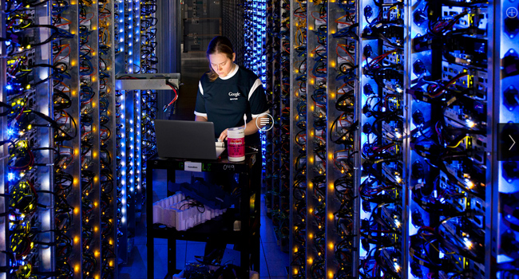
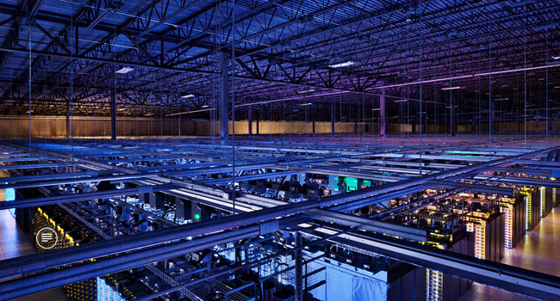
Google’s Data Centers
http://memeburn.com/2012/10/10-of-the-coolest-photos-from-inside-googles-secret-data-centres/

Slide 18
Partitioning Schemes
Document-based Partitioning
apple
banana
apple
banana
1, 10
2
3, 5
3, 5
apple
banana
…
1, 3, 5, 10
2, 3, 5
Term-based Partitioning
apple
banana
1, 3, 5, 10
2, 3, 5
apple
banana
…
1, 3, 5, 10
2, 3, 5

Slide 19
Comparing the Two Schemes
Event | Document-Based | Term-Based
Fetch query results | All computers fetch local results and merge | Single machine fetches result for each term
Machine goes down | Some docs not in results | Some terms cannot be processed
Index new doc | Add new terms/docs to single machine | Rebuild index
Guess which scheme Google uses?
Notes:
For TB, what if machine has a popular term? Gets overloaded with work while machines with infrequently used terms sit idle. DB spreads out the load better to achieve better parallelization.
“The Google implementation uses a document-partitioned index with massive replication and redundancy at all levels: the machine, the processor cluster, and the site.” – Zobel and Moffat, Inverted files for text search engines, CSUR, 2006.

Slide 20
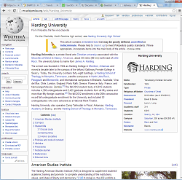
If two documents contain the same query terms, how do we determine which one is more relevant?
?

Slide 21
Term Frequency
Query for “dogs” results in two pages:
Dogs, dogs, I love them dogs!
Dogs are wonderful animals.
TF = 3
TF = 1
Doc A
Doc B
Which page should be ranked higher?
Simple method called term frequency: Count number of times the term occurs in the document
Pages with higher TF get ranked higher

Slide 22
Normalizing Term Frequency
Query for “dogs” results in two pages:
Dogs, dogs, I love them dogs!
Dogs are wonderful animals.
TF = 3/6 = 0.5
TF = 1/4 = 0.25
Doc A
Doc B
To avoid favoring shorter documents, TF should be normalized
Divide by total number of words in the document
Other divisors possible

Slide 23
TF Can Be Spammed!
Watch out!
Dogs, dogs, I love them dogs!
dogs
dogs
dogs
dogs
dogs
TF is susceptible to spamming, so SEs look for unusually high TF values when looking for spam

Slide 24
Inverse Document Frequency
Problem: Some terms are frequently used throughout the corpus and therefore aren’t useful when discriminating docs from each other
Less frequently used terms are more helpful
IDF(term) = total docs in corpus / docs with term
Low frequency terms will have high IDF

Slide 25
Inverse Document Frequency
To keep IDF from growing too large as corpus grows: IDF(term) = log₂(total docs in corpus / docs with term)
IDF is not as easy to spam since it involves all docs in corpus
Could stuff rare words in your pages to raise IDF for those terms, but people don’t often search for rare terms

Slide 26
TF-IDF
TF and IDF are usually combined into a single score
TF-IDF = TF × IDF = occurrence in doc / words in doc × log₂(total docs in corpus / docs with term)
When computing TF-IDF score of a doc for n terms:
Score = TF-IDF(term₁) + TF-IDF(term₂) + … + TF-IDF(term_{n})

Slide 27
TF-IDF Example
Using Bing, compute the TF-IDF scores for 2 documents that contain the words harding AND university
Assume Bing has 20 billion documents indexed
Actions to perform:
Query Bing with harding university to pick 2 docs
Query Bing with just harding to determine how many docs contain harding
Query Bing with just university to determine how many docs contain university

Slide 28
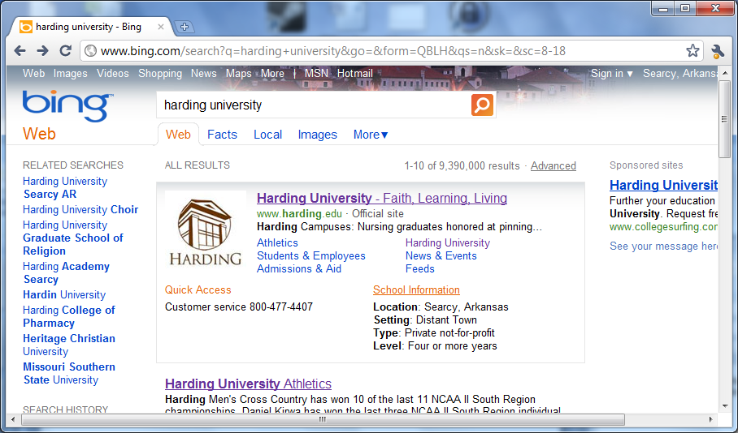
1) Search for harding university and choose two results

Slide 29
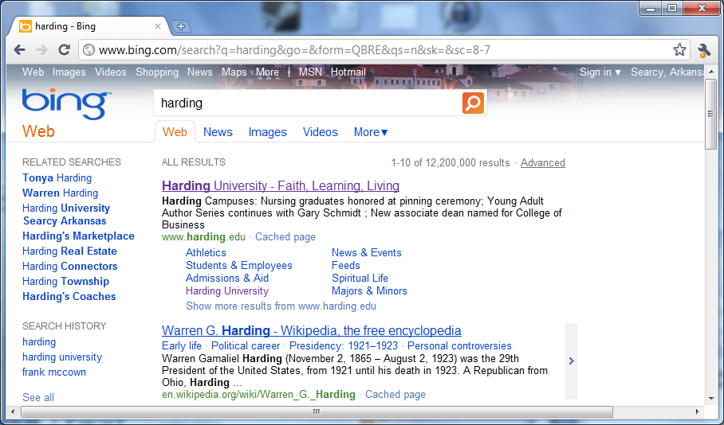
2) Search for harding
Gross exaggeration
Notes:
Search engines provide a very rough estimate of how many pages in their index have a particular search term, and you cannot trust this number. However, it’s the best estimate we have as an outside observer.

Slide 30
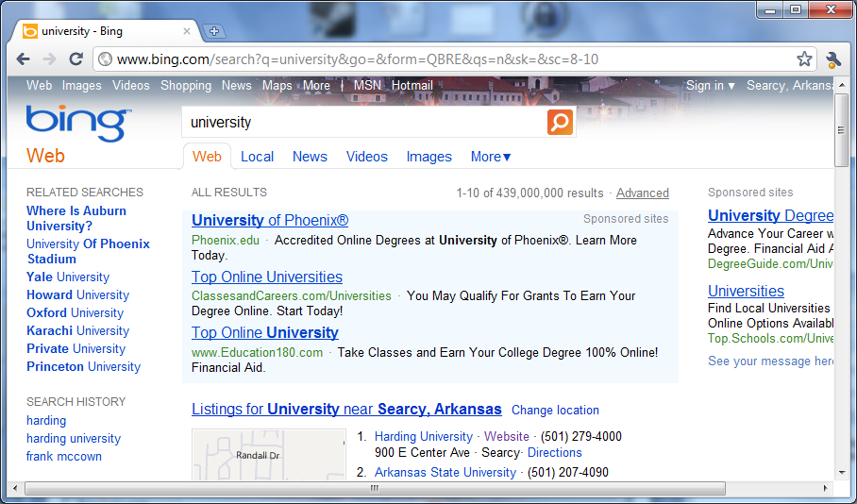
2) Search for university

Slide 31
Doc 1: http://www.harding.edu/pharmacy/
Copy and paste into MS Word or other word processor to obtain number of words and count occurrences
TF(harding) = 19 / 967
IDF(harding) = log₂(20B / 12.2M)
TF(university) = 13 / 967
IDF(university) = log₂(20B / 439M)
TF-IDF(harding) + TF-IDF(university) = 0.020 × 10.680 + 0.012 × 5.510 = 0.280

Slide 32
Doc 2: http://en.wikipedia.org/wiki/Harding_University
TF(harding) = 44 / 3,135
IDF(harding) = log₂(20B / 12.2M)
TF(university) = 25 / 3,135
IDF(university) = log₂(20B / 439M)
TF-IDF(harding) + TF-IDF(university) = 0.014 × 10.680 + 0.008 × 5.510 = 0.194
Doc 1 = 0.280 so it has higher score

Slide 33
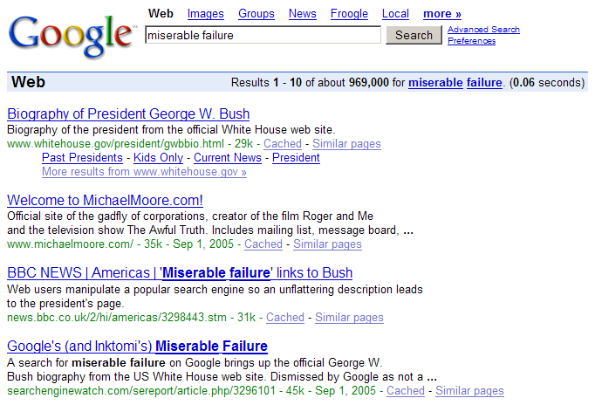
Increasing Relevance
Index link’s anchor text with page it points to
<a href=“skill.html”>Ninja skills</a>
Watch out: Google bombs
http://en.wikipedia.org/wiki/File:Google_Bomb_Miserable_Failure.png

Slide 34
Increasing Relevance
Index words in URL
Weigh importance of terms based on HTML or CSS styles
Web site responsiveness¹
Account for last modification date
Allow for misspellings
Link-based metrics
Popularity-based metrics
¹http://googlewebmastercentral.blogspot.com/2010/04/using-site-speed-in-web-search-ranking.html

Slide 35
Further Reading
Levene (2010), An Introduction to Search Engines and Web Page Navigation
Croft et al. (2010), Search Engines: Information Retrieval in Practice
Zobel & Moffat (2006), Inverted files for text search engines, ACM Computing Surveys, 38(2)
Google Webmaster Guidelines http://support.google.com/webmasters/bin/answer.py?hl=en&answer=35769

