Slide 1
How Does a Search Engine Work? Part 2
Dr. Frank McCown
Intro to Web Science
Harding University
This work is licensed under a Creative Commons Attribution-NonCommercial-ShareAlike 3.0 Unported License

Slide 2
What we’ll cover…
How links between web pages can be used to improve ranking search engine results
Link spam and how to overcome it

Slide 3
Link Analysis
Content analysis is useful, but combining with link analysis allow us to rank pages much more successfully
2 popular methods
Sergey Brin and Larry Page’s PageRank
Jon Kleinberg’s Hyperlink-Induced Topic Search (HITS)

Slide 4
What Does a Link Mean?
A
B
A recommends B
A specifically does not recommend B
B is an authoritative reference for something in A
A & B are about the same thing (topic locality)

Slide 5
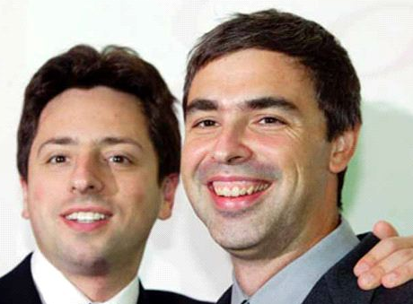
PageRank
Developed by Brin and Page (Google) while Ph.D. students at Stanford
Links are a recommendation system
The more links that point to you, the more important you are
Inlinks from important pages are weightier than inlinks from unimportant pages
The more outlinks you have, the less weight your links carry
Page et al., The PageRank citation ranking: Bringing order to the web, 1998 Image: http://scrapetv.com/News/News%20Pages/Technology/images/sergey-brin-larry-page.jpg

Slide 6
Random Surfer Model
Model helpful for understanding PageRank
The Random Surfer starts at a randomly chosen page and selects a link at random to follow
PageRank of a page reflects the probability that the surfer lands on that page after clicking any number of links
Image: http://missloki84.deviantart.com/art/Random-Surfer-at-Huntington-Beach-319287873

Slide 7
Example of Random Surfer
A
Start at: B
¼ probability of going to A
¼ probability of going to C
¼ probability of going to D
¼ probability of going to E
Choose: E
½ probability of going to C ½ probability of going to D
B
C
D
E

Slide 8
Problem 1: Dangling Node
What if we go to A? We’re stuck at a dead-end!
Solution: Teleport to any other page at random
A
B
C
D
E

Slide 9
Problem 2: Infinite Loop
What if we get stuck in an a cycle?
Solution: Teleport to any other page at random
A
X
Y

Slide 10
Rank Sinks
Dangling nodes and cycles are called rank sinks
Solution is to add a teleportation probability α to every decision
α% chance of getting bored and jumping somewhere else, (1- α)% chance of choosing one of the available links
α = .15 is typical

Slide 11
PageRank Definition
Teleportation probability
Sum of PR of all pages pointing to P_{i}
PageRank of page P_{i}
Total num of pages
Number of outlinks from P_{j}
B_{Pi} is set of all pages pointing to P_{i}

Slide 12
PageRank Example
A
PR(C) = .15/5 + .85 ×
(PR(B)/4 + PR(E)/2)
Problem: What is PR(B)
and PR(E)?
Solution: Give all pages same PR to start (1/|P|) & iteratively calculate new PR
B
C
D
E

Slide 13
PageRank Example
PR(A) = .03 + .85 × PR(B)/4
= .0725
PR(B) = .03 + . 85 × PR(D)/1 = .2
PR(C) = .03 + .85(PR(B)/4 +
PR(E)/2)
= .03 + .85(.2/4 + .2/2)
= .1575
PR(D) = .03 + .85(PR(B)/4 +
PR(E)/2) = .1575 PR(E) = .03 + .85(PR(B)/4 +
PR(C)/1)
= .2425
A
B
C
D
E

Slide 14
Calculating PageRank
PageRank is computed over and over until it converges, around 20 times
Can also be calculated efficiently using matrix multiplication

Slide 15
PageRank Definition as Matrix
Stated as a matrix equation where R is the vector of PageRank values and T the matrix for transition probabilities:
where T_{ij} is the probability of going from page j to i:
if a link from page j to i
exists, otherwise
Total num of pages
Total outlinks from page j

Slide 16
PageRank Matrix Example
No link from C to A so value = 0.15/5
. . .03 . .
. . . . .
. . . . .
. . . . .
. .243 . . .
PR_{A}
PR_{B}
PR_{C}
PR_{D}
PR_{E}
.2
.2
.2
.2
.2
=
Init PR values
1/|P|
= 0.15/5 + (1 – 0.15)/4 = 0.243

Slide 17
PageRank Issues
Richer-get-richer phenomenon
May be difficult for new pages with few inlinks to compete with older, highly linked pages with high PageRank
Could promote small fraction of new pages at random¹ or add decay factor to links
Study² showed just counting number of inlinks gives similar ranking as PageRank
Study was on small scale and pages were not necessarily “typical”
Counting inlinks more susceptible to spamming
¹Pandey et al., Shuffling a stacked deck, VLDB 2005
²Amento et al., Does “authority” mean quality?

Slide 18
HITS
Hyperlink-induced topic search (HITS) by Jon Kleinberg¹
Hub: page with outlinks to informative web pages
Authority: informative/authoritative page with many inlinks
Recursive definition:
Good hubs point to good authorities
Good authorities are pointed to by good hubs
H
A
¹Kleinberg, Authoritative sources in a hyperlinked environment, J. ACM, 1999
Image: http://scgp.stonybrook.edu/archives/6084

Slide 19
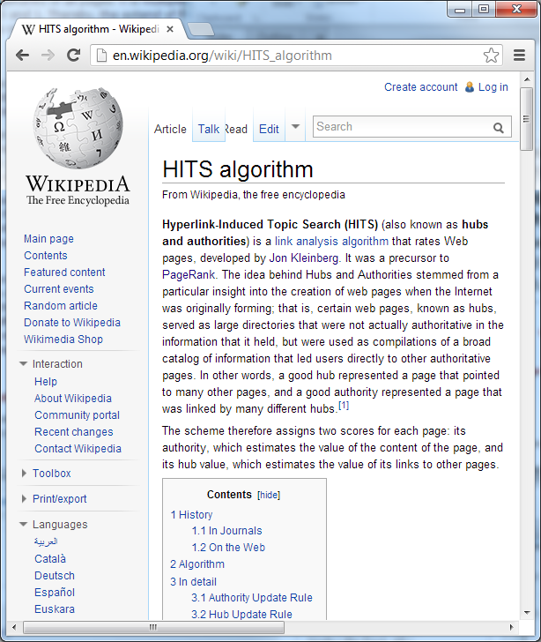
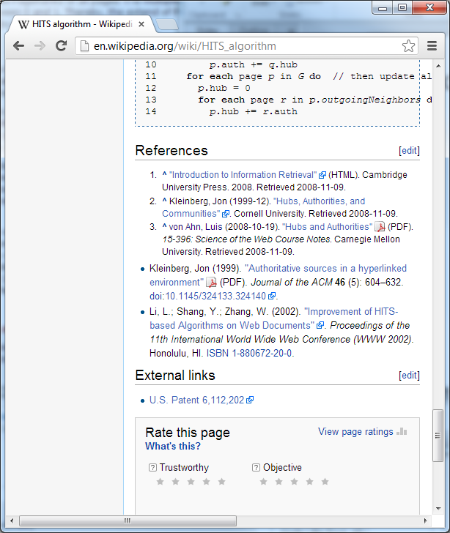
Good Authority & Hub?

Slide 20
HITS Algorithm
Retrieve pages most relevant to search query → root set
Retrieve all pages linked to/from the root set → base set
Perform authority and hub calculations iteratively on all nodes in the subgraph
When finished, every node has an authority score and hub score

Slide 21
Root and Base Sets
Base set
I
H
Root set
A
B
G
D
C
E
F
Resulting subgraph between 1K – 5K pages

Slide 22
Calculate H and A
E is set of all directed edges in subgraph
e_{qp} is edge from page q to p
inlinks
outlinks

Slide 23
Calculating H and A
H and A scores computed repetitively until they converge, about 10-15 iterations
Can also be calculated efficiently using matrix multiplication

Slide 24
Example Subgraph
A B C D
A
B
0 1 1 0
1 0 1 0
0 1 0 1
0 1 0 0
A
B
C
D
C
D
Adjacency matrix

Slide 25
Auth Scores
Best authority
A_{A}
A_{B}
A_{C}
A_{D}
0 1 0 0
1 0 1 1
1 1 0 0
0 0 1 0
1
1
1
1
1
3
2
1
=
x
=
Authority scores
Transposed adjacency matrix
Init hub scores
Resulting
auth scores

Slide 26
Hub Scores
Best hub
H_{A}
H_{B}
H_{C}
H_{D}
0 1 1 0
1 0 1 0
0 1 0 1
0 1 0 0
1
3
2
1
5
3
4
3
=
x
=
Hub scores
Adjacency matrix
Init auth scores
Resulting
hub scores

Slide 27
Problems with HITS
Has not been widely used
IBM holds patent
Query dependence
Later implementations have made query independent
Topic drift
Pages in expanded base set may not be on same topic as root pages
Solution is to examine link text when expanding

Slide 28
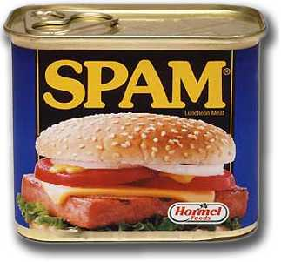
Link Spam
There is a strong economic incentive to rank highly in a SERP
White hat SEO firms follow published guidelines to improve customer rankings¹
To boost PageRank, black hat SEO practices include:
Building elaborate link farms
Exchanging reciprocal links
Posting links on blogs and forums
¹Google’s Webmaster Guidelines http://www.google.com/support/webmasters/bin/answer.py?answer=35769

Slide 29
Combating Link Spam
Sites like Wikipedia can discourage links than only promote PageRank by using “nofollow”
<a href=“http://somesite.com/” rel=“nofollow”>Go here!</a>
Davison¹ identified 75 features for comparing source and destination pages
Overlap, identical page titles, same links, etc.
TrustRank²
Bias teleportation in PageRank to set of trusted web pages
¹Davison, Recognizing nepotistic links on the web, 2000
²Gyöngyi et al., Combating web spam with TrustRank, VLDB 2004

Slide 30
Combating Link Spam cont.
SpamRank¹
PageRank for whole Web has power-law distribution
Penalize pages whose supporting pages do not approximate power-law dist
Anti-TrustRank²
Give high weight to known spam pages and propagate values using PageRank
New pages can be classified spam if large contribution of PageRank from known spam pages or if high Anti-TrustRank
¹Benczúr et al., SpamRank – fully automated link spam detection, AIRWeb 2005
²Krishnan & Raj, Web spam detection with Anti-TrustRank, AIRWeb 2006

