Slide 1
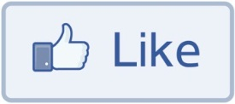
Social Networks
Dr. Frank McCown
Intro to Web Science
Harding University
This work is licensed under a Creative Commons Attribution-NonCommercial-ShareAlike 3.0 Unported License

Slide 2
Slides based on Ch 2 and 3 of Networks, Crowds and Markets by Easley & Kleinberg (2010)
http://www.cs.cornell.edu/home/kleinber/networks-book/

Slide 3
Social Network
Definition: Graph composed of actors (people, organizations, groups) that are tied by social links
relationship
A
follows
B
actors

Slide 4
Online Social Networks (OSN)
Digital incarnation of a social network
Created by social network sites, social networking services
Web-based services that allows users to:¹
construct (semi-)public profiles within the system
“connect” to other users
view and traverse lists of connections created by others
¹Boyd & Ellison (2007) - Social Network Sites: Definition, History, and Scholarship

Slide 6
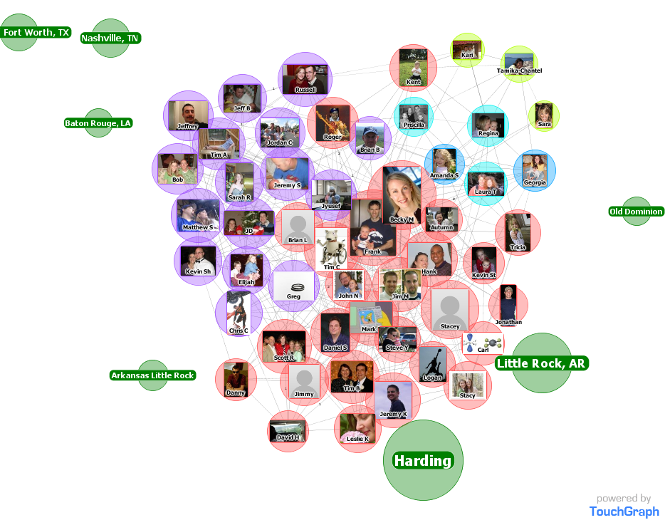
Facebook Friends

Slide 7
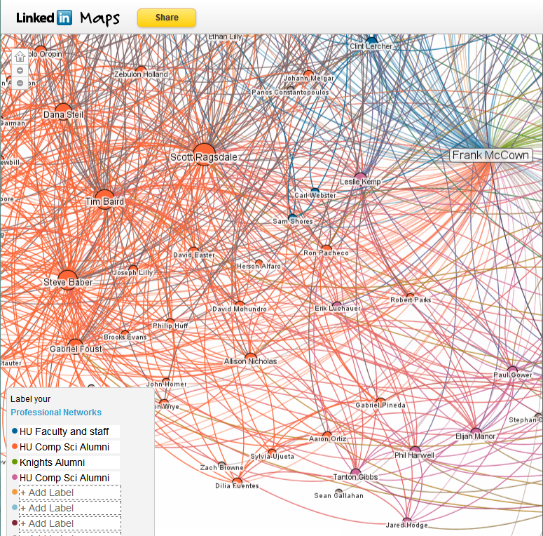
LinkedIn Maps

Slide 8
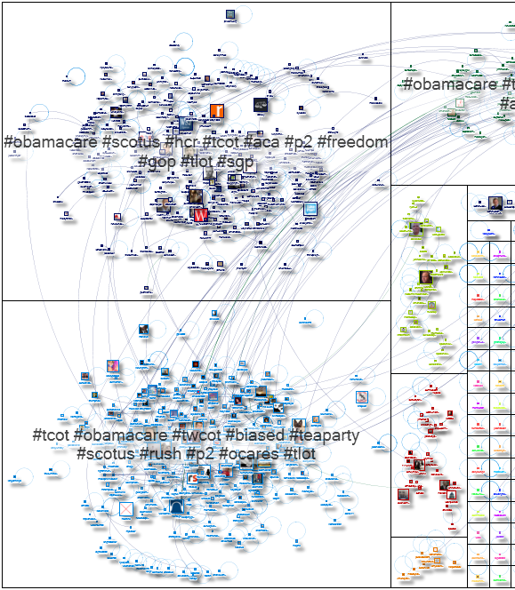
Tweets containing “obamacare”
http://www.nodexlgraphgallery.org/Pages/Graph.aspx?graphID=514

Slide 9
Why Study Social Networks?
Social scientists use social networks to study how people interact and develop theories of social behavior. OSNs offer opportunities to study social networks at larger scale
Understanding the structure of OSNs can lead to systems in the future that want to improve security, leverage trust, improve social interaction, etc.

Slide 10
Why Study Social Networks?
Search engines like Google are using OSNs to improve web search¹
Search engines like Aardvark (now defunct) are being built on top of OSNs²
Information diffusion: How does (mis)information spread on social networks/Web?³
¹http://googleblog.blogspot.com/2011/03/1s-right-recommendations-right-when-you.html
²http://en.wikipedia.org/wiki/Aardvark_(search_engine) ³ http://cnets.indiana.edu/groups/nan/truthy

Slide 11
Graph Types
Directed
Undirected
A
B
A
B
C
C
e.g., Twitter followers
e.g., Facebook friends

Slide 12
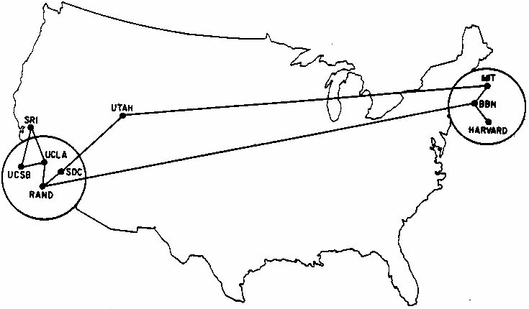
Cycles
Shortest cycle
The Internet - June 1970
http://som.csudh.edu/cis/lpress/history/arpamaps/press6.jpg

Slide 13
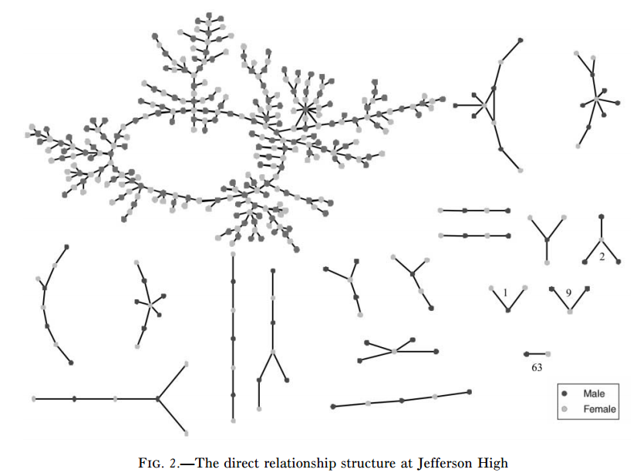
Components
Giant component
Bearman, et al., Chains of Affection: The Structure of Adolescent Romantic and Sexual Networks (2004)

Slide 14
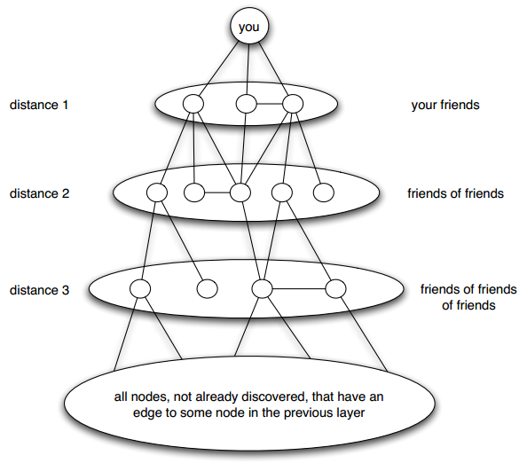
Distance
Length of shortest path
Breadth-first search
Easley & Kleinberg, Fig 2.8

Slide 15
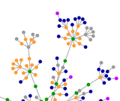
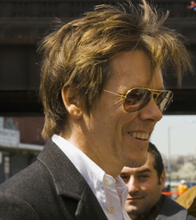
Small World Network
Six degrees of separation
From title of play by John Guare
First tested by Stanley Milgram in 1960s who found median length of 6 between two individuals
Six degrees of Kevin Bacon
OSNs make studying this phenomena a little easier
http://en.wikipedia.org/wiki/Six_Degrees_of_Kevin_Bacon

Slide 16
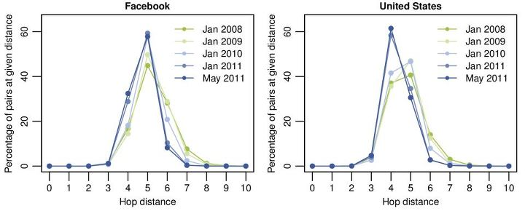
Four Degrees of Separation
Study of all Facebook users (721 million) in 2011 revealed ave distance of 4.74
https://www.facebook.com/notes/facebook-data-team/anatomy-of-facebook/10150388519243859

Slide 17
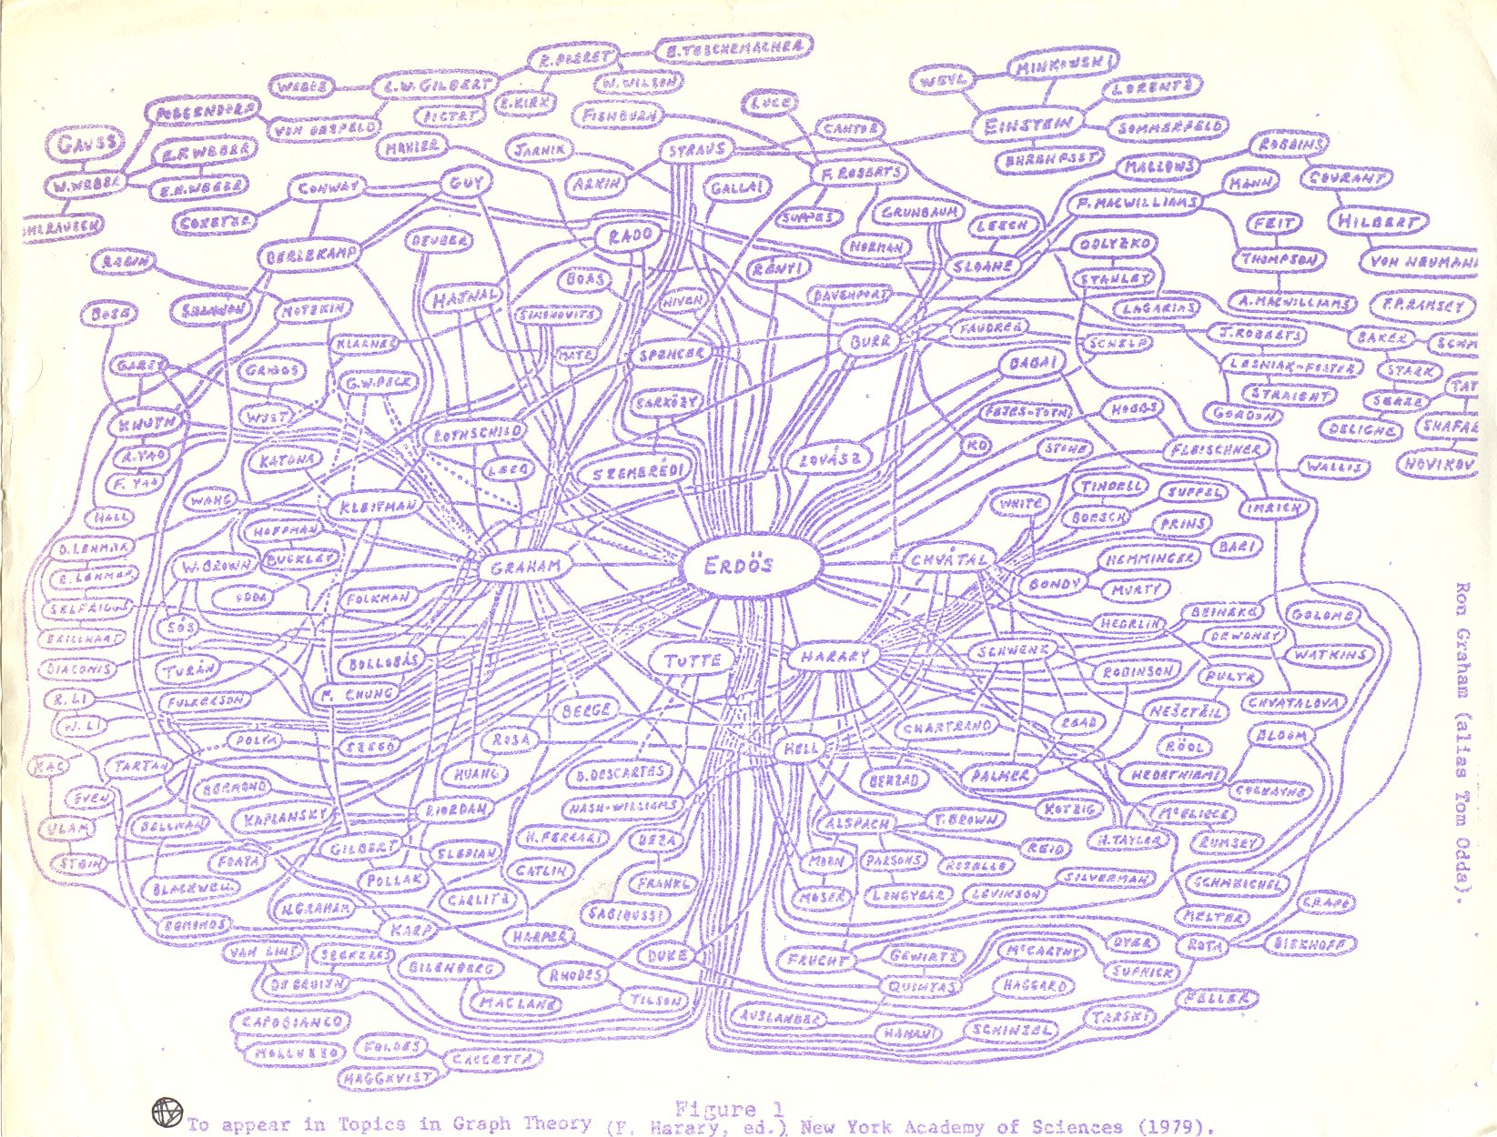
Erdos Number
Ron Graham’s hand-drawn graph
http://www.oakland.edu/enp/trivia/

Slide 18
Network Evolution
Social networks tend to change over time
You make new friends, lose contact with others
You change schools, jobs, etc.
We’re often interested in examining multiple snapshots of the social graph through time

Slide 19
“If two people in a social network have a friend in common, then there is an increased likelihood that they will become friends themselves at home point in the future.”
- Anatole Rapoport (1953)

Slide 20
Triadic Closure
Common friend
A
B
C
Likely to appear

Slide 21
Reasons for Triadic Closure
Opportunity – A spending time with B & C increases chance they will meet
Trust – Research shows that B & C are more likely to trust each other if they are aware of mutual friend A
Incentive – Research shows that latent stress occurs when mutual friends are not friends with each other

Slide 22
Measuring Triadic Closure
Clustering coefficient – probability that any two randomly selected friends of a node are also friends
= 0 when none of node’s friends are friends with each other
= 1 when all of node’s friends are friends with each other
# of friend pairs
CC for a node =
# of possible friend pairs

Slide 23
Clustering Coefficient
A’s CC: BC / BC = 1
A
F’s CC: - / BE = 0
B
C
D
F
C’s CC: AB / AB, AD, BD = 1/3
E
CC for a node = # of friend pairs / # of possible friend pairs

Slide 24
Bridges
A
B
Edge is a bridge if removing the edge creates two components

Slide 25
Local Bridges
C
A
B
Edge is a local bridge if endpoints have no friends in common

Slide 26
Local Bridges
C
A
B
Removing a local bridge does not create two components!

Slide 27
Strong and Weak Ties
Weak
Strong
C
A
B
Not everyone is your BFF!

Slide 28
Variable Tie Strength
0
10
6
C
1
9
A
B
Can use more fine-grained methods to determine tie strength, like number of Facebook messages exchanged

Slide 29
Tie Strength and Triadic Closure
A
B
A
B
C
C
More likely to form
Less likely to form
Triadic closure is more likely to form when initial edges are strong

Slide 30
Strong Triadic Closure Property
Node A satisfies the Strong Triadic Closure Property if it has strong ties to two other nodes B and C, and there is some edge between B and C
satisfies
violates
A
B
A
B
C
C

Slide 31
Strong Triadic Closure and Bridges
Can a node with at least 2 strong edges satisfy the STC property and be involved in a local bridge that is a strong tie?
C
A
B
?
Answer: No! Why not?

Slide 32
Strong Triadic Closure and Bridges
STC property says edge must form when two strong edges emanate from the same node
Therefore a network that satisfies the STC property and has a sufficient number of string ties will likely have only weak local bridges
Does not always hold in real social networks, but useful theoretical framework in which to understand connections and test theories

Slide 33
Large-Scale Data Studies
Put new concepts to work by examining several large-scale studies
Examples:
Cell phone usage
Facebook
Twitter

Slide 34
Cell Phone Social Network
Onnela et al., Structure and tie strengths in mobile communication networks (2007)
18 weeks of cell phone data covering 20% of country’s population
Node = cell phone user
Edge = if two nodes called each other (both directions)
Tie strength = duration of calls

Slide 35
Cell Phone Social Network
Instead of determining if edge is a local bridge or not, use neighborhood overlap
= 1 if all neighbors of A and B are connected
= 0 if no neighbors are connected (local bridge)
Close to 0 is “almost” a local bridge
Neighborhood overlap
neighbors of both A and B
=
neighbors of A or B

Slide 36
Neighborhood Overlap
D
C
E
A
B
F
G
Neighborhood overlap of AD
E
=
=
1/5
C, E, F, G, B

Slide 37
Neighborhood Overlap
D
C
E
A
B
F
G
Neighborhood overlap of AB
-
=
=
0
D, E, F, G, etc.

Slide 38
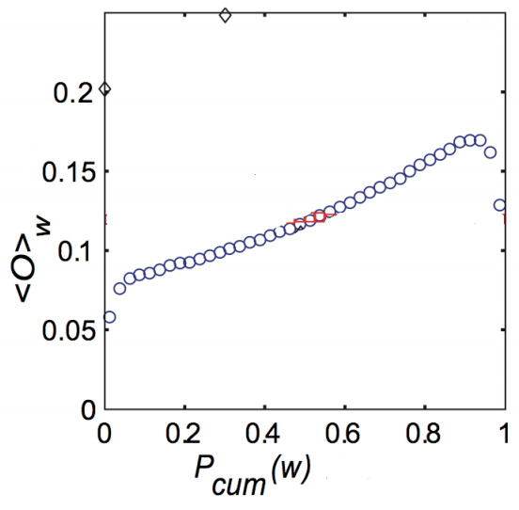
Neighborhood Overlap
Onnela et al.’s findings
Tie Strength
http://www.cs.cornell.edu/home/kleinber/networks-book/networks-book-ch03.pdf
Notes:
The graph shows that as you increase the amount of time talking to someone, there is an increased chance that the person you are talking to has also called others you have called.

Slide 39
Removing Ties
84% of cell phone graph nodes lied in a single giant component
Do weak ties link strongly connected components?
Removed edges one at a time starting with strongest edges → giant component slowly erodes
Removed edges starting with weakest edges → giant component shrank quicker, remnants broke apart quickly once critical weak edges removed

Slide 40
Tie Strength on Facebook
Marlow et al., Maintained relationships on Facebook, 2009, http://overstated.net/2009/03/09/maintained-relationships-on-facebook
Analyzed tie strength of Facebook users using one month of interactions

Slide 41
Three Categories of Links
Reciprocal/Mutual – messages sent both ways
One-way – at least one message sent (friend may or may not have reciprocated)
Maintained – user clicked on Friend’s content (from feed) or profile more than once

Slide 42
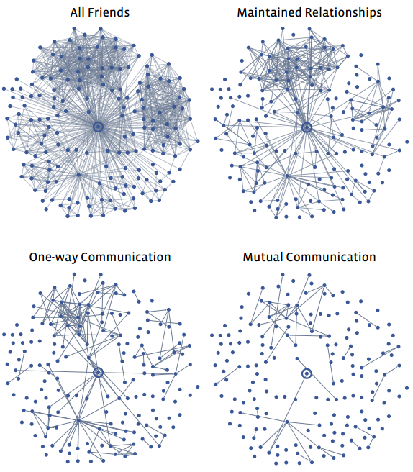
Typical User’s Network
Less interest
College & high school friends?
http://overstated.net/2009/03/09/maintained-relationships-on-facebook

Slide 43
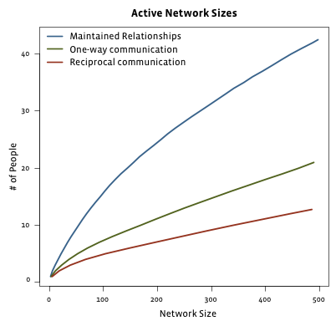
Limits to Maintaining Relationships
passive engagement
Reciprocal – messages sent both ways
One-way – at least one message sent
Maintained – user clicked on Friend’s content (from feed) or profile more than once
Can’t keep up with everyone!
http://overstated.net/2009/03/09/maintained-relationships-on-facebook

Slide 44
Tie Strength on Twitter
Huberman et al., Social networks that matter: Twitter under the microscope, First Monday, Jan 2009
Analyzed tie strength of 211,024 active Twitter users during observation period
Followees – people being followed
Friend – person who user has directed at least two tweets to (strong ties)

Slide 45
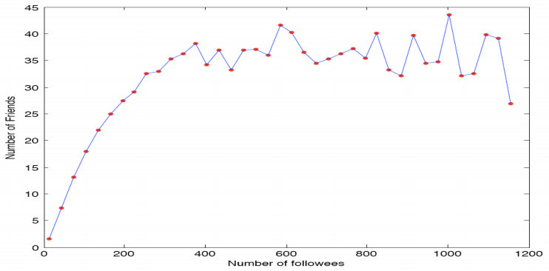
Friends vs. Followees
Limit number of strong ties a user can maintain
http://arxiv.org/pdf/0812.1045.pdf

Slide 46
Now let’s shift the attention away from the edges and towards the nodes…

Slide 47
Edge Embeddedness
Defined as the number of common neighbors shared by two endpoints
Equal to numerator in neighborhood overlap
Local bridges have embeddedness of zero
A
Embeddedness of A-B = 1
Embeddedness of A-C = 2
B
D
C

Slide 48
Example
C
Zero embeddedness
B
A
D
All edges have high embeddedness

Slide 49
Embeddedness and Trust
Research shows that if you and I are connected by an embedded edge (we share a mutual friend), there is more trust and confidence in the integrity of the transactions (social, economic, etc.) between us
If I cheat you, our mutual friends are likely to find out, and they are less likely to trust me in the future!
Threat is absent for edges of zero embeddedness; no mutual friends to punish me!

Slide 50
C
Riskier
B
A
D
High levels
of trust
B also must deal with potentially contradictory norms and expectations from various groups

Slide 51
It’s Good to be B…
Node B is at the end of multiple local bridges
Node B spans a structural hole in the network – space between two components that do not interact closely
If network represents a company or organization, some advantages for B:
B has early access to info that originates in various components
Having access to this info can amplify B’s creativity by combining disparate info into novel ideas
B acts as “gatekeeper” and can control flow of information to various components

Slide 52
C
Riskier
B
A
D
High levels
of trust
Who would you rather be? A with trusted relationships or risk-taker B?

Slide 53
Other Helpful Resources
Bibliography of Research on Social Network Sites http://www.danah.org/researchBibs/sns.php
Christakis and Fowler, Connected (2009)
Kadushin, Understanding Social Networks (2011)

