Slide 1
Tools for Visualizing Networks
Dr. Frank McCown
Intro to Web Science
Harding University
This work is licensed under a Creative Commons Attribution-NonCommercial-ShareAlike 3.0 Unported License

Slide 2
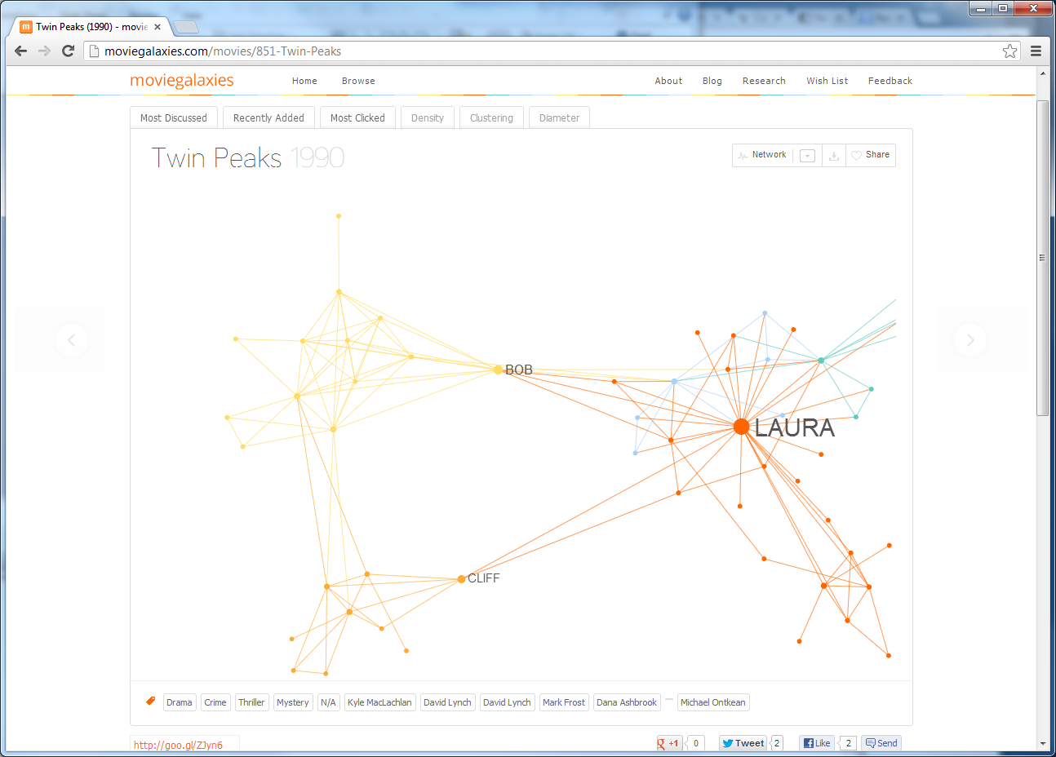
http://moviegalaxies.com/movies/851-Twin-Peaks

Slide 3
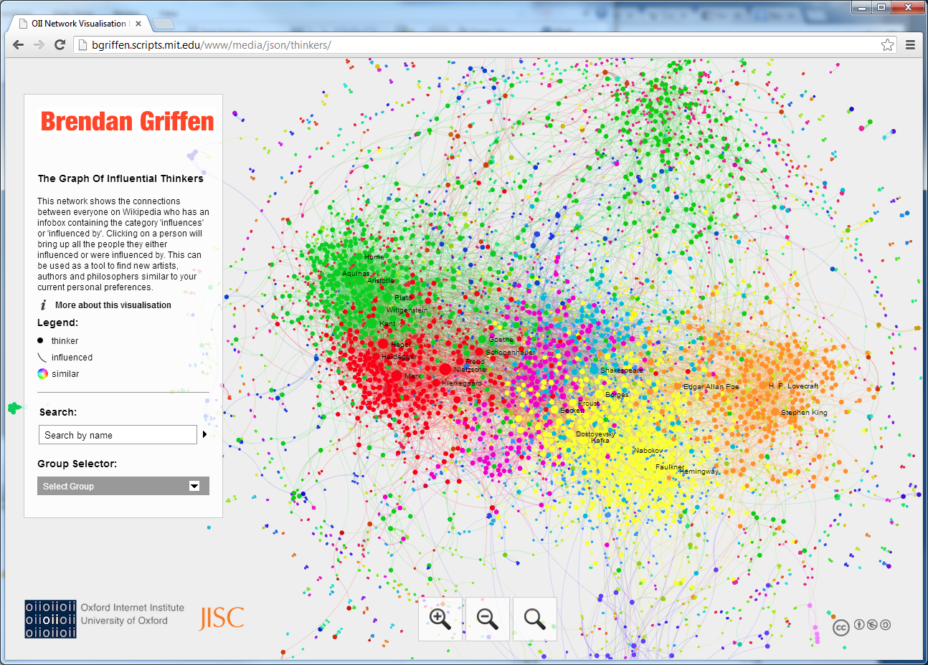
http://bgriffen.scripts.mit.edu/www/media/json/thinkers/

Slide 4
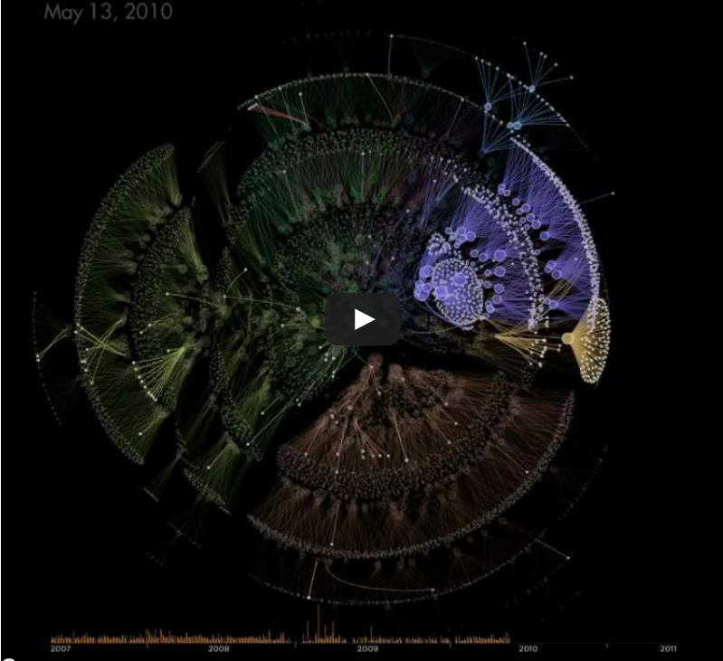
http://www.autodeskresearch.com/projects/orgorgchart

Slide 5
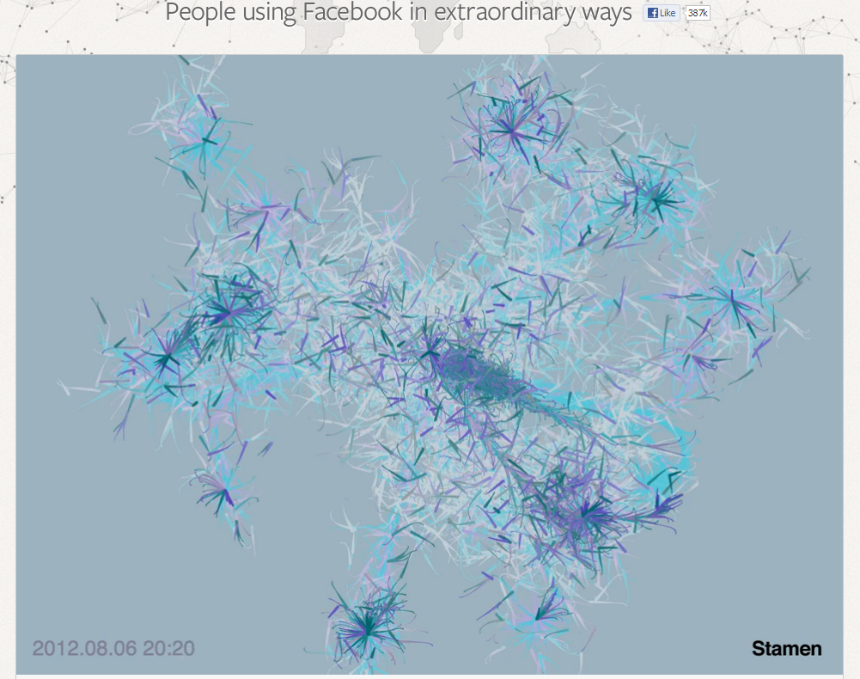
http://www.facebookstories.com/stories/2200/data-visualization-photo-sharing-explosions

Slide 6
Creating a Visualization
Obtain the data
Parse, filter, etc. data into format appropriate for importing
Import into visualization software
Tinker, tinker, tinker
Wow your friends and family
See more visualizations here: http://flowingdata.com/category/visualization/network-visualization/

Slide 7
Overview
Many good commercial products available
Here we only cover free, open source software
By no means exhaustive

Slide 8
Stand-Alone Software
Graphviz
Many libraries from other programming languages use it
Gephi
Interactive visualization and exploration platform
NodeXL
Miscrosoft Excel template

Slide 9
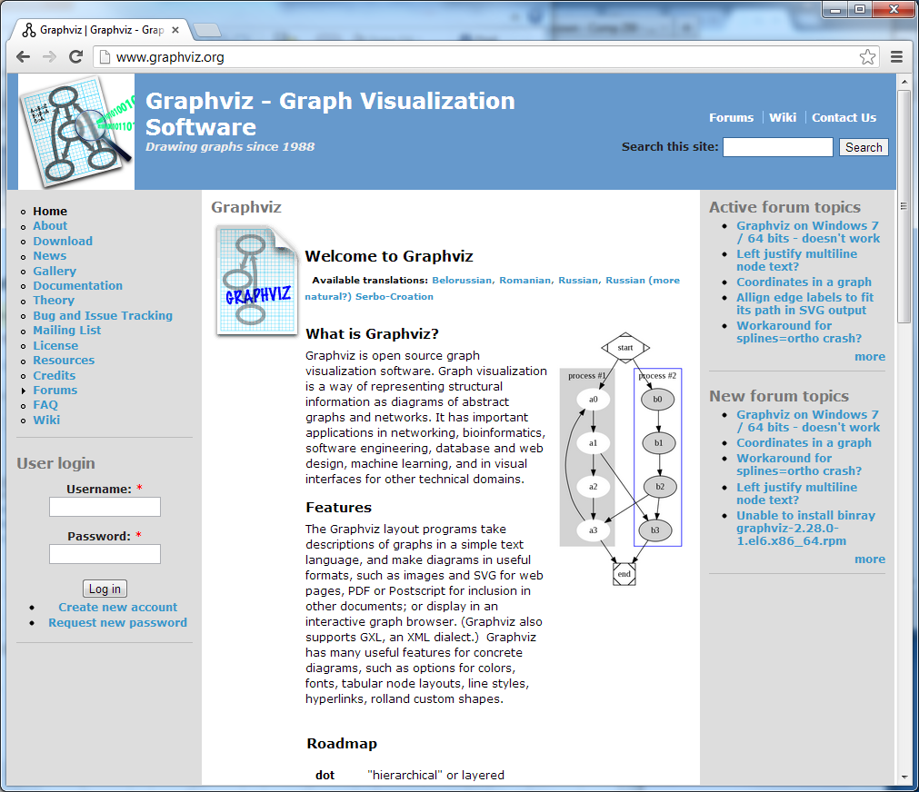

Slide 10
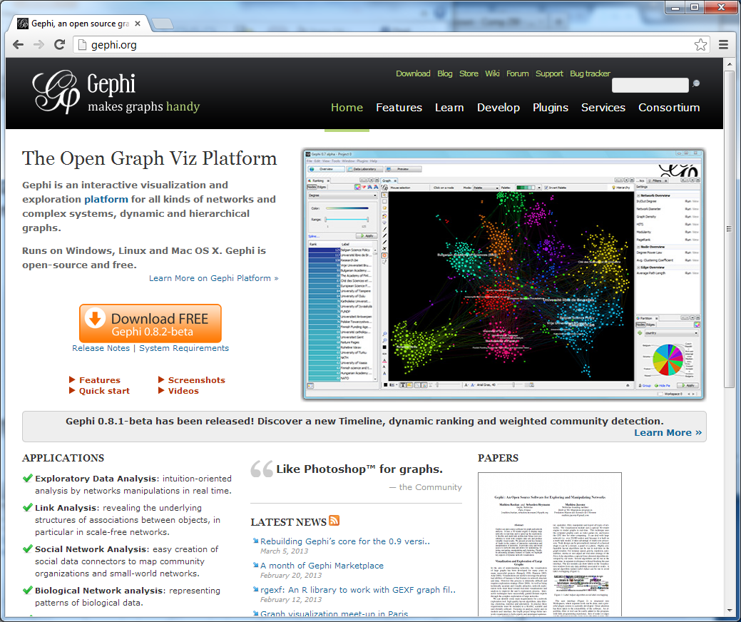

Slide 11
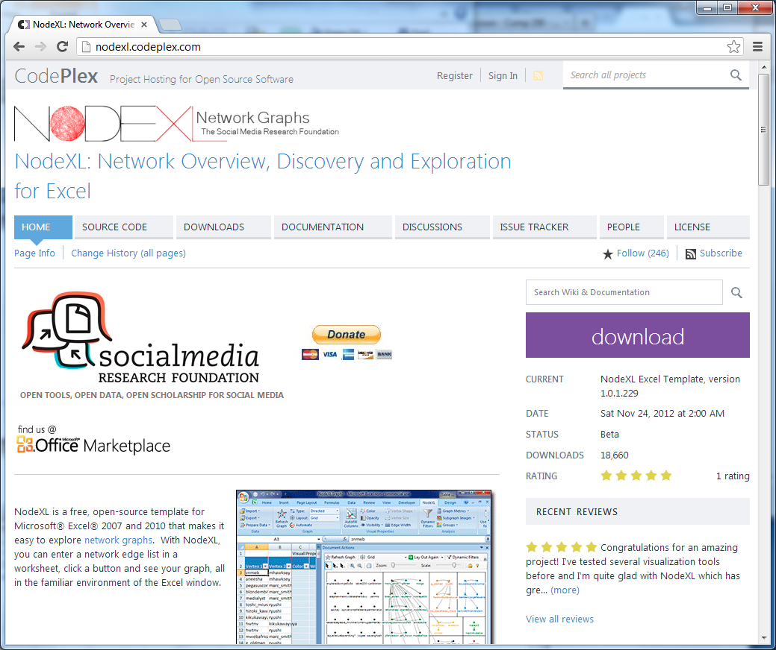

Slide 12
Visualizations in a Web Browser
D3.js (used to be Protovis)
JavaScript, CSS, and SVG for web-native visualizations
JavaScript InfoViz Toolkit
Wide variety of JavaScript visualizations
Processing.js
JavaScript porting of Processing

Slide 15
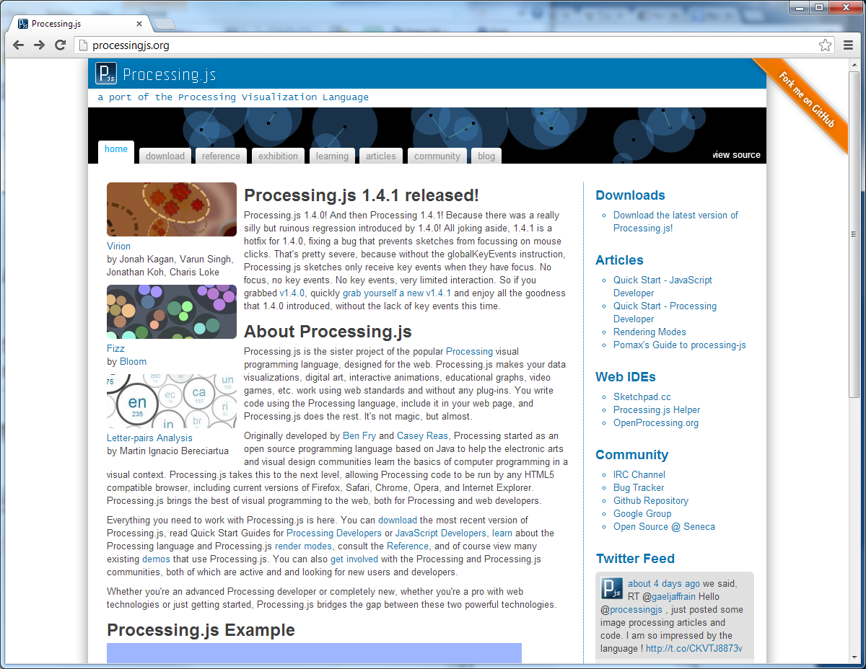

Slide 16
Python Libraries
Matplotlib - Python 2D plotting library http://matplotlib.org/
NetworkX – creating and manipulating graphs http://networkx.github.com/
Uses Matplotlib or Graphviz for displaying graphs
Supports Python 3.x
igraph – creating, manipulating, and displaying graphs http://igraph.sourceforge.net/
Windows version for Python 2.5 and 2.6 only

Slide 17
Further Reading
Brandes et al., 2013, Handbook of Graph Drawing and Visualization, Ch. 26 Social Networks http://cs.brown.edu/~rt/gdhandbook/chapters/social.pdf
Freeman, 2000, Visualizing Social Networks, Journal of Social Structure http://www.cmu.edu/joss/content/articles/volume1/Freeman.html

