Slide 1

Web Architecture
Dr. Frank McCown
Intro to Web Science
Harding University
This work is licensed under a Creative Commons Attribution-NonCommercial-ShareAlike 3.0 Unported License

Slide 2
Internet != Web
File transfer
Web
IM
VoIP
Streaming video
email
The Internet
Notes:
BitTorrent – accounts for about half of all Internet traffic

Slide 3
“The Internet is a global system of interconnected computer networks that use the standard Internet Protocol Suite (TCP/IP) to serve billions of users worldwide.”
http://en.wikipedia.org/wiki/Internet
Internet
Computer 1
Computer 2
255.254.253.252
1.2.3.4

Slide 4
Internet Protocol Suite
Internet Protocol (IP): directs packets to a specific computer using an IP address
Transmission Control Protocol (TCP): directs packets to a specific application on a computer using a port number.
  Common port numbers:
    22 – ssh
    23 – telnet
    25 – email
    80 – Web

Slide 5
Overview of the Web
Internet
Client – Web Browser
Web Server
255.254.253.252
1.2.3.4
World Wide Web: The system of interlinked hypertext documents accessed over the Internet using the HTTP protocol.

Slide 6
Hypertext Transfer Protocol (HTTP)
HTTP is the set of rules that govern communication between web browsers and web servers.
Client Request
GET /comp/ HTTP/1.1
Host: www.harding.edu
Server Response
HTTP/1.1 200 OK
Content-Length: 6018
Content-Type: text/html
Content-Location: http://www.harding.edu/comp/
Last-Modified: Mon, 05 Jul 2010 18:49:40 GMT
Server: Microsoft-IIS/6.0
<!DOCTYPE html PUBLIC "-//W3C//DTD HTML 4.01//EN" "http://www.w3.org/TR/html4/strict.dtd"> <html> <head> <title>Harding University - Computer Science</title>
Example request for http://www.harding.edu/comp/

Slide 7
Domain Name System (DNS)
DNS is a hierarchical look-up service that converts a given hostname into its equivalent IP address
DNS Server
www.harding.edu
128.82.4.20
www.google.com → 1.4.5.8
www.cnn.com → 4.6.2.8
www.hulu.com → 6.7.8.9
Etc ...
DNS servers contact parent servers for missing entries
Authoritative name servers are responsible for specific domains
Warning: DNS cache poisoning

Slide 8
Example: Web Page Request
DNS
(1) Enter URL
(2) foo.org
(3) 1.2.3.4
http://foo.org/bar.html
(4) HTTP GET bar.html
(5) Locate the resource
(6) HTTP Response
(7) Parse HTML
& display
(8) HTTP GET image1
(N) HTTP GET imageX
Potentially many requests & responses
Client (Web Browser)
Web Server

Slide 9
More Formal Definitions
HTTP defined by Request for Comments (RFCs) 1945, 2068, and 2616
Other RFCs for defining URLs (1736, 1738), URIs (1630, 2396), etc.
Web architecture defined in W3C’s The Architecture of the World Wide Web, Volume One
  http://www.w3.org/TR/webarch/

Slide 10
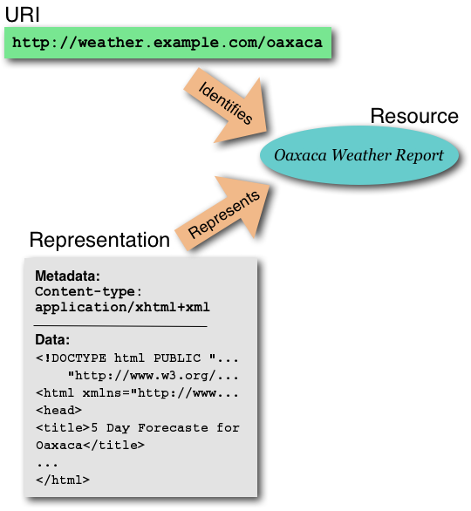
Web Definition
“The World Wide Web (WWW, or simply Web) is an information space in which the items of interest, referred to as resources, are identified by global identifiers called Uniform Resource Identifiers (URI).”
http://www.w3.org/TR/webarch/

Slide 11
URIs, Resources, and Representations
URIs identify Resources
Representations represent Resources
When URIs are dereferenced, they return representations (not resources)
Different representations may be returned for the same URI (e.g., English vs. French version)
http://www.w3.org/TR/webarch/

Slide 12
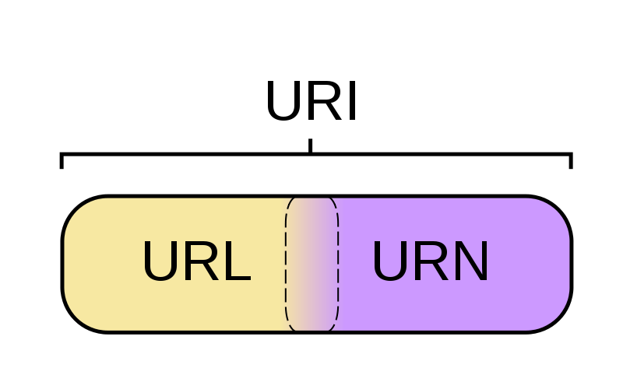
What’s a URx?
URI - String of chars used to identify a name or resource
on the Internet
URL - Where to find a resource
URN - Name of a resource
Figure: http://en.wikipedia.org/wiki/File:URI_Euler_Diagram_no_lone_URIs.svg

Slide 13
URI Components
foo://username:password@example.com:8042/over/there/index.dtb;type=animal?name=ferret#nose
\ / \________________/\_________/ \__/ \___/ \_/ \_________/ \_________/ \__/
| | | | | | | | |
| userinfo hostname port | | parameter query fragment
| \_______________________________/ \_____________|____|____________/
scheme | | | |
| authority |path|
| | |
| path interpretable as filename
| ___________|____________ |
/ \ / \ |
urn:example:animal:ferret:nose interpretable as extension
Other examples:
http://example.org/absolute/path/to/resource.txt
ftp://example.org/resource.txt
urn:issn:1535-3613
Figure: http://en.wikipedia.org/wiki/URI_scheme

Slide 14
Content Negotiation
Content negotiation (RFC 2616 sec 12) is used in HTTP to allow servers to send different representations of the same resource at the same URI
The user agent tells the server which encoding, language, media type, etc. it prefers, and the server responds with the “best” representation
Example HTTP request headers:
Accept-Language: fr; q=1.0, en; q=0.5
Accept: text/html; q=1.0, text/*; q=0.8,
image/gif; q=0.6, image/jpeg; q=0.6, image/*;
q=0.5, */*; q=0.1
This agent prefers French over English, HTML over other document types, and GIF and JPEG over other image formats

Slide 15

Memento – Date/Time Negotiation
Memento is a new(ish) protocol which uses
HTTP content negotiation to retrieve older
versions (Mementos) of web resources
Agent request URI with Accept-Datetime
set to desired date/time
Server responds with a link to a TimeGate
which knows the Mementos available for the URI
Agent makes request to TimeGate and receives response with the URL to the Memento
Learn more: http://mementoweb.org/

Slide 16
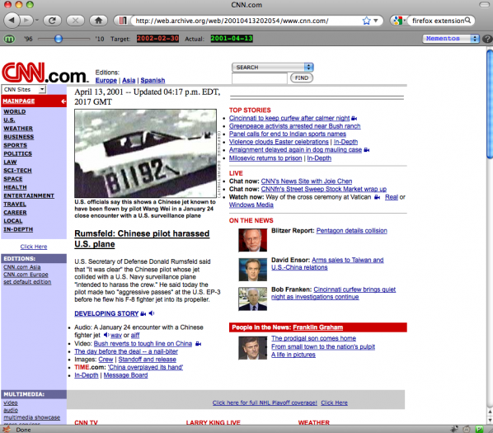
MementoFox
Firefox Add-on which gives it Memento capability
https://addons.mozilla.org/en-us/firefox/addon/mementofox/

Slide 17
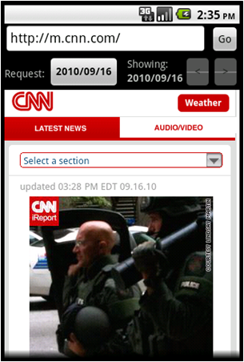
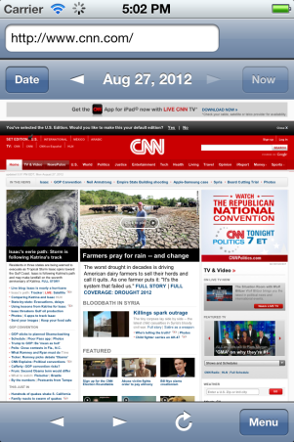
Memento Browser
Android
iOS
http://code.google.com/p/memento-browser/

Slide 18
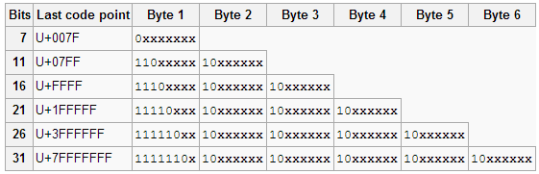
Character Encoding
HTML documents could be transmitted with 1 byte per char, but only works for ASCII. What about everyone else?
UTF-8 can represent every character in Unicode
UTF-8 is the dominant character encoding standard for WWW
UTF-8 is variable-length
  ASCII chars (values 0-127) use 1 byte, others use 3, 4, or more bytes depending on
http://en.wikipedia.org/wiki/UTF-8

