Slide 1

Web Characterization:
What Does the Web Look Like?
Dr. Frank McCown
Intro to Web Science
Harding University
This work is licensed under a Creative Commons Attribution-NonCommercial-ShareAlike 3.0 Unported License

Slide 2
W3C Characterization Activity
Work from 1998-1999
Provided definitions for common Web terms like resource, link, proxy, server, etc., some of which are now dated
http://www.w3.org/1999/05/WCA-terms/
Attempted to answer questions like: How many web pages are there? and How fast is the Web growing?
Summary in Pitkow, Summary of WWW Characterizations, Journal of the World Wide Web, 1999

Slide 3
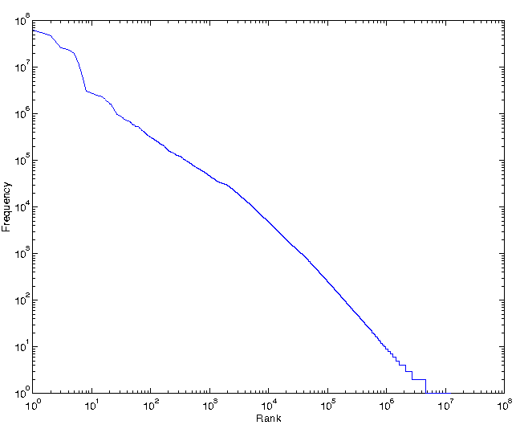
Web Page Popularity
The Zipf distribution of number of page hits versus rank for five days of AOL December 1997 data
Summary of WWW Characterizations

Slide 4
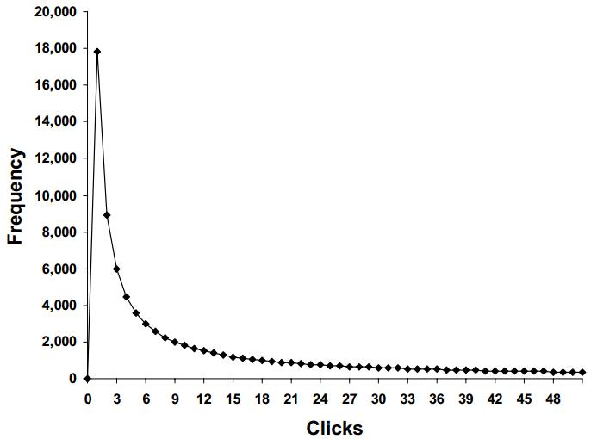
Web Page Popularity
The number of clicks per user at the Xerox WWW Site during May 1998.
The curve follows an Inverse Gaussian Distribution, which has a heavy right tail.
Summary of WWW Characterizations

Slide 5
OCLC Characterization Research
Work from 1998-2002
Analyzed Web samples annually to look for trends
Sample obtained by randomly sampling IP addresses and connecting to port 80
  Today this method would miss a large number of websites that use virtual hosting – multiple domain names hosted on same computer using one IP address
Findings: O'Neill et al., Trends in the Evolution of the Public Web, D-Lib Magazine, Apr 2003

Slide 6
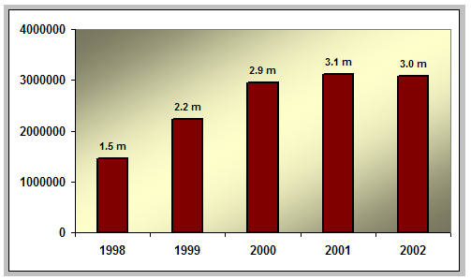
Number of Public Websites
O'Neill et al., Trends in the Evolution of the Public Web, D-Lib Magazine, Apr 2003

Slide 7
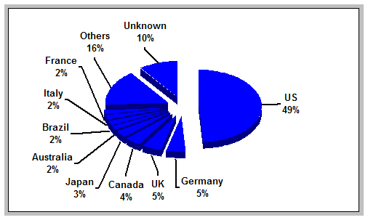
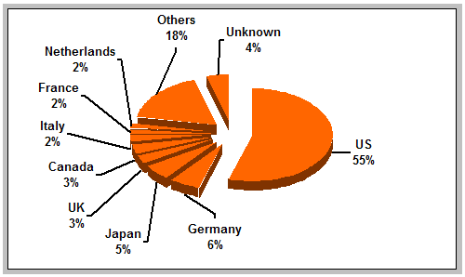
Distribution of Websites by Country
1999
2002
O'Neill et al., Trends in the Evolution of the Public Web, D-Lib Magazine, Apr 2003

Slide 8
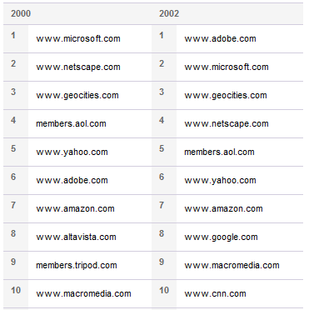
Popular Websites by In-Links
OCLC Most Linked-To Websites¹
Most Linked-To Websites (Jan 2013)²
facebook.com
twitter.com
google.com
youtube.com
adobe.com
wordpress.org
blogspot.com
wikipedia.org
godaddy.com
wordpress.com
¹http://www.oclc.org/research/activities/past/orprojects/wcp/stats/linkage.htm
²http://www.seomoz.org/top500

Slide 9
Popular Websites by Visits
Alexa’s Top Websites (Jan 2013)¹
Most Linked-To Websites (Jan 2013)²
facebook.com
google.com
youtube.com
yahoo.com
baidu.com
wikipedia.org
live.com
amazon.com
qq.com
twitter.com
facebook.com
twitter.com
google.com
youtube.com
adobe.com
wordpress.org
blogspot.com
wikipedia.org
godaddy.com
wordpress.com
¹http://www.alexa.com/topsites
²http://www.seomoz.org/top500

Slide 10
Bow-Tie Structure of the Web
17 Million nodes
Broder et. al (Graph Structure of the Web, 2000)
Examined a large web graph (200M pages, 1.5B links)
Notes:
SCC = Strongly Connected Component

Slide 11
Characterizing National Web Domains
A large-scale study by Baeza-Yates at al.¹ analyzed web collections from 10 national domains and multinational Web spaces of African and Indochinese Web sites
Examined languages, file sizes, pages per site, link structure, etc.
¹Baeza-Yates et al. , Characterization of national Web domains, ACM Trans. Internet Technol., May 2007

Slide 12
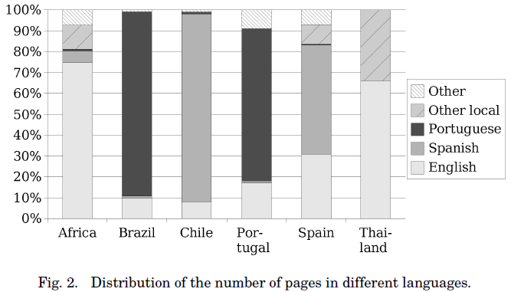
Web Page Languages
Baeza-Yates et al. , Characterization of national Web domains, ACM Trans. Internet Technol., May 2007

Slide 13
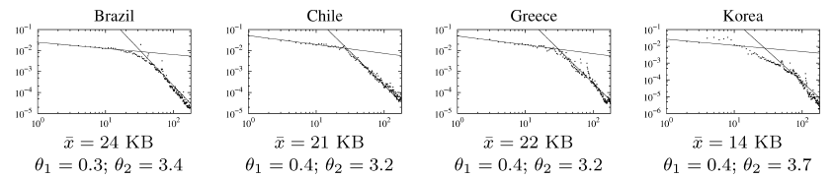
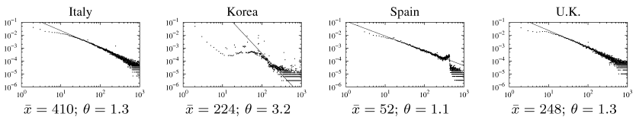
Some Power-law Distributions
File sizes for small and large files
Pages per site
Baeza-Yates et al. , Characterization of national Web domains, ACM Trans. Internet Technol., May 2007

Slide 14
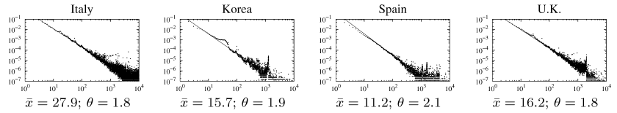
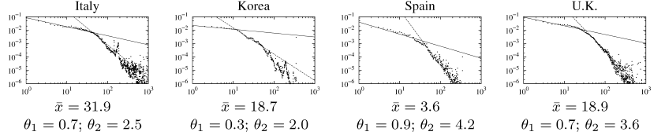
In and Out Degree of Web Pages
In-degree of web pages
Out-degree of web pages for few and many outlinks
Baeza-Yates et al. , Characterization of national Web domains, ACM Trans. Internet Technol., May 2007

Slide 15
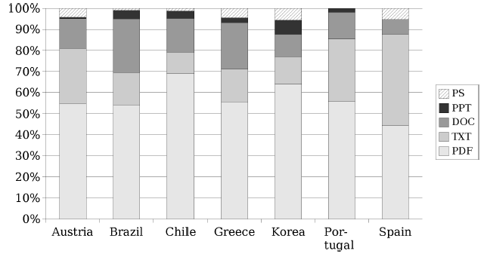
Non-HTML File Content
More than 95% of content was HTML
Baeza-Yates et al. , Characterization of national Web domains, ACM Trans. Internet Technol., May 2007

Slide 16
How dynamic is the Web?
How often are pages added to the Web?
How often are pages are removed from the Web?
How often do pages change?
What kinds of changes do pages typically exhibit?
How does the link structure change over time?

Slide 17
How dynamic is the Web?
Two studies attempt to answer these questions:
  2004 study (Fetterly et al.¹) of 150 million web pages over 11 weeks analyzed weekly snapshots
  2004 study (Ntoulas et al.²) of 150 websites over one year analyzed weekly snapshots
What follows are some selected highlights
¹Fetterly et al. , A large-scale study of the evolution of Web pages, Software Practice & Experience ,2004
²Ntoulas et al. , What's new on the web?: the evolution of the web from a search engine perspective, Proc WWW 2004

Slide 18
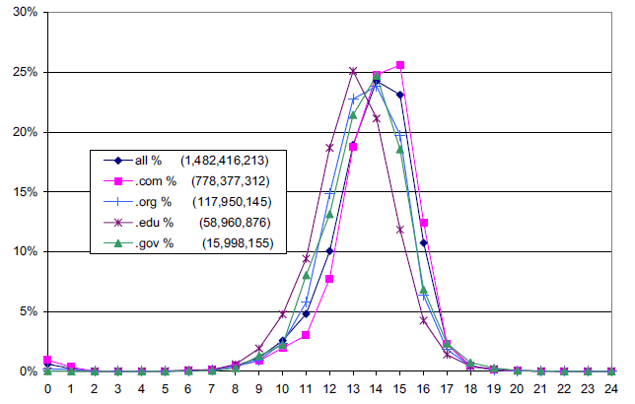
Document Length
2^{n} bytes
Fetterly et al. ,2004

Slide 19
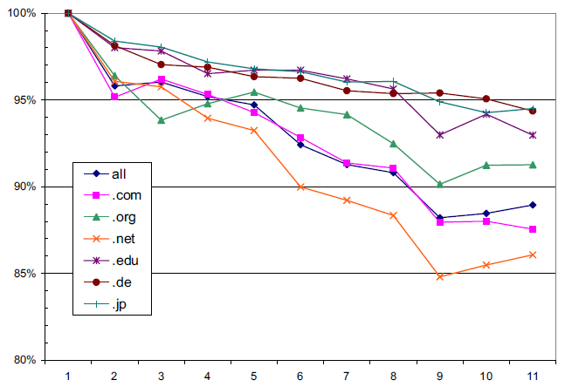
Successful Downloads
Weeks
Fetterly et al. ,2004

Slide 20
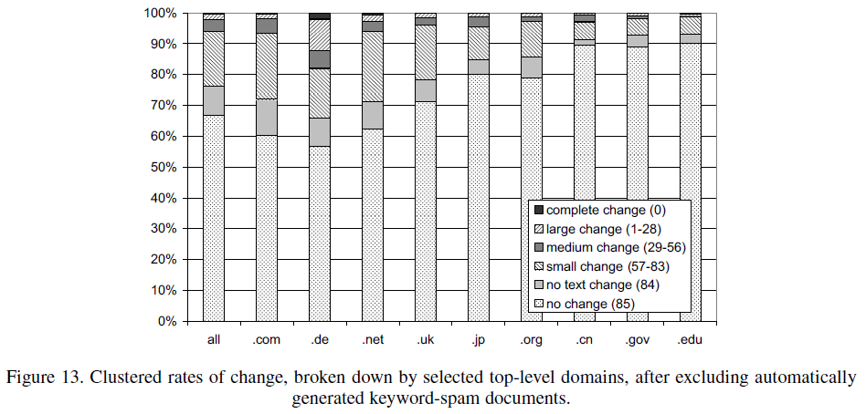
Rates of Change by TLD
Fetterly et al. ,2004

Slide 21
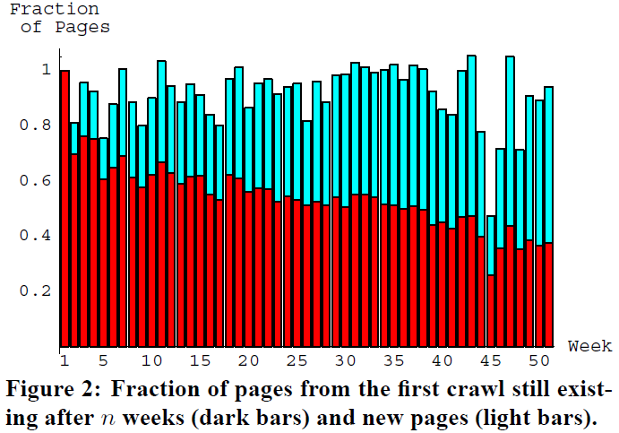
New Pages
Ntoulas et al. , 2004

Slide 22
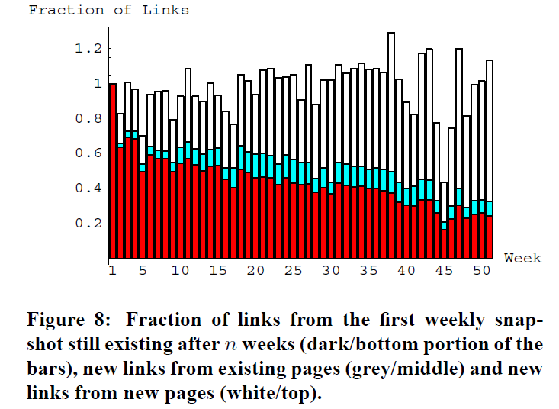
Link Evolution
Ntoulas et al. , 2004

Slide 23
Summary of Findings
Fetterly et al., 2004
Ntoulas et al., 2004
When pages change, they change in trivial ways or just their markup
Strong relationship between TLD and rate of change but not degree of change
The larger the document, the more likely it is to be changed more frequently and significantly
Past frequency of changes to a page is good predictor of future page changes
Web page changes are usually minor
New pages are created at rate of 8% per week
Only 20% of pages today will be accessible in a year
Large number of pages borrow content from existing pages
Every week, 25% new links are created, and after 1 year, 80% of links are replaced with new ones
Past degree of change to web page is good predictor of future degree of change

Slide 24
Linkrot: The 404 Problem
Kahle (‘97) - Average page lifetime is 44 days
Koehler (‘99, ‘04) - 67% URLs lost in 4 years
Lawrence et al. (‘01) - 23%-53% URLs in CiteSeer papers invalid over 5 year span (3% of invalid URLs “unfindable”)
Spinellis (‘03) - 27% URLs in CACM/Computer papers gone in 5 years
Fetterly et al. (‘03) – about 0.5% of web pages disappeared per week
Ntoulas et al. (‘04) – predicted only 20% of pages today will be accessible in a year
McCown et al. (‘05) - 10 year half-life for URLs in D-Lib Magazine articles
SalahEldeen & Nelson (‘12) – 11% of URLs from Tweets disappear after 1 year

Slide 25
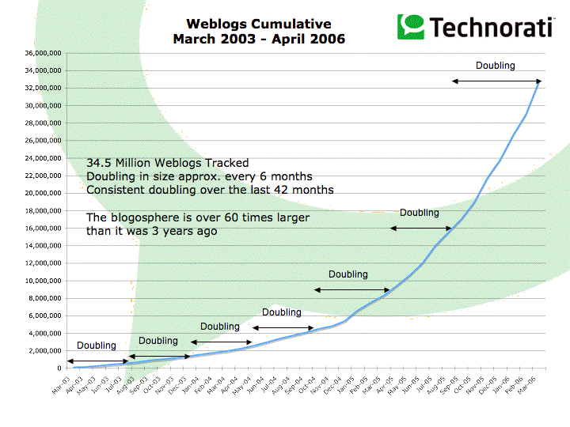
Blogosphere
http://www.sifry.com/alerts/archives/000432.html

