Slide 1
Searching the Web
Dr. Frank McCown
Intro to Web Science
Harding University
This work is licensed under a Creative Commons Attribution-NonCommercial-ShareAlike 3.0 Unported License

Slide 2
http://venturebeat.files.wordpress.com/2010/10/needle.jpg?w=558&h=9999&crop=0

Slide 3
How do you locate information on the Web?
When seeking information online, one must choose the best way to fulfill one’s information need
Most popular:
Web directories
Search engines – primary focus of this lecture
Social media

Slide 4
Web Directories
Pages ordered in a hierarchy
Usually powered by humans
Yahoo started as a web directory in 1994 and still maintains one: http://dir.yahoo.com/
Open Directory Project (ODP) is largest and is maintained by volunteers http://www.dmoz.org/

Slide 5
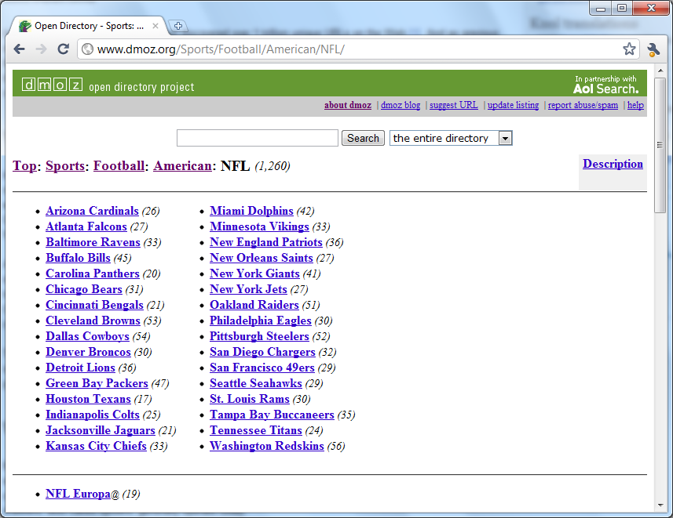

Slide 6
Search Engines
Most often used to fill an information need
Pages are collected automatically by web crawlers
Users enter search terms into text box get back a SERP (search engine result page)
Queries are generally modified and resubmitted to the SE if the desired results are not found on the first few pages of results
Types of search engines:
Web search engines (Google, Bing, Baidu)
Metasearch engines – includes Deep Web (Dogpile, WebCrawler)
Specialized (or focused) search engines (Google Scholar, MapQuest)

Slide 7
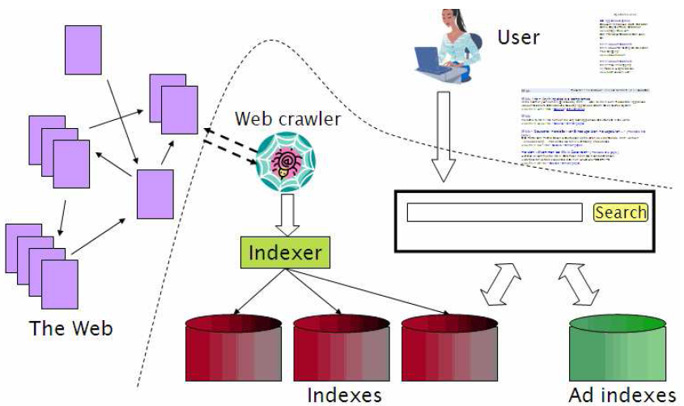
Components of a Search Engine
Figure from Introduction to Information Retrieval by Manning et al., Ch 19.

Slide 8
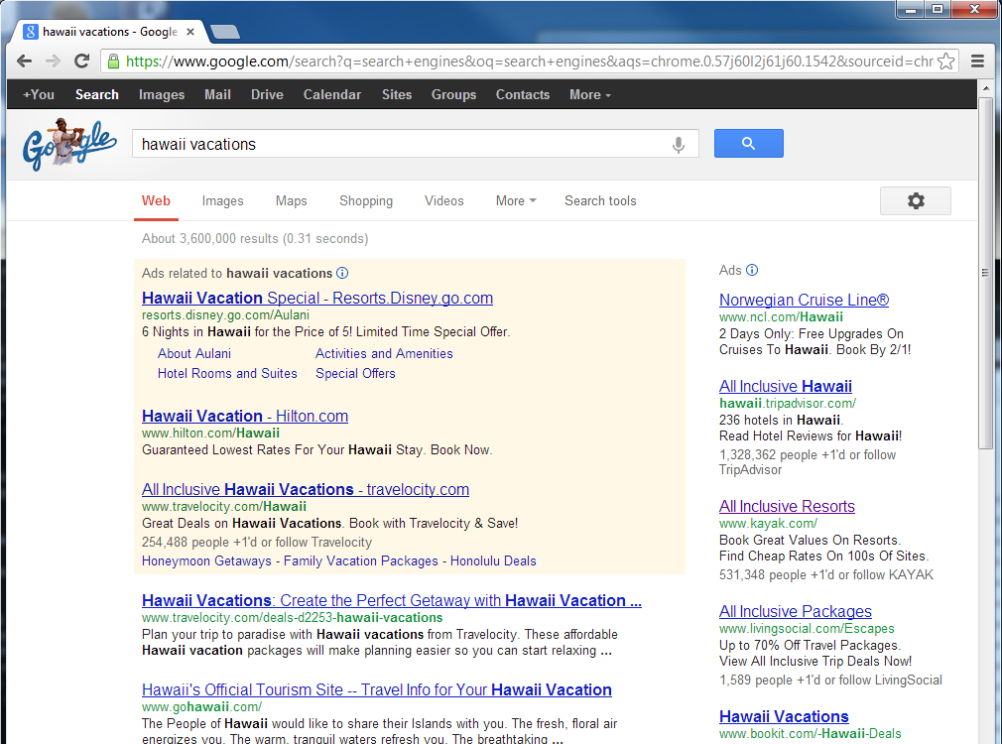
SERP
Search query
Paid results
Page title
Organic results
Text snippet

Slide 9
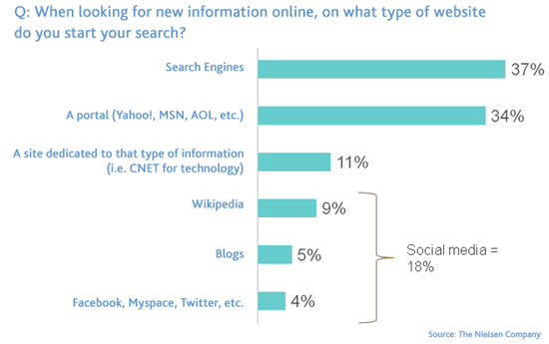
Social Media
Increasingly being used to find info
Limits influence of results to trusted group
Nielsen study (August 2009)
Figure: http://www.briansolis.com/2009/10/social-media-accounts-for-18-of-information-search-market/

Slide 10
Search Queries
Search engines store every query, but companies usually don’t share with the public because of privacy issues
2006 AOL search log incident
2006 govt subpoenas Google incident
Often short: 2.4 words on average¹ but getting longer²
Most users do not use advanced features¹
Distribution of terms is long-tailed³
¹ Spink et al., Searching the web: The public and their queries,2001
² http://searchengineland.com/search-queries-getting-longer-16676
³Lempel & Moran, WWW 2003

Slide 11
Search Queries
10-15% contain misspellings¹
Often repeated: Yahoo study² showed 1/3 of all queries are repeat queries, and 87% of users click on same result
¹ Cucerzan & Brill, 2004
² Teevan et al., History Repeats Itself: Repeat Queries in Yahoo's Logs, Proc SIGIR 2006

Slide 12
Query Classifications
Informational
Intent is to acquire info about a topic
Examples: safe vehicles, albert einstein
Navigational
Intent is to find a particular site
Examples: facebook, google
Transactional
Intent is to perform an activity mediated by a website
Examples: children books, cheap flights
Broder, Taxonomy of web search, SIGIR Forum, 2002

Slide 13
Determining Query Type
It is impossible to know the user’s intent, but we can guess based on the result(s) selected
Example: safe vehicles
Informational if selects web page about vehicle safety
Navigational if selects safevehicle.com
Transactional if selects web page that sells safe vehicles
Requires access to SE’s transaction logs
Broder, Taxonomy of web search, SIGIR Forum, 2002

Slide 14
Query Classifications
Study by Jansen et al., Determining the User Intent of Web Search Engine Queries, WWW 2007 (link)
Analyzed transaction logs from 3 search engines containing 5M queries
Findings
Informational: 80.6%
Navigational: 10.2%
Transactional: 9.2%

Slide 15
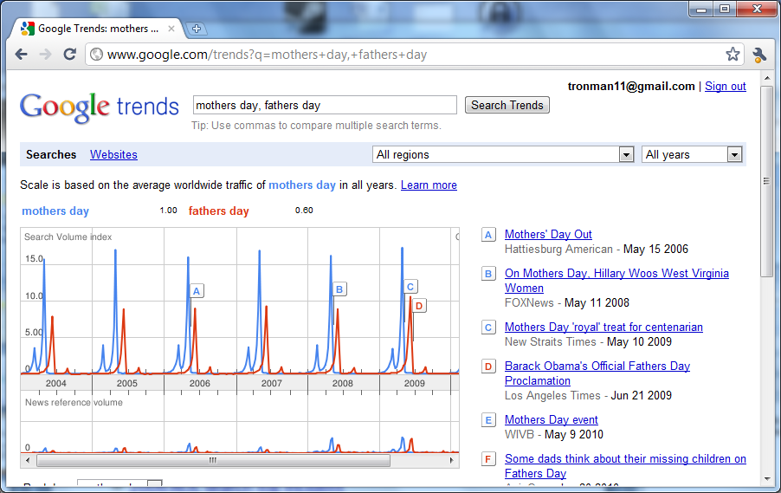
Google Trends http://www.google.com/trends

Slide 16
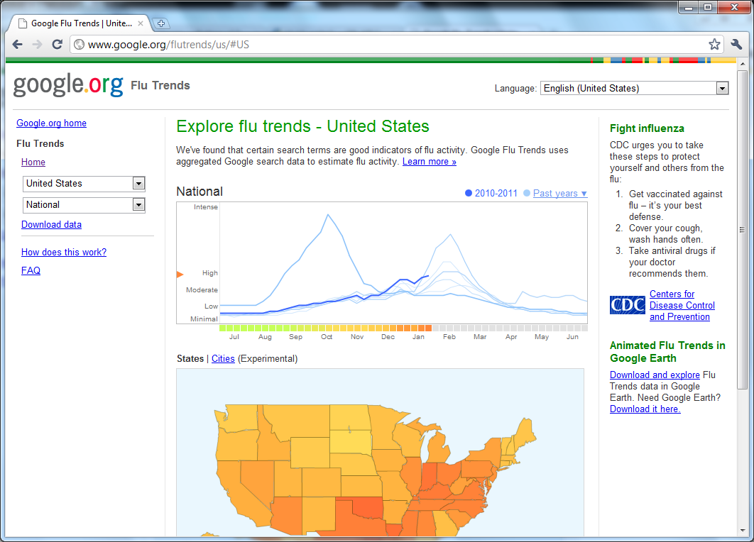
Google Flu Trends http://www.google.org/flutrends/

Slide 17
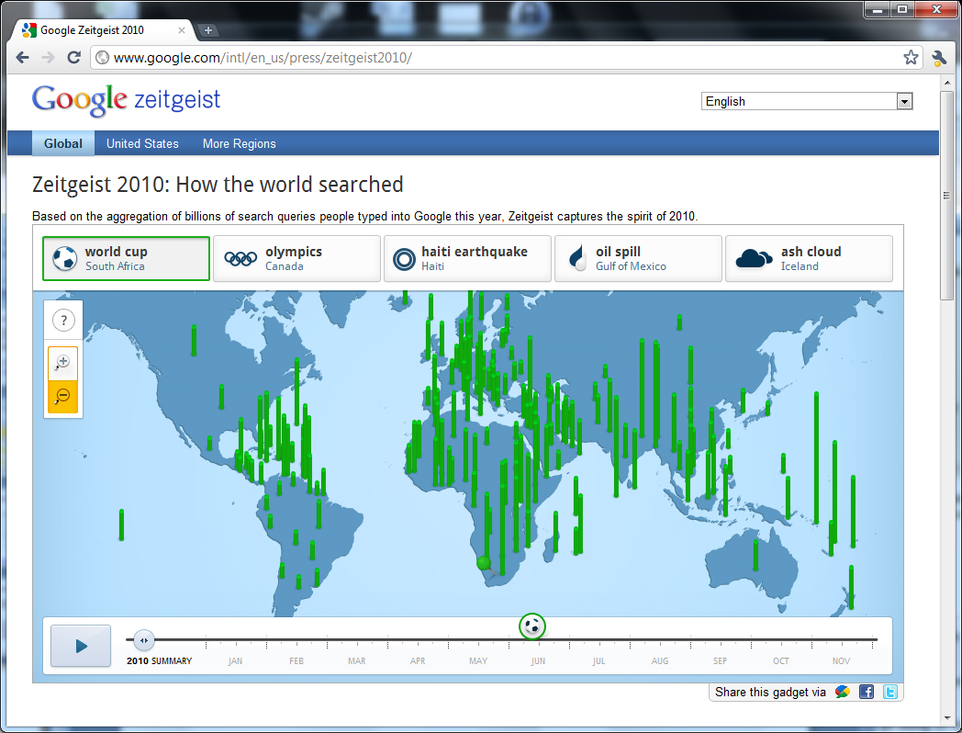
Google Zeitgeist http://www.google.com/intl/en_us/press/zeitgeist2010/

Slide 18
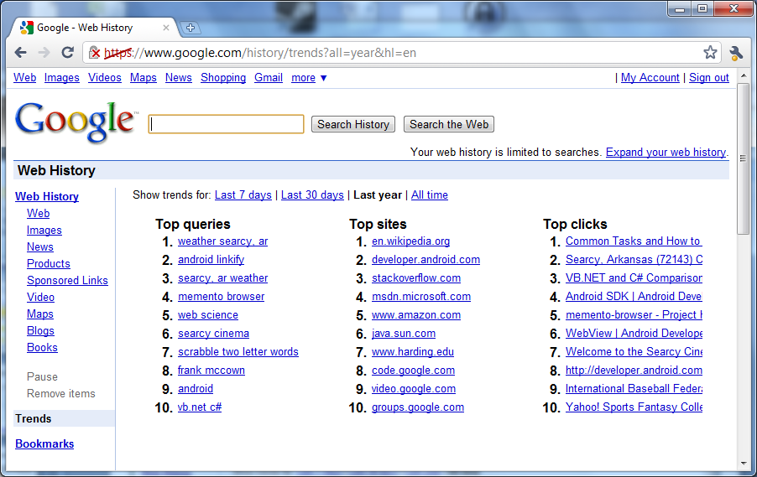
My 2010 Top Queries, Sites, & Clicks

Slide 19
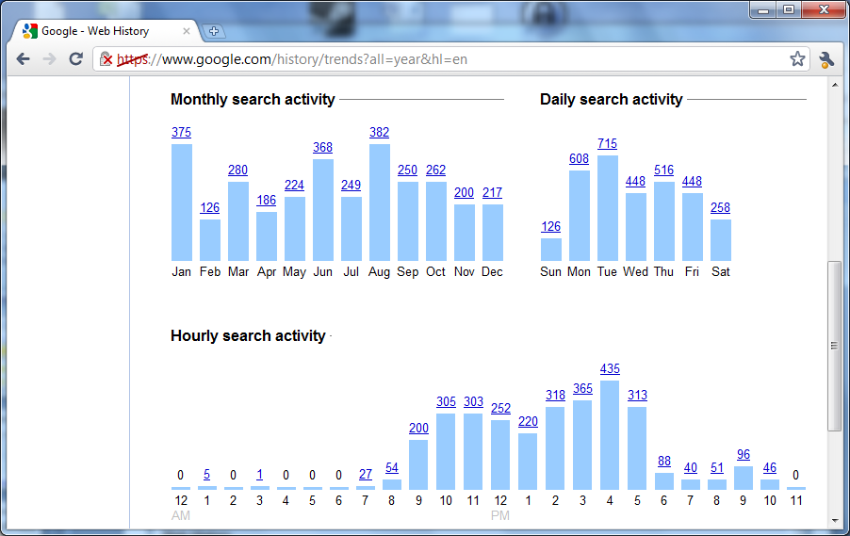
My 2010 Monthly, Daily, & Hourly Search Activity

Slide 20
Relevance
Search engines are useful if they return relevant results
Relevance is hard to pin down because it depends on user’s intent & context which is often not known
Relevance can be increased by personalizing search results
What is the user’s location?
What queries has this user made before?
How does the user’s searching behavior compare to others?
Two popular metrics are used to evaluate whether the results returned by a search engine are relevant: precision and recall

Slide 21
Precision and Recall
Relevant
Overlap
Retrieved
Corpus
Precision = Overlap / Retrieved
Recall = Overlap / Relevant

Slide 22
Example
Given a corpus of 100 documents
20 are about football
Search for football results in 50 returned documents, 10 are about football
Precision = Overlap / Retrieved = 10/50 = .2
Recall = Overlap / Relevant = 10/20 = .5
Note: Usually precision and recall are at odds

Slide 23
High Precision, Low Recall
Missing a lot of relevant docs!
Relevant
Retrieved
Corpus
Precision = Overlap / Retrieved
Recall = Overlap / Relevant

Slide 24
Low Precision, High Recall
Lots of irrelevant docs!
Retrieved
Relevant
Corpus
Precision = Overlap / Retrieved
Recall = Overlap / Relevant

Slide 25
Evaluating Search Engines
We don’t usually know how many documents on the entire Web are about a particular topic, so computing recall for a web search engine is not possible
Most people view only the first page or two of search results, so the top N results are most important where N is 10 or 20
P@N is the precision of the top N results

Slide 26
Comparing Search Engine with Digital Library
McCown et al.¹ compared the P@10 of Google and the National Science Digital Library (NSDL)
School teachers evaluated relevance of search results in regards to Virginia's Standards of Learning
Overall, Google’s precision was found to be 38.2% compared to NSDL’s 17.1%
¹McCown et al., Evaluation of the NSDL and Google search engines for obtaining pedagogical resources, Proc ECDL 2005

Slide 27
F-score
F-score combines precision and recall into single metric
F-score is harmonic mean of precision and recall
Highest = 1, Lowest = 0

Slide 28
Quality of Ranking
Issue search query to SE and have humans rank the first N results in order of relevance
Compare human ranking with SE ranking (e.g., Spearman rank-order correlation coeﬃcient)
Other ranking methods can be used
Discounted cumulative gain (DCG)² which gives higher ranked results more weight than lower ranked results
M measure³ similar function as DCG which gives sliding scale of importance based on ranking
¹Vaughan, New measurements for search engine evaluation proposed and tested, Info Proc & Mang (2004)
²Järvelin & Kekäläinen, Cumulated gain-based evaluation of IR techniques, TOIS (2004)
³Bar-Ilan et al., Methods for comparing rankings of search engine results, Computer Networks (2006)

Slide 29
Other Sources
Mark Levene, An Introduction to Search Engines and Web Navigation, Ch 2 & 4, 2010
Steven Levy, Exclusive: How Google’s Algorithm Rules the Web, Wired Magazine http://www.wired.com/magazine/2010/02/ff_google_algorithm/

