Slide 1
A Developer’s Introduction to Google Android
Dr. Frank McCown
Harding University
Spring 2014
This work is licensed under Creative
Commons Attribution-NonCommercial 3.0

Slide 2


http://findmearobot.com/Pages/Required%20robots/Images/Do%20androids%20dream%20of%20electric%20sheep.jpg
http://doctorbeatnik.files.wordpress.com/2009/10/blade_runner2.jpg

Slide 3
Brief History
2005
  Google acquires startup Android Inc. to start Android platform
  Work on Dalvik VM begins
2007
  Open Handset Alliance announced
  Early look at SDK
2008
  Google sponsors 1st Android Developer Challenge
  T-Mobile G1 announced
  SDK 1.0 released
  Android released open source (Apache License)
  Android Dev Phone 1 released
Pro Android by Hashimi & Komatineni (2009)
Notes:
Open Handset Alliance, a consortium of 47 hardware, software, and telecom companies devoted to advancing open standards for mobile devices. Includes Texas Instruments, Broadcom Corporation, Google, HTC, Intel, LG, Marvell Technology Group, Motorola, Nvidia, Qualcomm, Samsung Electronics, Sprint Nextel and T-Mobile

Slide 4
Brief History cont.
2009
  SDK 1.5 (Cupcake)
    New soft keyboard with “autocomplete” feature
  SDK 1.6 (Donut)
    Support Wide VGA
  SDK 2.0/2.0.1/2.1 (Eclair)
    Revamped UI, browser
2010
  Nexus One released to the public
  SDK 2.2 (Froyo)
    Flash support, tethering
  SDK 2.3 (Gingerbread)
    UI update, system-wide copy-paste

Slide 5

Brief History cont.
2011
  SDK 3.0 (Honeycomb) for tablets only
    New UI for tablets, support multi-core processors
  SDK 3.1 and 3.2
    Hardware support and UI improvements
  SDK 4.0 (Ice Cream Sandwich)
    For Q4, combination of Gingerbread and Honeycomb

Slide 6
Brief History cont.
2012
  SDK 4.1, and 4.2 (Jelly Bean) for tablets only
    UI functionality and performance improvements
2013
  SDK 4.3
    Improvements to Jelly Bean
  SDK 4.4 (KitKat)
    Wide range of improvements

Slide 7
What is Google Android?
A software stack for mobile devices that includes
  An operating system
  Middleware
  Key Applications
Uses Linux to provide core system services
  Security
  Memory management
  Process management
  Power management
  Hardware drivers

Slide 8
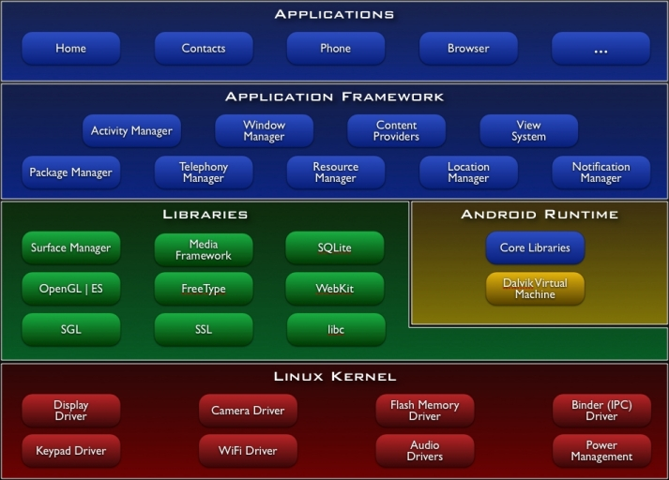
http://developer.android.com/guide/basics/what-is-android.html

Slide 9
Setup Development Environment
Install JDK 7 (oracle.com)
Download and SDK bundle
http://developer.android.com/sdk/
  Installs Eclipse + Android Developer Tools (ADT) plugin
  Latest Android platform
  Latest Android system emulator for emulator

Slide 10
Android Emulator or AVD
Emulator is essential to testing app but is not a substitute for a real device
Emulators are called Android Virtual Devices (AVDs)
Android SDK and AVD Manager allows you to create AVDs that target any Android API level
AVD have configurable resolutions, RAM, SD cards, skins, and other hardware

Slide 11
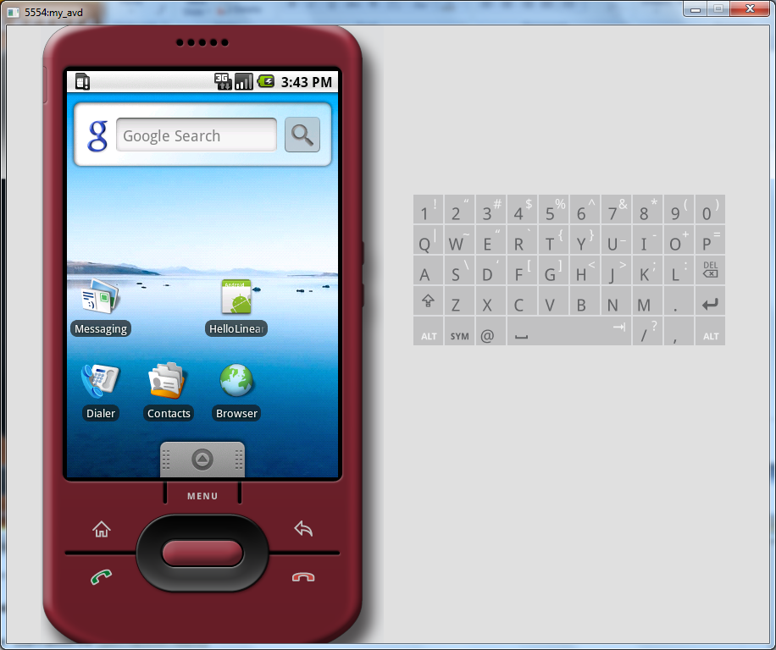
Android Emulator: 1.6 Device

Slide 12
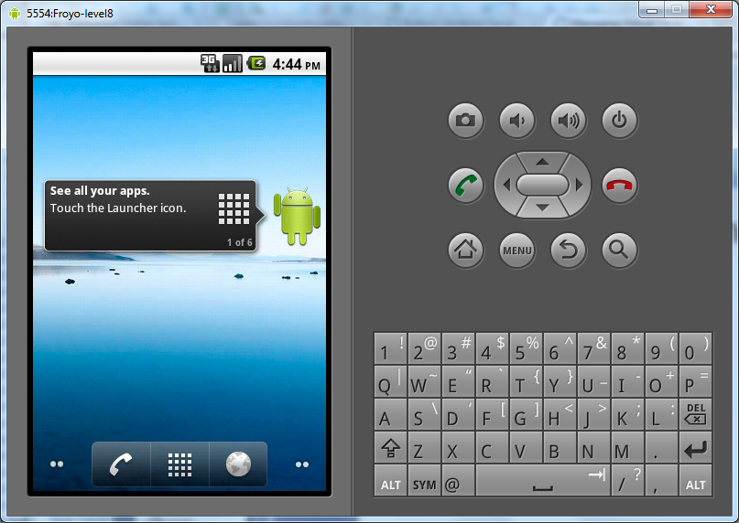
Android Emulator: 2.2 Device

Slide 13
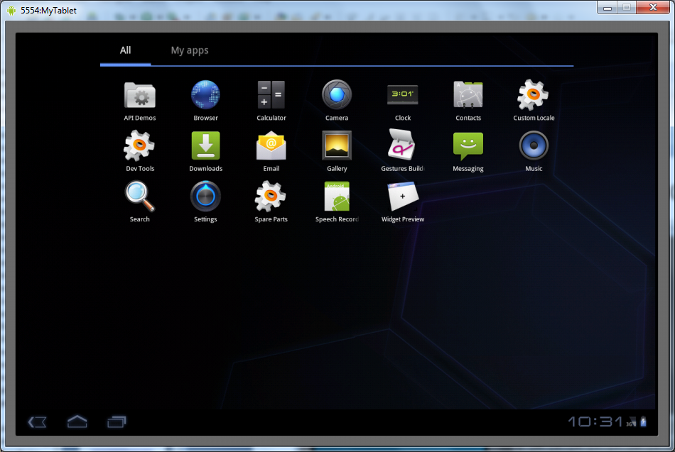
Android Emulator: 3.0 Device

Slide 14
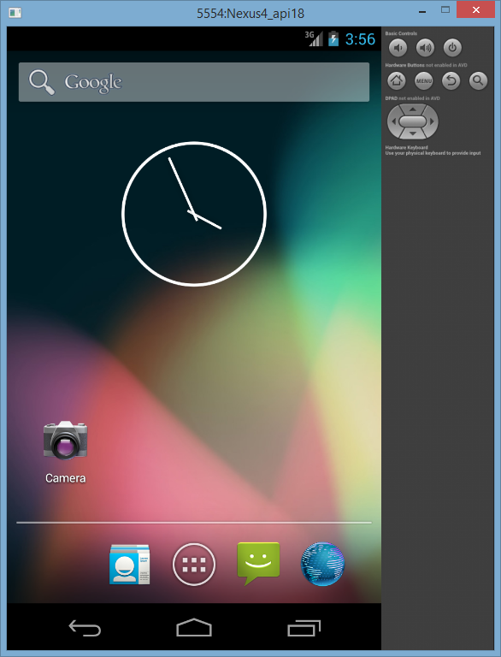
Android Emulator: 4.2 Device

Slide 15
Emulator Basics
Host computer’s keyboard works
Host’s mouse works like finger
Uses host’s Internet connection
Side buttons work: Home, Menu, Back, Search, volume up and down, etc.
Ctrl-F11 toggle landscape → portrait
Alt-Enter toggle full-screen mode
More info at http://developer.android.com/guide/developing/devices/emulator.html

Slide 16
Emulator Limitations
No support for placing or receiving actual phone calls
  Simulate phone calls (placed and received) through the emulator console
No support for USB connections
No support for camera/video capture (input)
No support for device-attached headphones
No support for determining connected state
No support for determining battery charge level and AC charging state
No support for determining SD card insert/eject
No support for Bluetooth
No support for simulating the accelerometer
  Use OpenIntents’s Sensor Simulator

Slide 17
In other words, test your app on an actual device!

Slide 18
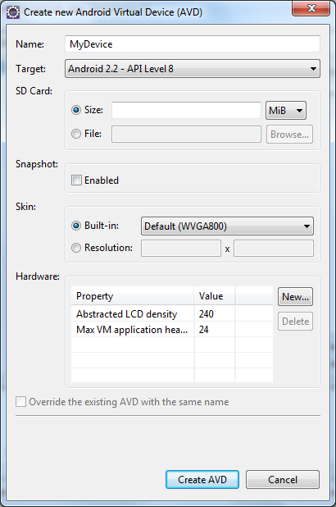
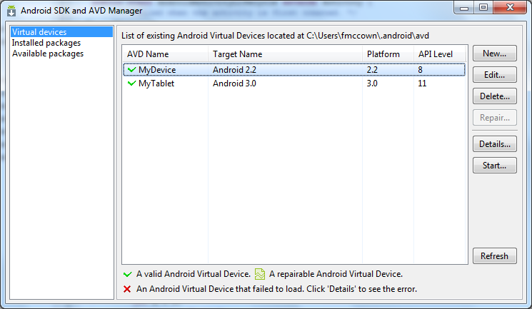
Create an AVD using
Android SDK and AVD Manager

Slide 19
Or From the Command Line
C:\android-sdk-windows\tools>android create avd -n MyDevice -t android-8
Android 2.2 is a basic Android platform.
Do you wish to create a custom hardware profile [no]
Created AVD 'MyDevice2' based on Android 2.2,
with the following hardware config:
hw.lcd.density=240
vm.heapSize=24
C:\android-sdk-windows\tools>emulator -avd MyDevice
Device name
Target platform
Launch device
More info:
http://developer.android.com/guide/developing/devices/managing-avds-cmdline.html

Slide 20
Android Runtime: Dalvik VM
Subset of Java developed by Google
Optimized for mobile devices (better memory management, battery utilization, etc.)
Dalvik runs .dex files that are compiled from .class files
Introduces some new libraries
Does not support some Java libraries like AWT

Slide 21
Applications Are Boxed
By default, each app is run in its own Linux process
  Process started when app’s code needs to be executed
  Threads can be started to handle time-consuming operations
Each process has its own Dalvik VM
By default, each app is assigned unique Linux ID
  Permissions are set so app’s files are only visible to that app

Slide 22

Producing an Android App
Java code
javac
Byte code
Dalvik exe
dx
.java
.class
classes.dex
aapt
Byte code
<xml>
Other .class files
AndroidManifest.xml
.apk
<str>
Resources
Notes:
Every application must have an AndroidManifest.xml file (with precisely that name) in its root directory. The manifest presents essential information about the application to the Android system, information the system must have before it can run any of the application's code. Among other things, the manifest does the following:
It names the Java package for the application. The package name serves as a unique identifier for the application.
It describes the components of the application — the activities, services, broadcast receivers, and content providers that the application is composed of. It names the classes that implement each of the components and publishes their capabilities (for example, which Intent messages they can handle). These declarations let the Android system know what the components are and under what conditions they can be launched.
It determines which processes will host application components.
It declares which permissions the application must have in order to access protected parts of the API and interact with other applications.
It also declares the permissions that others are required to have in order to interact with the application's components.
It lists the Instrumentation classes that provide profiling and other information as the application is running. These declarations are present in the manifest only while the application is being developed and tested; they're removed before the application is published.
It declares the minimum level of the Android API that the application requires.
It lists the libraries that the application must be linked against.

Slide 23
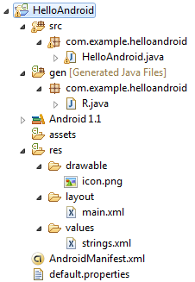
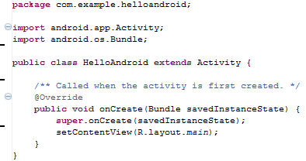
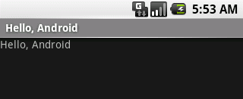
Hello Android Tutorial
http://developer.android.com/resources/tutorials/hello-world.html

Slide 24
Important Files
src/HelloAndroid.java
  Activity which is started when app executes
res/layout/main.xml
  Defines & lays out widgets for the activity
res/values/strings.xml
  String constants used by app
gen/R.java (Don’t touch!)
  Auto-generated file with identifiers from main.xml, strings.xml, and elsewhere
AndroidManifest.xml
  Declares all the app’s components
  Names libraries app needs to be linked against
  Identifies permissions the app expects to be granted

Slide 25
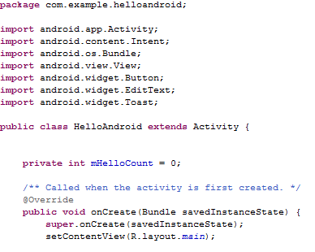
src/HelloAndroid.java
Activity which is started when app executes

Slide 26
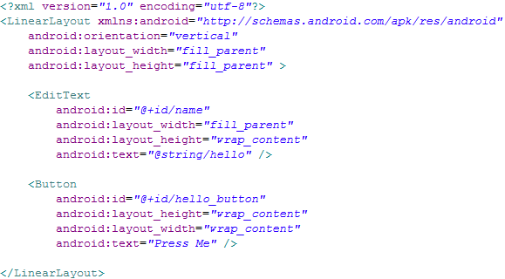
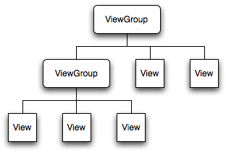
res/layout/main.xml
Declares layouts & widgets for the activity
Tree from: http://developer.android.com/guide/topics/ui/index.html
Notes:
A ViewGroup is a special view that can contain other views (called children.) The view group is the base class for layouts and views containers. The ViewGroup subclass is the base class for layouts, which are invisible containers that hold other Views (or other ViewGroups) and define their layout properties. LinearLayout is a subclass of ViewGroup.
The View class represents the basic building block for user interface components. A View occupies a rectangular area on the screen and is responsible for drawing and event handling. View is the base class for widgets, which are used to create interactive UI components (buttons, text fields, etc.).

Slide 27
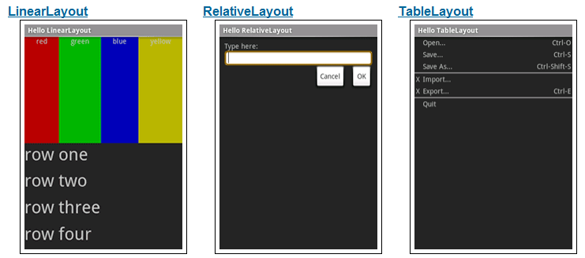
Various Layouts
http://developer.android.com/resources/tutorials/views/index.html

Slide 28
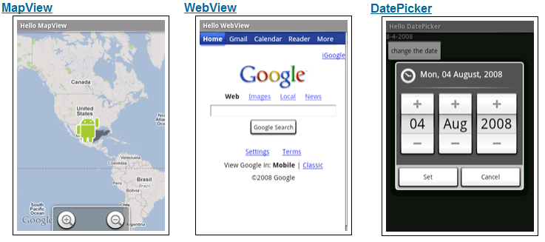
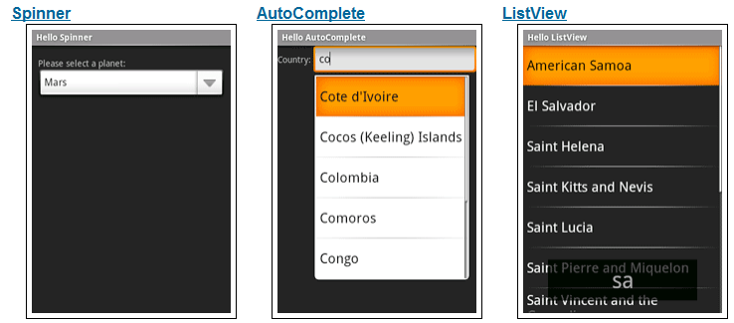
Various Widgets
http://developer.android.com/resources/tutorials/views/index.html

Slide 29

res/values/strings.xml
String constants used by app
Used for supporting Localization
  res/values-es/values/strings.xml to support Spanish
  res/values-fr/values/strings.xml to support French
  Etc.

Slide 30
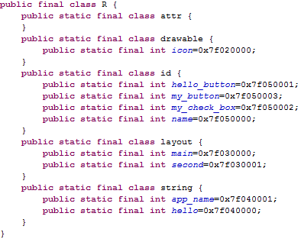
gen/R.java
Auto-generated file with identifiers from main.xml, strings.xml, and elsewhere
Do not modify!

Slide 31
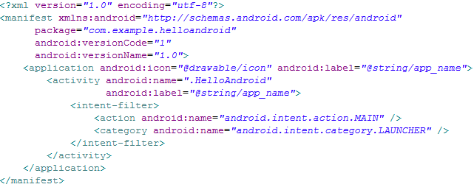
AndroidManifest.xml
Declares all the app’s components
Names libraries app needs to be linked against
Identifies permissions the app expects to be granted
Notes:
This is the most common IntentFilter seen in Android applications. The action android.intent.action.MAIN indicates that this is the first activity that should be executed when starting this app. The category android.intent.category.LAUNCHER places this Activity in
the launcher window (the window that lists all the available apps).

Slide 32
Four Application Components
Activities
  Presents a visual UI for a single endeavor
  Single app may be composed of several activities
  Examples: list of photos, buttons to start/stop a song
Services
  Performs background work (no UI)
  Examples: play background music, retrieve data over a network
Broadcast Receivers
  Receives and reacts to broadcast announcements (no UI)
  Broadcast examples: battery is low, pic is taken, lang pref changed
Content Providers
  Provides app data to other applications (no UI)
  Examples: share contact info from SQLite, image from the file system

Slide 33
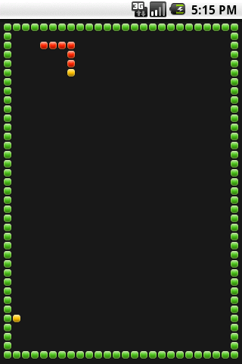
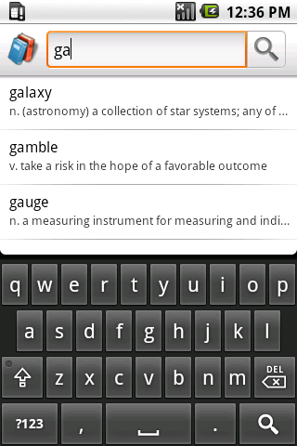
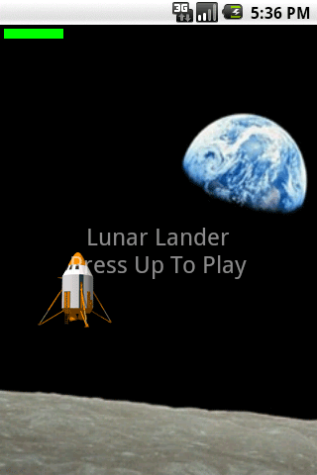
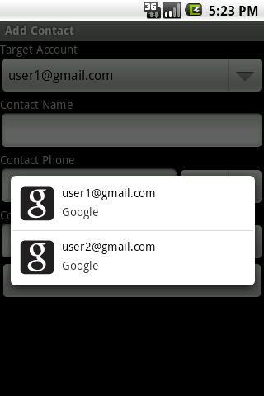
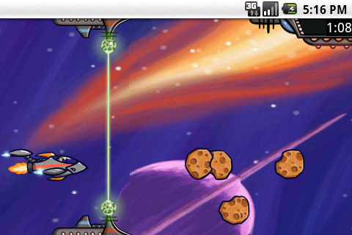
SDK Samples

Slide 34
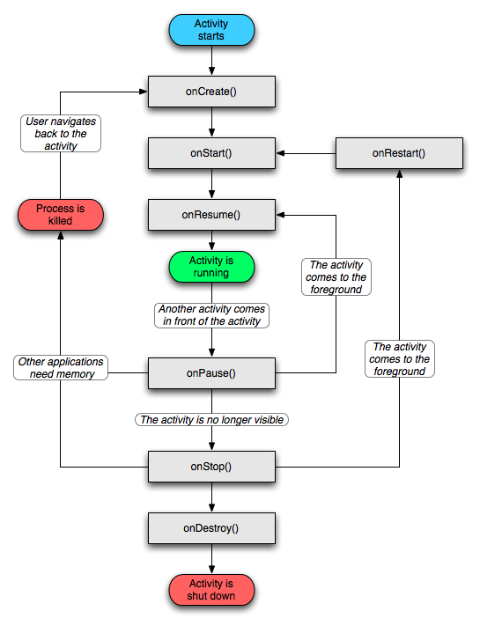
Activity Lifecycle
http://developer.android.com/reference/android/app/Activity.html

Slide 35
References
Android Introduction by Marko Gargenta, http://www.lecturemaker.com/2009/10/android-software-platform/
Android Dev Guide http://developer.android.com/guide/topics/fundamentals.html
Pro Android by Hashimi & Komatineni (2009)

