Slide 1
Searching for Images, Video, and Audio
Dr. Frank McCown
Intro to Web Science
Harding University
This work is licensed under a Creative Commons Attribution-NonCommercial-ShareAlike 3.0 Unported License

Slide 2
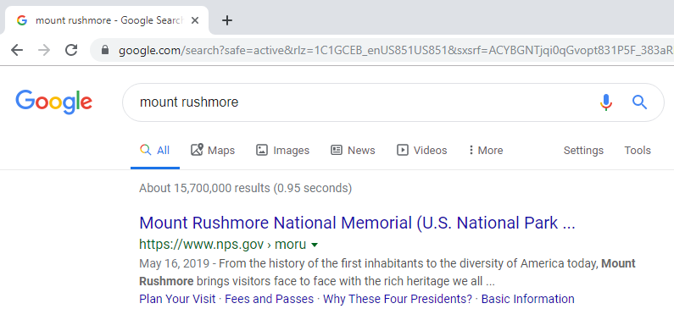
What about searching for non-textual resources?

Slide 3
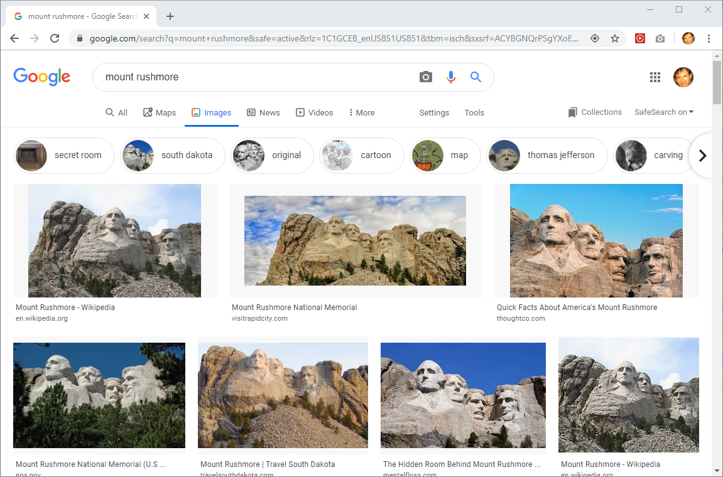

Slide 4
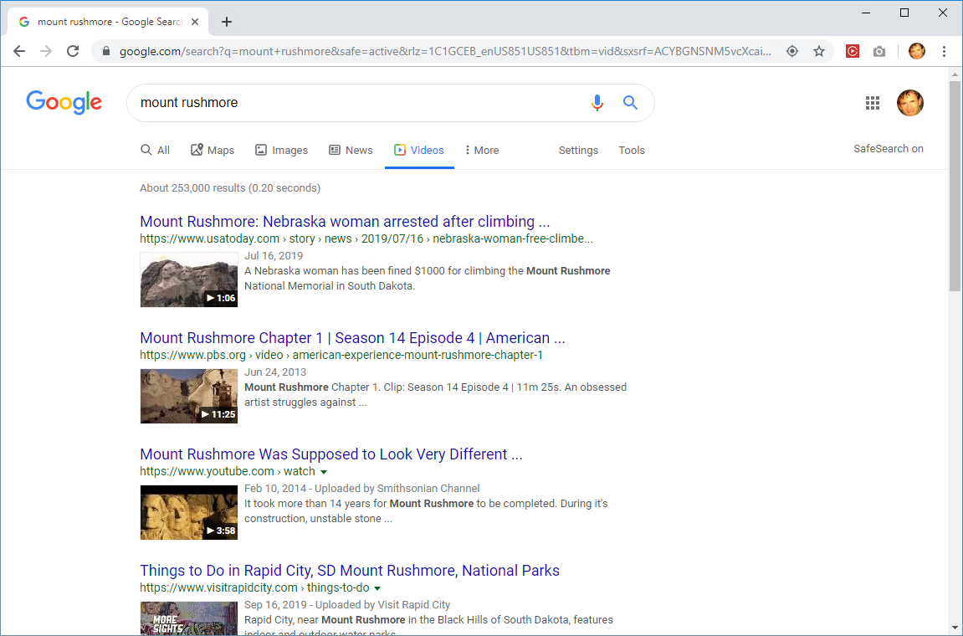

Slide 5
Applications of image search
Travel and tourism
Education and training
Entertainment
E-commerce
Design and fashion
History and art
Filtering out offensive material

Slide 6
Heavy reliance on text
Search textual title, captions, user-supplied tags, and other metadata
<img alt="Photograph of Mount Rushmore" src="MtRushmore.jpg" width="284" height="189"> <div>Mount Rushmore with sculptures of George Washington, Thomas Jefferson, Theodore Roosevelt, and Abraham Lincoln (left to right)</div>

Slide 7
Problems with relying on text
May not be any associated text or tags
Example: Directory listing of images
Text may not capture important object features
Title of music file may not provide ability to search for a particular melody

Slide 8
Content-based retrieval
Techniques developed for searching non-text media using content features
Words in images or videos can be converted into text
Optical character recognition (OCR)
Speech recognition technology
Convert recorded speech into text
OCR and speech recognition produce “noisy” text – text with small errors

Slide 9
OCR example
http://www.search-engines-book.com/slides/

Slide 10
Speech recognizer example
Transcript:
French prosecutors are investigating former Chilean strongman Augusto Pinochet… The national court in Spain has ruled crimes committed by the Pinochet regime fall under Spanish jurisdiction.
Speech recognizer output:
french prosecutors are investigating former Chilean strongman of coastal fish today the national court in spain has ruled crimes committed by the tennessee with james all under Spanish jurisdiction
http://www.search-engines-book.com/slides/

Slide 11
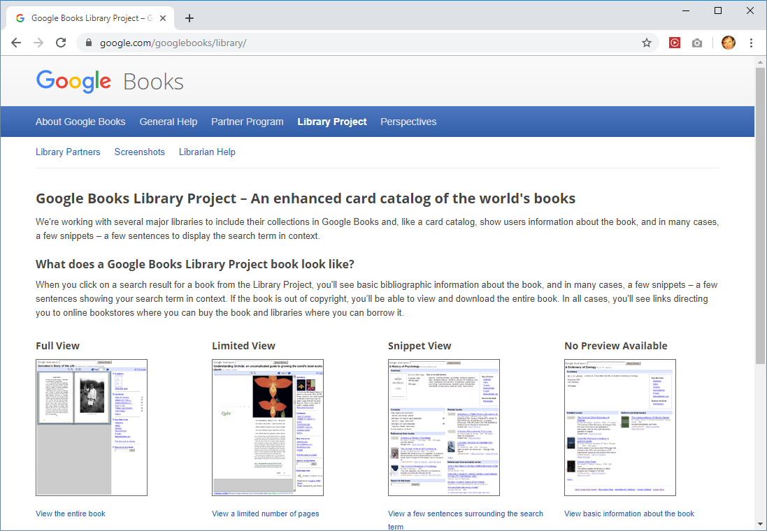
Google Books Library Project

Slide 12
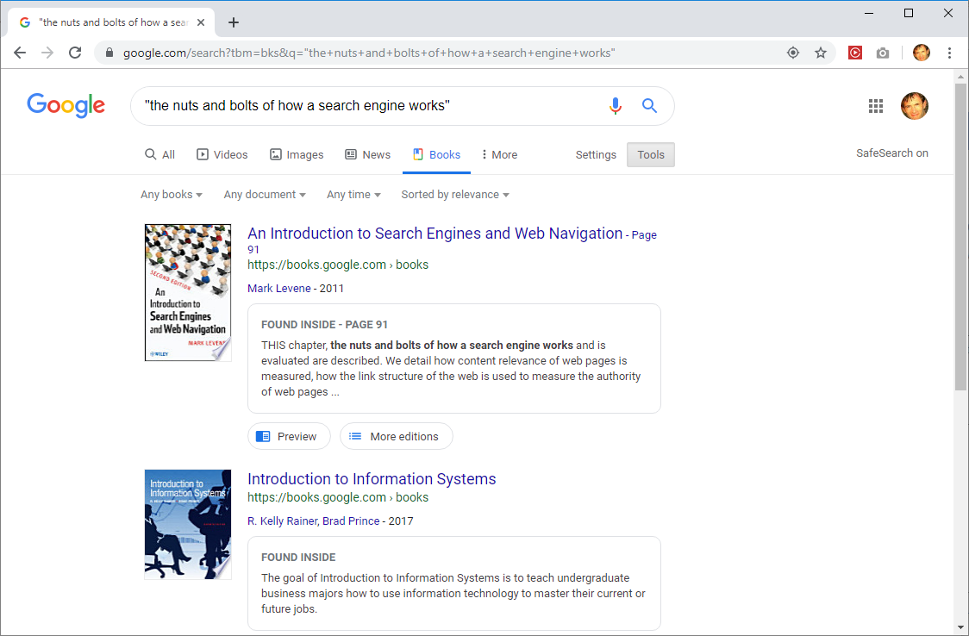

Slide 13
Searching by image characteristics
Images can be analyzed for various characteristics to allow refined searches
Size: Width and height of image
Color: Colors used in the image
Type: Photo, clip art, line drawing, etc.
Time: When discovered on the web

Slide 14
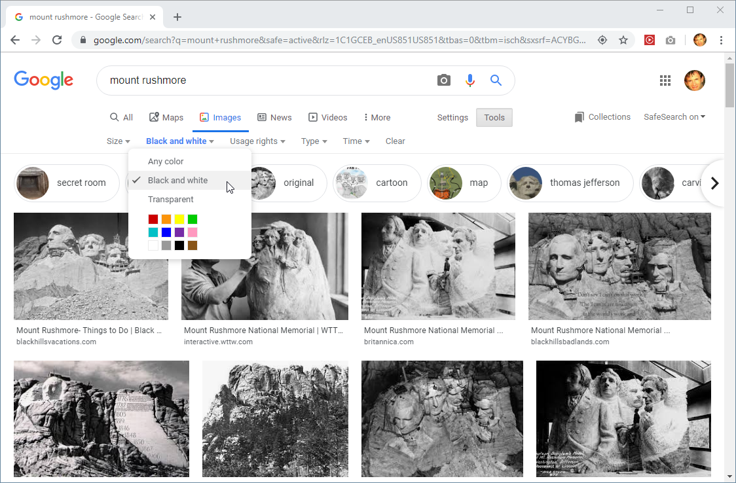

Slide 15
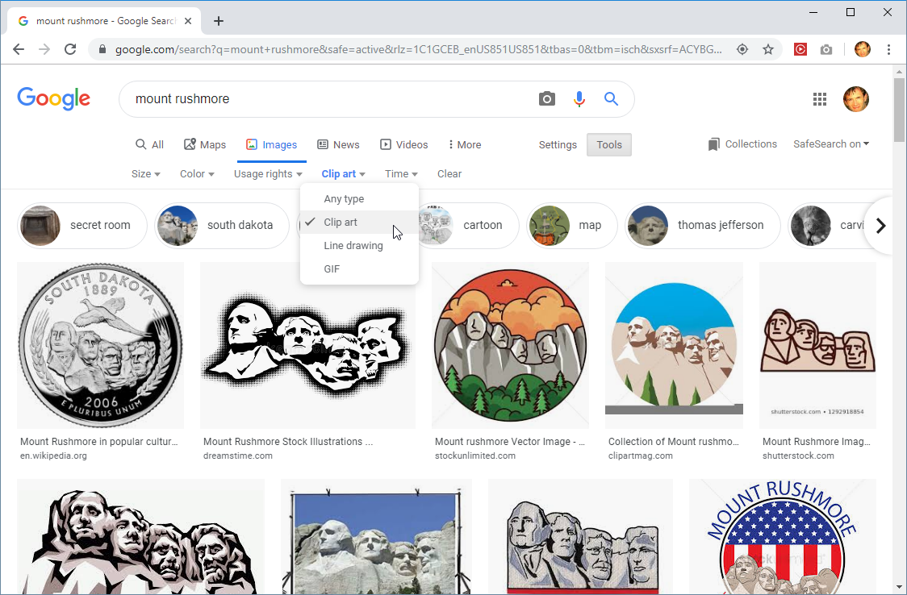

Slide 16
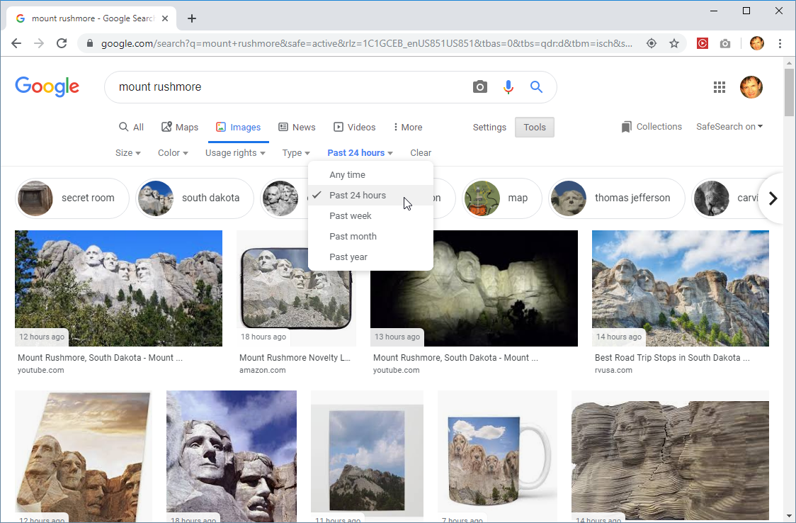

Slide 17
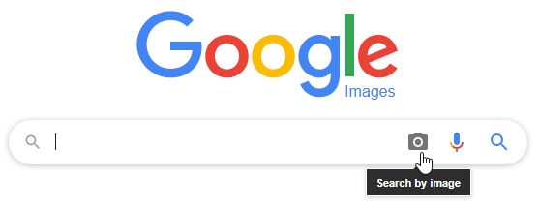
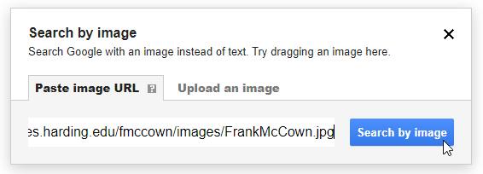
Search by image
Instead of text query, use image query

Slide 18
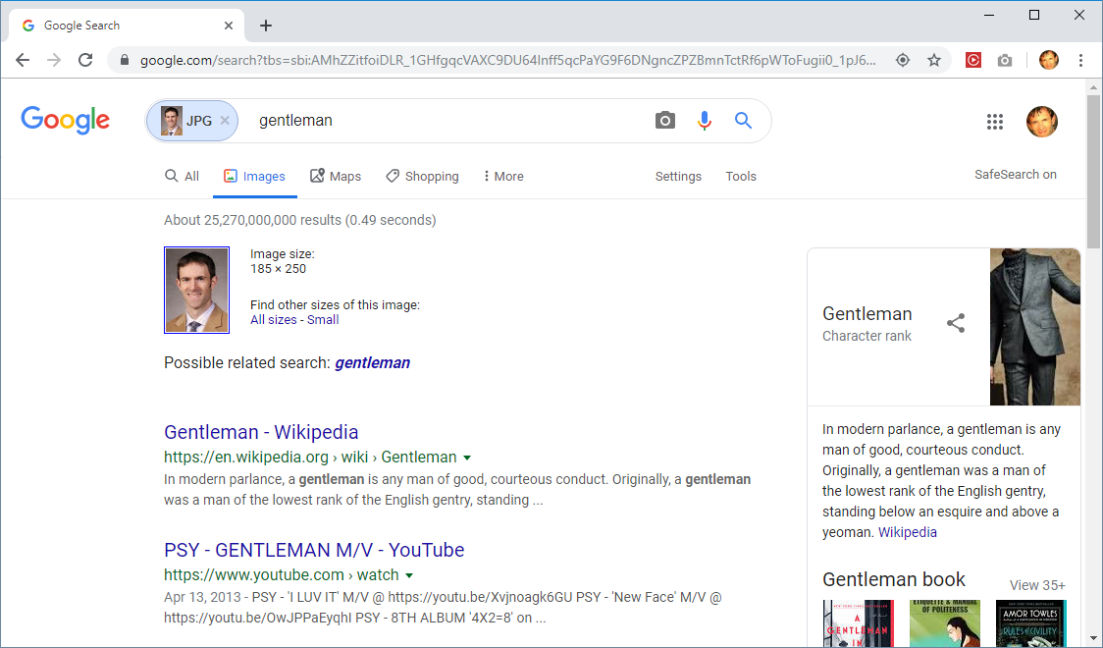
Example: Google Search by Image
Term most associated with this image “type” due to jacket?

Slide 19
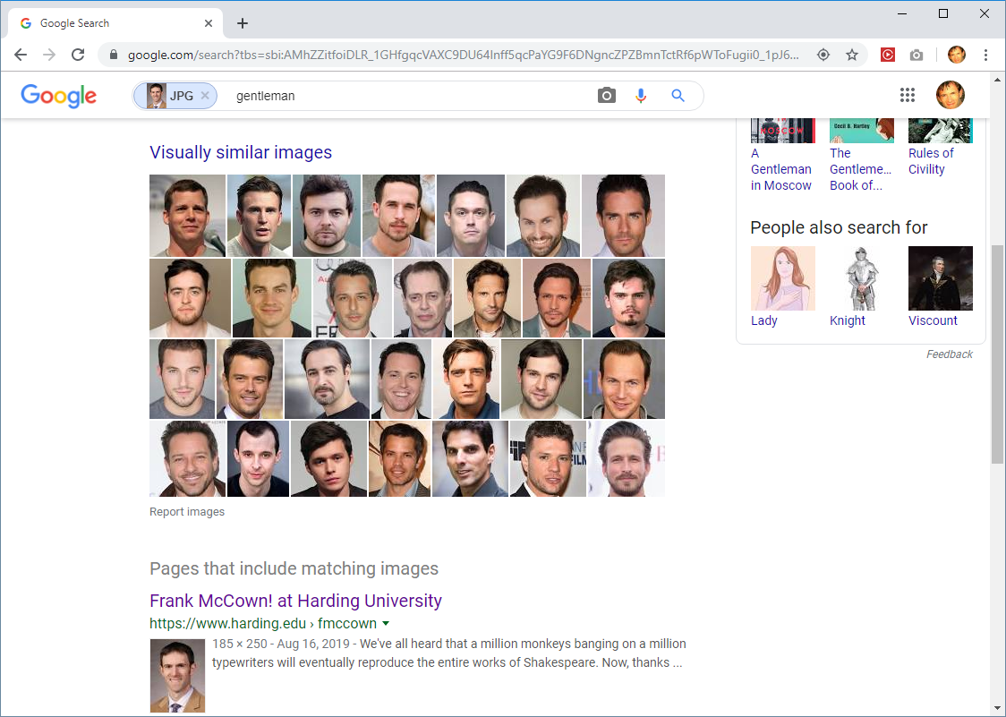
Not using face-recognition technology

Slide 20
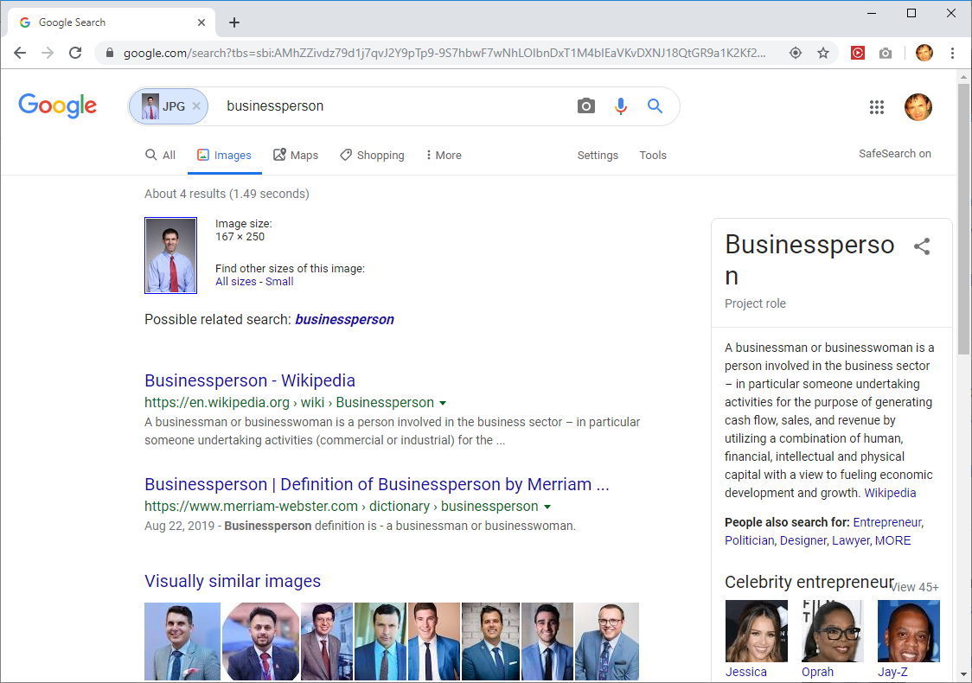
Due to tie?

Slide 21
Color histogram
Common image content feature to compare
Process:
Convert RGB values from 256 levels to 8 levels
Possible color combination reduced from 256×256×256 = 16.8 million to 8×8×8 = 512
For each pixel in image, increment bin corresponding to RGB value
Resulting values can be indexed for fast retrieval
Given an image query, compare color histogram of image with image collection

Slide 22
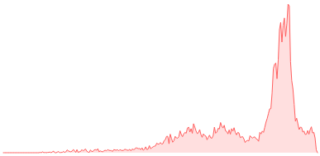
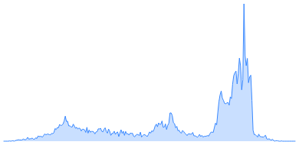
Color histogram example
https://pinetools.com/image-histogram

Slide 23
Comparing color histograms
Ideal for finding images with strong color similarity
Poor at comparing image contents
May be combined with other features:
Texture features: Spatial arrangement of gray levels
Shape features: Object boundaries and edges

Slide 24
Content-based image search: Texture (top rows) and shape features (bottom row)
http://www.search-engines-book.com/slides/

Slide 25
Video retrieval
Similar to image retrieval, but with more features
Filename
Internal metadata (creation date, duration, author)
Title and description
User-generated tags
Speech recognition or transcription
Subtitles

Slide 26
Video retrieval
Video segmented into scenes with visually coherent frames
Key frames selected from scenes
http://www.search-engines-book.com/slides/

Slide 27
Annotate key frames
Using training data, a machine learning classifier can generate keywords that match similar images in each key frame
http://www.search-engines-book.com/slides/

Slide 28
Content-based video search
Search by video (aka “reverse video search”) use cases:
Find illegal use of copyrighted material
Debunk fake news
Find similar videos that capture an event
Several companies offer reverse video search
http://www.videntifier.com/
https://berify.com/
https://www.tecxipio.com/reverse-video-search-api

Slide 29
Audio retrieval
Search by text
Filename
Internal metadata (creation date, duration, artist, etc.)
Title and description
User-generated tags
Speech recognition or transcription
Lyrics

Slide 30
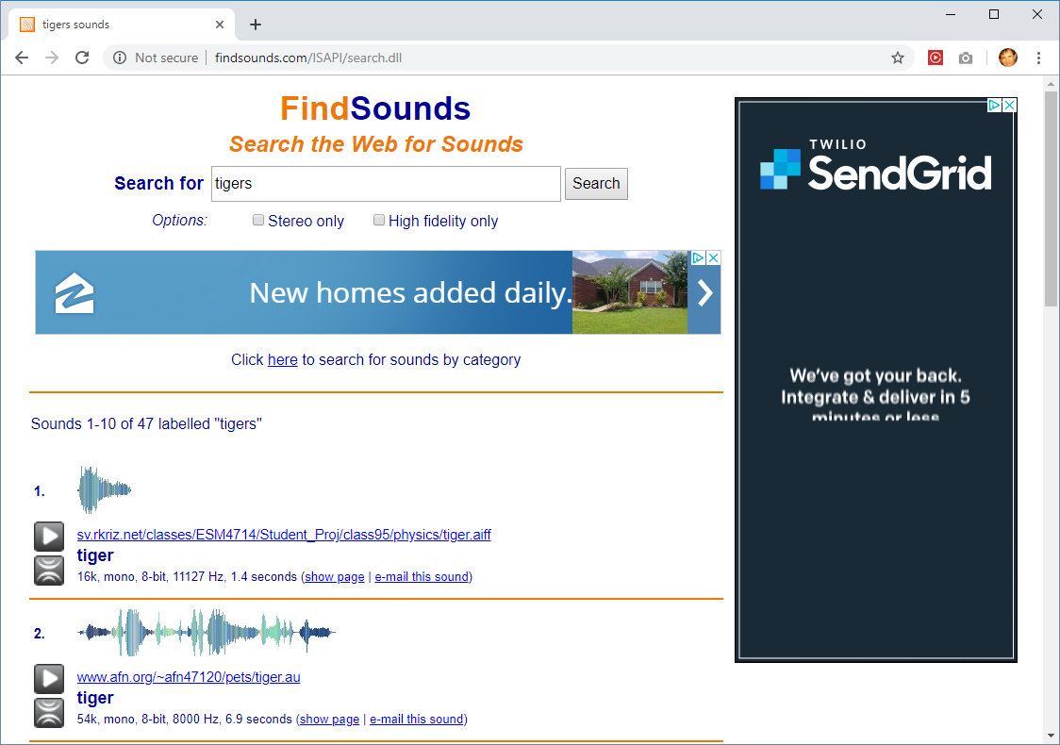

Slide 31
Content-based audio search
Search by audio (aka “reverse audio search”) use cases:
Song search: Know the tune but not the title or artist
Find other recordings of the song
Find similar audio that captures an event
Several companies offer reverse audio search
https://picard.musicbrainz.org/ (Python)
https://www.midomi.com/
Mobile apps: SoundHound and Shazam

Slide 32
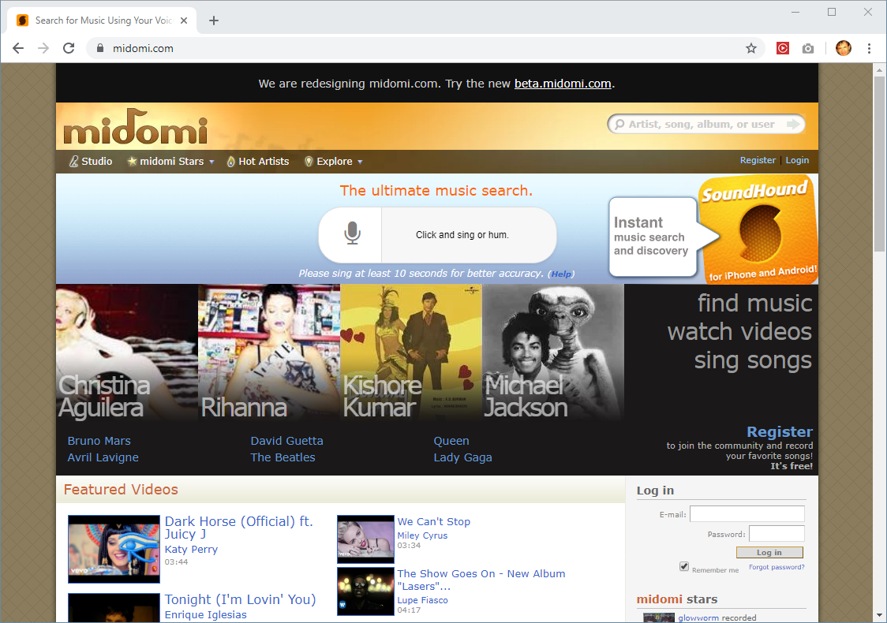

Slide 33
Digital representation of music
Music has less associated with words than images
Many different representations
audio, MIDI, score, etc.
Search based on features
spectrogram peaks, note sequences, relative pitch, etc.
http://www.search-engines-book.com/slides/

Slide 34
Approaches to indexing audio
Create “signature” by hashing representation
Based on peaks of spectrogram
Used by mobile apps that recognize music based on short recordings
Query-by-humming
User hums or sings part of song
Query converted into a melody representation and compared to song corpus
Note sequence, relative pitches, intervals between notes

Slide 35
Further Reading
Levene (2010), An Introduction to Search Engines and Web Page Navigation
Croft et al. (2010), Search Engines: Information Retrieval in Practice

