Slide 1
Significant Nodes in a Network
Dr. Frank McCown
Web Science
Harding University
This work is licensed under a Creative Commons Attribution-NonCommercial-ShareAlike 3.0 Unported License

Slide 2
Centrality
Which nodes are the most important?

Slide 3
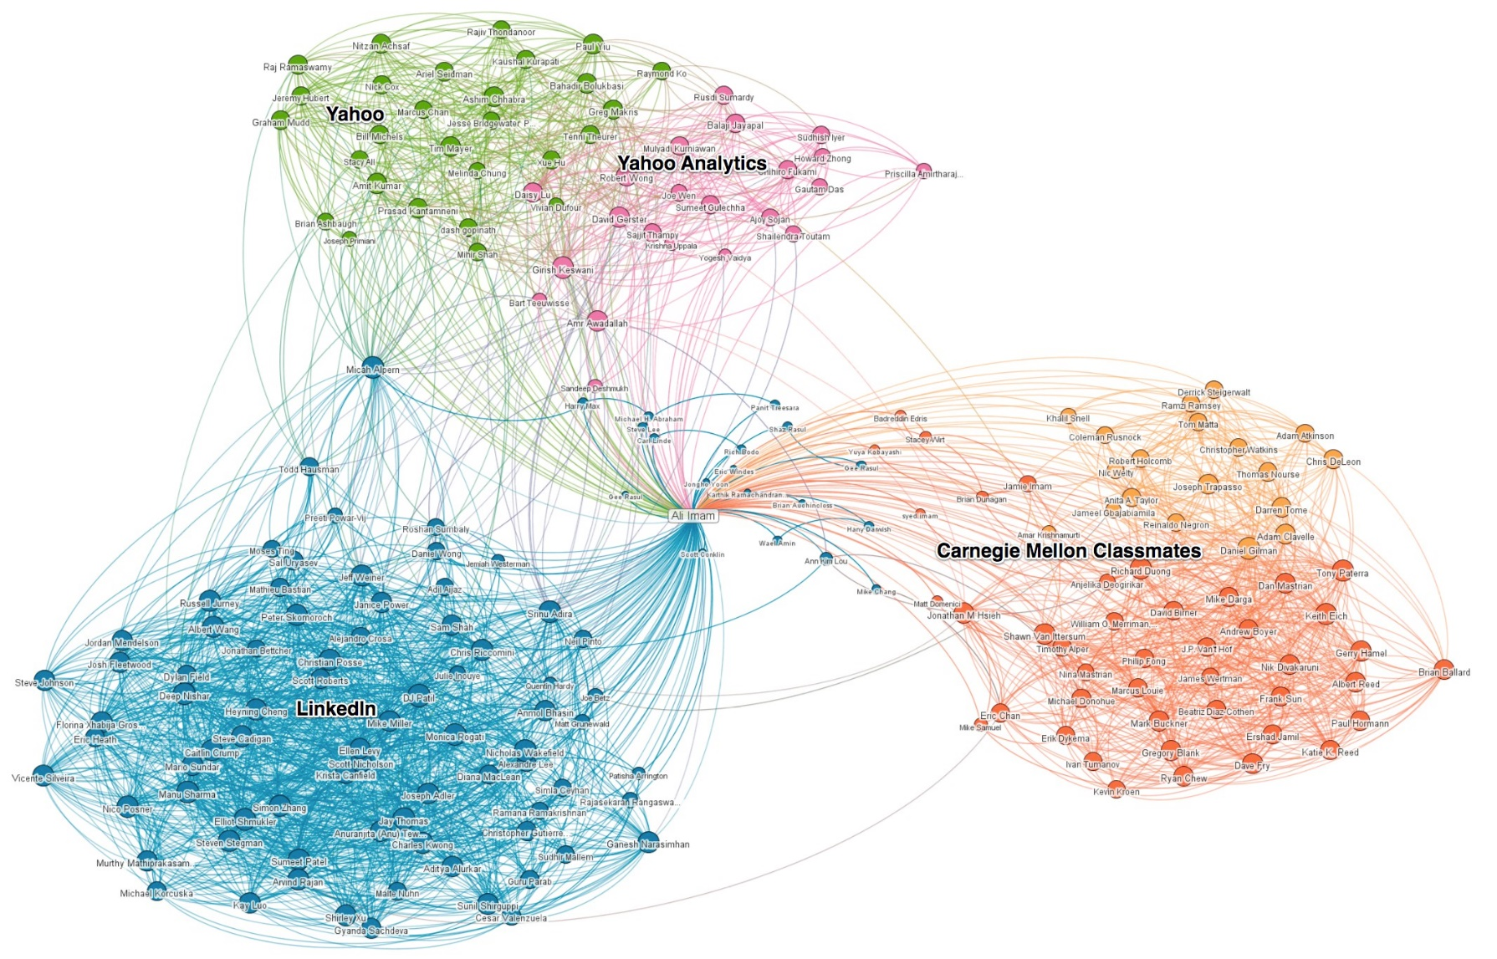
Example from LinkedIn Network
spans multiple communities
highly embedded in community
LinkedIn Network (Imam, 2011)

Slide 4
Common Centrality Measures
Degree centrality – Number of edges connecting a node
For directed graphs: indegree and outdegree centrality

Slide 5
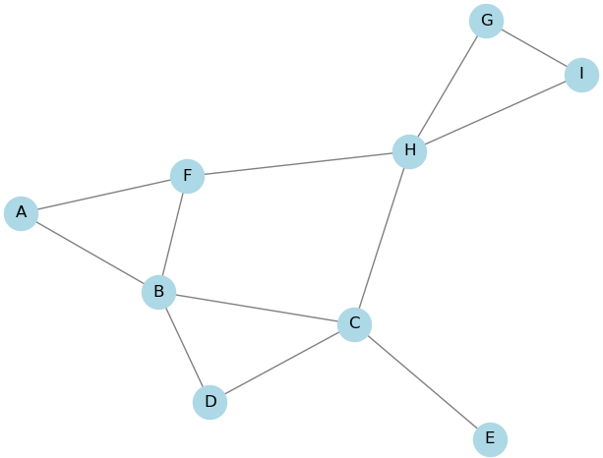
Degree Centrality
degree centrality = 2
degree centrality = 4
Notes:
G = nx.read_adjlist('adjlist.txt')
nx.draw(G, with_labels=True, pos = nx.spring_layout(G, seed=1), node_color='lightblue',
edge_color='gray', node_size=600)
adjlist.txt: A B
B C
C B D E
D B
F A B
G H
H C F I
I G

Slide 6
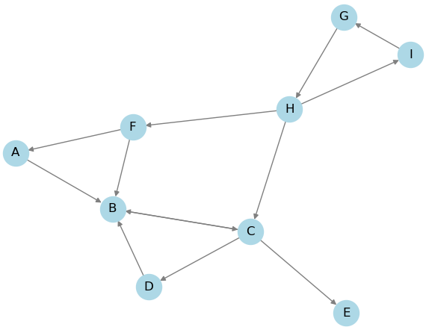
Degree Centrality for Directed Graph
indegree centrality = 2
outdegree centrality = 3
indegree centrality = 4
outdegree centrality = 1
Notes:
Gdir = nx.read_adjlist(‘adjlist_directed.txt',
create_using=nx.DiGraph())

Slide 7
Common Centrality Measures
Degree centrality – Number of edges connecting a node
For weighted graphs: indegree and outdegree centrality
May be normalized: num edges / possible edges

Slide 8
Normalized Degree Centrality
degree centrality = 2/8 = 0.25
degree centrality = 4/8 = 0.5
Notes:
nx.degree_centrality(G)

Slide 9
Normalized Degree Centrality for Directed Graph
indegree centrality = 2/8 = 0.25
outdegree centrality = 3/8 = 0.375
indegree centrality = 4/8 = 0.5
outdegree centrality = 1/8 = 0.125
Notes:
nx.in_degree_centrality(Gdir)
nx.out_degree_centrality(Gdir)

Slide 10
Common Centrality Measures
Degree centrality – Number of edges connecting a node
Betweenness centrality – Number of times a node lies on shortest path between any 2 nodes
Requires breadth-first search (BFS) for every node pair
May be normalized:
num shortest paths through node all possible shortest paths

Slide 11
Betweenness Centrality
Shortest from H->A, G->A, I->A, H->B (0.5), G->B (0.5), I->B (0.5),
betweenness = 4.5
Shortest path from H->G
betweenness = 1
Not on shortest path
betweenness = 0
Notes:
nx.betweenness_centrality(Gdir, normalized=False)
{'A': 0.0, 'B': 8.0, 'C': 14.5, 'D': 0.0, 'E': 0.0, 'F': 4.5, 'G': 7.0, 'H': 13.0, 'I': 1.0}

Slide 12
Normalized Betweenness Centrality
betweenness = 4.5/56 = 0.080
betweenness = 1/56 = 0.018
betweenness = 0/56 = 0
Notes:
nx.betweenness_centrality(Gdir)
{'A': 0.0, 'B': 0.14285714285714285, 'C': 0.2589285714285714, 'D': 0.0, 'E': 0.0, 'F': 0.08035714285714285, 'G': 0.125, 'H': 0.23214285714285712, 'I': 0.017857142857142856}

Slide 13
Common Centrality Measures
Degree centrality – Number of edges connecting a node
Betweenness centrality – Number of times a node lies on shortest path between any 2 nodes
Eigenvector centrality – Sum of centrality values of the node’s neighbors

Slide 14
Eigenvector Centrality
Rewards nodes for connecting to other highly connected nodes
High eigenvector score means node is connected to many nodes that also have high scores
Rich get richer phenomenon (Matthew effect)
Google’s PageRank algorithm for ranking web pages is very similar

Slide 15
Eigenvector Centrality
Near 0
0.51
0.67

Slide 16
Other Helpful Resources
Easley & Kleinberg, Networks, Crowds, and Markets (2010)
Christakis and Fowler, Connected (2009)
Kadushin, Understanding Social Networks (2011)

