Slide 1
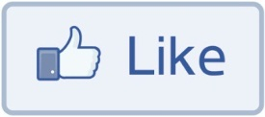
Social Networks: Tie Strength
Dr. Frank McCown
Intro to Web Science
Harding University
This work is licensed under a Creative Commons Attribution-NonCommercial-ShareAlike 3.0 Unported License

Slide 2
Slides based on Ch 3 of Networks, Crowds and Markets by Easley & Kleinberg (2010)
http://www.cs.cornell.edu/home/kleinber/networks-book/

Slide 3
Strong vs. Weak Ties
Tie strength refers to general sense of closeness with another person
Strong: Friends, dependable sources of social or emotional support
Weak: Acquaintances, act as bridges that connect clusters within a social network

Slide 4
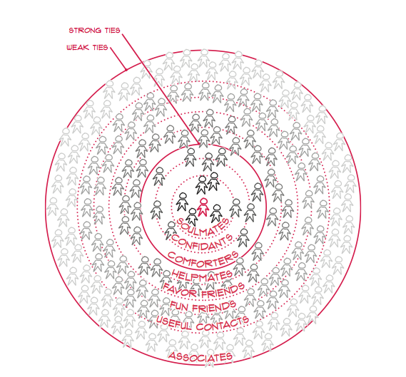
Paul Adams (2012) Grouped
Image: http://ptgmedia.pearsoncmg.com/images/9780321804112/samplefiles/0321804112.pdf

Slide 5
5-15-50-150-500 Rule
Robin Dunbar (2010) How Many Friends Does One Person Need?
Dunbar’s number: Humans can comfortably maintain 150 stable relationships
Common social network pattern
Inner circle: 5
Sympathy group: 12-15
Semi-regular group: 50
Stable social group: 150 (Dunbar’s number)
Friend of friends group: 500 (weak ties)
Notes:
Robin Ian MacDonald Dunbar (born 28 June 1947): a British anthropologist and evolutionary psychologist and a specialist in primate behavior at University of Oxford. Best known for his Dunbar’s number: a measurement of the “cognitive limit to the number of individuals with whom any one person can maintain stable relationships” https://en.wikipedia.org/wiki/Dunbar%27s_number

Slide 6
“If two people in a social network have a friend in common, then there is an increased likelihood that they will become friends themselves at home point in the future.”
- Anatol Rapoport (1953)

Slide 7
Triadic Closure
Common friend
A
B
C
Likely to appear

Slide 8
Reasons for Triadic Closure
Opportunity – A spending time with B & C increases chance they will meet
Trust – Research shows that B & C are more likely to trust each other if they are aware of mutual friend A
Incentive – Research shows that latent stress occurs when mutual friends are not friends with each other

Slide 9
Measuring Triadic Closure
Clustering coefficient – probability that any two randomly selected friends of a node are also friends
= 0 when none of node’s friends are friends with each other
= 1 when all of node’s friends are friends with each other
# of friend pairs
CC for a node =
# of possible friend pairs

Slide 10
Clustering Coefficient
A’s CC: BC / BC = 1
A
F’s CC: - / BE = 0
B
C
D
F
C’s CC: AB / AB, AD, BD = 1/3
E
CC for a node = # of friend pairs / # of possible friend pairs

Slide 11
Tie Strength and Triadic Closure
A
B
A
B
C
C
More likely to form
Less likely to form
Triadic closure is more likely to form when initial edges are strong

Slide 12
Bridges
A
B
Edge is a bridge if removing the edge creates two components

Slide 13
Local Bridges
C
A
B
Local bridge – Edge whose 1) endpoints have no nodes in common and 2) removal does not create new components

Slide 14
Strong and Weak Ties
Weak
Strong
C
A
B
Not everyone is your BFF!

Slide 15
Variable Tie Strength
0
10
6
C
1
9
A
B
Can use more fine-grained methods to determine tie strength, like number of Facebook messages exchanged

Slide 16
Strong Triadic Closure Property
Node A satisfies the Strong Triadic Closure Property if it has strong ties to two other nodes B and C, and there is some edge between B and C
satisfies
violates
A
B
A
B
C
C

Slide 17
Strong Triadic Closure and Bridges
Can a node with at least 2 strong edges satisfy the STC property and be involved in a local bridge that is a strong tie?
C
A
B
?
Answer: No! Why not?

Slide 18
Strong Triadic Closure and Bridges
STC property says edge must form when two strong edges emanate from the same node
Therefore a network that satisfies the STC property and has a sufficient number of strong ties will likely have only weak local bridges
Does not always hold in real social networks, but useful theoretical framework in which to understand connections and test theories

Slide 19
Large-Scale Data Studies
Put new concepts to work by examining several large-scale studies
Examples:
Cell phone usage
Facebook
Twitter

Slide 20
Cell Phone Social Network
Onnela et al. (2007), Structure and tie strengths in mobile communication networks
18 weeks of cell phone data covering 20% of country’s population
Node = cell phone user
Edge = if two nodes called each other (both directions)
Tie strength = duration of calls

Slide 21
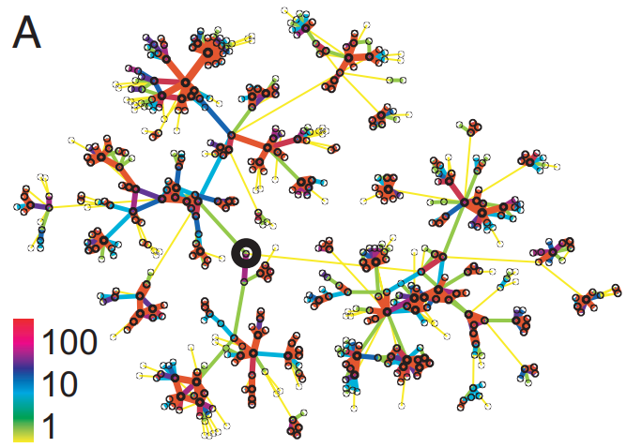
Structure around randomly chosen individual
Call
duration
https://www.pnas.org/content/pnas/104/18/7332.full.pdf

Slide 22
Cell Phone Social Network
Instead of determining if edge is a local bridge or not, use neighborhood overlap
= 1 if all neighbors of A and B are connected
= 0 if no neighbors are connected (local bridge)
Close to 0 is “almost” a local bridge
Neighborhood overlap
neighbors of both A and B
=
neighbors of A or B

Slide 23
Neighborhood Overlap
D
C
E
A
B
F
G
Neighborhood overlap of AD
E
=
=
1/5
C, E, F, G, B

Slide 24
Neighborhood Overlap
D
C
E
A
B
F
G
Neighborhood overlap of AB
-
=
=
0
D, E, F, G, etc.

Slide 25
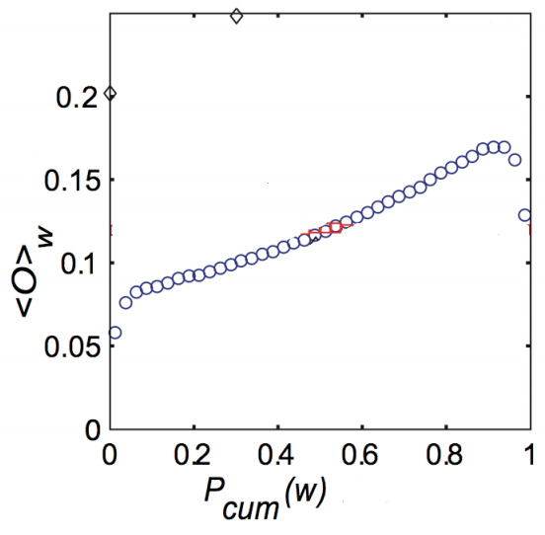
Neighborhood Overlap
Onnela et al.’s findings
Tie Strength
http://www.cs.cornell.edu/home/kleinber/networks-book/networks-book-ch03.pdf
Notes:
The graph shows that as you increase the amount of time talking to someone, there is an increased chance that the person you are talking to has also called others you have called.

Slide 26
Removing Ties
84% of cell phone graph nodes lied in a single giant component
Do weak ties link strongly connected components?
Removed edges one at a time starting with strongest edges → giant component slowly erodes
Removed edges starting with weakest edges → giant component shrank quicker, remnants broke apart quickly once critical weak edges removed

Slide 27
Tie Strength on Facebook
Marlow et al. (2009), Maintained relationships on Facebook http://overstated.net/2009/03/09/maintained-relationships-on-facebook/
Analyzed tie strength of Facebook users using one month of interactions
Three categories of links:
Reciprocal/Mutual – messages sent both ways
One-way – at least one message sent (friend may or may not have reciprocated)
Maintained – user clicked on Friend’s content (from feed) or profile more than once

Slide 28
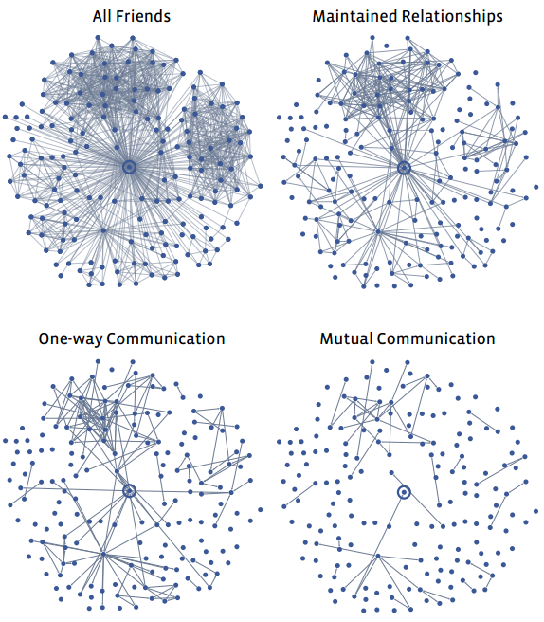
Typical User’s Network
Less interest
College & high school friends?
http://overstated.net/2009/03/09/maintained-relationships-on-facebook

Slide 29
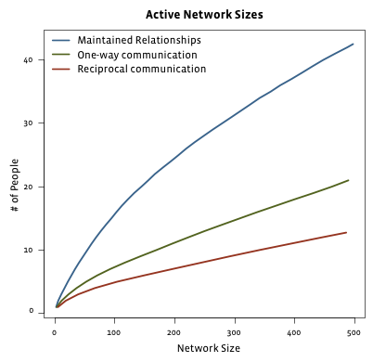
Limits to Maintaining Relationships
passive engagement
Reciprocal – messages sent both ways
One-way – at least one message sent
Maintained – user clicked on Friend’s content (from feed) or profile more than once
Can’t keep up with everyone!
http://overstated.net/2009/03/09/maintained-relationships-on-facebook

Slide 30
Tie Strength on Twitter
Huberman et al. (2009), Social networks that matter: Twitter under the microscope, First Monday
Analyzed tie strength of 211,024 active Twitter users during observation period
Followees – people being followed
Friend – person who user has directed at least two tweets to (strong ties)

Slide 31
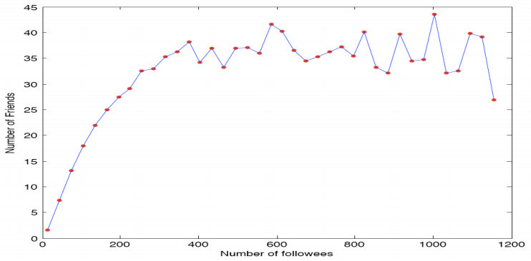
Friends vs. Followees
Limit number of strong ties a user can maintain
http://arxiv.org/pdf/0812.1045.pdf
Notes:
Dunbar’s number = 150

Slide 32
A node’s position in a network can have it’s advantages…

Slide 33
Edge Embeddedness
Defined as the number of common neighbors shared by two endpoints
Equal to numerator in neighborhood overlap
Local bridges have embeddedness of zero
A
Embeddedness of A-B = 1
Embeddedness of A-C = 2
B
D
C

Slide 34
Example
C
Zero embeddedness
B
A
D
All edges have high embeddedness

Slide 35
Embeddedness and Trust
Research shows if you and I are connected by an embedded edge (we share a mutual friend), there is more trust and confidence in the integrity of our shared transactions (social, economic, etc.)
If I cheat you, our mutual friends are likely to find out, and they are less likely to trust me in the future!
Threat is absent for edges of zero embeddedness; no mutual friends to punish me!

Slide 36
C
Riskier
B
A
D
High levels
of trust
B also must deal with potentially contradictory norms and expectations from various groups

Slide 37
It’s Good to be B…
Node B is at the end of multiple local bridges
Node B spans a structural hole in the network – space between two components that do not interact closely
If network represents a company or organization, some advantages for B:
B has early access to info that originates in various components
Having access to this info can amplify B’s creativity by combining disparate info into novel ideas
B acts as “gatekeeper” and can control flow of information to various components

Slide 38
C
Riskier
B
A
D
High levels
of trust
Who would you rather be? A with trusted relationships or risk-taker B?

