Slide 1
Searching the Web
Dr. Frank McCown
Intro to Web Science
Harding University
This work is licensed under a Creative Commons Attribution-NonCommercial-ShareAlike 3.0 Unported License

Slide 2
http://venturebeat.files.wordpress.com/2010/10/needle.jpg?w=558&h=9999&crop=0

Slide 3
How do you locate information on the Web?
When seeking information online, one must choose the best way to fulfill one’s information need
Most popular:
Web directories
Search engines – primary focus of this lecture
Social media

Slide 4
Web Directories
Pages ordered in a hierarchy
Usually powered by humans
Yahoo started as a web directory in 1994 and finally closed in 2015
Open Directory Project (ODP) was largest and maintained by volunteers (dmoz.org), but closed in 2017
Curlie (curlie.org) is successor

Slide 5
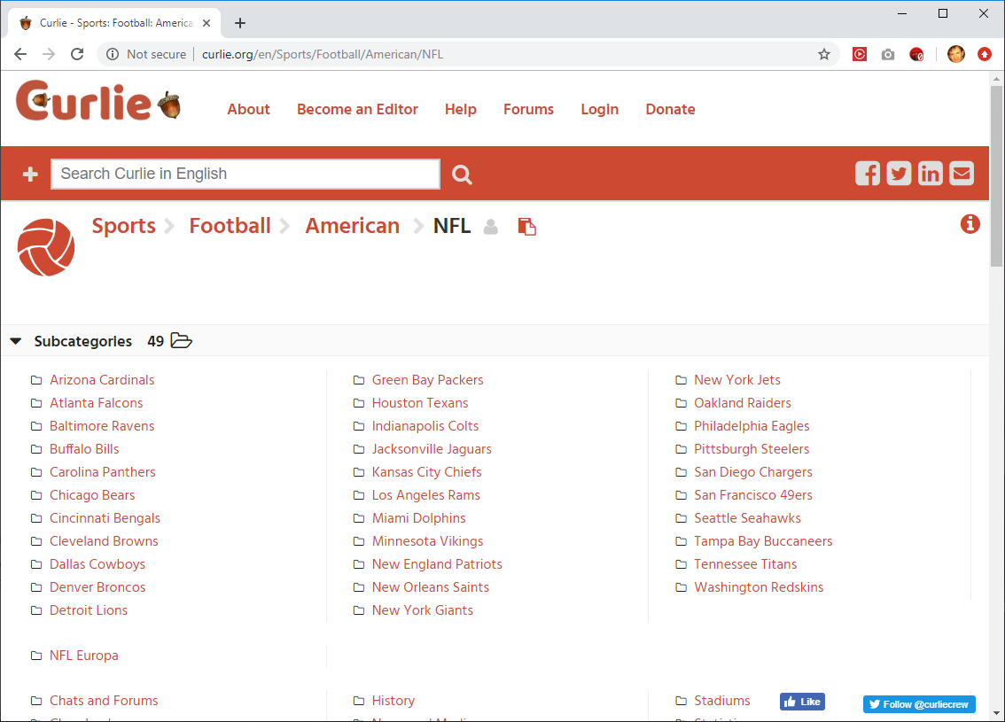

Slide 6
Search Engines
Most often used to fill an information need
Pages are collected automatically by web crawlers
Users enter search terms into text box get back a SERP (search engine result page)
Queries are generally modified and resubmitted to the SE if the desired results are not found on the first few pages of results
Types of search engines:
Web search engines (Google, Bing, Baidu)
Metasearch engines – includes Deep Web (Dogpile, WebCrawler)
Specialized (or focused) search engines (Google Scholar, MapQuest)

Slide 7
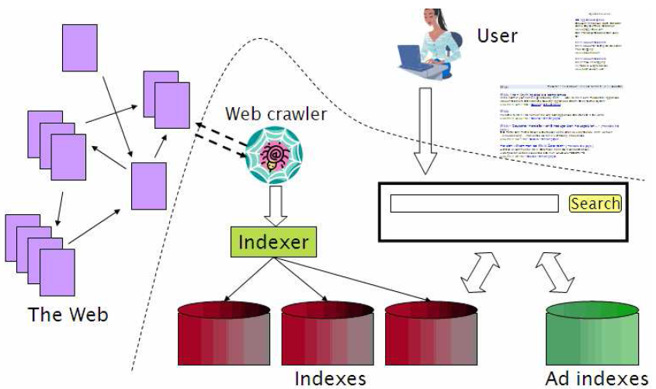
Components of a Search Engine
Figure from Introduction to Information Retrieval by Manning et al., Ch 19.

Slide 8
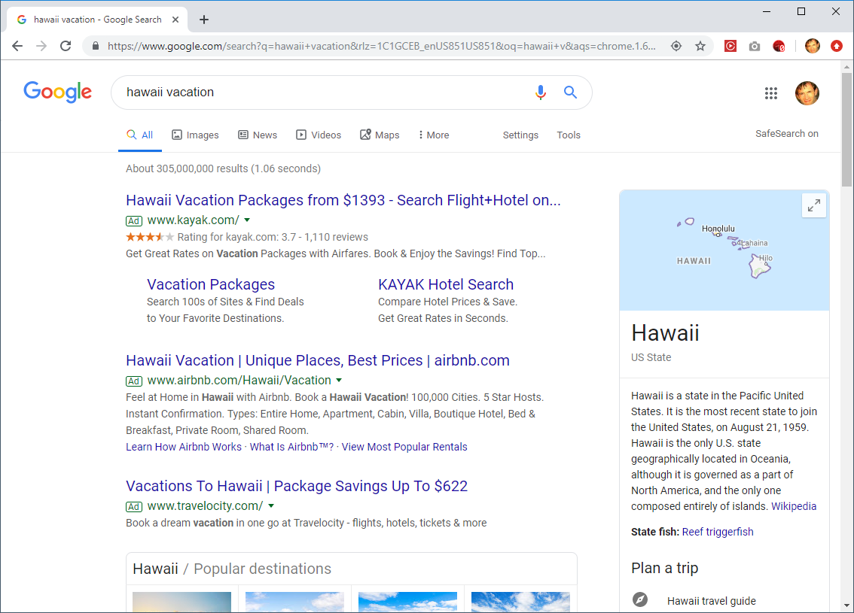
Search query
SERP
Paid results

Slide 9
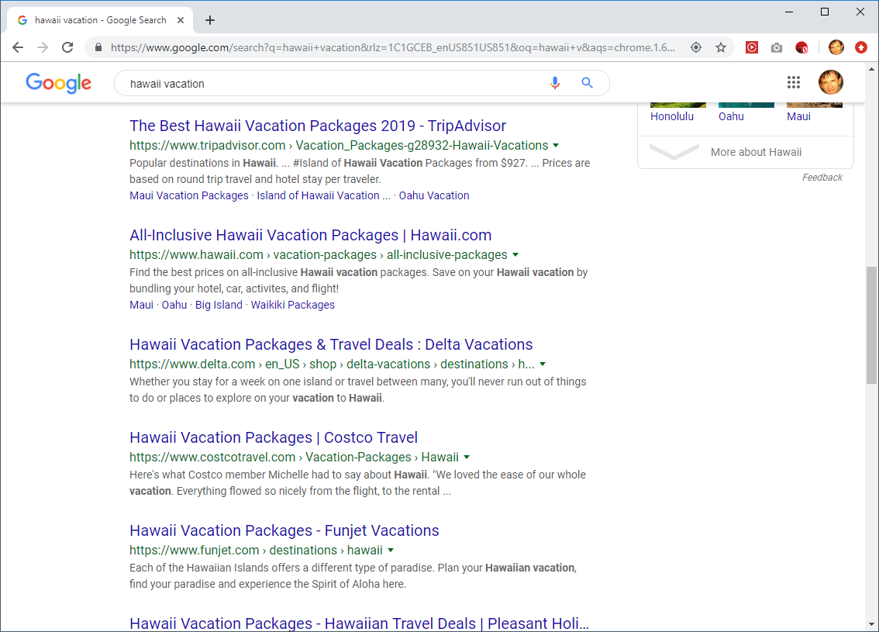
SERP
Organic results
Page title
Text snippet

Slide 10
Query Classifications
Informational
Intent is to acquire info about a topic
Examples: safe vehicles, albert einstein
Navigational
Intent is to find a particular site
Examples: facebook, google
Transactional
Intent is to perform an activity mediated by a website
Examples: children books, cheap flights
Broder, Taxonomy of web search, SIGIR Forum, 2002

Slide 11
Determining Query Type
It is impossible to know the user’s intent, but we can guess based on the result(s) selected
Example: safe vehicles
Informational if selects web page about vehicle safety
Navigational if selects safevehicle.com
Transactional if selects web page that sells safe vehicles
Requires access to SE’s transaction logs
Broder, Taxonomy of web search, SIGIR Forum, 2002

Slide 12
Query Classifications
Study by Jansen et al., Determining the User Intent of Web Search Engine Queries, WWW 2007 (link)
Analyzed transaction logs from 3 search engines containing 5M queries
Findings
Informational: 80.6%
Navigational: 10.2%
Transactional: 9.2%

Slide 13
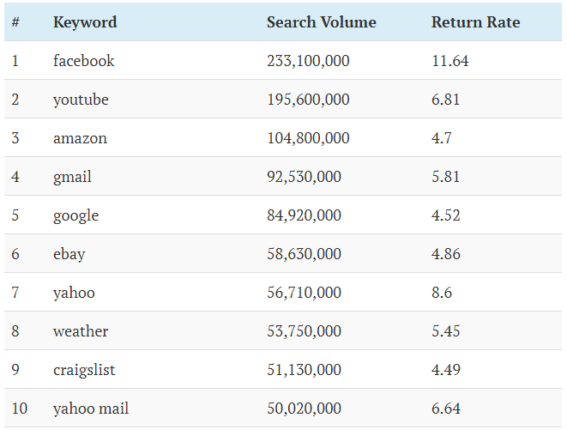
Top 10 Google searches in the US (July 2019)
https://ahrefs.com/blog/top-google-searches/

Slide 14
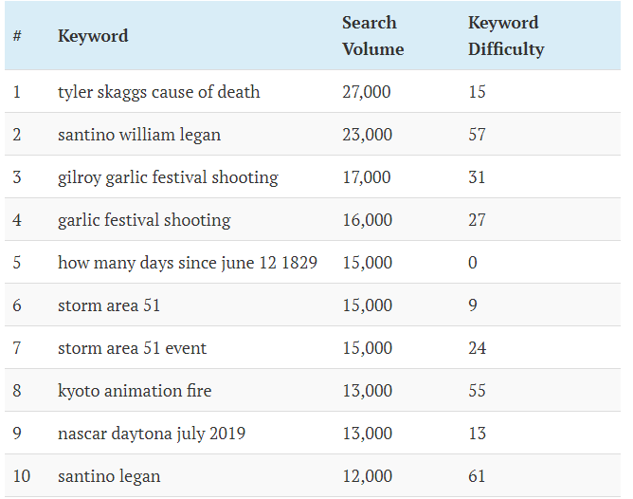
Top 10 NEW Google searches in the US (July 2019)
https://ahrefs.com/blog/top-google-searches/

Slide 15
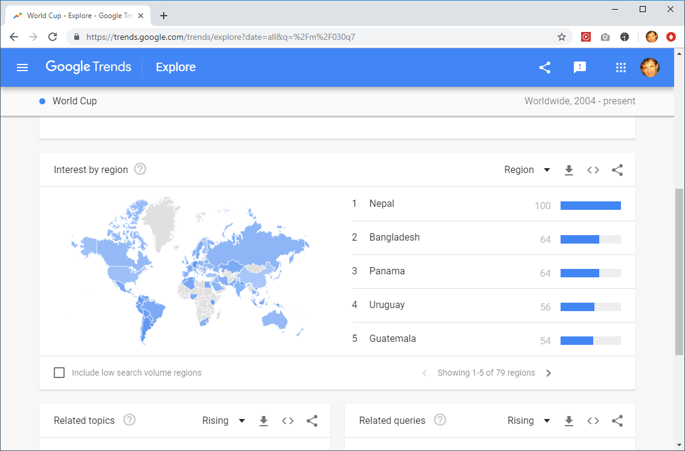
Google Trends (https://trends.google.com)

Slide 16
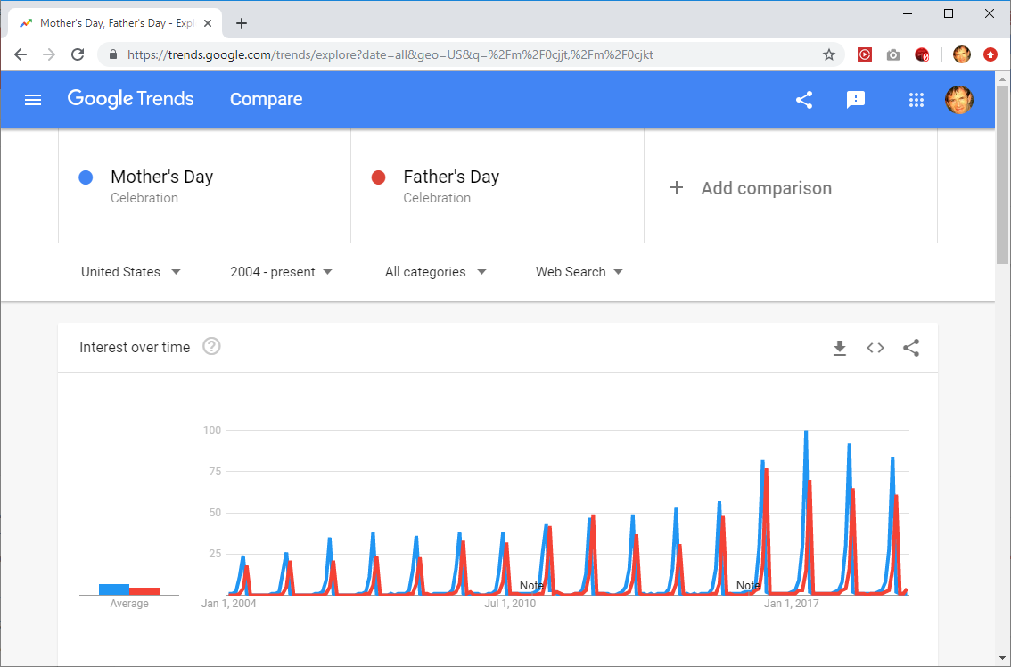
Google Trends (https://trends.google.com)

Slide 17
Relevance
Search engines are useful if they return relevant results
Relevance depends on user’s intent & context, which is often not known
Efforts to increase relevance:
What is the user’s location?
What queries has this user made before?
How does the user’s searching behavior compare to others?
Two popular metrics used to evaluate relevance in search results: precision and recall

Slide 18
Precision and Recall
precision = how much extra stuff did you get?
recall = how much did you miss?
Relevant
Overlap
Retrieved
Corpus
Precision = Overlap / Retrieved
Recall = Overlap / Relevant

Slide 19
Example
Given a corpus of 100 documents
20 are about football
Search for football results in 50 returned documents, 10 are about football
Precision = Overlap / Retrieved = 10/50 = .2
Recall = Overlap / Relevant = 10/20 = .5
Note: Usually precision and recall are at odds

Slide 20
Precision and Recall
1
Precision
figure 1.2
in FBY
0
1
Recall

Slide 21
High Precision, Low Recall
Missing a lot of relevant docs!
Relevant
Retrieved
Corpus
Precision = Overlap / Retrieved
Recall = Overlap / Relevant

Slide 22
Low Precision, High Recall
Lots of irrelevant docs!
Retrieved
Relevant
Corpus
Precision = Overlap / Retrieved
Recall = Overlap / Relevant

Slide 23
Evaluating Web Search Engines
Precision
P@N is the precision of the top N results
Most people only click links on first SERP page, so the top N results are most important where N is 10 or 20
Recall
Impossible to know how many documents on the entire web are about a particular topic, so computing recall for a web search engine is not possible
Relative recall is a way to evaluate SE overlap
(recall of system A) / (recall of A + B + … + N)

Slide 24
Quality of Ranking
Issue search query to SE and have humans rank the first N results in order of relevance
Compare human ranking with SE ranking (e.g., Spearman rank-order correlation coeﬃcient)
Other ranking methods can be used
Discounted cumulative gain (DCG)² which gives higher ranked results more weight than lower ranked results
M measure³ similar function as DCG which gives sliding scale of importance based on ranking
¹Vaughan, New measurements for search engine evaluation proposed and tested, Info Proc & Mang (2004)
²Järvelin & Kekäläinen, Cumulated gain-based evaluation of IR techniques, TOIS (2004)
³Bar-Ilan et al., Methods for comparing rankings of search engine results, Computer Networks (2006)

Slide 25
Other Sources
Mark Levene, An Introduction to Search Engines and Web Navigation, Ch 2 & 4, 2010
Steven Levy, Exclusive: How Google’s Algorithm Rules the Web, Wired Magazine http://www.wired.com/magazine/2010/02/ff_google_algorithm/
Precision and recall (Wikipedia) https://en.wikipedia.org/wiki/Precision_and_recall

