Slide 1
History of the Graphical User Interface (GUI)
Frank McCown
COMP 445 - GUI Programming
Harding University

Slide 2
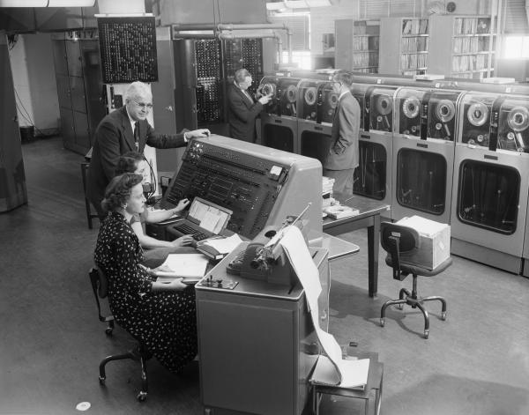
1950s – Batch processing: punched cards used to feed programs into the computer, results come back hours later
Tabulating the 1954 census with a UNIVAC http://explorepahistory.com/displayimage.php?imgId=1-2-1536

Slide 3
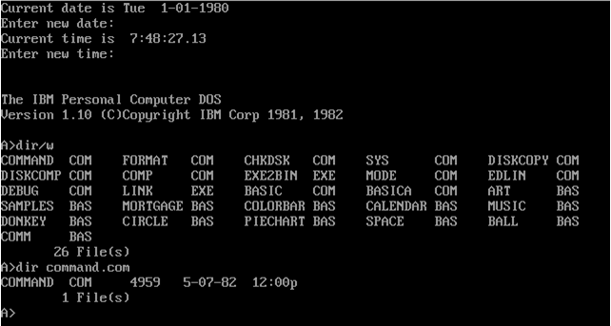
1960s – Command-line interfaces (CLIs) require typing memorized commands
DOS screen from 1980: http://osxbook.com/book/bonus/ancient/vpc/images/dos1x.gif

Slide 4
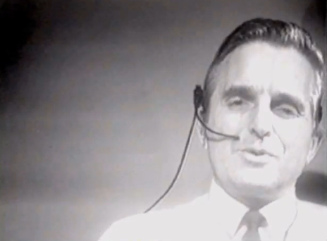
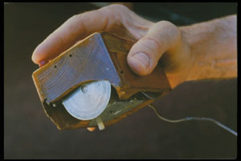
1968 – Doug Engelbart demonstrates NLS, a system which uses a mouse, pointers, hypertext, and multiple windows
The first mouse
“The Demo”
http://en.wikipedia.org/wiki/File:Firstmouseunderside.jpg
Notes:
On December 9, 1968, Douglas C. Engelbart and the group of 17 researchers working with him in the Augmentation Research Center at Stanford Research Institute in Menlo Park, CA, presented a 90-minute live public demonstration of the oN-Line System (NLS) they had been working on since 1962.

Slide 5
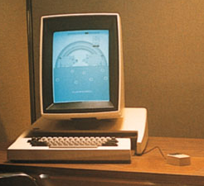
1970s – Researchers at Xerox Palo Alto Research Center (many from SRI) develop WIMP paradigm (Windows, Icons, Menus, Pointers)
1973 – Xerox Alto: commercial failure due to expense, poor user interface, and lack of programs
Image: http://toastytech.com/guis/altosystem.jpg

Slide 6
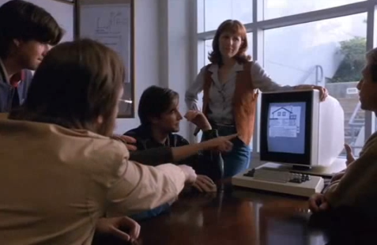
1979 – Steve Jobs and other Apple engineers visit Xerox. Pirates of Silicon Valley dramatizes the events, but Apple had already been working on the GUI before the visit
“I felt like one of the Mongol hoards coming to loot and plunder a bunch of defenseless villagers.” – Steve Wozniak in Pirates of Silicon Valley

Slide 7
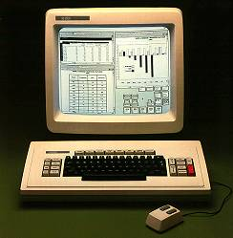
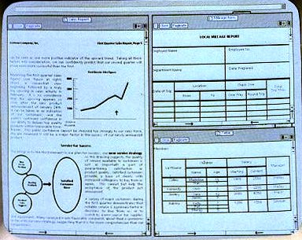
1981 – Xerox Star: focus on WYSIWYG. Commercial failure (25K sold) due to expense ($16K each), performance (minutes to save a file, couple of hours to recover from crash), and poor marketing
Promo: https://www.youtube.com/watch?v=zVw86emu-K0
Image: http://toastytech.com/guis/star.html

Slide 8
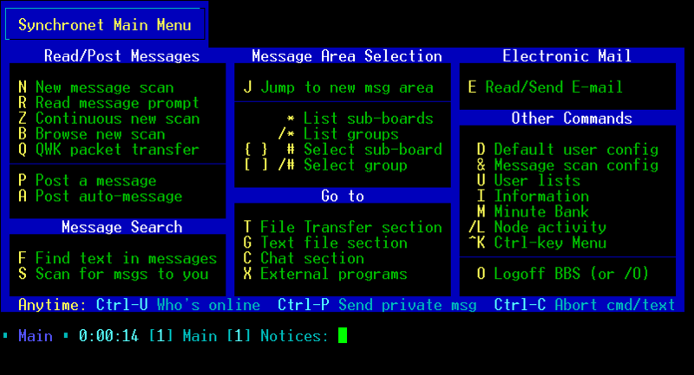
1980s – Text user interfaces (TUIs), retronym coined after GUIs
http://en.wikipedia.org/wiki/Text_user_interface

Slide 9
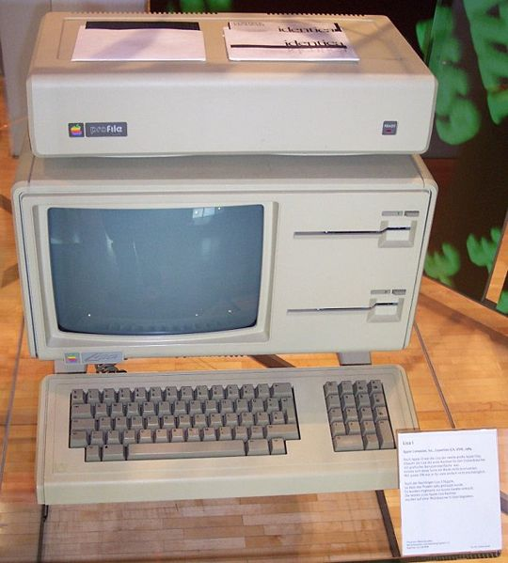
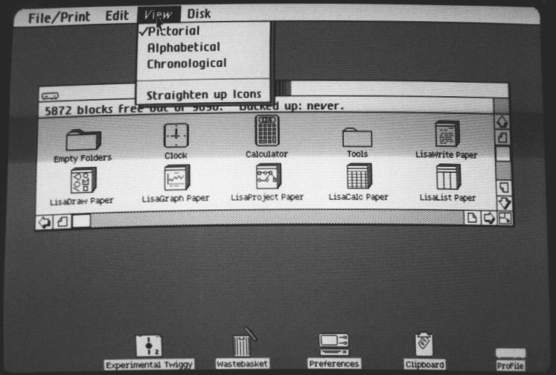
1983 – Apple Lisa: Many developers from Xerox, not commercially successful
Images: http://en.wikipedia.org/wiki/File:Apple_Lisa.jpg http://toastytech.com/guis/lisaos1LisaTour.html
Notes:
Named after Steve Job’s daughter?

Slide 10
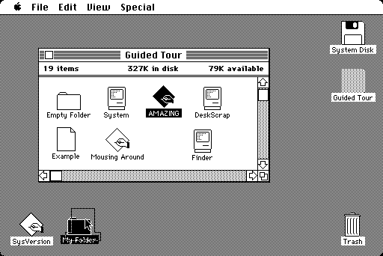
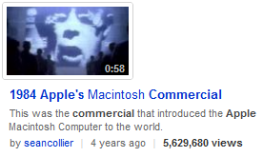
1984 – Apple Macintosh popularizes the GUI.
Super Bowl commercial shown once, most expensive ever made at that time
Image: http://toastytech.com/guis/macos1.html
Notes:
Cannot minimize a window.

Slide 11
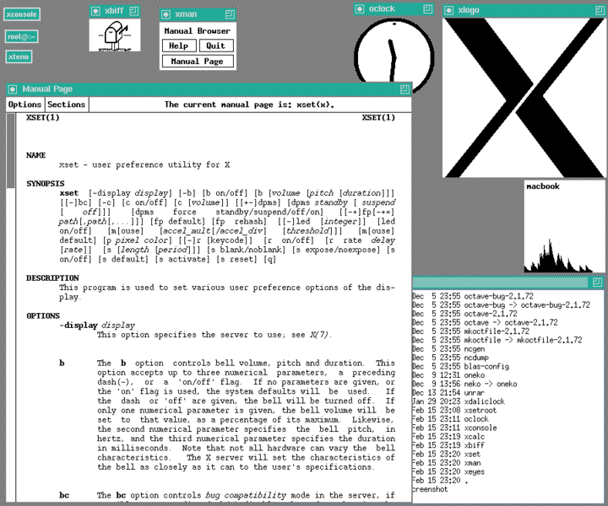
1984 – MIT’s X Window System: hardware-independent platform and networking protocol for developing GUIs on UNIX-like systems
Image: http://en.wikipedia.org/wiki/File:X-Window-System.png

Slide 12
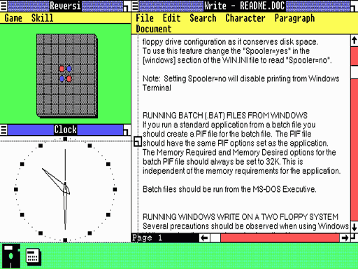
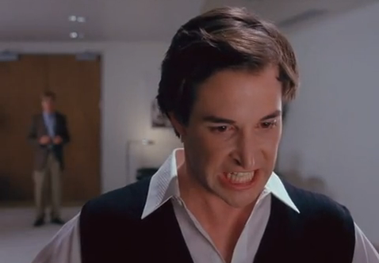
1985 – Windows 1.0 – provided GUI interface to MS-DOS. No overlapping windows (tiled instead).
“You’re stealing from us!” – Steve Jobs to Bill Gates in Pirates of Silicon Valley
Image: http://lowendmac.com/orchard/06/apple-vs-microsoft.html

Slide 13
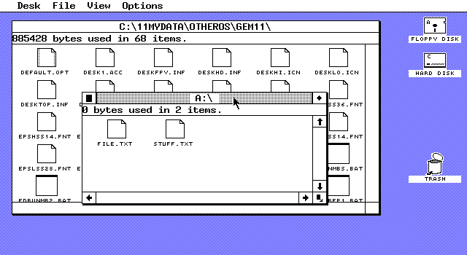
1985 – Microsoft and IBM start work on OS/2 meant to eventually replace MS-DOS and Windows
1986 – Apple threatens to sue Digital Research because their GUI desktop looked too much like Apple’s Mac. Digital Research cripples their desktop so Apple won’t sue
DRI’s GEM 1.1 desktop
http://en.wikipedia.org/wiki/File:Gem_11_Desktop.png

Slide 14
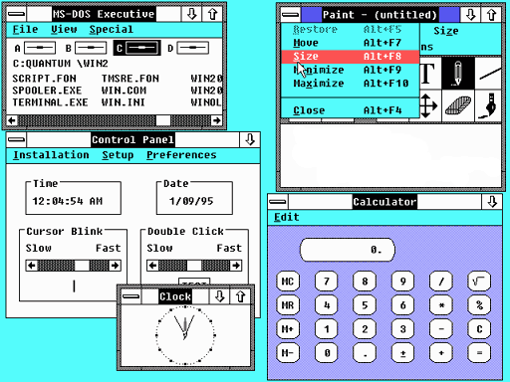
1987 – Windows 2.0 – Overlapping and resizable windows, keyboard and mouse enhancements
Image: http://en.wikipedia.org/wiki/File:Windows_2.0.png

Slide 15
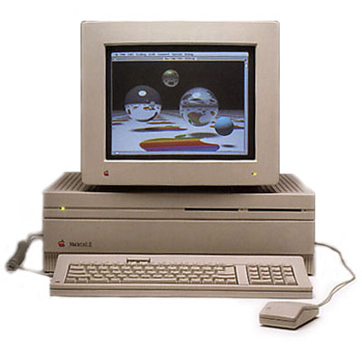
1987 – Macintosh II: first full-color Mac
http://www.techdigest.tv/2009/06/galleries/the_ten_greates.php?pic=1

Slide 16
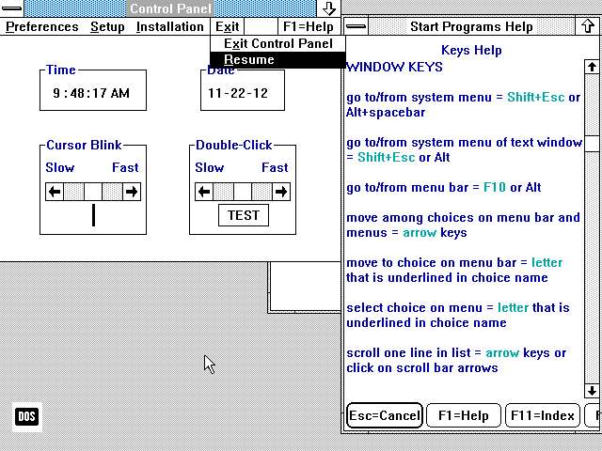
1988 – OS/2 1.10 Standard Edition (SE) has GUI written by Microsoft, looks a lot like Windows 2
“I believe OS/2 is destined to be the most important operating system, and possibly program, of all time.” – Bill Gates (1987)
http://toastytech.com/guis/os211menu.png
Notes:
Exit drop-down. No OK buttons on dialog boxes. 2 years later MS and IBM would have a falling out.

Slide 17
1988 – Apple sues Microsoft claiming Windows 2.0 violates Apple's copyrights on the "visual displays" of the Macintosh. Microsoft countersues and eventually wins in 1993
1989 – Xerox sues Apple for violating copyrights used in Lisa and Macintosh, but judge dismisses lawsuit without any action
1990 – Windows 3.0: Access to 16 MB. Microsoft and IBM split ways on OS/2

Slide 18
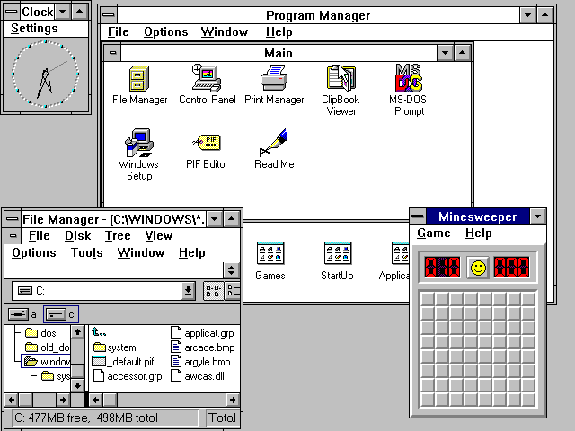
1992 – Windows 3.1 – Widely popular DOS shell: TrueType fonts, multimedia, standardized common dialog boxes
Image: http://en.wikipedia.org/wiki/File:Windows_3.11_workspace.png

Slide 19
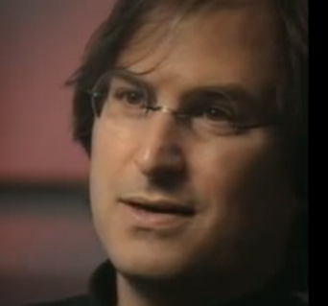
1993 – Windows NT – MS’s first 32 bit OS, no longer a shell over MS-DOS HTML forms incorporate radio buttons, check boxes, drop-down lists, etc.
“We have always been shameless about stealing good ideas.” - Steve Jobs in Triumph of the Nerds (1996)

Slide 20
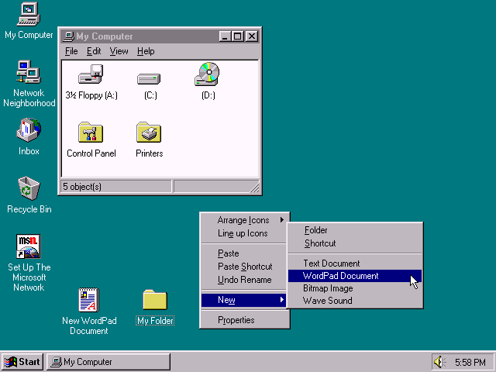
1995 – Windows 95: Revamps Win 3.1 interface, introduces task bar and Start button
http://toastytech.com/guis/win95desktop2.png

Slide 21
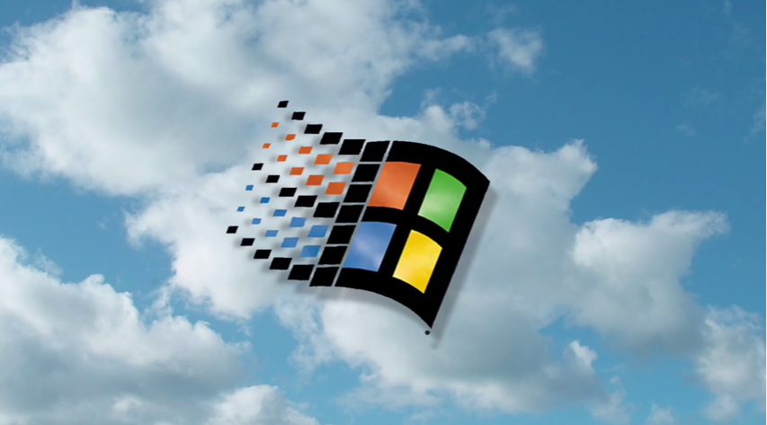
Windows 95 Launch Video
Featuring “Start Me Up” by The Rolling Stones
https://www.youtube.com/watch?v=OPyWDMmYJhQ&t=7s
Notes:
Microsoft paid Rolling Stones $3M to use “Start Me Up” in their marketing campaign.

Slide 22
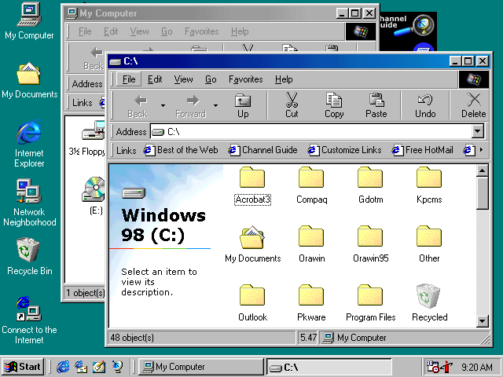
1998 – Windows 98: Integration with Web, IE is bundled with OS (controversy)
http://toastytech.com/guis/win98.html

Slide 23
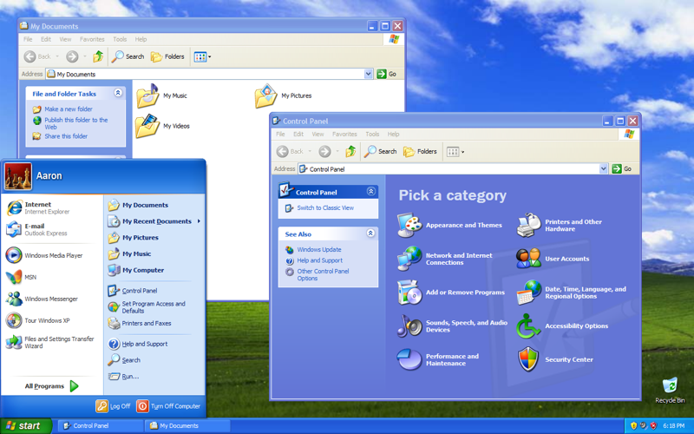
2001 – Windows XP – Product activation, GUI enhancements, support for 64-bit processors
http://en.wikipedia.org/wiki/File:Windows_XP_SP3.png
Notes:
Many businesses still using XP but vulnerable to security problems that MS is no longer fixing.
https://www.wired.com/2017/05/still-use-windows-xp-prepare-worst/

Slide 24
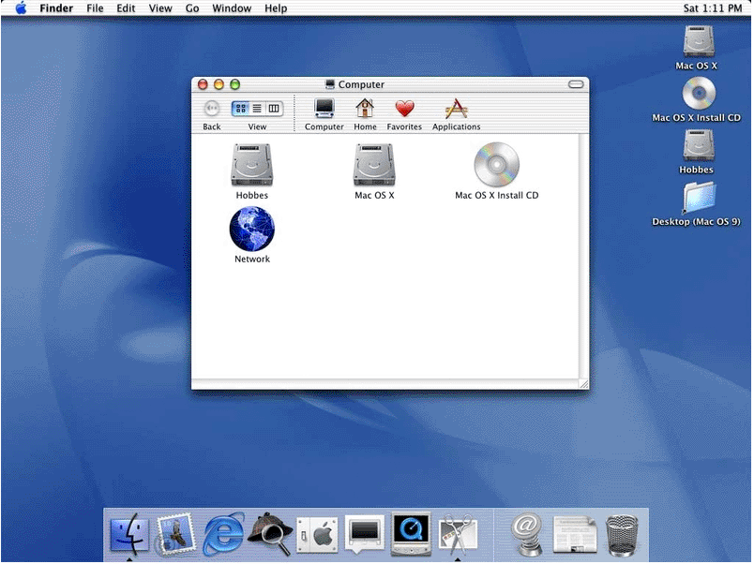
2001 – Apple revamps GUI with MacOS X (BSD Unix core)
Finally able to minimize!
Dock for commonly used apps and minimized apps
Image: http://theoligarch.com/microsoft_vs_apple_history.htm
Notes:
Adds lots of “eye candy” which provides little technical advantage, but users like it.

Slide 25
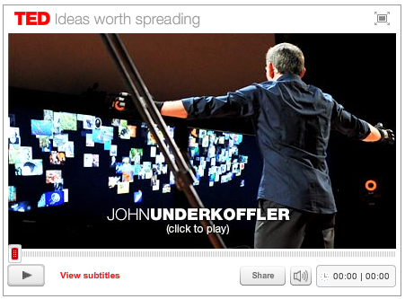
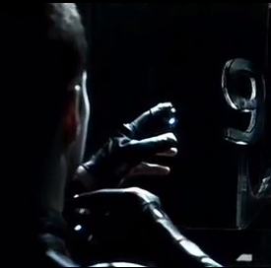
2002 –Minority Report popularizes gesture UI
2005 – Ajax technique coined by Jesse James Garrett, sparks move from desktop apps to web apps
2010 TED talk by John Underkoffler
http://en.wikipedia.org/wiki/File:Ipodwheelwiki.svg

Slide 26
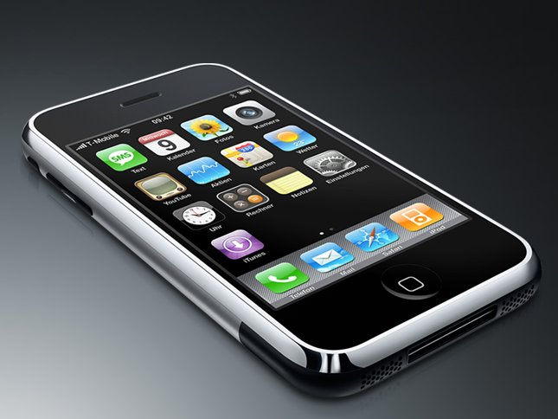
2007 – Apple’s iPhone popularizes the touch screen interface
http://passion-for-iphone.blogspot.com/

Slide 27
2008 – HTML5 working draft proposes UI elements to match desktop app functionality
2010 – Windows 7 introduces few UI tweaks but is commercially successful
2010 – Apple’s iPad brings touch screen interface to the tablet

Slide 28
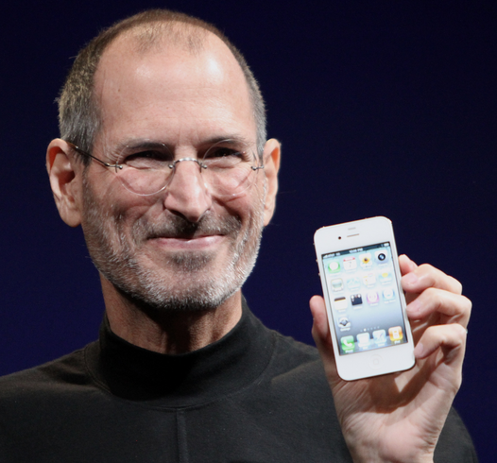
2010 – Apple files lawsuit against HTC (maker of Android phones) claiming 20 patents were violated, some related to iPhone’s UI
2011 – Apple files lawsuit against Samsung for violating patents for iPhone and iPad
“[We] think competition is healthy, but competitors should create their own original technology, not steal ours."

Slide 29
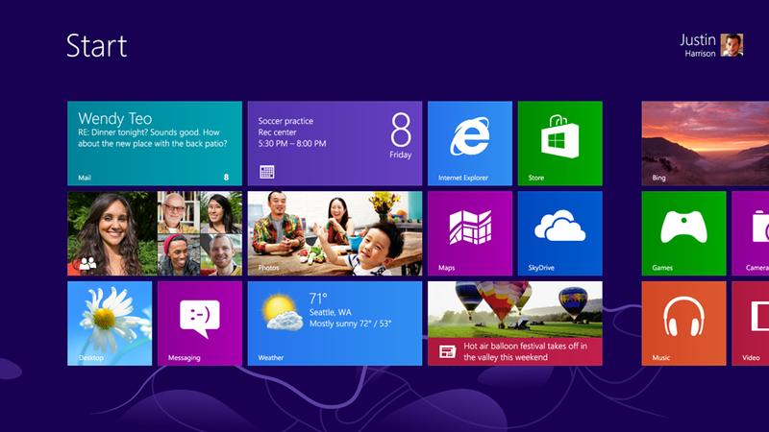
2012 – MS ditches skeuomorphs and uses flat design in Windows 8, brings touch-screen UI to the desktop
Where’s the Start button?
Image: http://en.wikipedia.org/wiki/File:Windows_8_start_screen.png
Notes:
No Start button confuses many. Flat interface removes many visual cues as to what is clickable.

Slide 30
What is a skeumorph?
A derivative object that retains ornamental design cues from inherent structures in the original object
Image: https://en.wikipedia.org/wiki/Skeuomorph#/media/File:Redstair_GEARcompressor.png

Slide 31
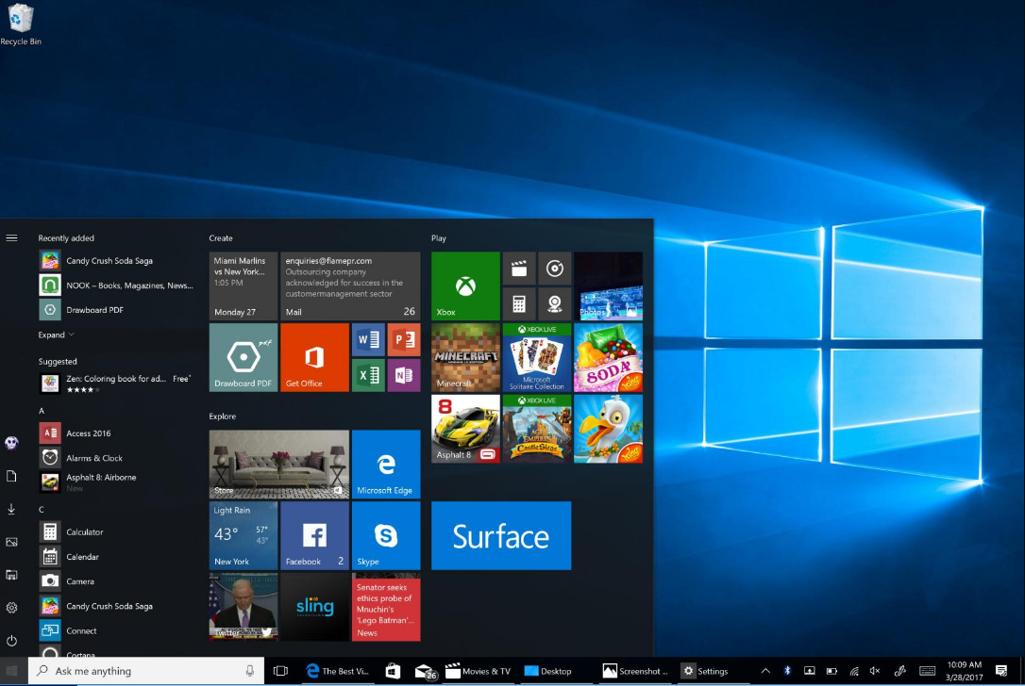
2015 – Windows 10 returns focus to desktop, Cortana personal assistant, Microsoft Edge
https://assets.pcmag.com/media/images/537201-microsoft-windows-10-creators-update-start-screen.jpg?thumb=y&width=1650&height=1100

Slide 32
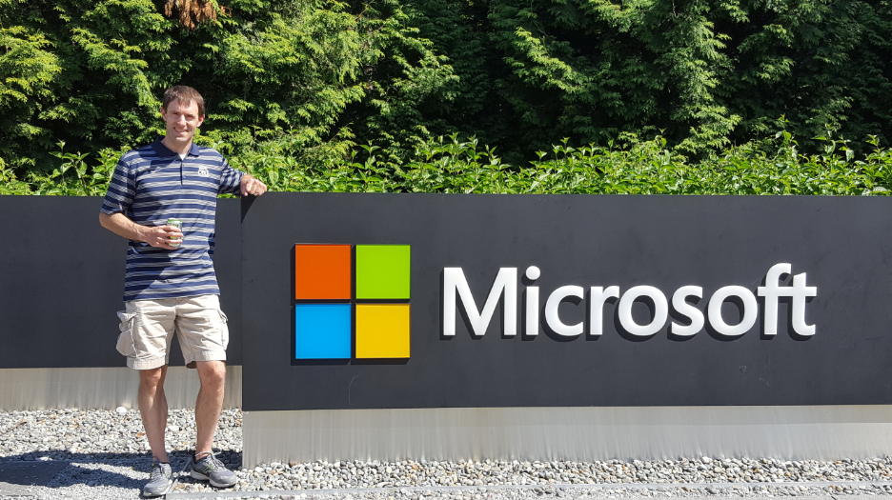
2017 – McCown visits the Microsoft campus in Redmond, WA
This place is HUGE!

