Slide 1
HARDING University Flying BISONS
Flight Readiness Review
A Study of Atmospheric Properties as a Function of Altitude

Slide 2
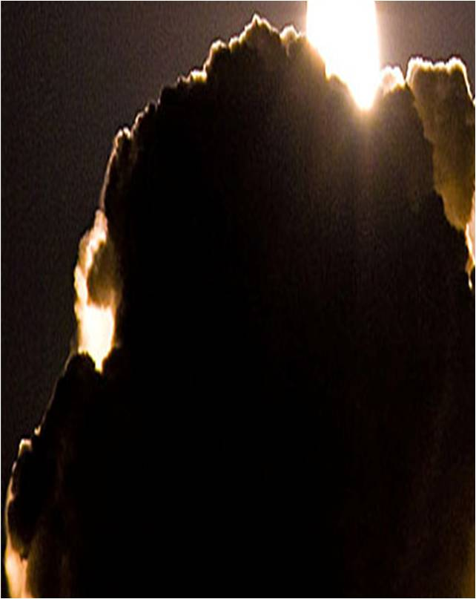
Major Revisions Since CDR
Vehicle Changes
Payload Changes
Other changes
Current progress

Slide 3
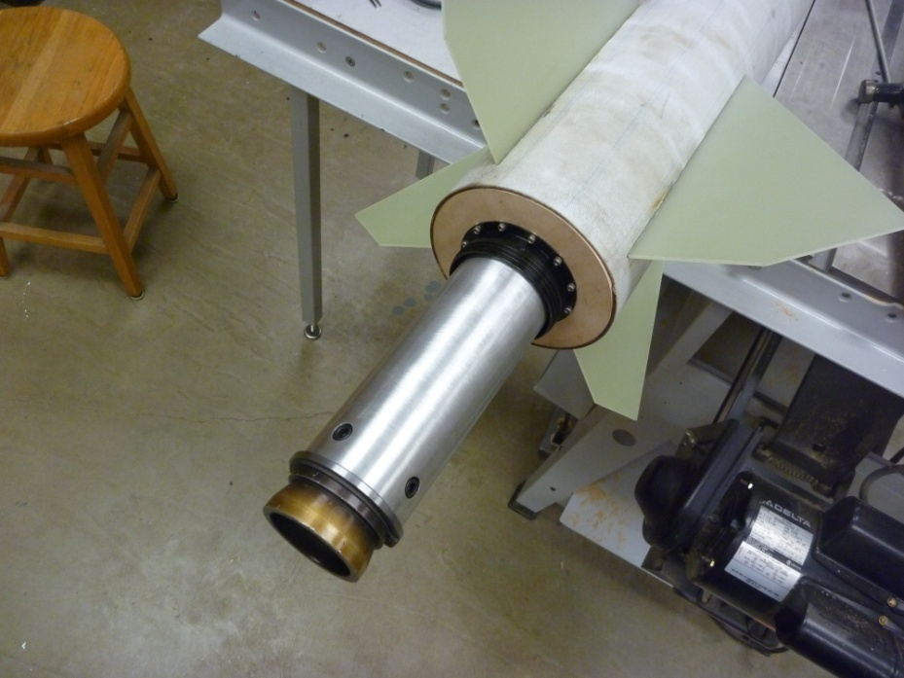
Airframe Design
Final Motor choice
75mm L-1222 hybrid motor from Contrail Rocket
Final sizing
110 inches in length,
and 643 ounces
Larger rocket to
compensate for larger
payload
Notes:
Discuss: flight stability in static margin diagram

Slide 4
Flight Stability
-Center of gravity
-Center of pressure
-Overall stability margin

Slide 5
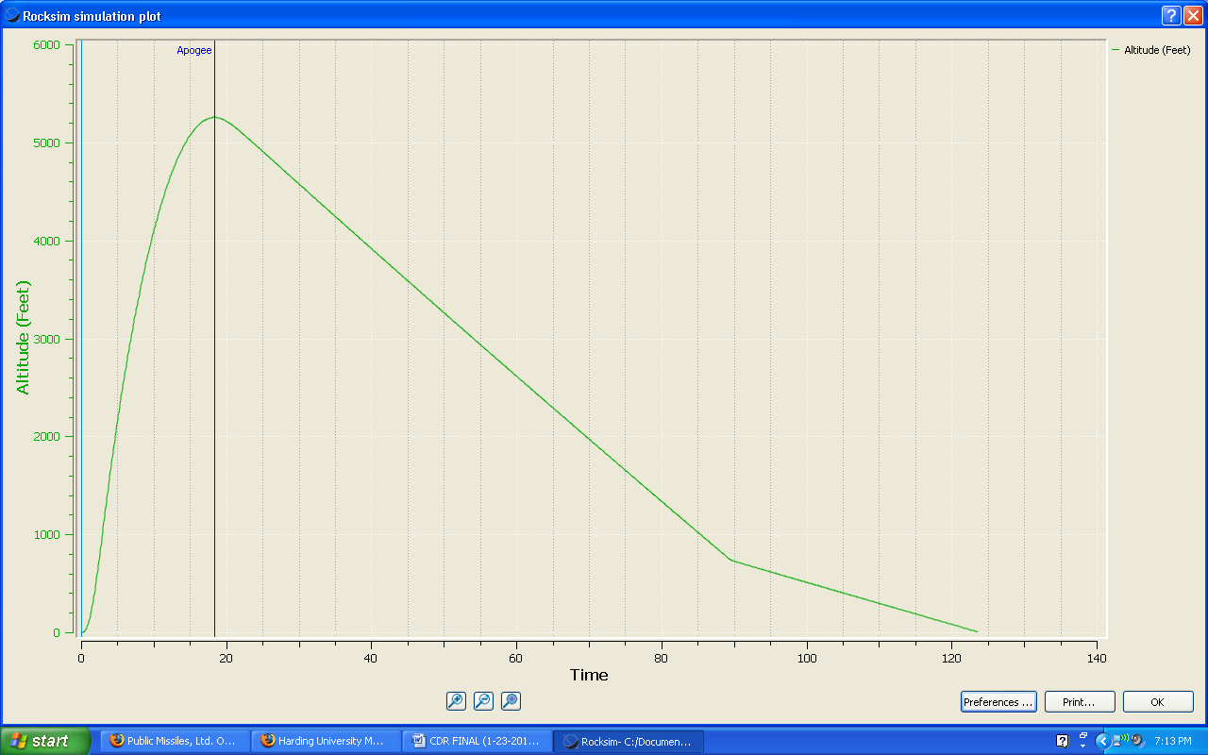
Flight Simulation
-Thrust to weight ratio
-Rail exit velocity
Flight simulation diagrams

Slide 6
Recovery
Parachute sizes
Drogue: 44” SkyAngle,
Deployed at apogee
Main: 120” conical parachute from Public Missiles
Deployed at 800 Feet
Descent rates
Dual deployment avionics tests
Ejection tests
Notes:
Discuss: parachute sizes and descent rates; Dual deployment avionics test

Slide 7
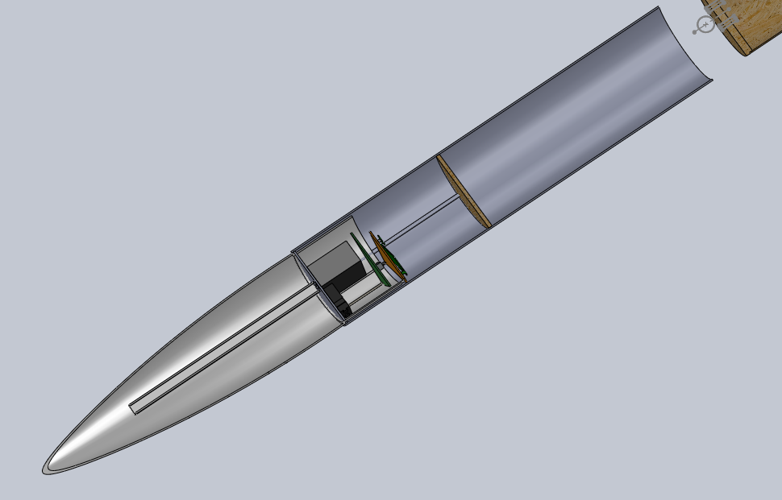
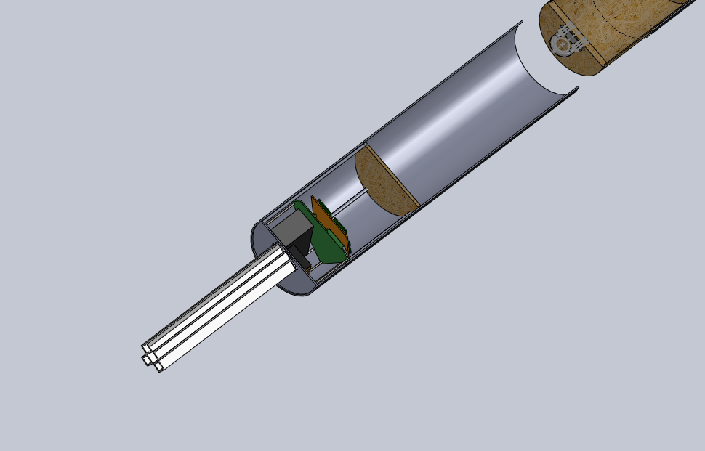
Payload
Integration feasibility
Dimensional fit
Deployment process
Concerns and mitigations
Notes:
Discuss payload integration feasibility

Slide 8
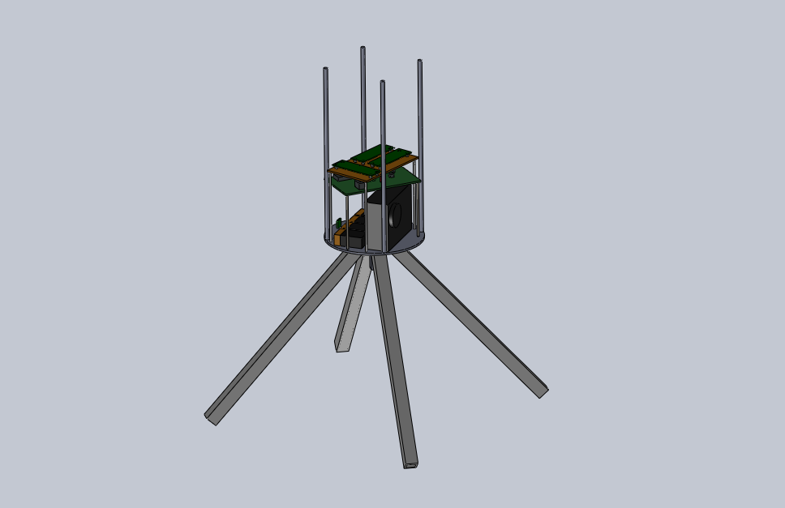
Final Payload Design

Slide 9
Launch Operations
Scale model flight test
Operational procedure
Safety precautions

Slide 10
Educational Engagement
Plan:
Educate about rocketry
Status:
Participated in America Reads Event
Presented the team’s work at the AURC
Set to present team’s work at the ASGC
Notes:
Discuss: educational engagement plan and its status

Slide 11
Plan of Action
Test plans and procedures
Test payload functionality
Full scale flight test
Notes:
Discuss: test plans & procedures; ejection charge amount test

