Slide 1
A Short History of the Internet and Web (Narrated)
Frank McCown
COMP 250 – Internet Development
Harding University
Photos were obtained from the Web, and copyright is held by the respective owners. Short History of Computing by Frank McCown is licensed under a Creative Commons Attribution-NonCommercial 3.0 Unported License

Slide 2
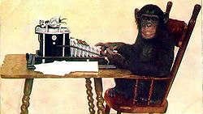
“We've all heard that a million monkeys banging on a million typewriters will eventually reproduce the entire works of Shakespeare. Now, thanks to the Internet, we know this is not true.”
- Robert Wilensky

Slide 3
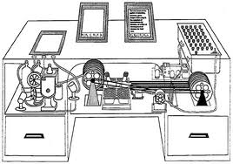
1945 – Vannevar Bush writes about “memex”, a futuristic, automatic, personal library system
1960s – Advanced Research Projects Agency (ARPA) does research on “internetwork”, connecting small and large networks
Notes:
Wikipedia: The memex (a portmanteau of "memory" and "index")^{[1]} is the name of the hypothetical proto-hypertext system that Vannevar Bushdescribed in his 1945 The Atlantic Monthly article "As We May Think" (AWMT).

Slide 4
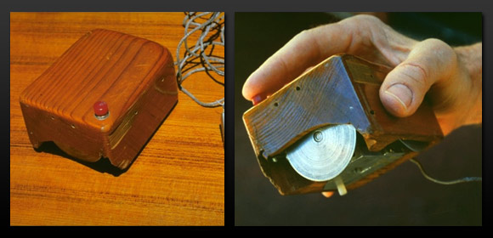
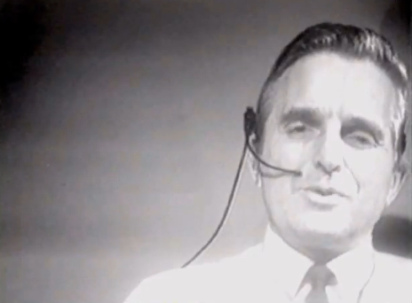
1968 – Doug Engelbart demonstrates NLS, a hypertext system that uses a “mouse”
“The Demo”
http://technologyyz.blogspot.com/2012/12/engelbart-mouse.html
Notes:
On December 9, 1968, Douglas C. Engelbart and the group of 17 researchers working with him in the Augmentation Research Center at Stanford Research Institute in Menlo Park, CA, presented a 90-minute live public demonstration of the online system, NLS, they had been working on since 1962.

Slide 5
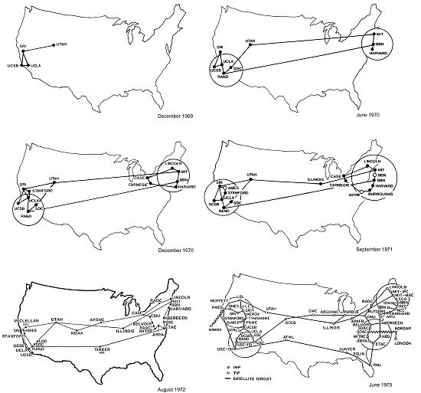
1969 – ARPANET goes online with 4 nodes
Dec 1969
June 1970
Dec 1970
Sept 1971
Aug 1972
June 1975
http://www.mappingcyberspace.com/gallery/figure1_2.html

Slide 6
1969 – Request for Comments (RFC) created for quickly disseminating ideas with other network researchers Telnet allows user to login to a remote computer (RFC 15)
1971 – Ray Tomlinson sends first e-mail (sent to himself and probably read “QWERTYUIOP”) FTP (File Transfer Protocol) allows files to be transferred between computers (RFC 114)

Slide 7
1981 – ARPANET (Internet) has 200 nodes
1982 – ARPANET standardizes its use of TCP/IP (Transmission Control Protocol / Internet Protocol) to send data packets across the network
1983 – Domain Name System (DNS) developed
1985 – NSFNET established, would later become major part of the Internet backbone
1986 – Over 10,000 nodes on ARPANET. US military portion of ARPANET splits off into MILNET (military-only network)

Slide 8
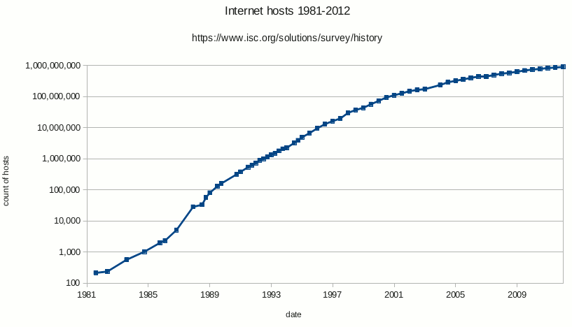
1988 – Over 100,000 nodes on Internet
http://en.wikipedia.org/wiki/File:Internet_host_count_1988-2012_log_scale.png

Slide 9
1988 – First Internet worm by Robert Tappan Morris crashes 6% of servers on Internet IANA established to oversee global IP address allocation (and other)
Images:http://en.wikipedia.org/wiki/Robert_Tappan_Morris

Slide 10
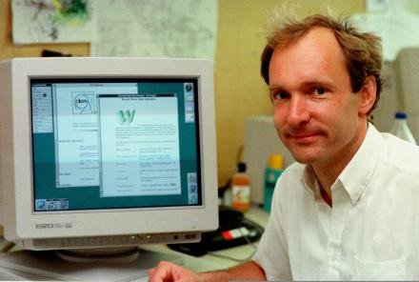
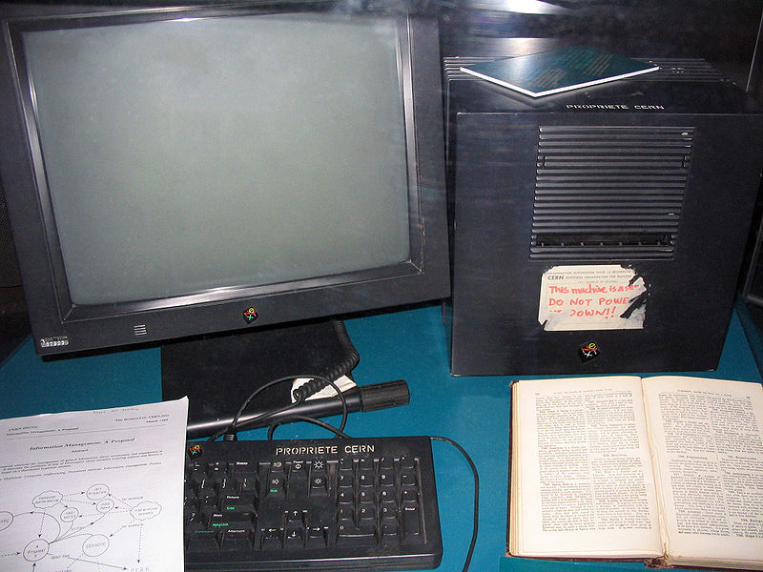
1990 – Tim Berners-Lee and others at CERN develop the WorldWideWeb (WWW), HTML documents transmitted over the Internet by a web server to web browsers using URIs and HTTP (1st web page online on Aug 6, 1991)
Images: http://www.radford.edu/sjennings15/text.htm http://en.wikipedia.org/wiki/Tim_Berners-Lee
Notes:
This NeXT Computer was used by Berners-Lee at CERN and became the world's first Web server.

Slide 11
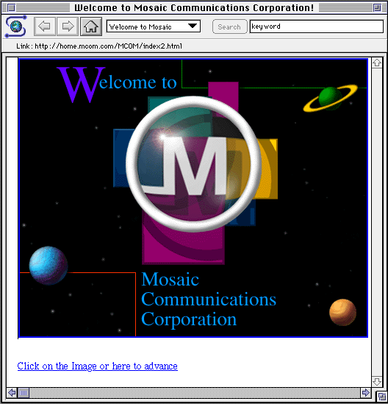
1992 – ViolaWWW browser for UNIX 50 web servers
1993 – 500 web servers Mosaic web browser – multi-platform and 1st browser to display inline images, written by Marc Andreesen
Image: http://en.wikipedia.org/wiki/File:NCSAMosaic1.0Mac.png
Notes:
Mosaic is credited with helping popularize the Web. Many of Mosaic’s developers went on to develop Netscape Navigator although the browsers did not share any of the same code. Netscape’s code descendant is Firefox.

Slide 12
1994 – 2,500 web servers WWW Consortium (W3C) began Netscape 1.0 Yahoo! Web directory started by Jerry Yang and David Filo
Notes:
The word "yahoo" is an acronym for "Yet Another Hierarchical Officious Oracle"

Slide 13
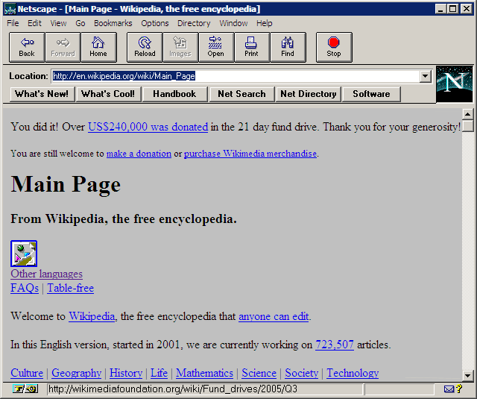
1995 – Netscape 2.0 – Supported plug-ins, frames, Java applets, JavaScript
http://upload.wikimedia.org/wikipedia/en/archive/2/2d/20130405022914!Netscape_2.02.png

Slide 14
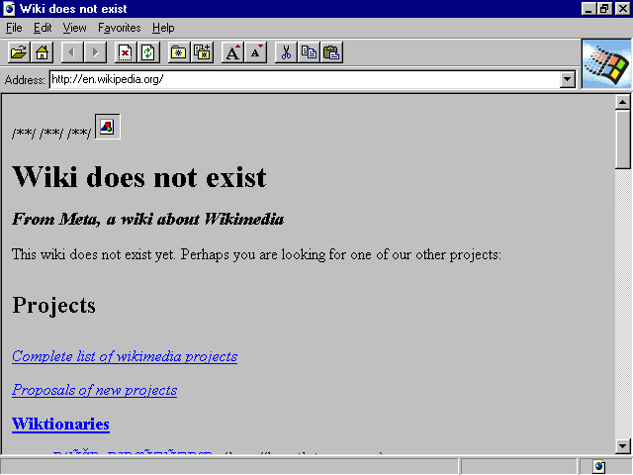
1995 - Internet Explorer 1.0 released by Microsoft
http://en.wikipedia.org/wiki/File:Internet_Explorer_1.0.png
Notes:
IE 1 was bundled for free with Windows 95 and later 98. Kicked off the Browser Wars and United States v. Microsoft
On April 3, 2000, Judge Jackson issued his findings of fact that Microsoft had abused its monopoly position by attempting to "dissuade Netscape from developing Navigator as a platform", that it "withheld crucial technical information", and attempted to reduce Navigator's usage share by "giving Internet Explorer away and rewarding firms that helped build its usage share" and "excluding Navigator from important distribution channels"

Slide 15
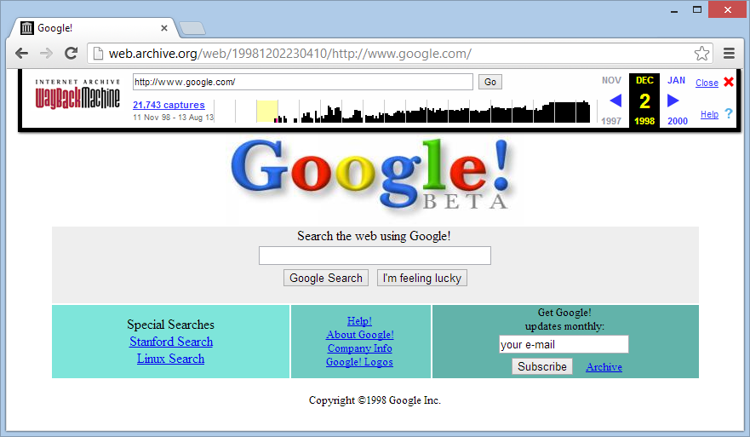
1996 – Macromedia Flash 1.0 (previously called FutureSplash Animator) Internet Archive begins archiving the Web

Slide 16
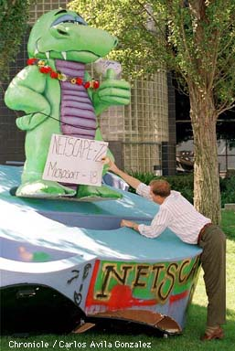
1997 – HTML 4.0 de facto standard Browser Wars I: Netscape vs. IE
“Netscape 72, Microsoft 18”
Image: http://home.snafu.de/tilman/mozilla/stomps.html

Slide 17
1998 – Network Solutions registers 2 millionth domain name Emergence of <XML> ICANN created to manage IP address space and DNS root zone
Notes:
Internet Corporation for Assigned Names and Numbers (ICANN)

Slide 18
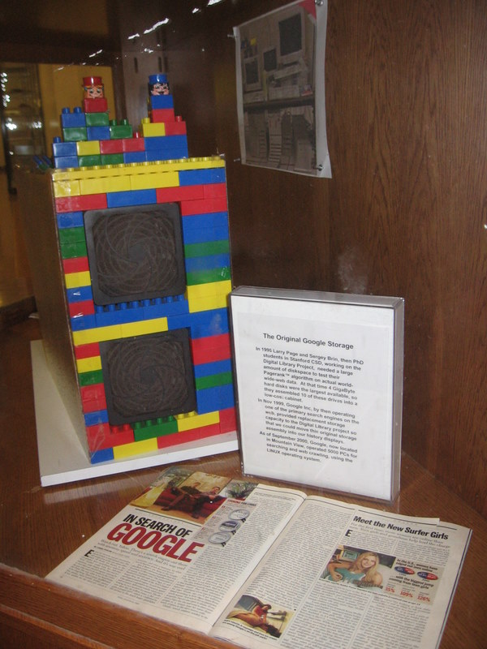
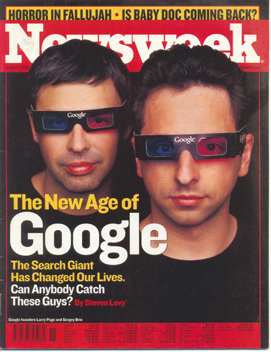
1998 – Google founded by Larry Page and Sergey Brin
Notes:
A photo of the first Google server “Backrub” which is encased in the comp sci building at Stanford Univ.

Slide 19
2000 – Napster sued over music sharing Web size estimates by NEC-RI and Inktomi surpass 1 billion indexable pages. XHTML 1.0 recommended by W3C

Slide 20
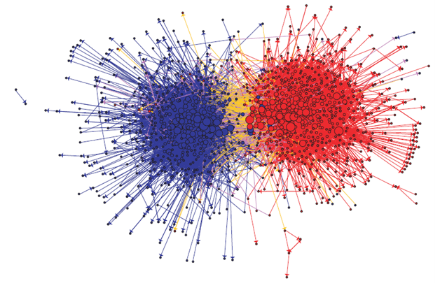
2001 – Wikipedia: encyclopedia that can be edited by anyone
2002 – Blogs become popular
The Political Blogosphere and the 2004 U.S. Election by Adamic & Glance

Slide 21
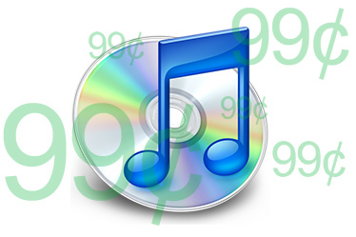
2003 – iTunes.com and other legal Internet music downloading services appear. iTunes.com registers 25th million song download in Dec (“Let It Snow! Let It Snow! Let It Snow!” by Frank Sinatra).
Image: http://www.engadget.com/2007/10/16/apple-officially-cuts-drm-free-track-prices-to-99/
Notes:
In Feb 2010, the 10 billionth song, “Guess Things Happen That Way” by Johnny Cash, was downloaded by Louie Sulcer of Woodstock, Georgia.

Slide 22
2003 – Security problems
SQL Slammer worm - largest and fastest spreading distributed denial of service (DDoS) attacks ever
Sobig.F virus - the fastest spreading virus ever
Blaster (MSBlast) worm – one of the most damaging worms ever
Image: http://www.lbl.gov/ITSD/CIS/compnews/2003/August/01-Sobig-worm.html
Notes:
Virus: Attaches itself to a program or files. It is usually attached to an executable file, and it can’t infect your computer unless you run or open the file, so it can’t spread without human action.
Worm: Type of virus that can travel without human interaction. It uses a transportation feature of the infected system, like email or network connections so it can duplicate itself.

Slide 23
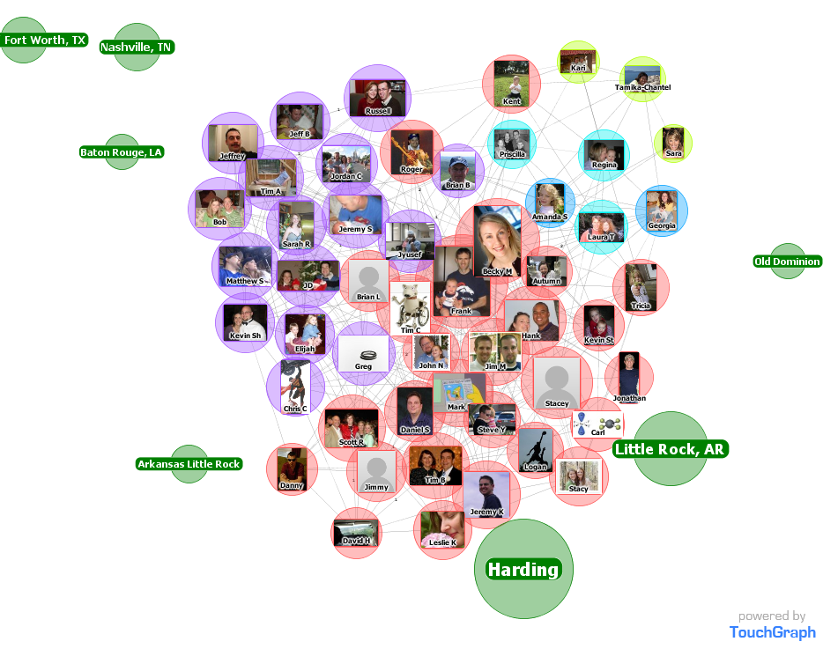
2004 – MySpace and Facebook popularize online social networks

Slide 24
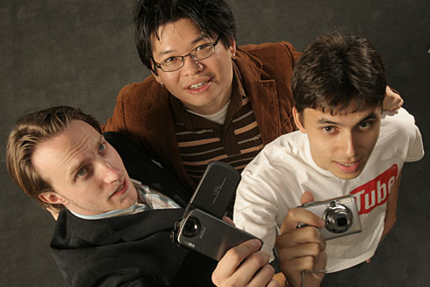
2005 – YouTube founded by three former PayPal employees and sold to Google the next year for $1.65B
Image: http://www.usatoday.com/tech/news/2006-10-11-youtube-karim_x.htm
Notes:
YouTube co-founders: Chad Hurley, Steve Chen, and Jawed Karim

Slide 25
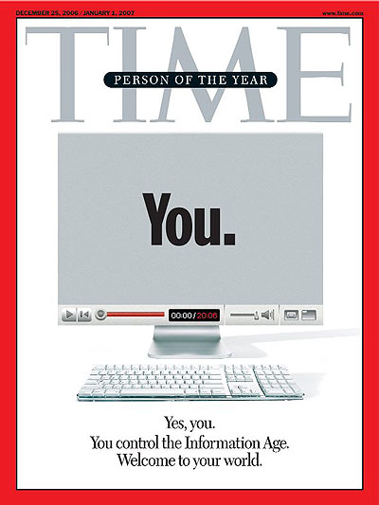
2006 – Twitter launches 140 character limit micro-blogging service Time Magazine’s person of the year: You. Acknowledges significance of user- generated content (Web 2.0)

Slide 26
2007 – One of the first massive cyber attacks: Estonian websites attacked by Russian hackers after relocating the Bronze Solider of Tallinn monument
Image: http://en.wikipedia.org/wiki/File:Tallinn_Bronze_Soldier_-_May_2006_-_029.jpg

Slide 27
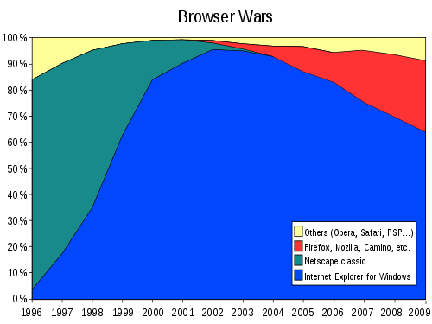
2008 – Firefox 3 sets Guinness World Record for the “largest number of software downloads in 24 hours.” (8M downloads)
Image: http://en.wikipedia.org/wiki/File:Browser_Wars.svg

Slide 28
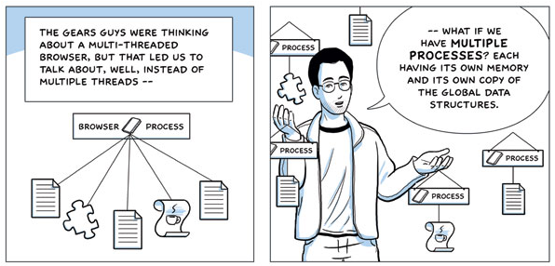
2008 – Google releases the Chrome web browser
Image: http://www.google.com/googlebooks/chrome/big_04.html

Slide 29
2008 – W3C releases First Public Working Draft of HTML5 spec
2012 – ICANN reveals 1,410 new generic top-level domains (gTLDs) like .apple, .catholic, and .dad
2013 – Mobile devices account for 18% of all web page views (StatCounter)
Notes:
HTML5 is currently a “candidate recommendation” and will become an official “recommendation” in 2014.

Slide 30
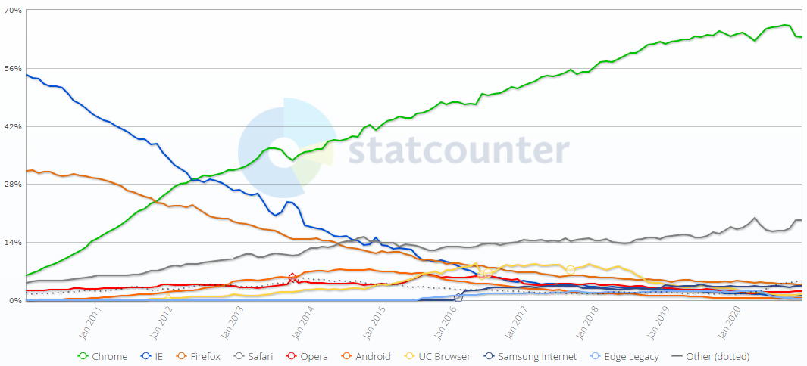
2020 – Chrome remains the dominant browser (Statcounter)
https://gs.statcounter.com/browser-market-share#monthly-201001-202012
Notes:
HTML5 is currently a “candidate recommendation” and will become an official “recommendation” in 2014.

