Slide 1
A Short History of Computing (Narrated)
Dr. Frank McCown Harding University Computer Science Dept
Photos were obtained from the Web, and copyright is held by the respective owners. Short History of Computing by Frank McCown is licensed under a Creative Commons Attribution-NonCommercial 3.0 Unported License

Slide 2
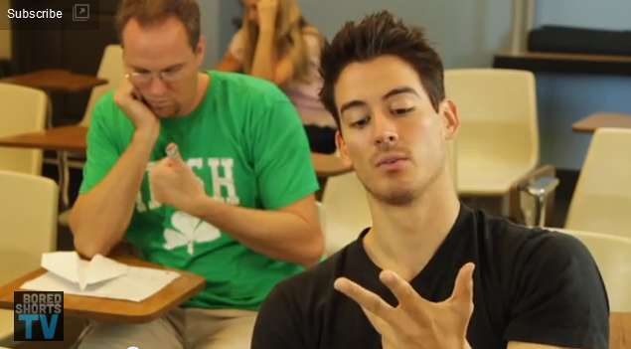
Fingers!
Digit: Latin for fingers
Kid Snippets: "Math Class" (Imagined by Kids) http://www.youtube.com/watch?v=KdxEAt91D7k

Slide 3
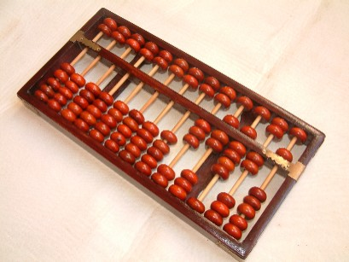
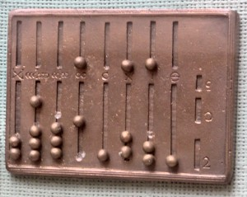
Abacus
Various forms date back to 2300 BC
Asian abacus
Roman abacus
http://en.wikipedia.org/wiki/File:Boulier1.JPG http://en.wikipedia.org/wiki/File:RomanAbacusRecon.jpg
Notes:
Wikipedia: The abacus, also called a counting frame, is a calculating tool used primarily in parts of Asia for performing arithmetic processes. Today, abacuses are often constructed as a bamboo frame with beads sliding on wires, but originally they were beans or stones moved in grooves in sand or on tablets of wood, stone, or metal. The abacus was in use centuries before the adoption of the written modern numeral system.

Slide 4
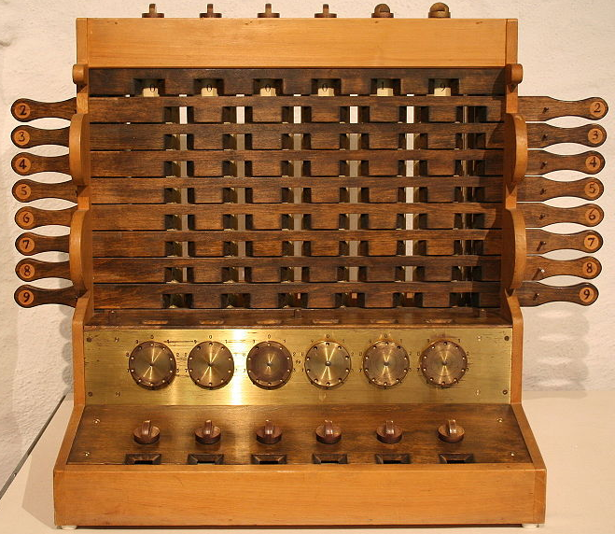
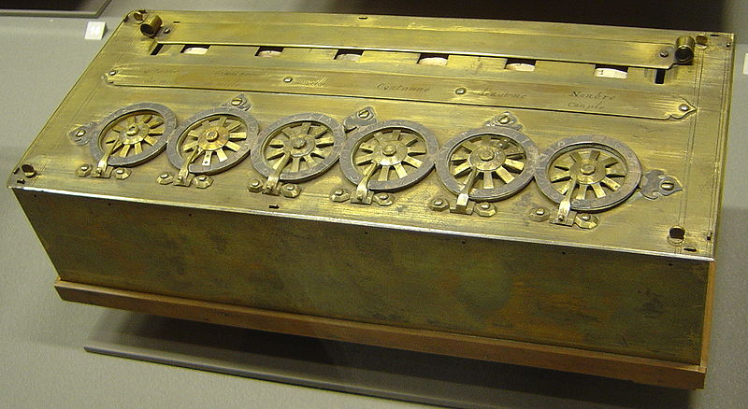
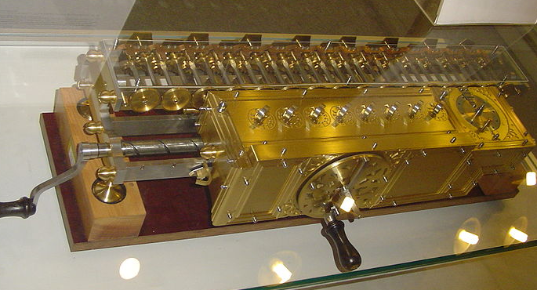
1600s: Mechanical Calculating Machines
1642: Blaise Pascal’s Pascaline
1610: Wilhelm Schickard’s calculating machine
1694: Gottfried Leibniz’s mechanical calculator
Photos courtesy of Wikipedia
Notes:
Wilhelm Schickard’s Calculating Machine - First mechanical calculating device that could add and subtract 6-digit numbers. All that is known about the machine is due to letters between Schickard and Johannes Kepler.
Blaise Pascal invents a mechanical calculator at age 19; does addition and subtraction only. On display at the Musée des Arts et Métiers, Paris Inv 823-1
Gottfried Wilhelm Leibniz invents a mechanical calculator that can perform + - x /. Only two machines were made. Display item from the Technische Sammlungen museum in Dresden, Germany.

Slide 5
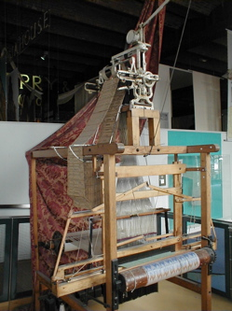
1801: Jacquard Loom
Joseph Jacquard invents loom that is “programmed” using punched cards
Machines replacing humans gives rise to fears: During the Industrial Revolution, Luddites broke into factories and mills and destroyed as many machines as possible
http://en.wikipedia.org/wiki/File:Jacquard.loom.full.view.jpg
Notes:
Jacquard loom on display at the Manchester museum of science and industry. Photograph taken by George H. Williams in July, 2004.

Slide 6
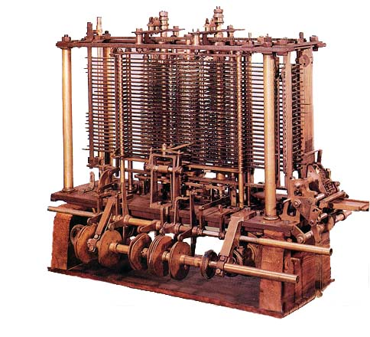
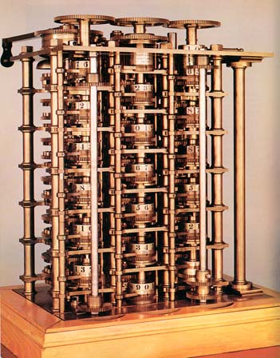
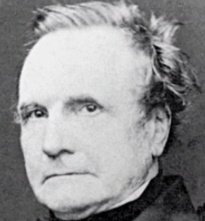
1860s: Babbage’s Engines
Charles Babbage invents (but never completely builds) two machines:
1) Difference Engine – To solve polynomial equations
2) Analytical Engine – General purpose machine, precursor to the computer
http://www.tcf.ua.edu/Classes/Jbutler/T389/ITHistoryOutline.htm http://www.gprok.gr/blog/wp-content/uploads/2010/03/analytical_engine.jpg
Notes:
Analytical Engine was to be the size of a locomotive. Completely mechanical, steam-powered. Had about 1K of memory. Used punch cards to program it. http://www.ted.com/talks/lang/en/john_graham_cumming_the_greatest_machine_that_never_was.html

Slide 7
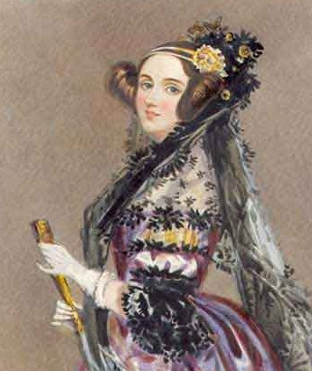
Mid 1800s: Ada Lovelace
Ada Lovelace, daughter of the poet Lord Byron, worked with Babbage on the Analytical Engine
Programmed Analytical Engine using punched cards
Considered first computer programmer
Ada programming language named after her
http://en.wikipedia.org/wiki/File:Ada_lovelace.jpg
Notes:
Jacquard loom on display at the Manchester museum of science and industry. Photograph taken by George H. Williams in July, 2004.

Slide 8
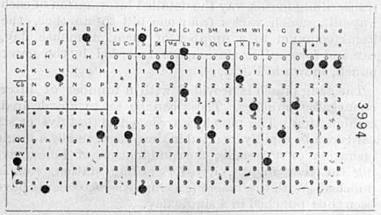
1890: Hollerith’s Census Machines
Herman Hollerith developed a machine for tabulating US census which used punched cards
1880 census took 8 years to tabulate
1890 census took 1 year
Hollerith’s Tabulating Machine Company later became part of IBM
http://en.wikipedia.org/wiki/File:Hollerith_punched_card.jpg

Slide 9
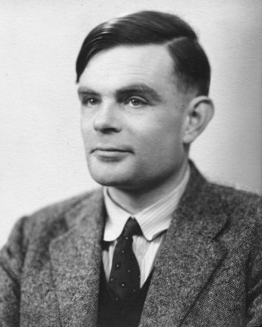
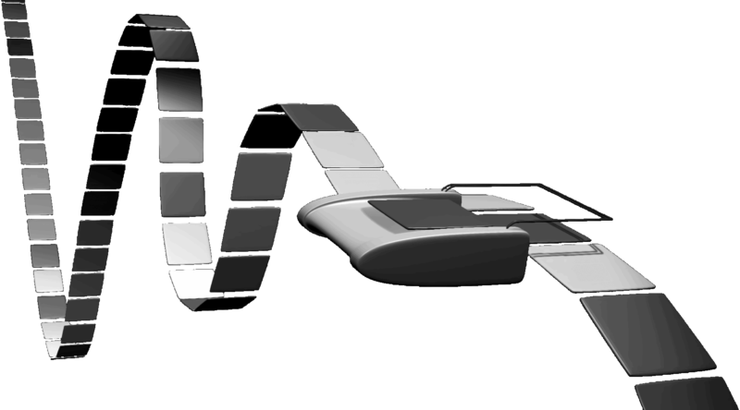
1936: Turing Machine
Alan Turing, considered the father of computer science, described a theoretical device called the Turing machine or “a-machine”. Formalized the concepts of computation and algorithms
Turing later helped crack German military codes during World War II
http://en.wikipedia.org/wiki/File:Alan_Turing_photo.jpg http://en.wikipedia.org/wiki/File:Maquina.png

Slide 10
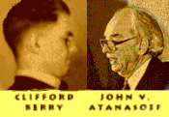
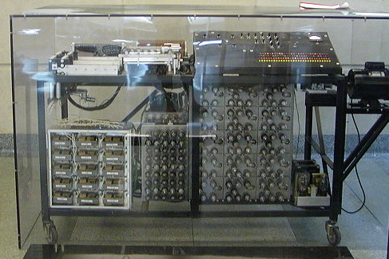
1939: Atanasoff-Berry Computer
John Atanasoff and Clifford Berry built the ABC at Iowa State which found solutions to systems of linear equations
Considered first fully electronic digital computing device, but was not programmable or fully functional
http://inventors.about.com/library/inventors/blatanasoff_berry.htm
http://en.wikipedia.org/wiki/File:Atanasoff-Berry_Computer_at_Durhum_Center.jpg
Notes:
Replica at Iowa State Univ.

Slide 11
Infamous Quotes
“I think there is a world market for maybe five computers.”
-Thomas Watson Senior, Chairman of IBM, in 1943
This would remain true for 10 more years.

Slide 12
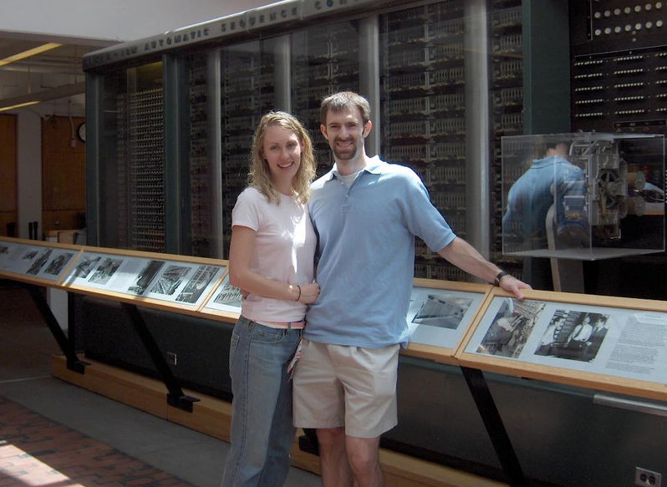
1944: Harvard Mark I
Howard Aiken designs Mark I, the first operational general-purpose electro-mechanical computer. Financed and built at IBM
On display at Harvard University
http://www.harding.edu/fmccown/photos/mark1_harvard.jpg
Notes:
Wikipedia: It could do three additions or subtractions in a second. A multiplication took six seconds, a division took 15.3 seconds, and a logarithm or a trigonometric function took over one minute.

Slide 13
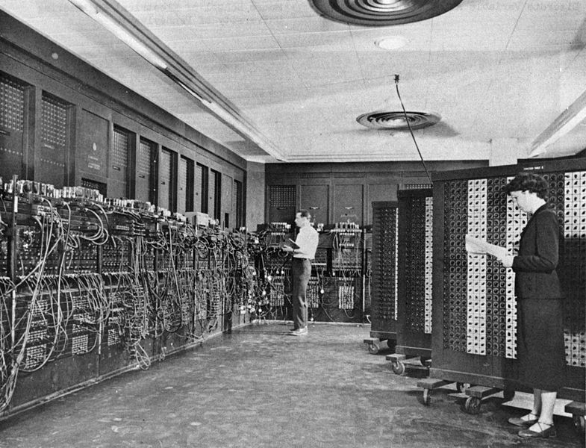
1946: ENIAC
John Mauchley and Presper Eckert complete the Electronic Numerical Integrator and Calculator (ENIAC) at Univ of Pennsylvania. Much based on Atanasoff’s ABC
First general purpose, digital electronic computer
Could compute a ballistic firing trajectory in 20 sec vs. 30 min conventional way
Dimensions: 30 x 30 feet
Weight: 30 tons
Powered by 18,000 vacuum tubes
http://en.wikipedia.org/wiki/File:Eniac.jpg

Slide 14
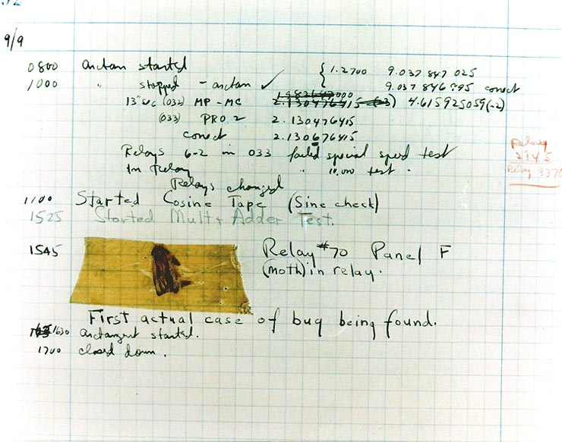
1947: Computer Bug
Computer operators working with Grace Murray Hopper on Harvard’s Mark II computer discover a “bug”, a moth lodged in the components, and paste it into the computer’s logbook which now resides in Smithsonian
http://en.wikipedia.org/wiki/File:H96566k.jpg
Notes:
A moth is not a true bug.
“Bug” term actually pre-dates computers; Thomas Edison used it in 1878

Slide 15
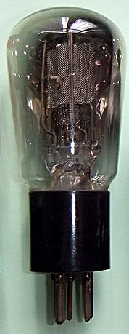
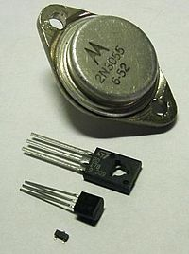
1947: Transistor
Bell Labs develops the transistor (right), an electronic switch made with a small piece of silicon with added impurities. It’s smaller, uses less power, more reliable, and cheaper to produce than vacuum tubes (left)
http://en.wikipedia.org/wiki/File:Triody_var.jpg http://en.wikipedia.org/wiki/File:Transistorer_(croped).jpg

Slide 16
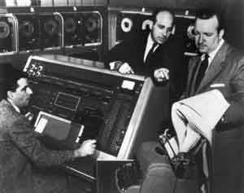
1951: UNIVAC I
UNIVersal Automatic Computer I (UNIVAC I), designed principally by Eckert and Mauchly, is the first commercially successful computer
Price: $1.25M - $1.5M
Units Produced: 46
Sweeney (left) and Eckert (center) demonstrate the U.S. Census Bureau's UNIVAC for CBS reporter Walter Cronkite (right).
http://en.wikipedia.org/wiki/File:UNIVAC_1_demo.jpg

Slide 17
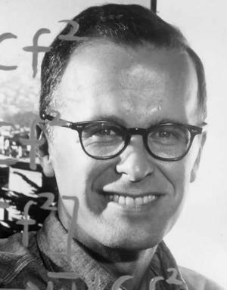
1954: FORTRAN
John Backus and IBM develop FORTRAN, the first successful high-level programming language and compiler
Designed for scientific problems and still widely used today
http://www.smh.com.au/news/technology/programming-language-pioneer-passes-away/2007/03/21/1174153117713.html

Slide 18
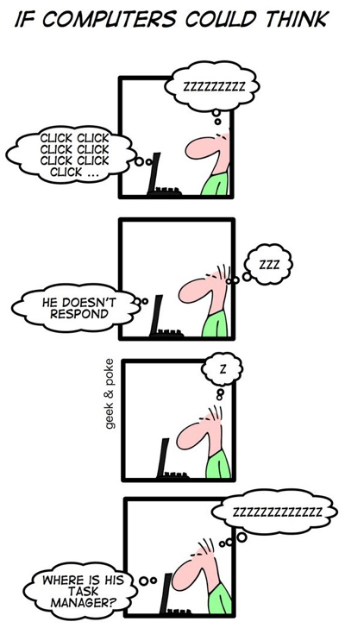
1955: Logic Theorist
The first artificial intelligence program written by Allen Newell, Herbert Simon and J. C. Shaw mimicked the problem solving skills of a human by proving math theorems
The term artificial intelligence (AI) would be coined in 1956 at the Dartmouth summer research project on artificial intelligence
http://itmanagement.earthweb.com/cnews/article.php/3883606/Tech-Comics-If-Computers-Could-Think.htm

Slide 19
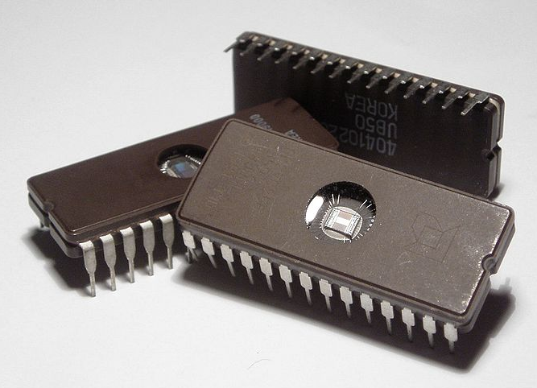
1958: Integrated Circuit
Integrated circuits (chips) independently co-invented by Jack Kilby of Texas Instruments and Robert Noyce of Fairchild Semiconductor
Transistors, and other electronic components all fabricated on single chip of silicon
Chip in DIP (Dual Inline Package)
http://en.wikipedia.org/wiki/File:Microchips.jpg

Slide 20
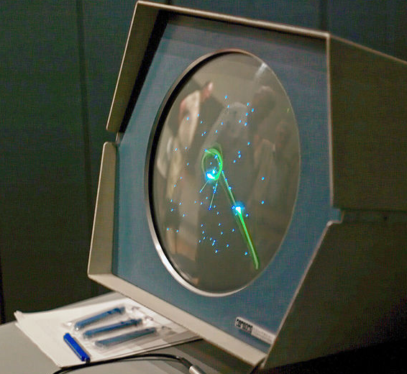
1962: Spacewar!
Spacewar! is the first computer game, written by Steve Russell (from MIT) and his small team for the PDP-1 computer
Spacewar! running on PDP-1
http://en.wikipedia.org/wiki/File:Spacewar!-PDP-1-20070512.jpg

Slide 21
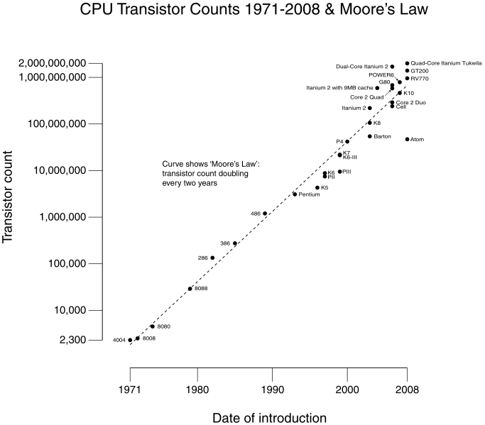
1965: Moore’s Law
Gordon Moore, a co-founder of Intel, predicts that the number of transistors which can be placed on a single chip will double every year. The prediction was later modified to every 2 years, but it has held steady and was dubbed “Moore’s Law” around 1970
http://en.wikipedia.org/wiki/File:Transistor_Count_and_Moore's_Law_-_2008.svg

Slide 22
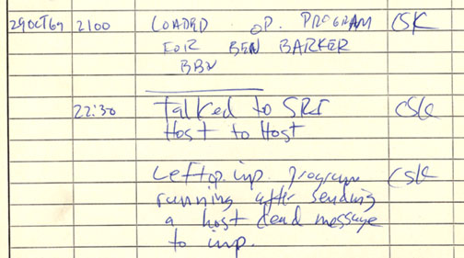
1969: ARPANET
ARPANET, which eventually becomes the Internet, goes online with 4 nodes. Department of Defense sponsors ARPA (Advanced Research Projects Agency) to build a robust interconnected network of geographically distant computers
ARPANET IMP log showing Charles S. Kline sent first message ever on ARPANET on Oct 29, 1969
http://en.wikipedia.org/wiki/ARPANET

Slide 23
1970: UNIX
UNIX operating system developed at Bell Laboratories by Ken Thompson, Dennis Ritchie, Brian Kernighan, and others. Re-written in 1972 using the C programming language
Several variations of UNIX are popular today: Mac OS X, Linux, BSD

Slide 24
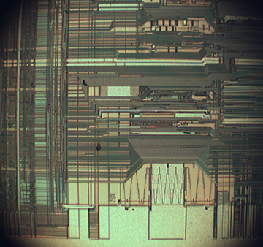
1971: Microprocessor
Microprocessor: entire CPU fits on a single chip. Three companies developed the microprocessor independently at the same time: Texas Instruments, Intel, and Garrett AiResearch
Look through microscope (200x) at Intel microprocessor
http://en.wikipedia.org/wiki/File:80486DX2_200x.png

Slide 25
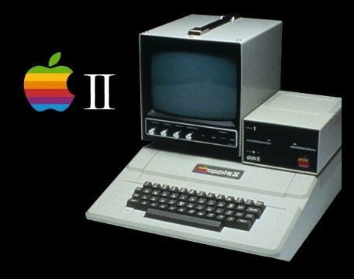
1977: Apple II Personal Computer
Apple II, designed primarily by Steve Wozniak, was the first highly successful, mass-produced personal computers (PCs)
Price: $1300 for model with 4 KB RAM, $2600 for 48 KB RAM model
http://img258.imageshack.us/i/appleiipd2.jpg/

Slide 26
Infamous Quotes
“There is no reason anyone would want a computer in their home.”
-Ken Olson, President and Founder of Digital, in 1977

Slide 27
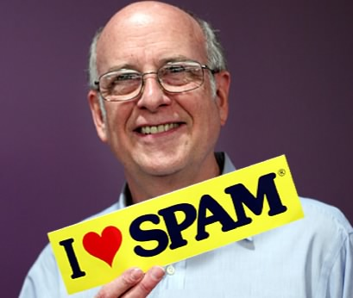
1978: Spam!
DIGITAL WILL BE GIVING A PRODUCT PRESENTATION OF THE NEWEST MEMBERS OF THE DECSYSTEM-20 FAMILY; THE DECSYSTEM-2020, 2020T, 2060, AND 2060T. THE DECSYSTEM-20 FAMILY OF
<cut>
PRESENTATIONS WE WILL BE GIVING IN CALIFORNIA THIS MONTH. THE LOCATIONS WILL BE:
THURSDAY, MAY 11, 1978 - 2 PM DUNFEY'S ROYAL COACH SAN MATEO, CA (4 MILES SOUTH OF S.F. AIRPORT AT BAYSHORE, RT 101 AND RT 92)
Gary Thuerk, an aggressive DEC marketer, attempted to send the first commercial spam message to every Arpanet address on the west coast (393 recipients)
http://www.thocp.net/reference/internet/spam.htm

Slide 28
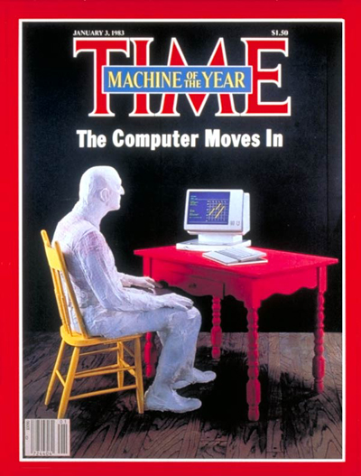
1981: IBM Personal Computer
IBM develops a PC with an Intel microprocessor and Microsoft’s DOS operating system
Price started at $1,565
300,000 sold in 1981;
3,274,000 sold in 1982
PC named “Machine of the Year” in 1982
http://www.time.com/time/covers/0,16641,19830103,00.html

Slide 29
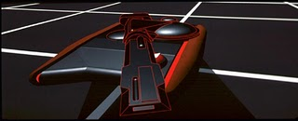
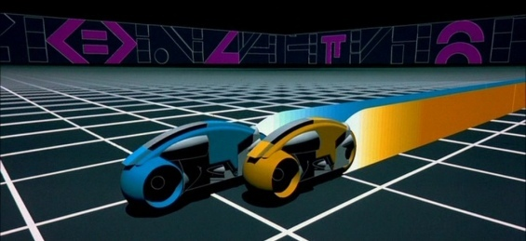
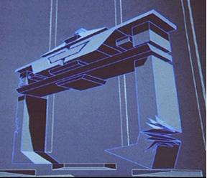
1982: Tron Movie
Disney’s Tron, a movie about the fictional world inside a computer, is the first major film to use extensive 3D computer graphics
http://cutprintreview.com/reviews/4-stars/tron-1982-review/ http://deep-structure.blogspot.com/2007/06/tron.html

Slide 30
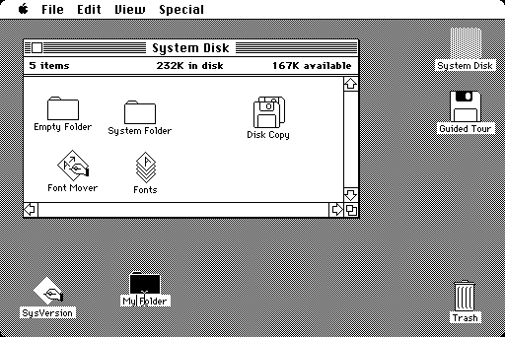
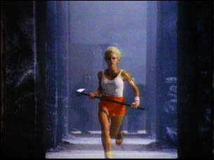
1984: Apple’s Macintosh
Apple Computers (Steve Jobs and Steve Wozniak) developed the Macintosh which popularized the graphical user interface (GUI)
Apple’s iconic 1984 commercial promoting the Macintosh was the most expensive commercial ever produced at the time (about $1 million) and played only once during the Super Bowl
http://en.wikipedia.org/wiki/File:Apple_Macintosh_Desktop.png http://www.youtube.com/watch?v=R706isyDrqI

Slide 31
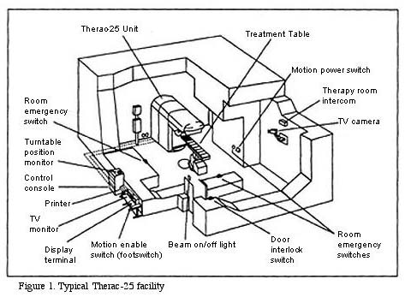
1985-87: Therac-25
Therac-25 provided radiation therapy to patients with cancer
Several software bugs caused radiation overdoses leading to five deaths and other serious injuries
Highlights seriousness of writing software and difficulty in finding bugs
http://computingcases.org/case_materials/therac/analysis/SocioTechnical_Analysis.html

Slide 32
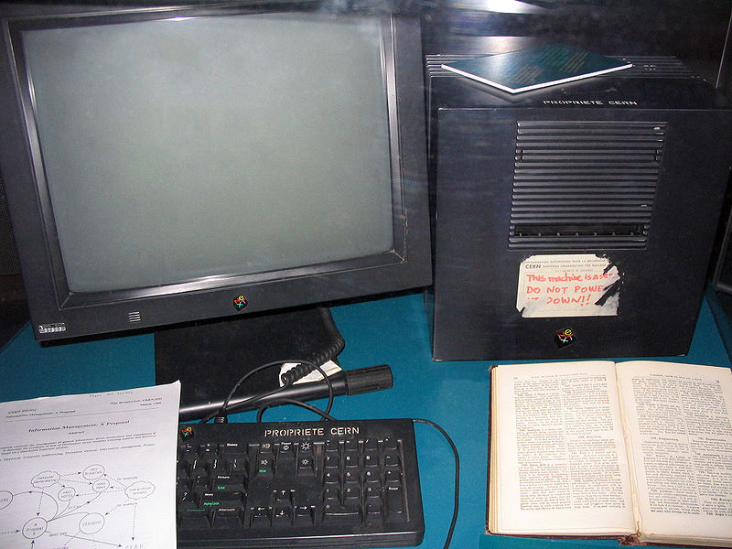
1990: World Wide Web
Tim Berners-Lee at CERN develops the WWW, a global web of interconnected documents, which runs on top of the Internet
The Web would become popular several years later when Netscape develops an easy-to-use web browser
Berners-Lee’s NeXT Computer which was the world’s first web server
http://en.wikipedia.org/wiki/Tim_Berners-Lee

Slide 33
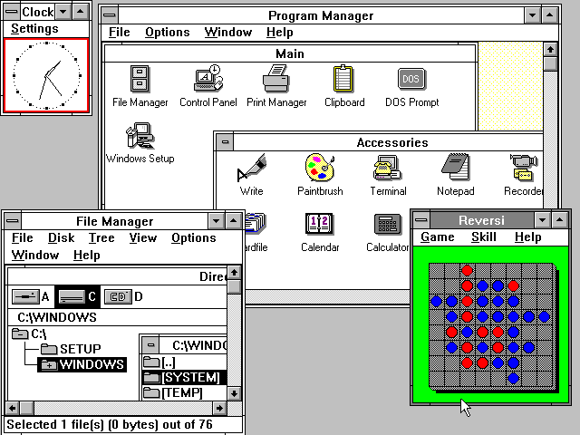
1992: Microsoft Windows
Microsoft (Bill Gates) releases Windows 3.1, the first version of Windows that was widely successful
http://en.wikipedia.org/wiki/File:Windows_3.0_workspace.png

Slide 34
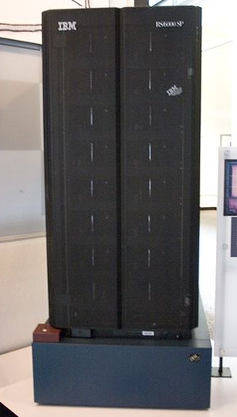
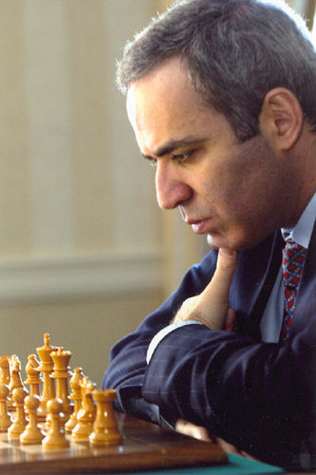
1997: Deep Blue
IBM's Deep Blue computer defeats world chess champion Garry Kasparov in their second six-game showdown, becoming the first computer system to defeat a reigning world champion under standard chess tournament time controls
http://en.wikipedia.org/wiki/File:Deep_Blue.jpg
http://en.wikipedia.org/wiki/File:Kasparov-29.jpg

Slide 35
Infamous Quotes
“I wouldn’t put my company on the Internet.”
-Ken Olson, Chairman Modular Computer Systems, in 1996

Slide 36
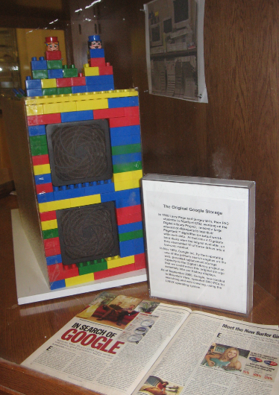
1998: Google
Ph.D. students Larry Page and Sergey Brin drop out of Stanford to create Google, a Web search engine which uses their novel PageRank algorithm to order search engine results
Google originated from a misspelling of googol which is 1 followed by 100 zeros
Google’s first server.
Photo taken in Gates Building lobby at Stanford University
Notes:
Photo from Computer History Museum

Slide 37
2003: Worms and Viruses
The most devastating Internet worms and viruses (SQL Slammer, Sobig.F, Blaster) cause millions of dollars in damages to individuals and companies
Worm: Self-replicating malware that spread through a network
Virus: Malware that infects a computer and often attaches to another executable file
Notes:
Photo from Computer History Museum

Slide 38
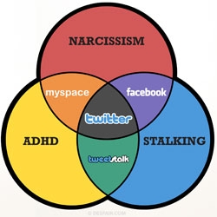
200x: Online Social Networks
Online social networks (and sharing too much trivial information) first became popular in the early 2000s
2002: Friendster created by Jonathan Abrams and Peter Chin
2003: MySpace created by eUniverse employees
2004: Facebook created by Mark Zuckerberg while a Harvard student
2006: Twitter created by Jack Dorsey
http://www.despair.com/somevedi.html
Notes:
Photo from Computer History Museum

Slide 39
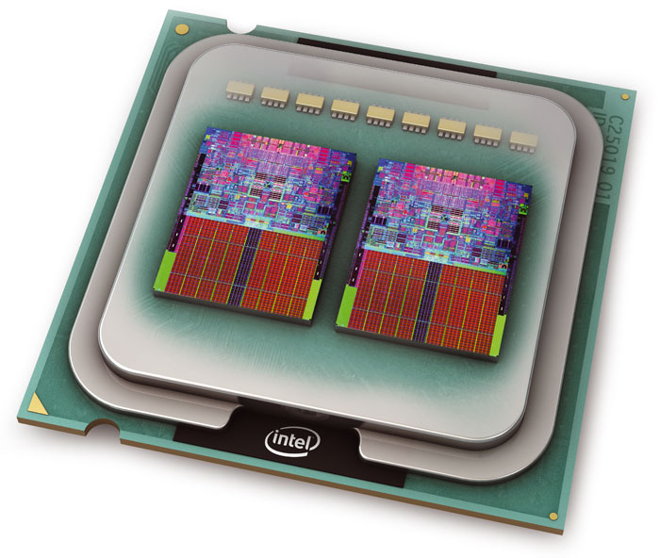
2005: Multi-core Processors
PCs with dual core CPUs hit the market. Multi-core CPUs have multiple processors on a single chip, and they allow more throughput with a lower processor speed, thus using less power
Places more emphasis in parallel programming
Notes:
Photo from Computer History Museum

Slide 40
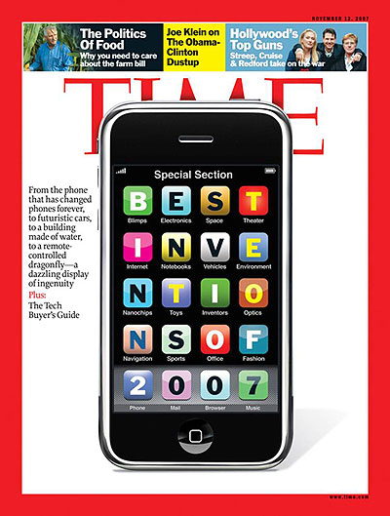
2007: iPhone
iPhone by Apple revolutionizes touch-screen interfaces for mobile devices
iPhone is Time Magazine’s 2007 Invention of the Year
http://www.time.com/time/covers/0,16641,20071112,00.html
Notes:
Photo from Computer History Museum

Slide 41
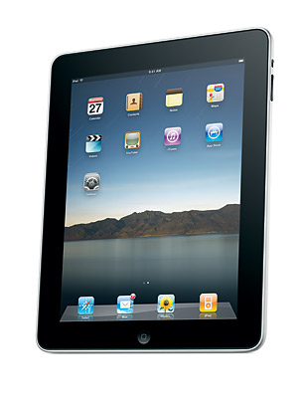
2010: iPad
iPad by Apple re-invigorates the tablet computing market
Notes:
Photo from Computer History Museum

Slide 42
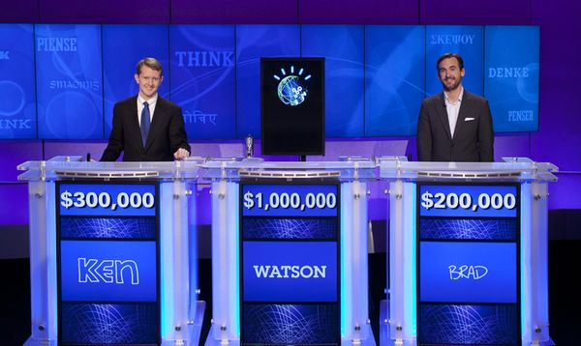
2011: IBM’s Watson
IBM’s Watson defeats veteran Jeopardy champs
http://latimesblogs.latimes.com/technology/2011/02/ibms-watson-on-jeopardy-the-machine-has-won.html

Slide 43
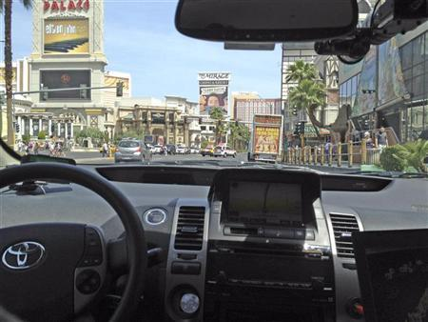
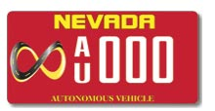
2012: Google’s Driverless Car
Google is awarded the first self-driven car license in Nevada
http://www.reuters.com/article/2012/05/08/uk-usa-nevada-google-idUSLNE84701320120508 http://www.fox5vegas.com/story/18164996/dmv-rolls-out-red-license-plates-for-self-driving-cars

Slide 44
2013: Google Glass
Wearable computers get lots of buzz
http://news.cnet.com/8301-1023_3-57578072-93/google-releases-full-google-glass-explainer-video/

Slide 45
The Future?
Smart clothing
Brain-powered prosthesis
Gesture recognition
Quantum computers
The Singularity?
http://healthinformatics.wikispaces.com/Smart+Clothes

