Slide 1
An Introduction to the Internet and the Web
Frank McCown
COMP 250 – Internet Development
Harding University

Slide 2
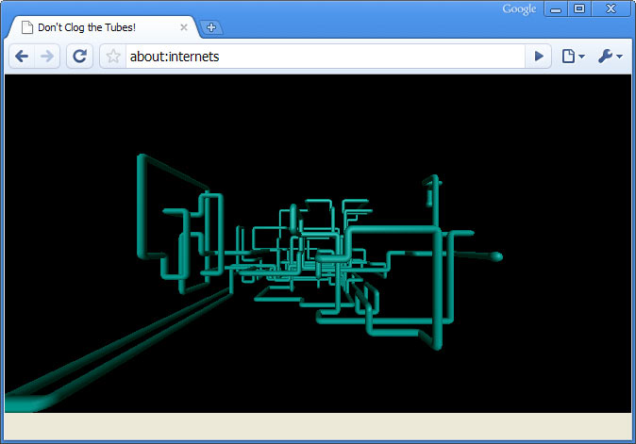
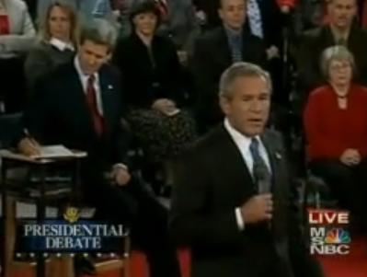
What is the Internet?
A “series of tubes” Senator Ted Stevens (June 28, 2006)
How many internets are there?
“I hear there’s rumors on the internets that we’re going to have a draft.” - George Bush (Oct 4, 2008)
Slide inspiration: Marty Stepp

Slide 3
http://www.opte.org/maps/

Slide 4
“The Internet is a global system of interconnected computer networks that use the standard Internet Protocol Suite (TCP/IP) to serve billions of users worldwide.” http://en.wikipedia.org/wiki/Internet
Internet
Computer 1
Computer 2
255.254.253.252
1.2.3.4

Slide 5
Internet Protocol Suite
Internet Protocol (IP): directs packets to a specific computer using an IP address
Transmission Control Protocol (TCP): directs packets to a specific application on a computer using a port number.
Common port numbers:
22 – ssh
23 – telnet
25 – email
80 – Web

Slide 6
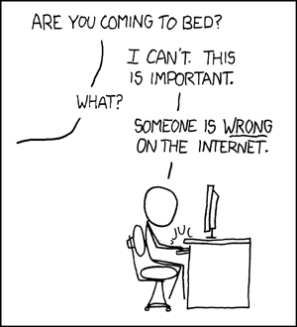

Slide 7
Internet != Web
File transfer
Web
IM
VoIP
Streaming video
email
The Internet
Notes:
BitTorrent – accounts for about half of all Internet traffic

Slide 8
Overview of the Web
Internet
Client – Web Browser
Web Server
255.254.253.252
1.2.3.4
World Wide Web: The system of interlinked hypertext documents accessed over the Internet using the HTTP protocol.

Slide 9
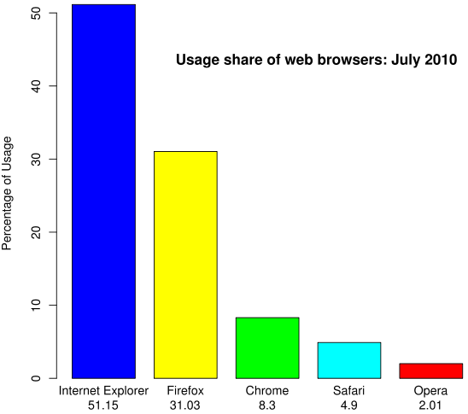
Web Browser
Software that runs on the client used to access and display web content.
http://en.wikipedia.org/wiki/Usage_share_of_web_browsers

Slide 10
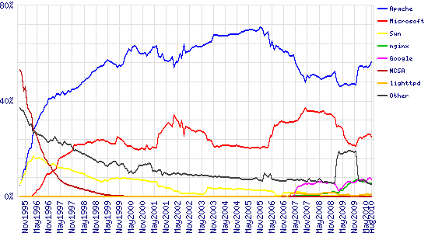
Web Server
A computer (or software running on a computer) on the Internet that listens for HTTP requests, typically on port 80, and responds with HTTP responses.
Market Share for Top Servers Across All Domains, Aug 1995 - Aug 2010
Apache : 54.9% Microsoft IIS: 25.9%
Google: 7.7%
ngnix: 5.6%
http://news.netcraft.com/archives/2010/08/11/august-2010-web-server-survey-4.html#more-2752

Slide 11
Hypertext Transfer Protocol (HTTP)
HTTP is the set of rules that govern communication between web browsers and web servers.
Client Request
GET /comp/ HTTP/1.1
Host: www.harding.edu
Server Response
HTTP/1.1 200 OK
Content-Length: 6018 Content-Type: text/html Content-Location: http://www.harding.edu/comp/ Last-Modified: Mon, 05 Jul 2010 18:49:40 GMT
Server: Microsoft-IIS/6.0
<!DOCTYPE html PUBLIC "-//W3C//DTD HTML 4.01//EN" "http://www.w3.org/TR/html4/strict.dtd"> <html> <head> <title>Harding University - Computer Science</title>
Example request for http://www.harding.edu/comp/

Slide 12
Uniform Resource Locator (URL)
A URL identifies the location of a resource on the Web.
local hostname
domain name
TLD
http://www.foo.org/abc/bar.html
scheme
hostname
path

Slide 13
Domain Name System (DNS)
DNS is a hierarchical look-up service that converts a given hostname into its equivalent IP address
DNS Server
www.harding.edu
128.82.4.20
www.google.com → 1.4.5.8
www.cnn.com → 4.6.2.8
www.hulu.com → 6.7.8.9
Etc ...
DNS servers contact parent servers for missing entries
Authoritative name servers are responsible for specific domains
Warning: DNS cache poisoning

Slide 14
Example: Web Page Request
DNS
(1) Enter URL
(2) foo.org
(3) 1.2.3.4
http://foo.org/bar.html
(4) HTTP GET bar.html
(5) Locate the resource
(6) HTTP Response
(7) Parse HTML & display
(8) HTTP GET image1
(N) HTTP GET imageN
Potentially many requests
Client / Web Browser
Web Server

Slide 15
Dissecting the Request
Request type
GET /comp/ HTTP/1.1
Host: www.harding.edu
User-Agent: Mozilla/5.0 Firefox/3.6.8

Slide 16
Dissecting the Request
Relative URL
GET /comp/ HTTP/1.1
Host: www.harding.edu
User-Agent: Mozilla/5.0 Firefox/3.6.8

Slide 17
Dissecting the Request
HTTP version
GET /comp/ HTTP/1.1
Host: www.harding.edu
User-Agent: Mozilla/5.0 Firefox/3.6.8

Slide 18
Dissecting the Request
Hostname
GET /comp/ HTTP/1.1
Host: www.harding.edu
User-Agent: Mozilla/5.0 Firefox/3.6.8

Slide 19
Dissecting the Request
Identify client
GET /comp/ HTTP/1.1
Host: www.harding.edu
User-Agent: Mozilla/5.0 Firefox/3.6.8

Slide 20
Dissecting the Response
HTTP version
Status code & phrase
HTTP/1.1 200 OK
Content-Length: 6018 Content-Type: text/html Content-Location: http://www.harding.edu/comp/ Last-Modified: Mon, 05 Jul 2010 18:49:40 GMT
Server: Microsoft-IIS/6.0
<!DOCTYPE html PUBLIC "-//W3C//DTD HTML 4.01//EN" "http://www.w3.org/TR/html4/strict.dtd"> <html> <head> <title>Harding University - Computer Science</title>
Etc...
Header
Message body

Slide 21
Status Line
Status code & phrase
HTTP/1.1 200 OK
HTTP version
Popular status codes:
200 Successful
301 Moved permanently
302 Found under different temporary URI
403 Forbidden – you don’t have permission
404 Not found
500 Internal server error

Slide 22
Dissecting the Response
Number of bytes in response
HTTP/1.1 200 OK
Content-Length: 6018 Content-Type: text/html Content-Location: http://www.harding.edu/comp/ Last-Modified: Mon, 05 Jul 2010 18:49:40 GMT
Server: Microsoft-IIS/6.0
<!DOCTYPE html PUBLIC "-//W3C//DTD HTML 4.01//EN" "http://www.w3.org/TR/html4/strict.dtd"> <html> <head> <title>Harding University - Computer Science</title>
Etc...
Header
Message body

Slide 23
Dissecting the Response
MIME type
HTTP/1.1 200 OK
Content-Length: 6018 Content-Type: text/html Content-Location: http://www.harding.edu/comp/ Last-Modified: Mon, 05 Jul 2010 18:49:40 GMT
Server: Microsoft-IIS/6.0
<!DOCTYPE html PUBLIC "-//W3C//DTD HTML 4.01//EN" "http://www.w3.org/TR/html4/strict.dtd"> <html> <head> <title>Harding University - Computer Science</title>
Etc...
Header
Message body

Slide 24
Popular MIME types
text/html
text/plain
image/jpeg
image/gif
image/png
application/pdf
application/msword
application/vnd.ms-excel
video/quicktime
IANA list of MIME types

Slide 25
Dissecting the Response
URI for resource
HTTP/1.1 200 OK
Content-Length: 6018 Content-Type: text/html Content-Location: http://www.harding.edu/comp/ Last-Modified: Mon, 05 Jul 2010 18:49:40 GMT
Server: Microsoft-IIS/6.0
<!DOCTYPE html PUBLIC "-//W3C//DTD HTML 4.01//EN" "http://www.w3.org/TR/html4/strict.dtd"> <html> <head> <title>Harding University - Computer Science</title>
Etc...
Header
Message body

Slide 26
Dissecting the Response
When the file was last modified on the server
HTTP/1.1 200 OK
Content-Length: 6018 Content-Type: text/html Content-Location: http://www.harding.edu/comp/ Last-Modified: Mon, 05 Jul 2010 18:49:40 GMT
Server: Microsoft-IIS/6.0
<!DOCTYPE html PUBLIC "-//W3C//DTD HTML 4.01//EN" "http://www.w3.org/TR/html4/strict.dtd"> <html> <head> <title>Harding University - Computer Science</title>
Etc...
Header
Message body

Slide 27
Dissecting the Response
HTTP/1.1 200 OK
Content-Length: 6018 Content-Type: text/html Content-Location: http://www.harding.edu/comp/ Last-Modified: Mon, 05 Jul 2010 18:49:40 GMT
Server: Microsoft-IIS/6.0
<!DOCTYPE html PUBLIC "-//W3C//DTD HTML 4.01//EN" "http://www.w3.org/TR/html4/strict.dtd"> <html> <head> <title>Harding University - Computer Science</title>
Etc...
Web server software
Header
Message body

Slide 28
Dissecting the Response
HTTP/1.1 200 OK
Content-Length: 6018 Content-Type: text/html Content-Location: http://www.harding.edu/comp/ Last-Modified: Mon, 05 Jul 2010 18:49:40 GMT
Server: Microsoft-IIS/6.0
<!DOCTYPE html PUBLIC "-//W3C//DTD HTML 4.01//EN" "http://www.w3.org/TR/html4/strict.dtd"> <html> <head> <title>Harding University - Computer Science</title>
Etc...
Header
Message body
HTML displayed in the browser

Slide 29
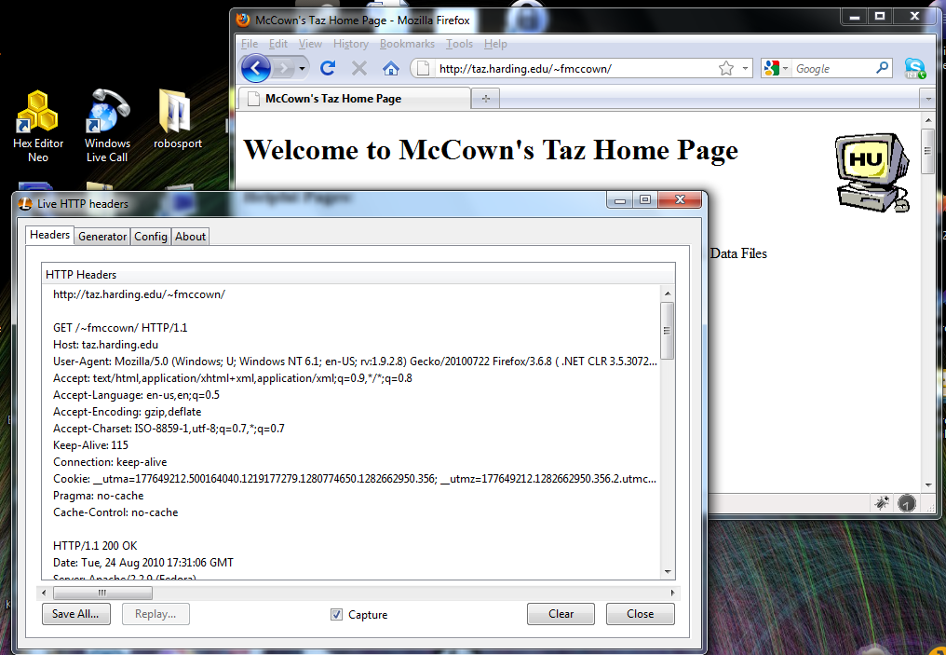
How can I see the HTTP headers?
FireFox Add-on: Live HTTP Headers

