Slide 1
Video Game Genres
COMP 475- Game Development Harding University
Spring 2012
Copyright of images are held by their respective owners.

Slide 2
Video Game Genres
Adventure
Action
Action-Adventure
Platformer
Fighting
First-Person Shooter
Real-Time Strategy (RTS)
Turn-Based Strategy
Role-Playing Game (RPG)
Massively Multiplayer Online Role-Playing Game (MMORPG)
Stealth
Survival Horror
Simulation
Racing
Sports
Rhythm
Puzzle
Mini-Games
Traditional
Educational
Serious
Source: Robert T. Bakie, Introduction to Game Development, Ch. 1.1, 2008

Slide 3
Adventure

Slide 4
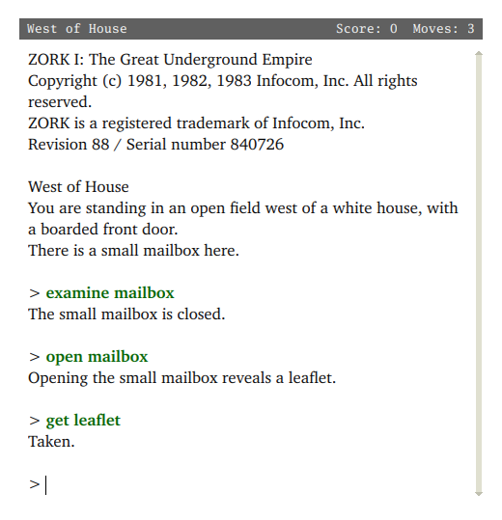
Zork
1980 – Infocom
http://en.wikipedia.org/wiki/File:Zork_I_computer_game.png

Slide 5
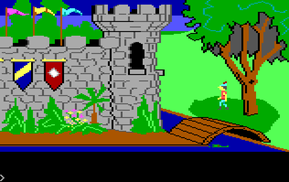
King’s Quest
1984 – Sierra Entertainment
http://en.wikipedia.org/wiki/File:Kings_Quest_Tandy.png

Slide 6
Action-Adventure

Slide 7
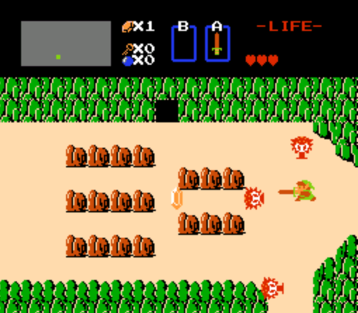
The Legend of Zelda 1986 – Nintendo
http://en.wikipedia.org/wiki/File:Legend_of_Zelda_NES.PNG

Slide 8
Platformer

Slide 9
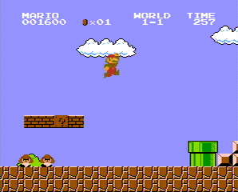
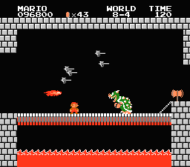
Super Mario Bros. 1983 – Nintendo
http://en.wikipedia.org/wiki/File:NES_Super_Mario_Bros.png http://en.wikipedia.org/wiki/File:Bowser_%28smb1%29.png http://en.wikipedia.org/wiki/File:Super_Mario_Bros_box.jpg

Slide 10
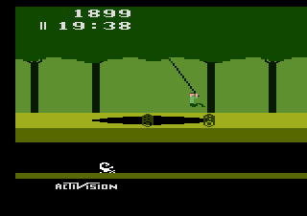
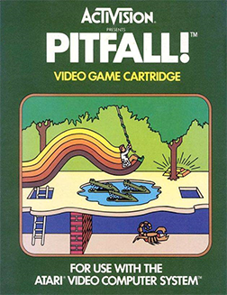
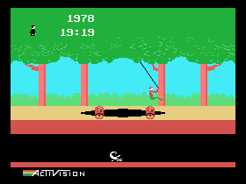
Pitfall! 1982 – Activision
http://upload.wikimedia.org/wikipedia/en/0/06/Pitfall%21_Coverart.png http://en.wikipedia.org/wiki/File:A2600_Pitfall.png http://en.wikipedia.org/wiki/File:Coleco_Pitfall.png

Slide 11
Fighting

Slide 12
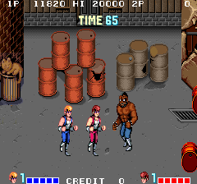
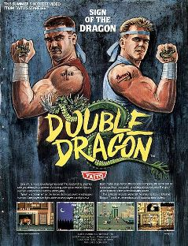
Double Dragon 1987 – Technos Japan
http://upload.wikimedia.org/wikipedia/en/e/e6/Ddragon_chirashi.jpg http://en.wikipedia.org/wiki/File:DDArcade.png

Slide 13
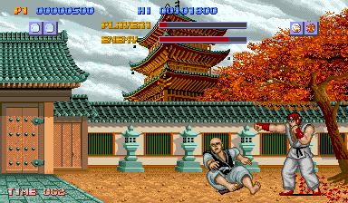
Street Fighter 1987 – Capcom
http://en.wikipedia.org/wiki/File:Street_Fighter_Logo.png http://en.wikipedia.org/wiki/File:Street_Fighter.png

Slide 14
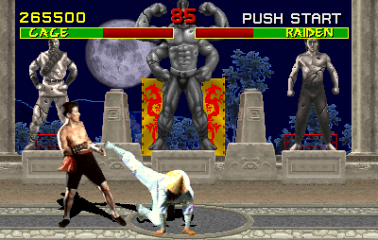
Mortal Kombat 1992 – Ed Boon and John Tobias
http://en.wikipedia.org/wiki/File:MKDL.PNG http://en.wikipedia.org/wiki/File:Mortal_Kombat.png

Slide 15
First-Person Shooter

Slide 16
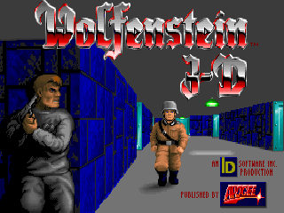
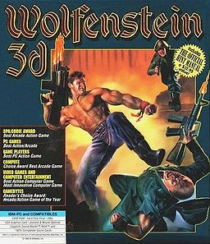
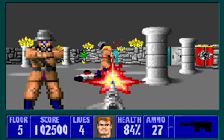
Wolfenstein 3D 1992 – id Software
http://en.wikipedia.org/wiki/File:Wolfenstein-3d.jpg
http://en.wikipedia.org/wiki/File:Wolfenstein_3D_title_screen.png http://en.wikipedia.org/wiki/File:Wolf3d_pc.png
Notes:
Wolfenstein 3D is a video game that is generally regarded as having popularized the first person shooter genre on the PC. It was created by id Software and published by Apogee Software. Released on May 5, 1992 for MS-DOS, the game was inspired by the 1980s Muse Software computer games Castle Wolfenstein and Beyond Castle Wolfenstein. It has been ported to a wide variety of systems

Slide 17
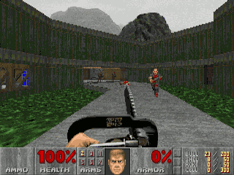
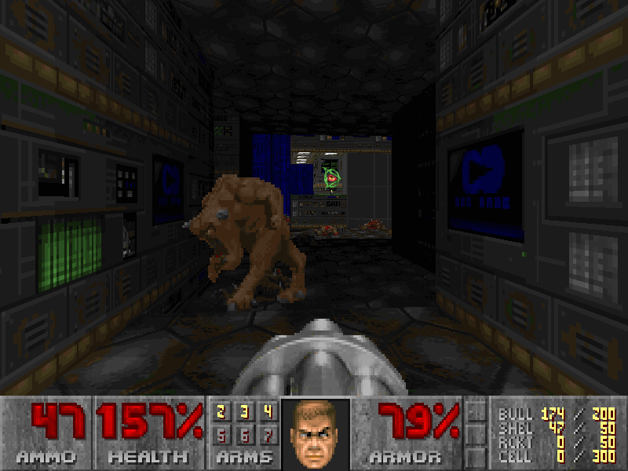
Doom 1993 – id Software
http://en.wikipedia.org/wiki/File:Doom-boxart.jpg http://en.wikipedia.org/wiki/File:Doom_ingame_1.png http://en.wikipedia.org/wiki/File:Doom_darkness.png
Notes:
Doom (occasionally typeset as DOOM^{[1]}) is a landmark 1993 first-person shooter computer game by id Software. It was initially released for MS-DOS and Sun Workstations. It is widely recognized for popularizing the first person shooter genre, pioneering immersive 3D graphics, networked multiplayer gaming, and support for custom expansions (WADs). Its graphic and interactive violence^{[2]} has also made Doom the subject of much controversy reaching outside the gaming world.

Slide 18
Real-Time Strategy (RTS)

Slide 19
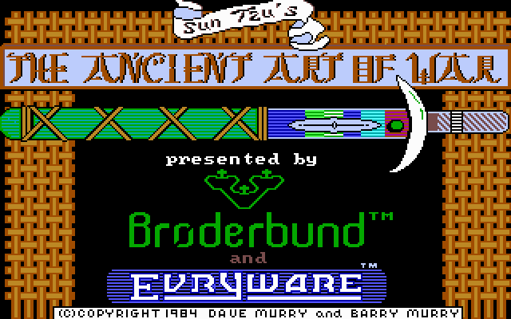
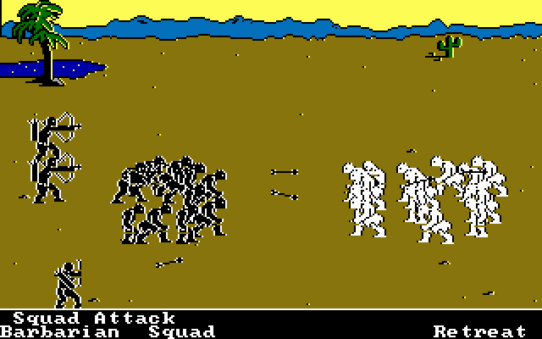
The Ancient Art of War 1984 – Evryware & Broderbund
http://www.myabandonware.com/game/the-ancient-art-of-war-3a
Notes:
The Ancient Art of War is a computer game developed by Evryware and published by Broderbund in 1984. In retrospect, it is generally recognized as one of the first real-time strategyor real-time tactics games.

Slide 20
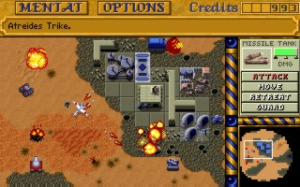
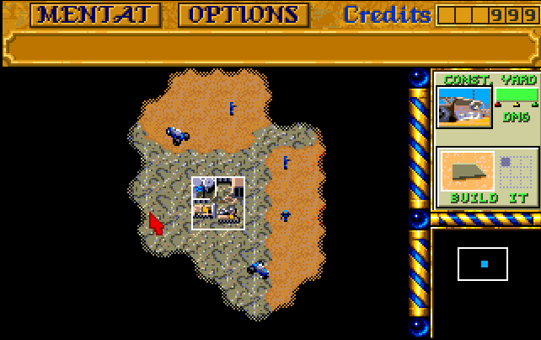
Dune II 1992 – Westwood Studios
http://en.wikipedia.org/wiki/File:DuneII.jpg http://en.wikipedia.org/wiki/File:Dune_2_screenshot_attack_on_base.jpg http://en.wikipedia.org/wiki/File:Dune2-amiga-ingame.png

Slide 21
Turn-Based Strategy
Notes:
Similar to RTS, but players take turns to make their moves.

Slide 22
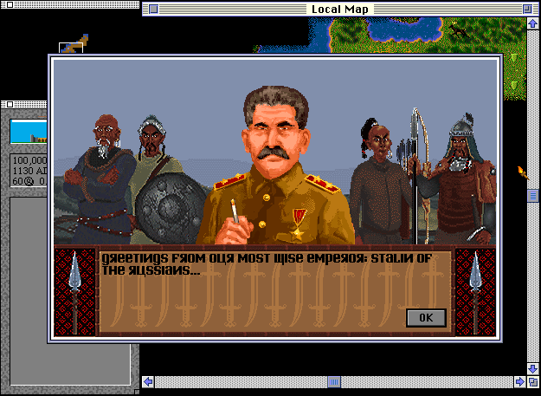
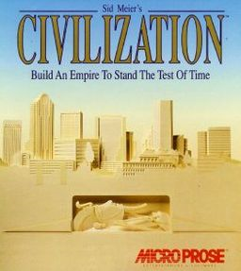
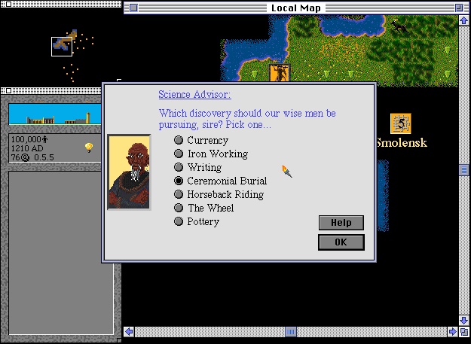
Civilization 1991 – Sid Meier
http://en.wikipedia.org/wiki/File:Civilizationboxart.jpg http://en.wikipedia.org/wiki/File:Civ01.png http://en.wikipedia.org/wiki/File:Civ02.png

Slide 23
Role-Playing Game (RPG)
Notes:
Video game version of pen and paper games like Dungeons and Dragons.

Slide 24
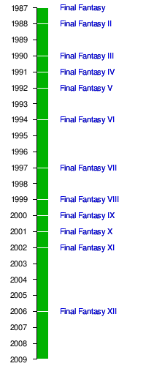
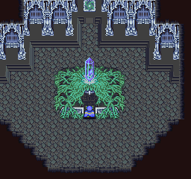
Final Fantasy 1987 – Hironobu Sakaguchi (Square Enix)
http://upload.wikimedia.org/wikipedia/en/timeline/2cd14ce093dfa0258fde75d6f18e3d47.png http://en.wikipedia.org/wiki/File:Final_Fantasy_V_death_crystal_screenshot.png
Notes:
Final Fantasy​ ( ファイナルファンタジー? ) is a media franchise created by Hironobu Sakaguchi, and is developed and owned by Square Enix (formerly Squaresoft). The franchise centers on a series of console role-playing games (RPGs), but includes motion pictures, anime, printed media, and other merchandise. The series began in 1987 as an eponymous video game developed to save Square from bankruptcy; the game was a success and spawned sequels. The video game series has since branched into other genres and platforms, such as tactical RPGs, portable games, a massively multiplayer online role-playing game, and games for mobile phones.

Slide 25
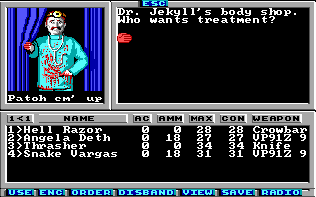
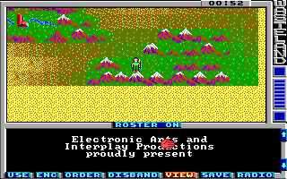
Wasteland 1988 – Electronic Arts & Interplay
http://www.abandonia.com/games/436/Wasteland
Notes:
Final Fantasy​ ( ファイナルファンタジー? ) is a media franchise created by Hironobu Sakaguchi, and is developed and owned by Square Enix (formerly Squaresoft). The franchise centers on a series of console role-playing games (RPGs), but includes motion pictures, anime, printed media, and other merchandise. The series began in 1987 as an eponymous video game developed to save Square from bankruptcy; the game was a success and spawned sequels. The video game series has since branched into other genres and platforms, such as tactical RPGs, portable games, a massively multiplayer online role-playing game, and games for mobile phones.

Slide 26
Massively Multiplayer Online Role-Playing Game (MMORPG)
Notes:
Also abbreviated MMO. Role-playing game set in a persistent virtual world populated by thousands of players simultaneously connected over the Internet. Player represented by an avatar.

Slide 27
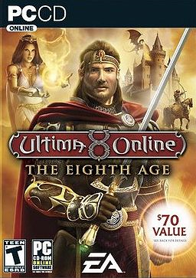
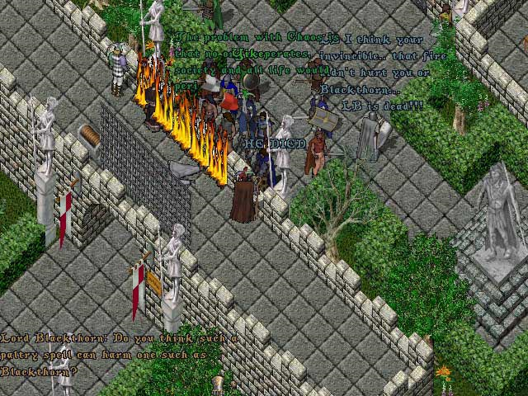
Ultima Online 1997 – Origin Systems
http://en.wikipedia.org/wiki/File:Ultima_Online_8th_Age.jpg http://en.wikipedia.org/wiki/File:UO_LB_assasination.jpg
Notes:
Ultima Online (UO) is a graphical massively multiplayer online role-playing game (MMORPG), released on September 25, 1997,^{[1]} by Origin Systems. It was instrumental to the development of the genre, and is still running today. The game is played online, in a fantasy setting similar to that of the other Ultima games that preceded it.
The success of Ultima Online opened the door for the creation of many new massively multiplayer games. Ultima Online is a fantasy role-playing game set in the Ultima universe. It is online-only and played by thousands of simultaneous users (who pay a monthly fee) on various game servers, also known as shards. It is known for its extensive timing-based player versus player combat system. To maintain order in the online community, there are Game Masters who resolve player disputes, police the shard for terms of service violations, and correct glitches in the game.

Slide 28
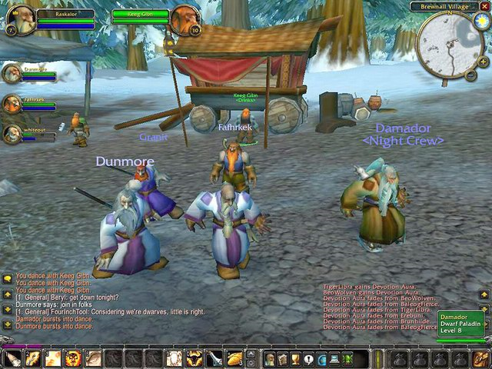
World of Warcraft 2004 – Blizzard Entertainment
http://en.wikipedia.org/wiki/File:WoW_Box_Art1.jpg http://www.youronlinelife.net/graphics/world_of_warcraft_1.jpg

Slide 29
Stealth (Sneakers)
Notes:
Similar to first-person or third-person shooters but less action-oriented and more methodical, deliberate gameplay.

Slide 30
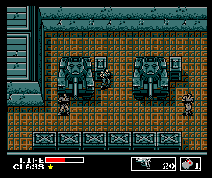
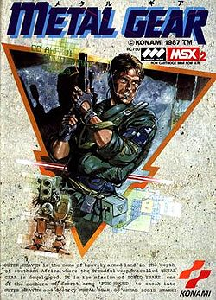
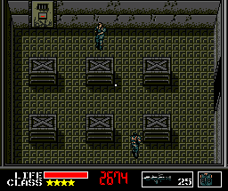
Metal Gear 1987 – Konami
http://en.wikipedia.org/wiki/File:Rc750j1f.jpg http://en.wikipedia.org/wiki/File:Mgear.png http://en.wikipedia.org/wiki/File:Big_Boss_MG1.png
Notes:
Metal Gear (メタルギア, Metaru Gia?) (commonly abbreviated MG) is a stealth game designed by Hideo Kojima.^{[1]} Metal Gear was developed and first published by Konami in 1987 for the MSX2 home computer. The game is considered to be the progenitor of the stealth game genre, in which avoiding direct encounter with the enemy is emphasized over attacking openly.

Slide 31
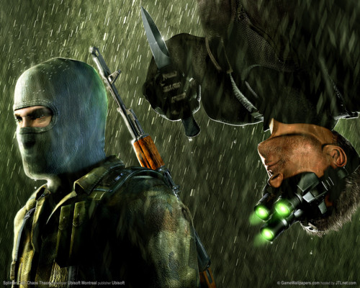
Splinter Cell 2002 – Ubisoft Montreal
http://en.wikipedia.org/wiki/File:Tharealsplintercell.jpg http://image.examiner.com/images/blog/wysiwyg/image/SSCT.jpg

Slide 32
Survival Horror
Notes:
Similar to first-person or third-person shooters but less action-oriented and more methodical, deliberate gameplay.

Slide 33
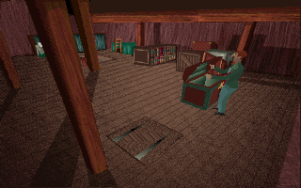
Alone in the Dark 1992 – Infogrames
http://en.wikipedia.org/wiki/File:Alone_in_the_Dark_boxart.jpg http://en.wikipedia.org/wiki/File:AITDscreenshot.gif

Slide 34
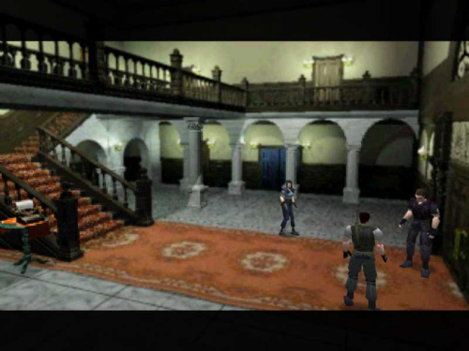
Resident Evil 1996 – Capcom
http://en.wikipedia.org/wiki/File:Resident_Evil_1_cover_art.jpg http://en.wikipedia.org/wiki/File:RE1_screen.jpg

Slide 35
Simulation

Slide 36
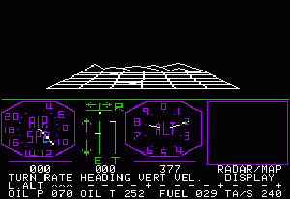
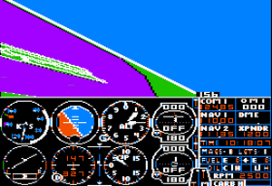
Microsoft Flight Simulator 1980 – Microsoft
http://en.wikipedia.org/wiki/File:Flight_Simulator_1.0_short_animation.thumb.gif http://en.wikipedia.org/wiki/File:Sublogic_Flight_Simulator_II.png

Slide 37
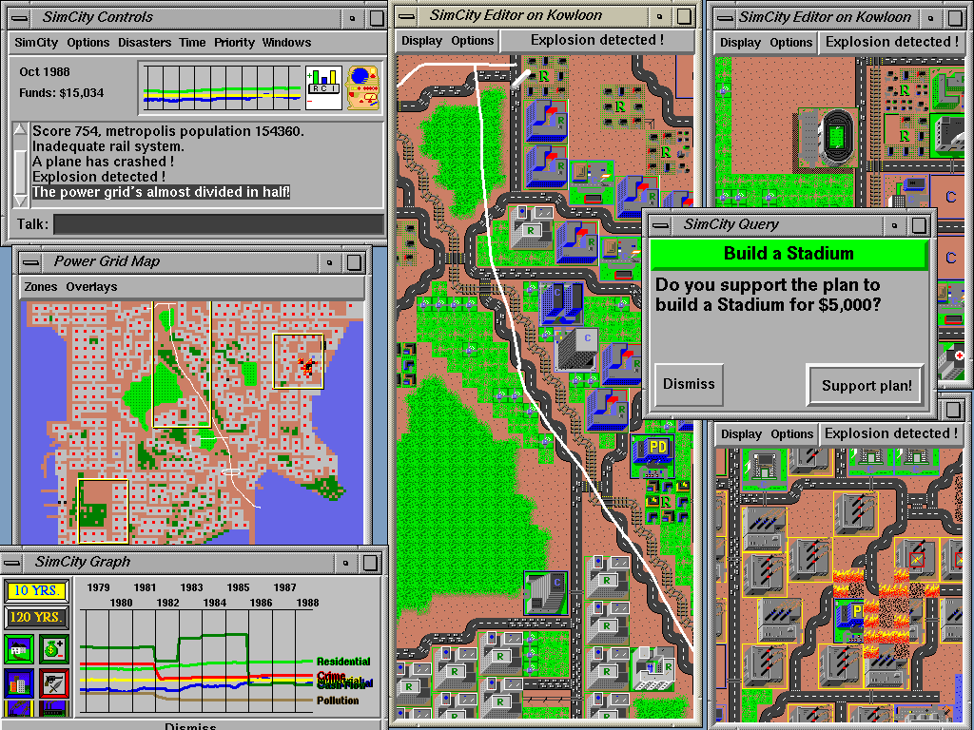
SimCity
1989 – Will Wright
http://en.wikipedia.org/wiki/File:SimCity-Indigo.gif

Slide 38
Racing

Slide 39
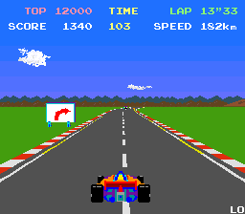
Pole Position 1982 – Namco
http://en.wikipedia.org/wiki/File:Pole0000.png
Notes:
First break-out racing game.

Slide 40
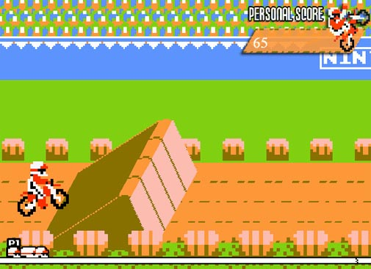
Excitebike 1984 – Nintendo
http://en.wikipedia.org/wiki/Excitebike http://n-europe.com/review.php?rid=297
Notes:
First break-out racing game.

Slide 41
Mario Kart (Wii) 2008 – Nintendo
http://www.thebuzzmedia.com/mario-kart-wii-review/ http://wii.gamespy.com/wii/mario-kart-wii/870096p1.html
Notes:
First break-out racing game.

Slide 42
Sports

Slide 43
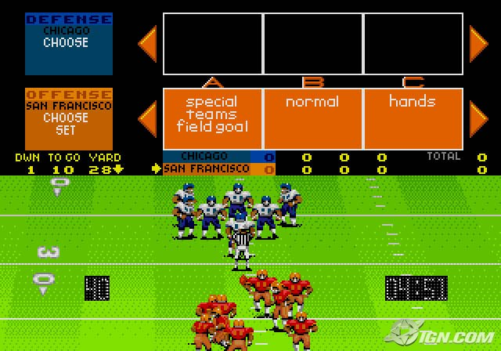
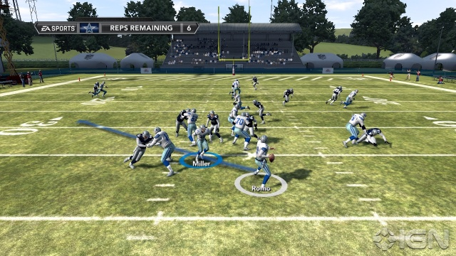
John Madden Football 1988 – Electronic Arts
John Madden Football (1988)
Madden NFL 12
http://en.wikipedia.org/wiki/File:John_madden_football.jpg http://xbox360.ign.com/dor/objects/109987/madden-nfl-12-hall-of-fame-edition/images/madden-nfl-12-20110512020835525.html

Slide 44
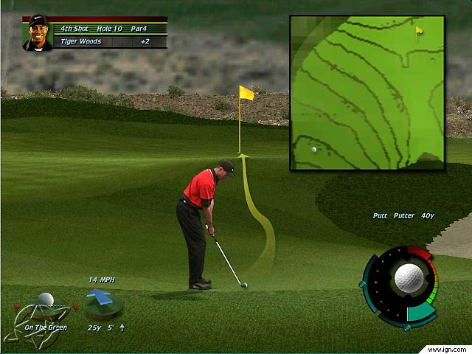
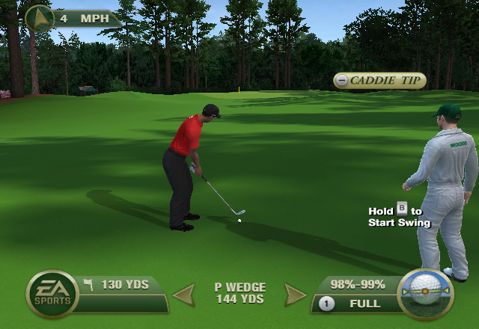
Tiger Woods PGA Tour Series 1998 – Electronic Arts
Tour 2000
Tour 12: The Masters
http://pc.ign.com/dor/tiger-woods-pga-tour-2000/13256/images/tiger2.html?page=mediaFull http://nintendo-okie.com/2011/04/05/tiger-woods-pga-tour-12-the-masters-review-wii/

Slide 45
Rhythm

Slide 46
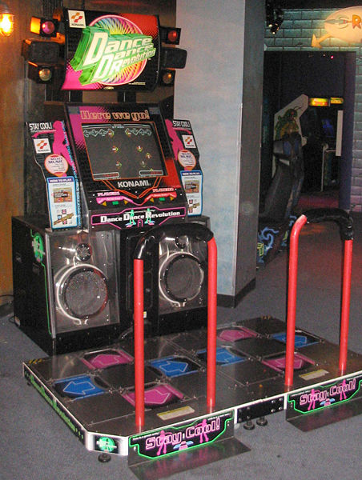
Dance Dance Revolution (DDR) 1998 – Konami
http://en.wikipedia.org/wiki/File:Dance_Dance_Revolution_North_American_arcade_machine_3.jpg http://wiimedia.ign.com/wii/image/article/760/760878/dance-dance-revolution-hottest-party-tba-20070202113538512_640w.jpg

Slide 47
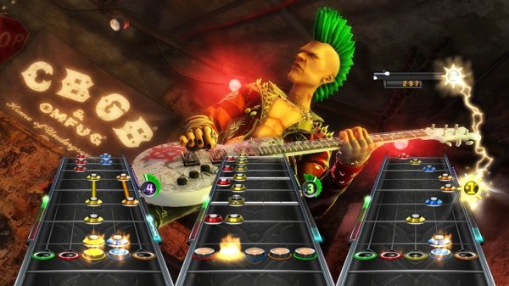
Guitar Hero 2005 – Activision
http://en.wikipedia.org/wiki/File:Guitar_Hero_series_controllers.jpg http://www.g4tv.com/thefeed/blog/post/711783/guitar-hero-franchise-just-on-hiatus-according-to-activision/

Slide 48
Puzzle

Slide 49
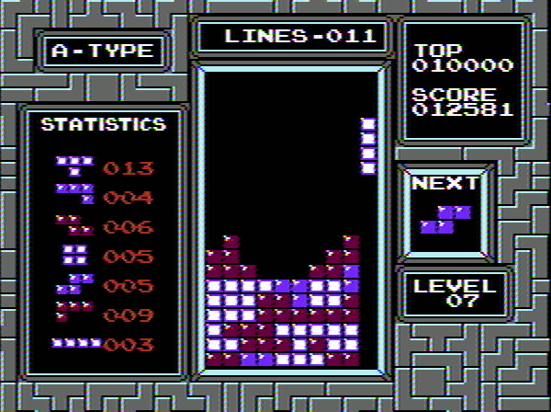
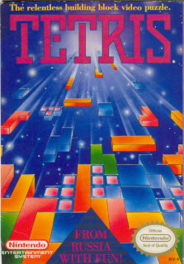
Tetris 1984 – Alexey Pajitnov
http://en.wikipedia.org/wiki/File:NES_Tetris_Box_Front.jpg http://en.wikipedia.org/wiki/File:Tetris_NES_play.png

Slide 50
Angry Birds 2009 – Rovio Mobile
“…some 200 million minutes are spent on Angry Birds titles each day.” http://thenextweb.com/apps/2011/02/16/angry-birds-gamers-spend-200-million-minutes-playing-each-day/
http://angrybirdsonline9.webs.com/ http://en.wikipedia.org/wiki/File:Angry-Birds-in-Game-Play-1.jpg

Slide 51
Mini-Games
Notes:
Short, simple games that exist within a larger traditional game. Sometimes a reward for completing a challenge or unlocked by discovering a secret. Larger game could be a thin veil for a collection of mini-games. Many games used on the web for advertising purposes could be described as mini-games.

Slide 52
Mario Party 1998 – Nintendo
http://en.wikipedia.org/wiki/File:Marioparty1.jpg http://en.wikipedia.org/wiki/File:MP1_MushroomMixUp.jpg

Slide 53
Traditional
Notes:
Computerized versions of card games and board games.

Slide 54
Chessmaster 1986 – The Software Toolworks
Chessmaster 10th edition
http://en.wikipedia.org/wiki/File:Marioparty1.jpg http://en.wikipedia.org/wiki/File:MP1_MushroomMixUp.jpg

Slide 55
Educational

Slide 56
Oregon Trail 1971 – Don Rawitsch, Bill Heinemann, and Paul Dillenberger
http://en.wikipedia.org/wiki/File:OregonTrailScreenshot.png

Slide 57
Number Munchers 1980s – Minnesota Educational Computing Consortium
http://www.platypuscomix.net/applepalooza/numbermunchers.html

Slide 58
Serious
Notes:
Entertaining way of teaching real-world events or processes to adults.

Slide 59
CyberCIEGE 2005 – Naval Postgraduate School and Rivermind, Inc.
http://en.wikipedia.org/wiki/File:Cyberciege.jpg
Notes:
CyberCIEGE is a serious game designed to teach network security concepts. Its development was sponsored by the U.S. Navy, and it is used as a training tool by agencies of the U.S. government, universities and community colleges. The game is freely available to the U.S. Government and a no-cost license is available for educational institutions.

Slide 60
Foldit 2008 – David Baker (Univ of Washington)
http://fold.it/portal/info/science
Notes:
Foldit is an online puzzle video game about protein folding. The game is part of an experimental research project, and is developed by the University of Washington's Center for Game Science in collaboration with the UW Department of Biochemistry. The objective of the game is to fold the structure of selected proteins to the best of the player's ability, using various tools provided within the game. The highest scoringsolutions are analysed by researchers, who determine whether or not there is a native structural configuration (or native state) that can be applied to the relevant proteins, in the "real world". Scientists can then use such solutions to solve "real-world" problems, by targeting and eradicating diseases, and creating biological innovations.

