Slide 1
A Developer’s Introduction to Google Android
Dr. Frank McCown
Harding University
Spring 2010

Slide 2


http://findmearobot.com/Pages/Required%20robots/Images/Do%20androids%20dream%20of%20electric%20sheep.jpg
http://doctorbeatnik.files.wordpress.com/2009/10/blade_runner2.jpg

Slide 3
Brief History
2005
  Google acquires startup Android Inc. to start Android platform
  Work on Dalvik VM begins
2007
  Open Handset Alliance announced
  Early look at SDK
2008
  Google sponsors 1st Android Developer Challenge
  T-Mobile G1 announced
  SDK 1.0 released
  Android released open source (Apache License)
  Android Dev Phone 1 released
Pro Android by Hashimi & Komatineni (2009)
Notes:
Open Handset Alliance, a consortium of 47 hardware, software, and telecom companies devoted to advancing open standards for mobile devices. Includes Texas Instruments, Broadcom Corporation, Google, HTC, Intel, LG, Marvell Technology Group, Motorola, Nvidia, Qualcomm, Samsung Electronics, Sprint Nextel and T-Mobile

Slide 4
Brief History cont.
2009
  SDK 1.5 (Cupcake)
    new soft keyboard with an "Autocomplete" feature
  SDK 1.6 (Donut)
  Android runs on 3.5% of all smartphones
    Gartner Inc. predicts 14% in 2012
2010
  SDK 2.0/2.0.1/2.1 (Éclair)
  Nexus One released to the public
http://en.wikipedia.org/wiki/Android_(operating_system)
http://www.computerworld.com/s/article/9139026/Android_to_grab_No._2_spot_by_2012_says_Gartner
Notes:
In October, 2009, Gartner Inc. predicted that by 2012, Android would become the world's second most popular smartphone platform, behind only the Symbian OS which powers Nokia phones very popular outside the US. Meanwhile, BlackBerry would fall from 2nd to 5th place, iPhone would remain in 3rd place, and Microsoft's Windows Mobile would remain in 4th place.

Slide 5
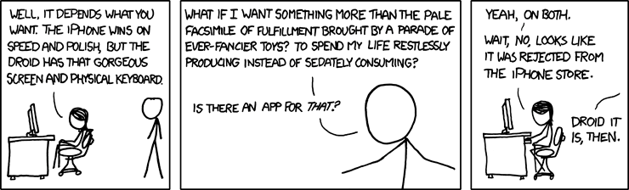
iPhone or Droid?
http://www.xkcd.com/662/

Slide 6
Key Differences: Android vs. iPhone
iPhone
Android
OS is proprietary
OS runs on iPhone or iPod Touches only
Apps written in Objective-C
Dev tools Mac-only
Apple must approve all apps → Application Store
Some apps are more important than others (Safari is your browser)
OS is open source
OS can be licensed for any mobile device
Apps written in Java
Dev tools for many OS’s
No approval process for apps → Android Market
All apps considered equal (choose your browser)

Slide 7
What is Google Android?
A software stack for mobile devices that includes
  An operating system
  Middleware
  Key Applications
Uses Linux to provide core system services
  Security
  Memory management
  Process management
  Power management
  Hardware drivers

Slide 8
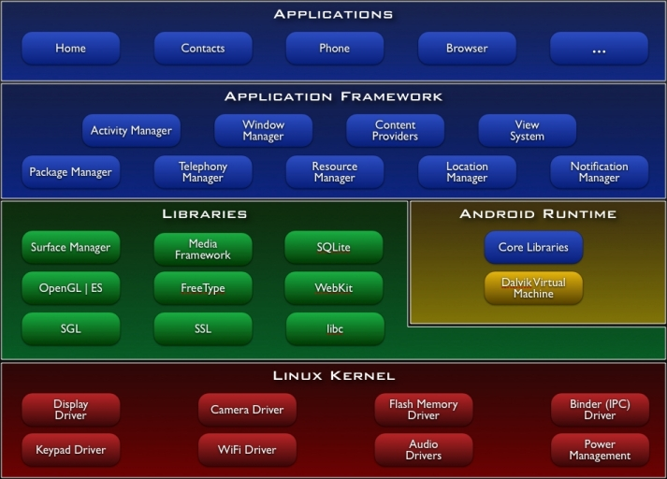
http://developer.android.com/guide/basics/what-is-android.html

Slide 9
Android Runtime: Dalvik VM
Subset of Java developed by Google
Optimized for mobile devices (better memory management, battery utilization, etc.)
Dalvik runs .dex files that are compiled from .class files
Introduces some new libraries
Does not support some Java libraries like AWT

Slide 10
Applications Are Boxed
By default, each app is run in its own Linux process
  Process started when app’s code needs to be executed
  Threads can be started to handle time-consuming operations
Each process has its own Dalvik VM
By default, each app is assigned unique Linux ID
  Permissions are set so app’s files are only visible to that app

Slide 11
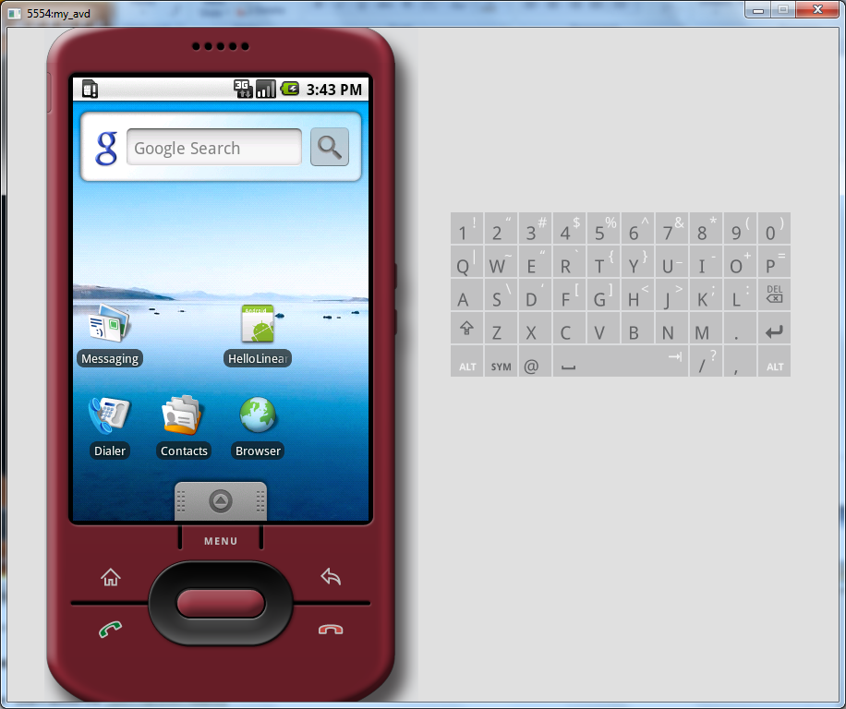
Android Emulator

Slide 12
Emulator Hardware
An ARMv5 CPU and the corresponding memory-management unit (MMU)
A 16-bit LCD display
One or more keyboards (a Qwerty-based keyboard and associated Dpad/Phone buttons)
A sound chip with output and input capabilities
Flash memory partitions (emulated through disk image files on the development machine)
A GSM modem, including a simulated SIM Card
http://developer.android.com/guide/developing/tools/emulator.html

Slide 13
Emulator Limitations
No support for placing or receiving actual phone calls. You can simulate phone calls (placed and received) through the emulator console, however.
No support for USB connections
No support for camera/video capture (input)
No support for device-attached headphones
No support for determining connected state
No support for determining battery charge level and AC charging state
No support for determining SD card insert/eject
No support for Bluetooth
No support for simulating the accelerometer
http://developer.android.com/guide/developing/tools/emulator.html

Slide 14
Setup Development Environment
Install JDK 5 or 6
Install Eclipse IDE for Java EE Developers (version 3.5 - Galileo)
Download and unpack the Android SDK
Install Android Development Tools (ADT) plugin for Eclipse
Detailed install instructions available on Android site
http://developer.android.com/sdk/installing.html

Slide 15

Producing an Android App
Java code
javac
Byte code
Dalvik exe
dx
.java
.class
classes.dex
aapt
Byte code
<xml>
Other .class files
AndroidManifest.xml
.apk
<str>
Resources
Notes:
Every application must have an AndroidManifest.xml file (with precisely that name) in its root directory. The manifest presents essential information about the application to the Android system, information the system must have before it can run any of the application's code. Among other things, the manifest does the following:
It names the Java package for the application. The package name serves as a unique identifier for the application.
It describes the components of the application — the activities, services, broadcast receivers, and content providers that the application is composed of. It names the classes that implement each of the components and publishes their capabilities (for example, which Intent messages they can handle). These declarations let the Android system know what the components are and under what conditions they can be launched.
It determines which processes will host application components.
It declares which permissions the application must have in order to access protected parts of the API and interact with other applications.
It also declares the permissions that others are required to have in order to interact with the application's components.
It lists the Instrumentation classes that provide profiling and other information as the application is running. These declarations are present in the manifest only while the application is being developed and tested; they're removed before the application is published.
It declares the minimum level of the Android API that the application requires.
It lists the libraries that the application must be linked against.

Slide 16
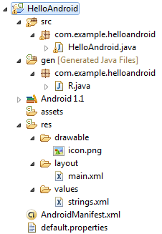
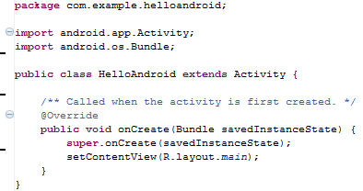
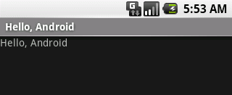
Hello Android Tutorial
http://developer.android.com/resources/tutorials/hello-world.html

Slide 17
Four Application Components
Activities
  Presents a visual UI for a single endeavor
  Examples: list of photos, buttons to start/stop a song
Services
  Performs background work (no UI)
  Examples: play background music, retrieve data over a network
Broadcast Receivers
  Receives and reacts to broadcast announcements (no UI)
  Broadcast examples: battery is low, pic is taken, lang pref changed
Content Providers
  Provides app data to other applications (no UI)
  Examples: share contact info from SQLite, provide image from the file system

Slide 18
Activating Components
Content providers are activated by a ContentResolver
Activities, services, & broadcast receivers are activated by intents
Intents are asynchronous messages
Example: A Service starts an Activity to pick a photo by using an intent. The photo is returned to the Service also using an intent.

Slide 19
Shutting Down Components
Content providers are only active when responding to ContentResolvers
Broadcast receivers are only active when responding to broadcast messages
Activities can stop themselves with finish() or stop other activities it started with finishActivity()
Services can stop themselves with stopSelf() or Context.stopService()

Slide 20
AndroidManifest.xml
Bundled into Android package (.apk file)
Declares all the app’s components
Names libraries app needs to be linked against
Identifies permissions the app expects to be granted

Slide 21
Data Storage
App’s data is private
Data can be shared using content providers
Four ways to store data:
  Preferences: Lightweight mechanism to store and retrieve key-value pairs of primitive data types
  Files: Store on mobile device or on a removable storage medium
  Databases: SQLite
  Network: Store/retrieve data stored elsewhere

Slide 22
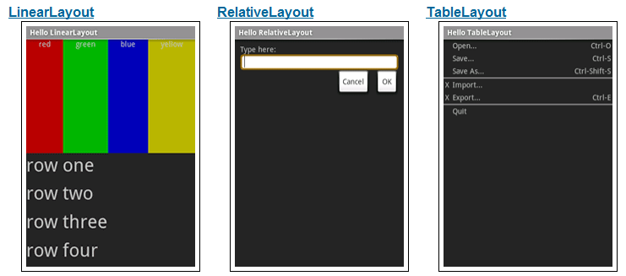
Various Layouts
http://developer.android.com/resources/tutorials/views/index.html

Slide 23
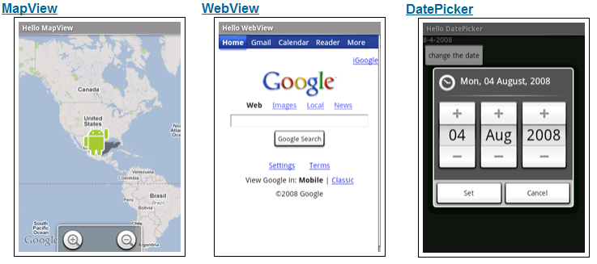
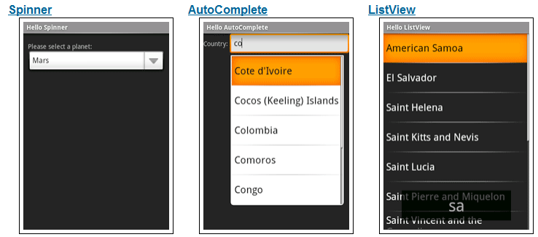
Various Widgets
http://developer.android.com/resources/tutorials/views/index.html

Slide 24
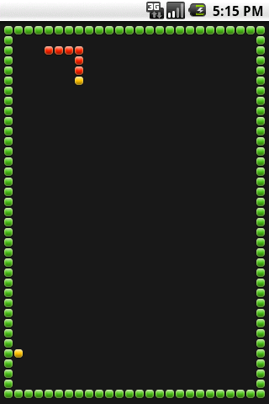
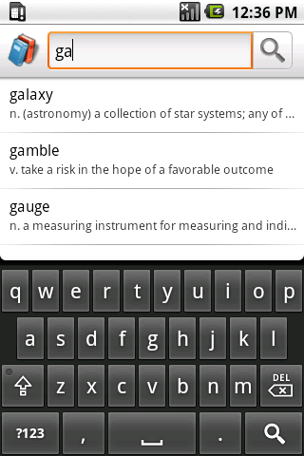
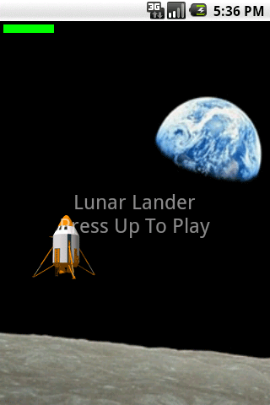
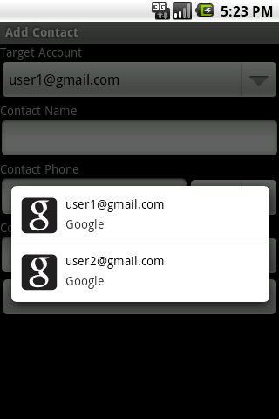
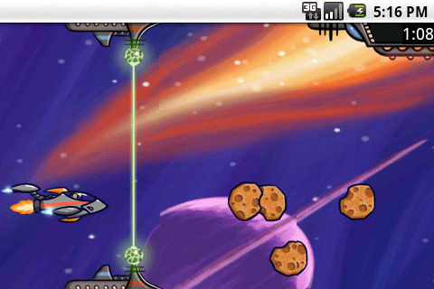
SDK Samples

Slide 25
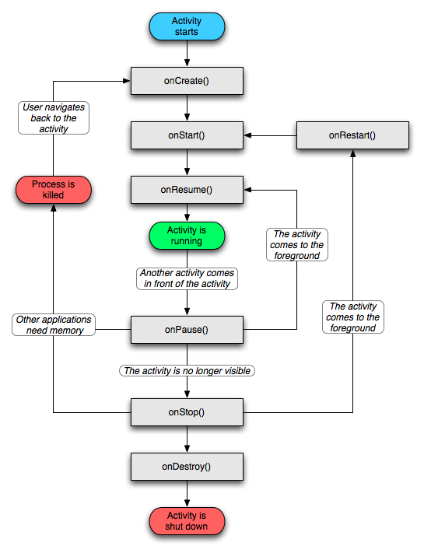
Activity Lifecycle
http://developer.android.com/reference/android/app/Activity.html

Slide 26
References
Android Introduction by Marko Gargenta, http://www.lecturemaker.com/2009/10/android-software-platform/
Android Dev Guide http://developer.android.com/guide/topics/fundamentals.html
Pro Android by Hashimi & Komatineni (2009)

Slide 27
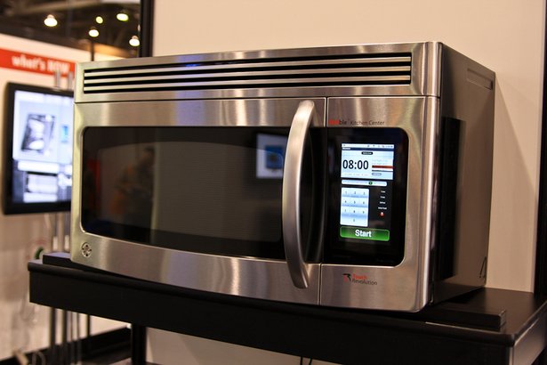
Questions?
http://www.pocket-lint.com/news/30712/android-powered-microwave-cooking-google

