Slide 1
Formation of Social Networks: Homophily, Social Influence, & Affiliation
Dr. Frank McCown
Intro to Web Science
Harding University
This work is licensed under a Creative Commons Attribution-NonCommercial-ShareAlike 3.0 Unported License

Slide 2
Slides based on Ch 4 of Networks, Crowds and Markets by Easley & Kleinberg (2010)
http://www.cs.cornell.edu/home/kleinber/networks-book/

Slide 3
Homophily
“Birds of a feather flock together.”
Your friends are more similar to you in age, race, interests, opinions, etc. than a random collection of individuals
Homophily: principle that we tend to be similar to our friends

Slide 4
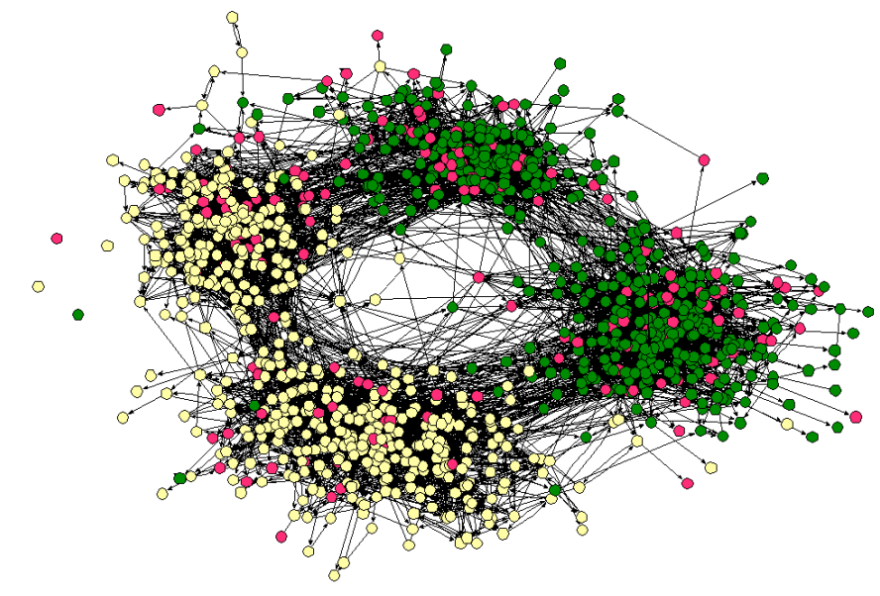
Social network from town’s middle and high schools
Clustering by race
Moody (2001)

Slide 5
Social network from town’s middle and high schools
Clustering by age
Moody (2001)

Slide 6
Homophily and Triadic Closure
Triadic closure: When two individuals share a common friend, a friendship between the two is more likely to occur
Homophily suggests two individuals are more alike because of common friend, so link may occur even if neither is aware of mutual friend!
Difficult to attribute formation of link to any one factor

Slide 7
Can we develop a simple test for the presence of homophily?

Slide 8
Example Male/Female Network
What would this network look like if it did not exhibit homophily?

Slide 9
Randomly Generated Network
Randomly assigned a gender according to gender balance of real network
Number of cross-gender edges should not change significantly relative to real network
If fraction p are males and q are females, what would be probably of…
p²
2pq
q²

Slide 10
Homophily Test: If the fraction of heterogeneous (cross-gender) edges is significantly less than 2pq then there is evidence for homophily
Cross-gender edges: 5 of 18
p = 6/9 = 2/3
q = 3/9 = 1/3
If no homophily, # of cross-gender edges should be 2pq = 4/9 = 8 out of 18
$∴$ Evidence of homophily

Slide 11
Notes on Homophily Test
“significantly less than” – How significant? A deviation below the mean is suitable
What if network had significantly more than 2pq cross-gender edges?
Inverse homophily
Example: Male-Female dating relationships

Slide 12
Notes on Homophily Test
Homophily test can be used to test any characteristic like race, age, native language, preferences, etc.
For characteristics that have more than 2 values, perform same type of calculation
Compare number of heterogeneous edges (edges with nodes that differ in interested characteristic) to what randomly generated graph would look like using real data as probabilities

Slide 13
Selection
Why is homophily often present in a social network?
Two major reasons: selection and social influence
Selection: People tend to choose friends that are like themselves

Slide 14
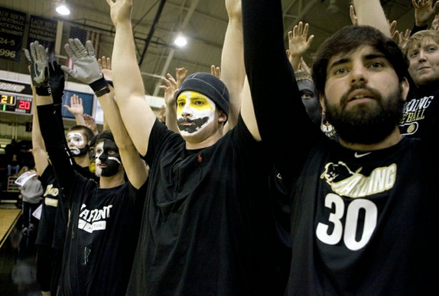
Selection
Can operate at different scales and levels of intentionality
You actively choose friends that are like yourself among a small group of people
Your school’s population is relatively homogeneous compared to overall population, so your environment compels you to choose friends like yourself

Slide 15
Mutable and Immutable Characteristics
Selection operates differently based on type of characteristic
Immutable: Characteristics that don’t change (gender, race) or change consistently with the population (age, generation)
Mutable: Characteristics that can change over time (behaviors, beliefs, interests, opinions)

Slide 16
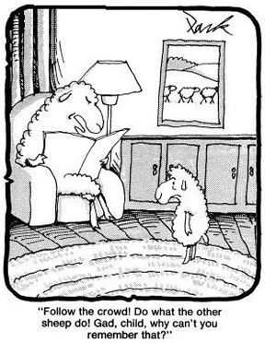
Social Influence
Research has shown that (surprise!) people are susceptible to social influence: they may change their behaviors to more closely resemble the behaviors of their friends
“Bad company corrupts good character.” – 1 Corinthians 15:33
Cartoon: http://nancybenet.com/dont-follow-the-crowd/

Slide 17
Selection and Social Influence
Social influence is reverse of selection
Selection: Individual characteristics drive the formation of links
Social influence: Existing links shape people’s mutable characteristics
Selection
Characteristics
Links
Social Inf

Slide 18
Longitudinal Studies
Difficult to tell if selection or social influence at play with a single snapshot of a network
Longitudinal studies tracking social connections and individual behaviors over time can help researchers uncover effect of social influence
Does behavior change after changes to network, or does network change after changes in behavior?

Slide 19
Example: Teenage Drug Use
Drug use affected more by selection or social influence?
Understanding these affects can be helpful in developing interventions
If drug use displays homophily in a network, targeting social influence (get friends to influence other friends to stop) might work best
But if homophily due to selection, former drug users may choose new friends and drug-using behavior of others is not strongly affected

Slide 20
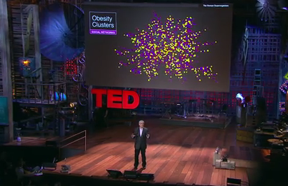
Social Influence of Obesity
Christakis and Fowler tracked obesity status and social network of 12,000 people over 32 years
Found homophily based on obesity status
They wanted to know why
Christakis & Fowler (2007) http://www.ted.com/talks/nicholas_christakis_the_hidden_influence_of_social_networks.html

Slide 21
Why Obesity Homophily?
Selection effects – people choose to befriend others of similar obesity status?
Confounding effects of homophily – other factors that correlate with obesity status?
Social influence – if friends changed their obesity status, did it influence person’s future obesity status?
Discovered significant evidence for hypothesis 3: Obesity is a type of “contagion” that can spread through social influence!

Slide 22
Affiliation Network
Putting context into the network by showing connections to activities, companies, organizations, neighborhoods, etc.
Bipartite graph: every edge joins two nodes belonging to different sets
Sue
Chess Club
Affiliations or foci
Bill
Band

Slide 23
Social-Affiliation Network
Two types of edges:
Person to person: Friendship or other social relationship
Person to foci: Participation in the focus
Gary
Sue
Chess Club
Alice
Band
Bill

Slide 24
Closure Processes
Gary
Sue
Triadic closure
Alice
Band
Sue
Focal closure: closure due to selection
Bill
Sue
Band
Membership closure: closure due to social influence
Gary

Slide 25
Research Questions About Closure
Would Sue be more likely to become friends with Alice if they shared more than one friend?
In other words, is triadic closure dependent on the number of shared friends?
More formally: What is the probability that two people form a link as a function of the number of mutual friends they share?
Gary
Sue
Gary
Sue
Alice
Alice
Moe

Slide 26
Research Questions About Closure
Focal closure: Probability that two people form a link as a function of the number of foci they are jointly affiliated with?
Membership closure: Probability that a person becomes involved in a particular focus as a function of the number of friends who are already involved in it?
Band
Sue
Bill
Ping Pong
Sue
Band
Gary
Jill

Slide 27
Research Methodology: Measuring Triadic Closure
Take two snapshots of network at times t₁ and t₂
For each k, identify all pairs of nodes who have exactly k friends in common at t₁ but who are not directly connected by an edge
Define T(k) to be fraction of these pairs that form an edge by t₂. This is the probability that a link will form between two people with k friends in common
Plot T(k) as function of k to illustrate effect of common friends on link formation

Slide 28
Research Methodology: Measuring Triadic Closure
Take two snapshots of network at times t₁ and t₂
t₁
t₂

Slide 29
Research Methodology: Measuring Triadic Closure
2. For each k, identify all pairs of nodes who have exactly k friends in common at t₁ but who are not directly connected by an edge
k = 0
t₁
t₂

Slide 30
Research Methodology: Measuring Triadic Closure
2. For each k, identify all pairs of nodes who have exactly k friends in common at t₁ but who are not directly connected by an edge
k = 0
t₁
t₂

Slide 31
Research Methodology: Measuring Triadic Closure
2. For each k, identify all pairs of nodes who have exactly k friends in common at t₁ but who are not directly connected by an edge
k = 0
Etc…
t₁
t₂

Slide 32
Research Methodology: Measuring Triadic Closure
2. For each k, identify all pairs of nodes who have exactly k friends in common at t₁ but who are not directly connected by an edge
k = 1
k = 2,
Etc…
t₁
t₂

Slide 33
Research Methodology: Measuring Triadic Closure
3. Define T(k) = fraction pairs that form an edge by t₂. This is the probability that a link will form between two people with k friends in common
T(1) = 1/1
T(0) = 1/11
t₁
t₂

Slide 34
Research Methodology: Measuring Triadic Closure
4. Plot T(k) as function of k to illustrate effect of common friends on link formation
T(k)
Prob of link
formation
k
Friends in common

Slide 35
Email Social Network
Kossinets and Watts (2006) examined email communication of 22,000 students over one year at a large US university
Made link between two people if an email was sent between the two in the last 60 days
Each snapshot is one day apart
T(k) averaged over multiple pairs of snapshots

Slide 36
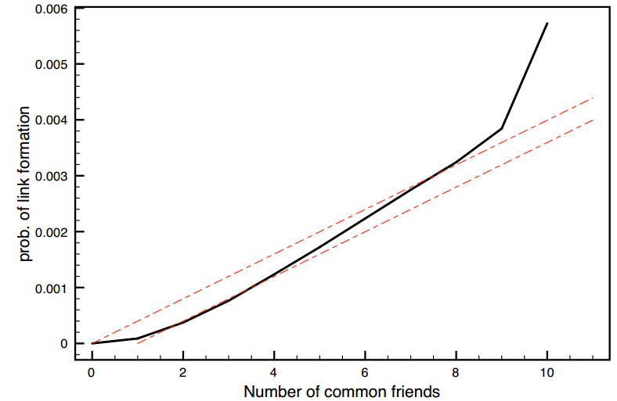
Triadic Closure in Email Data Set
Almost no emails exchanged when no friends in common
Figure from http://www.cs.cornell.edu/home/kleinber/networks-book/networks-book-ch04.pdf

Slide 37
Triadic Closure in Email Data Set
Significant increase but on much smaller subpopulation
Significant increase going from 1 to 2 friends
Figure from http://www.cs.cornell.edu/home/kleinber/networks-book/networks-book-ch04.pdf

Slide 38
Triadic Closure in Email Data Set
Baseline model: probability p of forming link when k friends in common T_{base}(k) = 1 – (1 – p)^{k}
T_{base}(k) = 1 – (1 – p)^{k-1}
Figure from http://www.cs.cornell.edu/home/kleinber/networks-book/networks-book-ch04.pdf

Slide 39
Email Social Network
To evaluate focal closure, Kossinets and Watts obtained class schedules for 22,000 students
Created social-affiliation network where classes are foci
Determined probability of link formation as function of number of shared foci
ENG 101
Sue
Bill
HIST 202

Slide 40
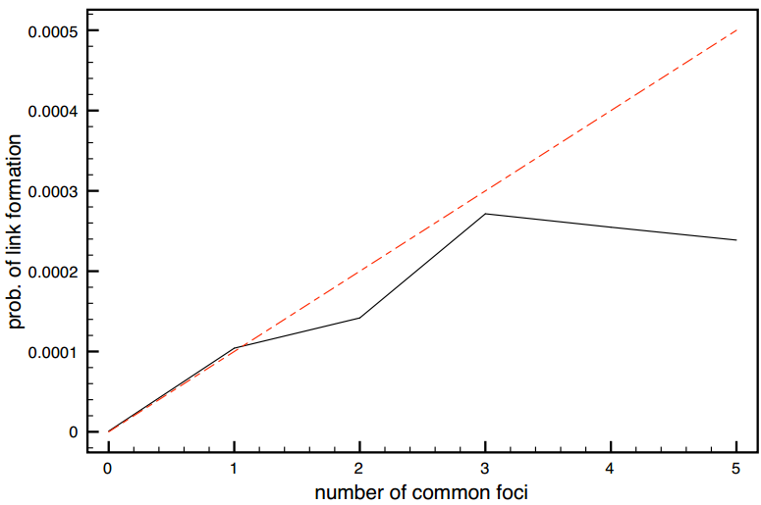
Focal Closure in Email Data Set
T_{base}(k) = 1 – (1 – p)^{k}
Sharing a class has nearly same effect as sharing a friend
Diminishing returns
Figure from http://www.cs.cornell.edu/home/kleinber/networks-book/networks-book-ch04.pdf

Slide 41
Measuring Membership Closure
Backstrom et al. (2006) created social-affiliation network for LiveJournal
Friendships designated by users in their profile
Foci are membership in user-defined communities
Sue
Jazz Comm
Gary
Jill
Notes:
LiveJournal is a social networking service where users can keep a blog. Moved to Russia in 2016.

Slide 42
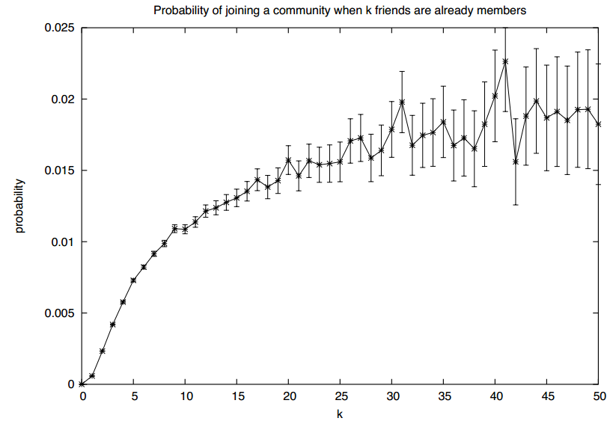
Membership Closure in LiveJournal Data Set
Significant increase going from 1 to 2
Diminishing returns
Figure from http://www.cs.cornell.edu/home/kleinber/networks-book/networks-book-ch04.pdf

Slide 43
Measuring Membership Closure
Crandall et al. (2008) created social-affiliation network for Wikipedia
Node for editors maintaining a user talk page
Link if two editors have communicated using talk page
Foci are articles edited by editors
Sue
Jazz Article
Gary
Jill

Slide 44
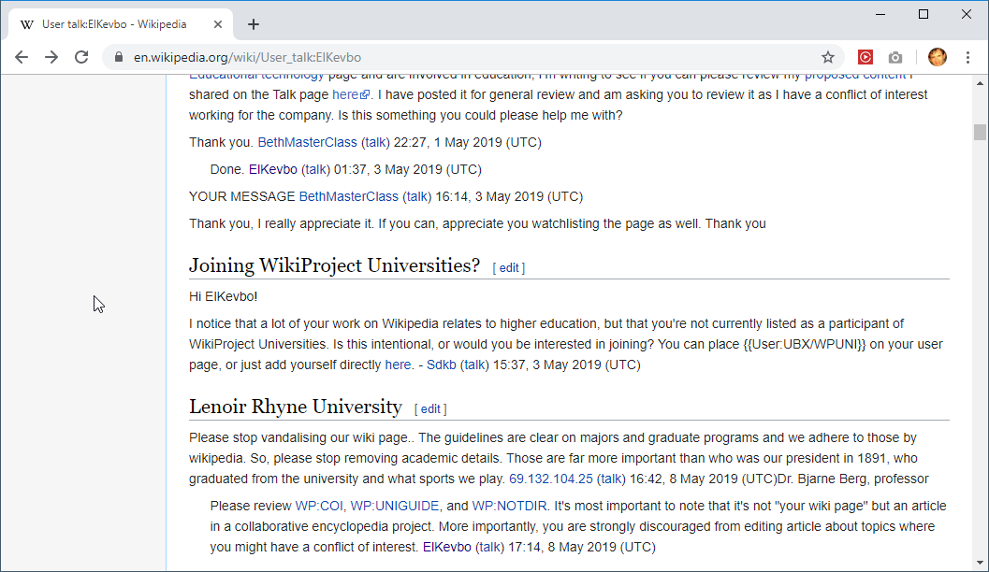
Example Talk page

Slide 45
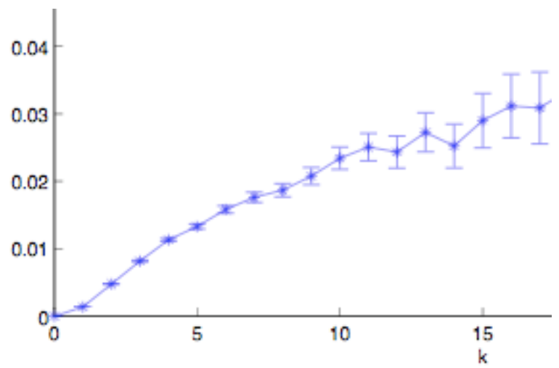
Membership Closure in Wikipedia Data Set
Probability of editing the same article when communicating with k editors that already edit the article
T(k)
Significant increase going from 1 to 2
Diminishing returns
Figure from http://www.cs.cornell.edu/home/kleinber/networks-book/networks-book-ch04.pdf

Slide 46
Selection and Social Influence
Further examination of Wikipedia data set to see evidence of homophily produced by selection and social influence
How do we measure similarity of two editors?
number of articles edited by both editors number of articles edited by at least one editor
Similar to neighborhood overlap of two editors in an affiliation network of editors and articles

Slide 47
Selection and Social Influence
Pairs of Wikipedia editors who have communicated are significantly more similar in behavior than editors who have never communicated
Does homophily arise because…
editors are talking with editors who have edited the same article? (selection)
editors are led to the articles by those they talk to? (social influence)

Slide 48
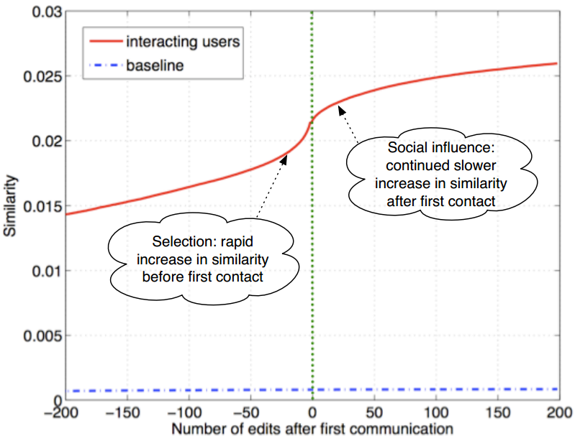
Figure from http://www.cs.cornell.edu/home/kleinber/networks-book/networks-book-ch04.pdf

Slide 49
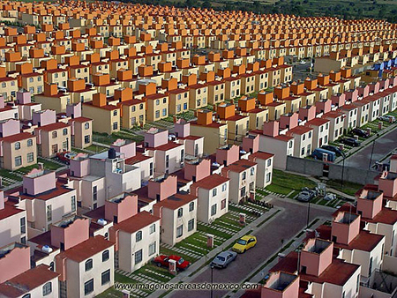
Segregation: Homophily at Work
Cities often divided into homogeneous neighborhoods based on ethnic and racial lines
Image: http://wideurbanworld.blogspot.com/2011/08/race-ethnicity-social-class-are-most.html

Slide 50
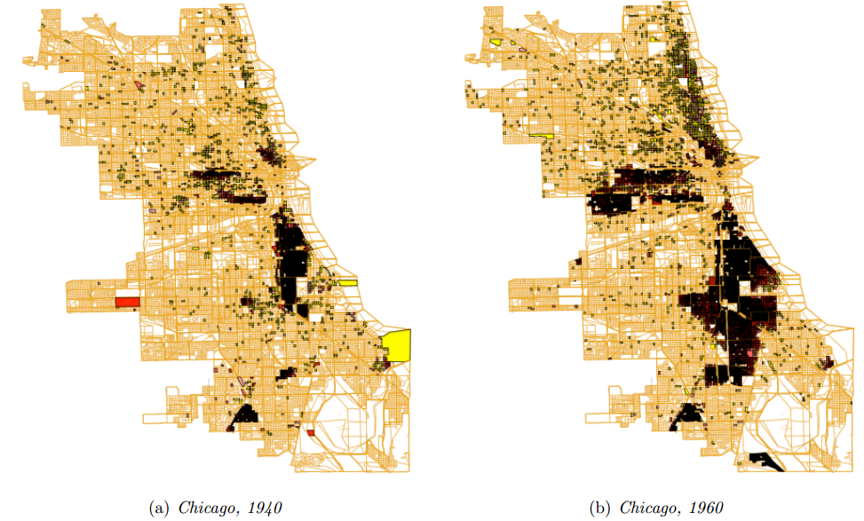
High density of African-Americans
Low density of African-Americans
Figure from http://www.cs.cornell.edu/home/kleinber/networks-book/networks-book-ch04.pdf

Slide 51
Schelling Model of Segregation
Thomas Schelling introduced simple model in 1970s that shows how global patterns of self-chosen segregation can occur due to the effects of homophily at the local level
Population formed by two types of individuals called agents (X and O)
Two types of agents represent immutable characteristic like race, ethnicity, country of origin, or native language

Slide 52
Agents placed randomly in grid
X | X | O
X | O | O | O
X | X |  | X | X
X | O |  | X | X
 | O | O
Agents are satisfied with their location in the grid if at least t of their neighbors are agents of the same type.
t = threshold

Slide 53
In each round, first identify all unsatisfied agents
X | X | O
X | O | O | O
X | X |  | X | X
X | O |  | X | X
 | O | O
Assume t is 3 – all agents prefer to have at least 3 neighboring agents that are of the same type

Slide 54
X | X | O
X | O | O | O
X | X |  | X | X
X | O |  | X | X
 | O | O
Unsatisfied because only 2 neighbors are X
Assume t is 3 – all agents prefer to have at least 3 neighboring agents that are of the same type

Slide 55
Unsatisfied because only 2 neighbors are X
X* | X | O
X | O | O | O
X | X |  | X | X
X | O |  | X | X
 | O | O
Assume t is 3 – all agents prefer to have at least 3 neighboring agents that are of the same type

Slide 56
Satisfied because 3 neighbors are O
X* | X* | O
X | O | O | O
X | X |  | X | X
X | O |  | X | X
 | O | O
Assume t is 3 – all agents prefer to have at least 3 neighboring agents that are of the same type

Slide 57
Satisfied because 4 neighbors are X
X* | X* | O
X | O | O | O
X | X |  | X | X
X | O |  | X | X
 | O | O
Assume t is 3 – all agents prefer to have at least 3 neighboring agents that are of the same type

Slide 58
Unsatisfied
X* | X* | O
X | O | O | O
X | X |  | X | X
X | O |  | X | X
 | O | O
Assume t is 3 – all agents prefer to have at least 3 neighboring agents that are of the same type

Slide 59
Satisfied
X* | X* | O
X | O* | O | O
X | X |  | X | X
X | O |  | X | X
 | O | O
Assume t is 3 – all agents prefer to have at least 3 neighboring agents that are of the same type

Slide 60
Unsatisfied
X* | X* | O
X | O* | O | O
X | X |  | X | X
X | O |  | X | X
 | O | O
Assume t is 3 – all agents prefer to have at least 3 neighboring agents that are of the same type

Slide 61
Etc… Here’s the final result where unsatisfied agents marked with *
X* | X* | O
X | O* | O | O*
X | X |  | X | X
X* | O* |  | X | X
 | O* | O*
Now all unsatisfied agents move to a location where they are satisfied

Slide 62
Note that the grid is now more segregated than before
Previously satisfied agent no longer satisfied!
 |  | O | O | O
X |  | O | O | O
X | X | X | X | X
 | X | X | X | X
 |  | O*
Sometimes an agent can’t find a new location that will satisfy – leave alone or move to random location

Slide 63
Model Variations
Schedule agents to move in random order or in sweeping motion
Agents move to nearest location that satisfies or random one
Threshold could be percentage or vary among or within population groups
World could wrap (left edge meets up with right edge)
Many other variations, but results usually end up the same: self-imposed segregation!

Slide 64
Schelling Simulators
Check out some of these simulators:
Frank McCown – Nifty Assignment http://nifty.stanford.edu/2014/mccown-schelling-model-segregation/
Uri Wilensky’s NetLogo Segregation model http://ccl.northwestern.edu/netlogo/models/Segregation
anylogic.com https://cloud.anylogic.com/model/a52d5c19-6a04-4ade-bea4-c2f7d470d037?mode=SETTINGS

Slide 65
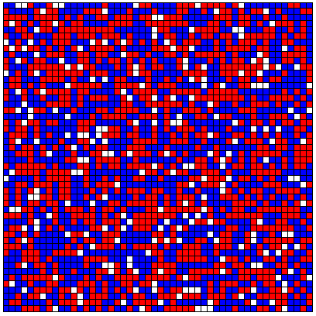
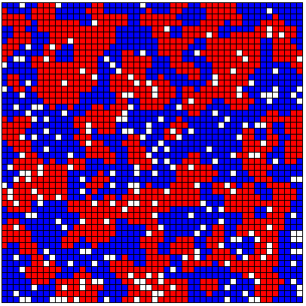
McCown’s Schelling Model using t = 30%
Randomly placed
After 15 rounds

Slide 66
Conclusion
Schelling model is an example of how immutable characteristics can become highly correlated with mutable characteristics
Choice of where to live (mutable) over time conforms to agents’ type (immutable) producing segregation (homophily)

