Slide 1
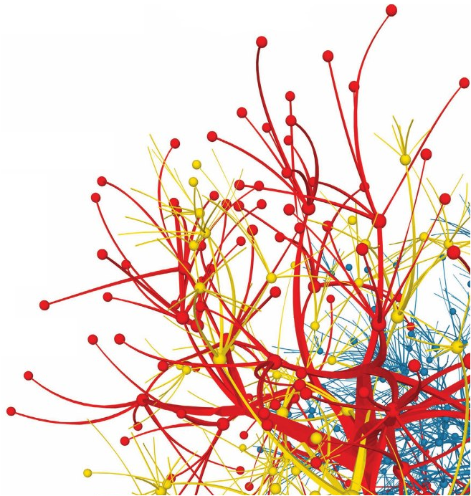

Introduction to Social Networks
Dr. Frank McCown
Intro to Web Science
Harding University
This work is licensed under a Creative Commons Attribution-NonCommercial-ShareAlike 3.0 Unported License

Slide 2
Social Network
Definition: Graph composed of actors (people, organizations, groups) that are tied by social links
relationship
A
follows
B
actors

Slide 3
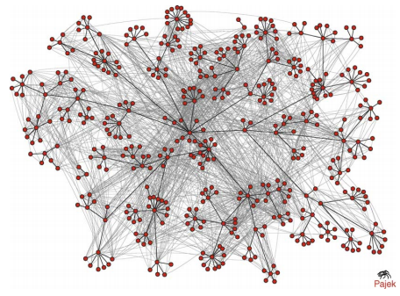
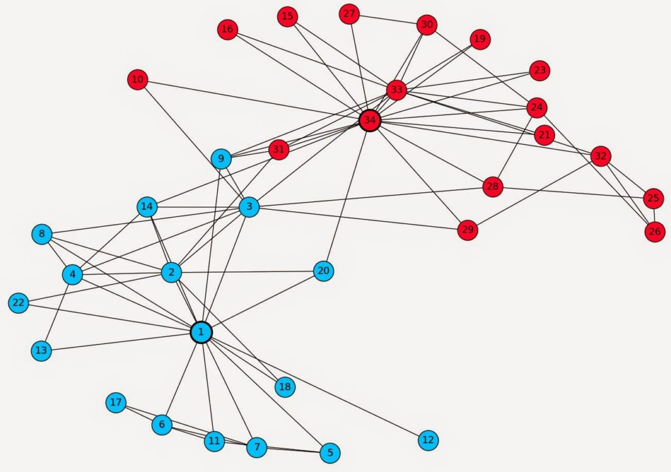
Social Networks
Zachary’s Karate Club Network
(Zachary, 1977)
Email between HP employees
(Adamic & Adar, 2005)

Slide 4
Online Social Networks (OSN)
Digital incarnation of a social network
Created by social network sites and services
Web-based services that allows users to:¹
  construct (semi-)public profiles within the system
  “connect” to other users
  view and traverse lists of connections created by others
¹Boyd & Ellison (2007) - Social Network Sites: Definition, History, and Scholarship

Slide 5









Slide 6
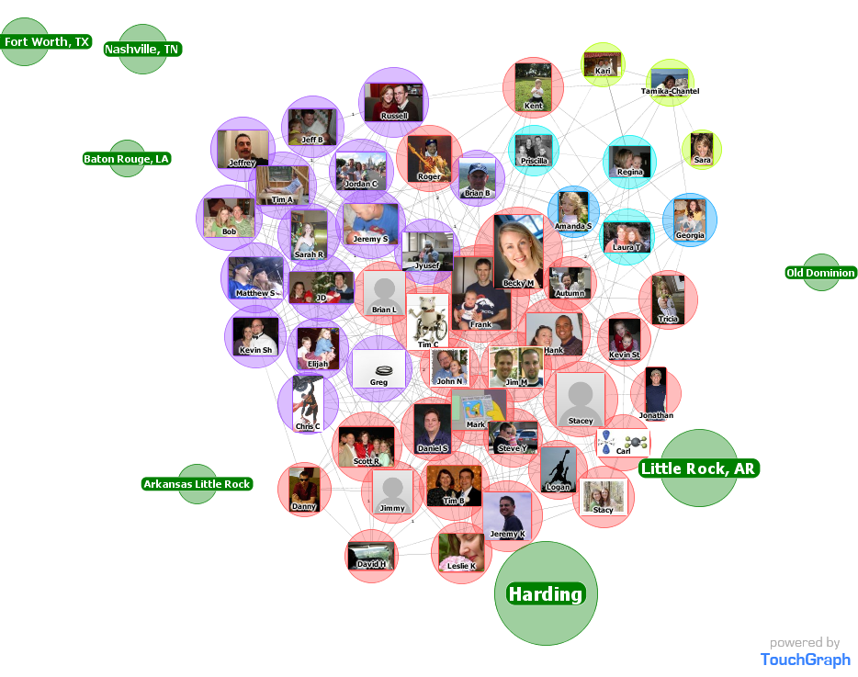
Facebook Friends

Slide 7
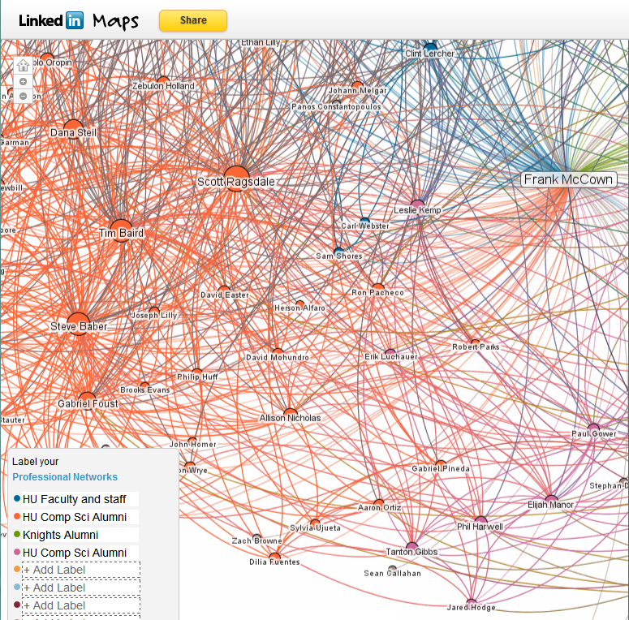
LinkedIn
Maps

Slide 8
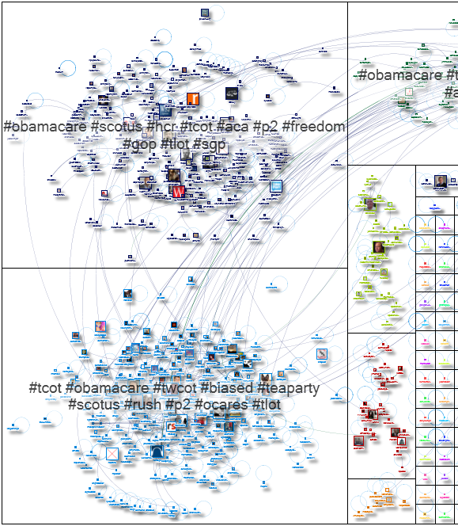
Tweets containing “obamacare”
http://www.nodexlgraphgallery.org/Pages/Graph.aspx?graphID=514

Slide 9
Why Study Social Networks?
Study how people interact
Develop theories of social behavior
Build systems that improve security, leverage trust, improve social interaction, etc.
Use OSNs to improve web search
Understand how (mis)information spreads on social networks

Slide 10
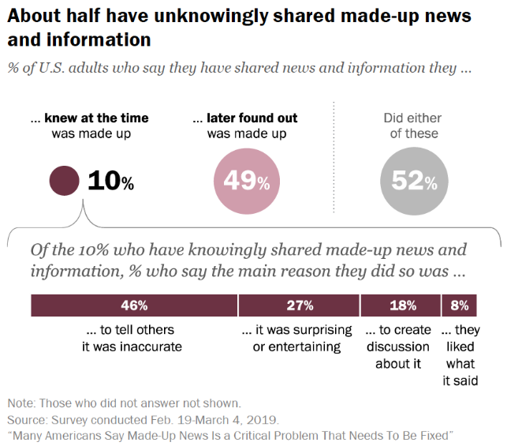
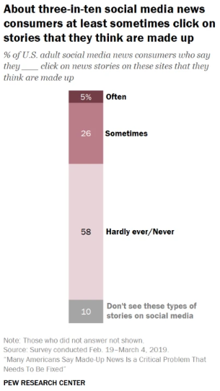
Many Americans Say Made-Up News Is a Critical Problem That Needs To Be Fixed
Mychell, et al. (2019)
https://www.journalism.org/2019/06/05/many-americans-say-made-up-news-is-a-critical-problem-that-needs-to-be-fixed/

Slide 11
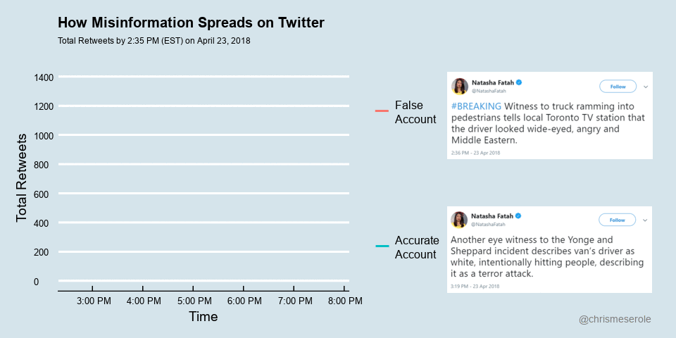
How misinformation spreads on social media—And what to do about it
Chis Meserole (2018)
https://www.brookings.edu/blog/order-from-chaos/2018/05/09/how-misinformation-spreads-on-social-media-and-what-to-do-about-it/

Slide 12
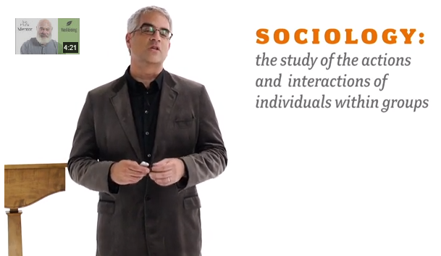
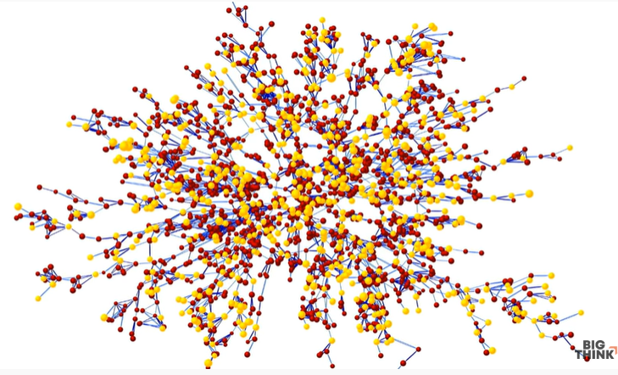
Nicholas Christakis
social scientist at Yale
https://www.youtube.com/watch?v=wadBvDPeE4E

Slide 13
Graph Types
Directed
Undirected
e.g., Twitter followers
e.g., Facebook friends

Slide 14
Graph Types
Weighted
Unweighted
5
2
3
e.g., Emails between people
e.g., Any communication between people

Slide 15
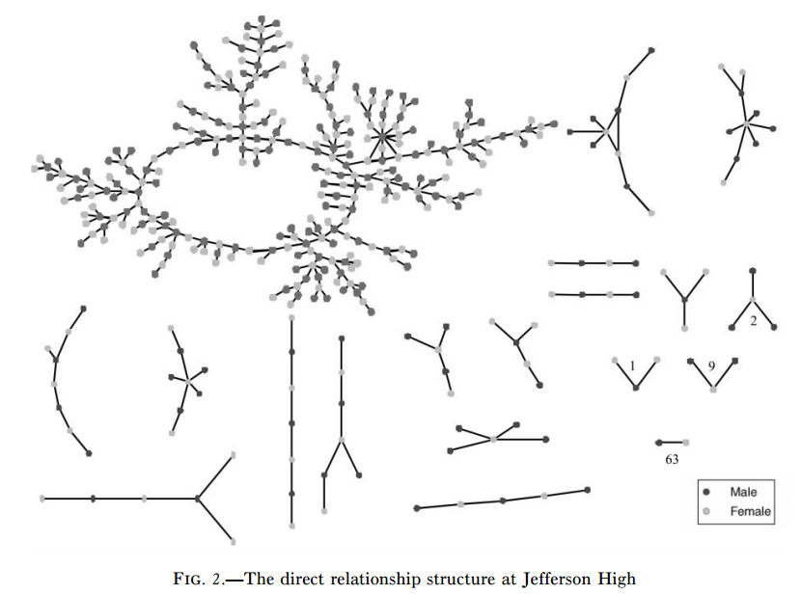
Components
Giant
component
Bearman, et al., Chains of Affection (2004)

Slide 16
Paths
End
Start
Bearman, et al., Chains of Affection (2004)

Slide 17
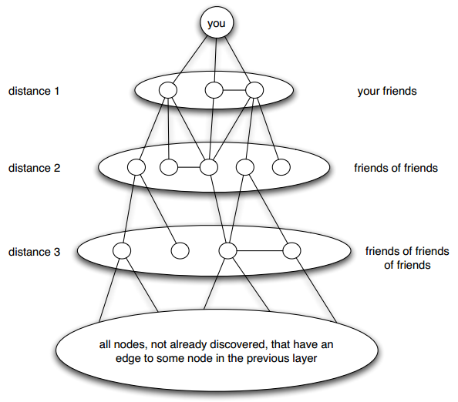
Distance
Length
of shortest
path
Breadth-first search
Easley & Kleinberg, Fig 2.8

Slide 18
Cycles
Cycle
Bearman, et al., Chains of Affection (2004)

Slide 19
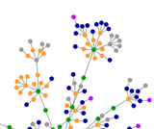
Small World Network
Six degrees of separation
From title of play by John Guare
First tested by Stanley Milgram in
1960s who found median length
of 6 between two individuals
OSNs make studying this
phenomena a little easier
http://en.wikipedia.org/wiki/Six_Degrees_of_Kevin_Bacon

Slide 20
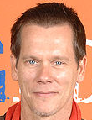


Six Degrees of Kevin Bacon
Bacon Number =
distance from Bacon
Ian McKellen
BN 2
BN 0
X-Men: First
Class (2011)
X-Men: Days of Future Past (2014)
Michael Fassbender
BN 1
Photos from Wikipedia

Slide 21
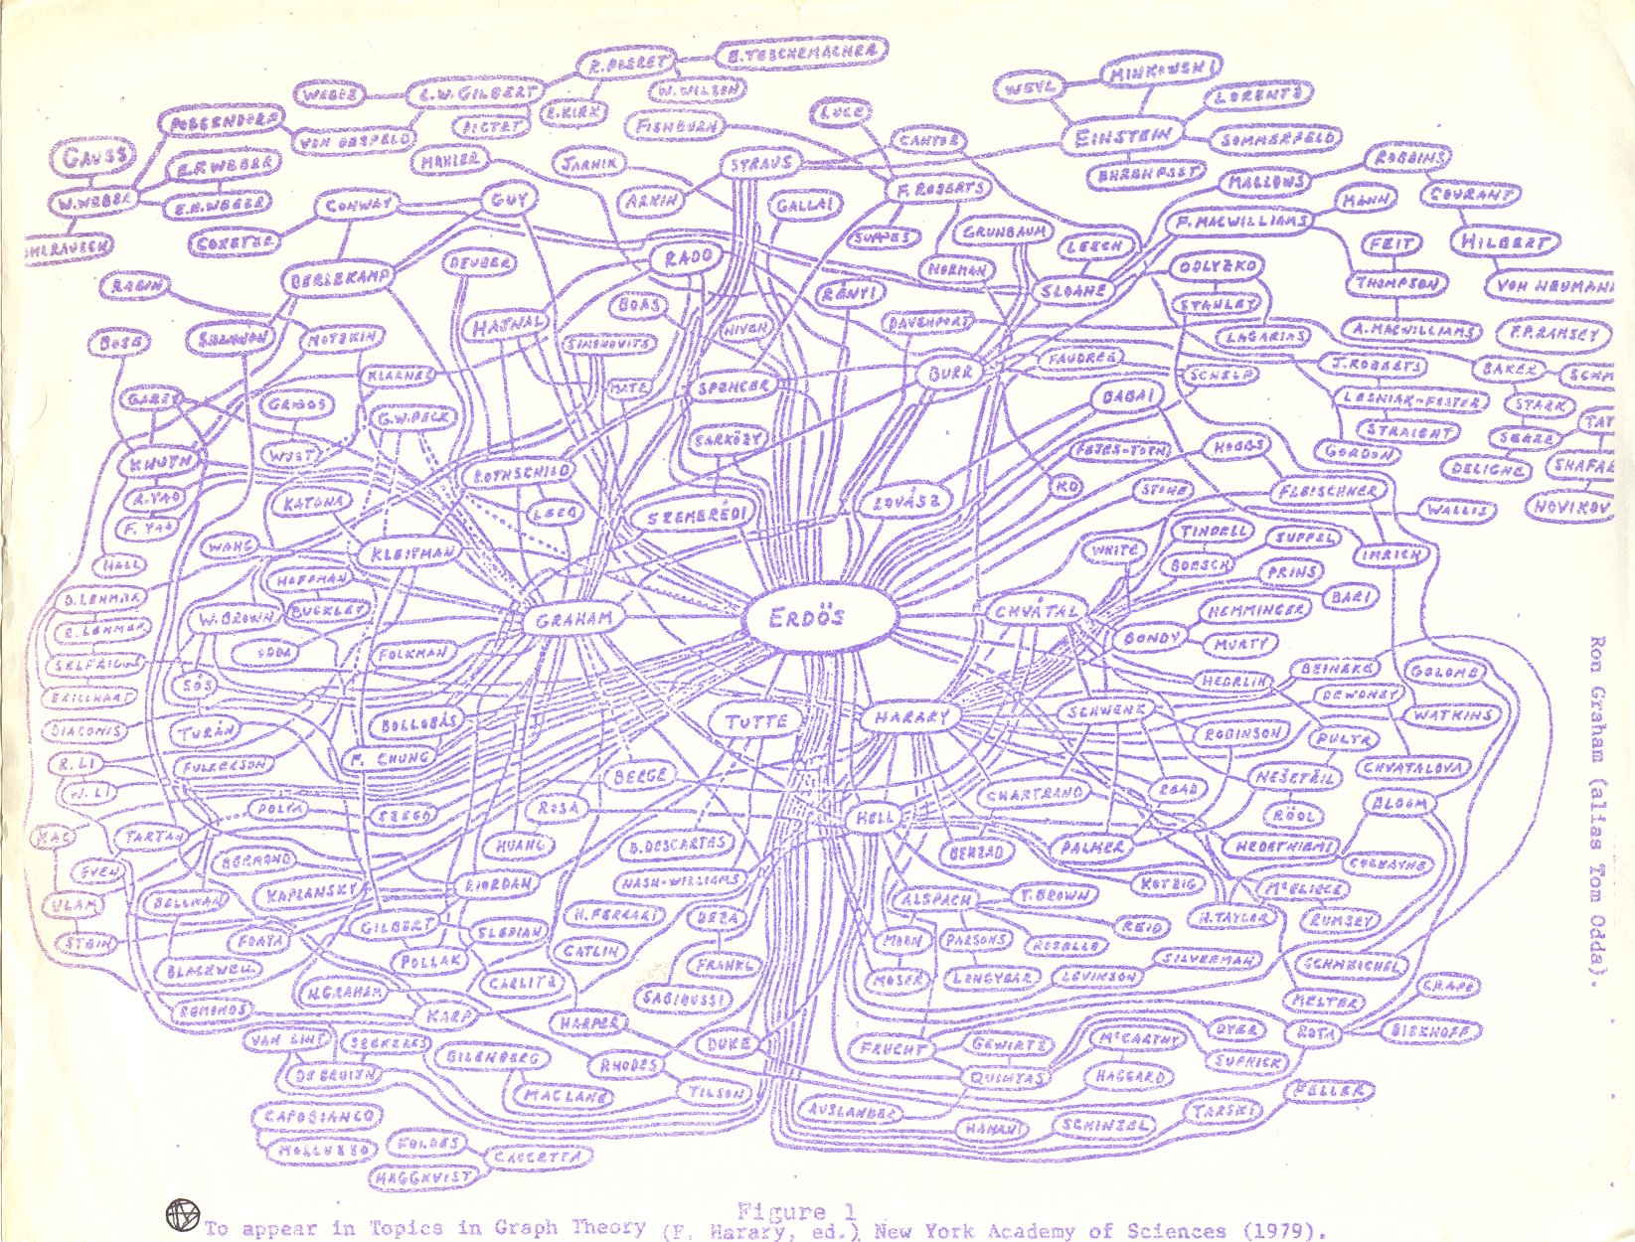
Erdos Number
Ron Graham’s hand-drawn graph
http://www.oakland.edu/enp/trivia/

Slide 22
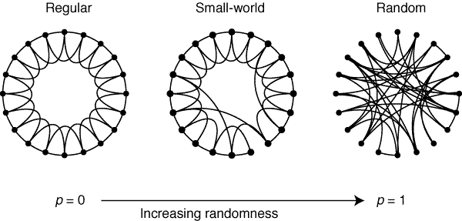
Regular → Small World → Random
Watts & Strogatz, Nature, 1998, http://dx.doi.og/10.1038/30918

Slide 23
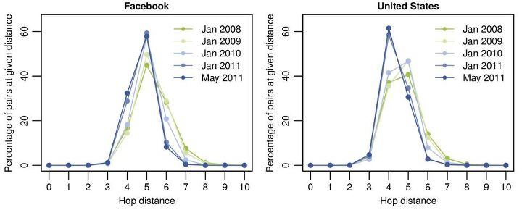
Four Degrees of Separation
Study of all Facebook users (721 million) in 2011 revealed ave distance of 4.74
https://www.facebook.com/notes/facebook-data-team/anatomy-of-facebook/10150388519243859

Slide 24
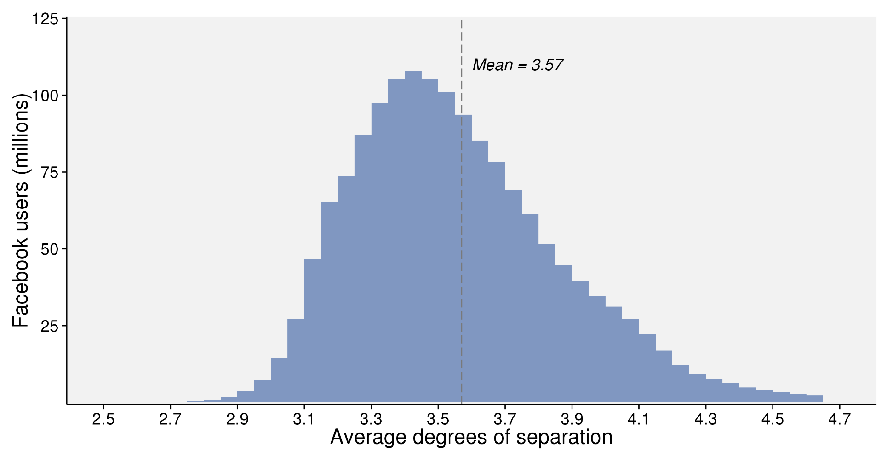
2016 Update: 3.57 Degrees
https://research.facebook.com/blog/three-and-a-half-degrees-of-separation/

Slide 25
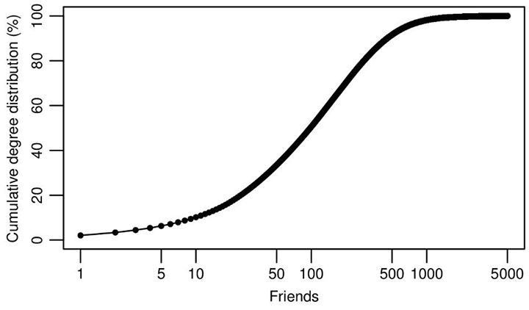
How Many Friends?
https://www.facebook.com/notes/facebook-data-team/anatomy-of-facebook/10150388519243859
example of a CDF: https://en.wikipedia.org/wiki/Cumulative_distribution_function

Slide 26
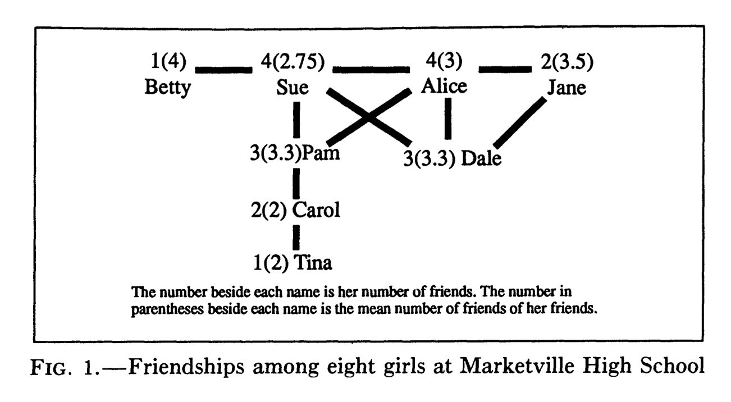
"Friendship Paradox"
Scott L. Feld (1991) Why Your Friends Have More Friends Than You Do
http://www.jstor.org/pss/2781907
http://www.uvm.edu/~pdodds/teaching/courses/2009-08UVM-300/docs/others/everything/feld1991a.pdf
http://en.wikipedia.org/wiki/Friendship_paradox
Your friends are also happier than you: http://arxiv.org/abs/1602.02665

Slide 27
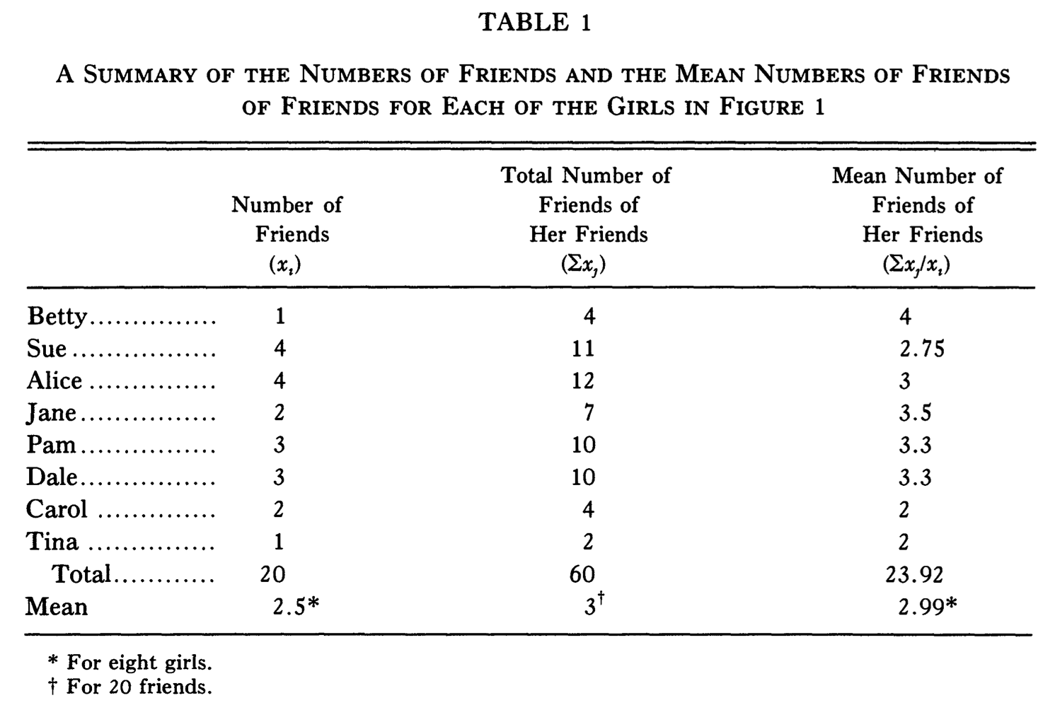
Sue & Alice Rule Marketville
(Carol is doing ok)
55% of girls have less than mean of their friends
28% of girls have more than mean of their friends

Slide 28
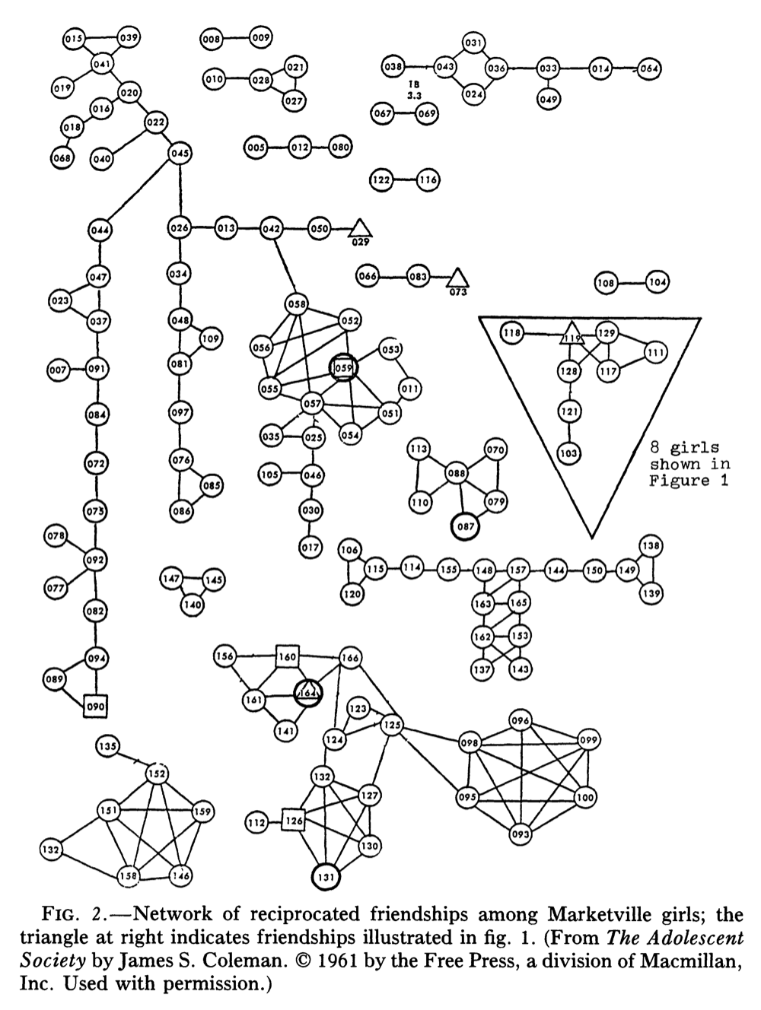
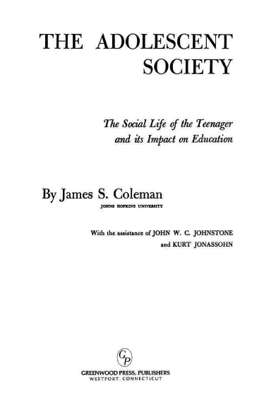
Complete Network
of Marketville
In 1961 study, friendship is via bi-directional
naming in a questionnaire (i.e., Facebook style).

Slide 29
Graph Data Representation
Adjacency matrix
Adjacency list
V1 → V2, V3
V2 → V1
V3 → V1
Edge list
V1,V2
V2,V3

Slide 30
Adjacency Matrix
A B C D
0 | 1 | 1 | 0
1 | 0 | 0 | 1
1 | 0 | 0 | 0
0 | 1 | 0 | 0
A
B
C
D
B
A
D
C

Slide 31
Adjacency Matrix with Weights
A B C D
0 | 5 | 3 | 0
5 | 0 | 0 | 2
3 | 0 | 0 | 0
0 | 2 | 0 | 0
A
B
C
D
5
B
A
2
3
D
C

Slide 32
Adjacency Matrix with Directed Edges
A B C D
0 | 1 | 1 | 0
0 | 0 | 0 | 0
0 | 0 | 0 | 0
0 | 1 | 0 | 0
A
B
C
D
B
A
D
C

Slide 33
Adjacency List
B
B
A
A
D
D
C
C
A → B, C
B → A, D
C → A
D → B
A → B, C
B →
C →
D → B

Slide 34
Edge List
B
B
5
B
A
A
A
2
D
D
3
D
C
C
C
AB
AC
BD
AB
AC
DB
AB (5)
AC (3)
BD (2)

Slide 35
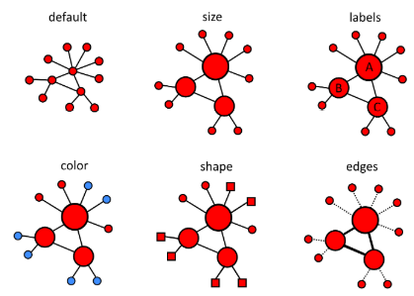
Visualizing Graphs
Most effective visualizations provide immediate understanding to viewer
Vary size, color, shape, and labels
Image from DataCamp: https://campus.datacamp.com/courses/network-analysis-in-r/introduction-to-networks-1?ex=9

Slide 36
Graph Layouts – Best Practices
Minimize edge crossing
No: Yes:
No overlapping vertices
No: Yes:
Uniform edge lengths
No: Yes:

Slide 37
Graph Layouts – Best Practices
Maximize graph symmetry
No: Yes:
Position more influential nodes toward center
No: Yes:

Slide 38
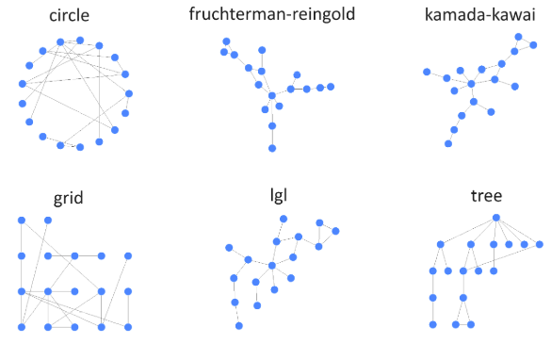
Common Layouts
Most graphing libraries contain several standard layouts
Image from DataCamp: https://campus.datacamp.com/courses/network-analysis-in-r/introduction-to-networks-1?ex=9

Slide 39
Other Helpful Resources
Bibliography of Research on Social Network Sites
http://www.danah.org/researchBibs/sns.php
Christakis and Fowler, Connected (2009)
Kadushin, Understanding Social Networks (2011)

