Slide 1

Introduction to Web Science
Dr. Frank McCown
Intro to Web Science
Harding University
This work is licensed under a Creative Commons Attribution-NonCommercial-ShareAlike 3.0 Unported License

Slide 2

What is
Web
Science?
Web Science is the interdisciplinary study of the Web as an entity and phenomenon. It includes studies of the Web’s properties, protocols, algorithms, and societal effects.
http://mags.acm.org/communications/200807/#pg1

Slide 3



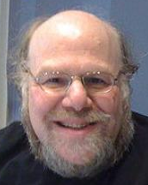

Background
Web Science initiative launched in Nov 2006 by University of Southampton and MIT
Nigel Shadbolt
Tim Berners-Lee
Wendy Hall
James Hendler
Daniel Weitzer
Images from http://webscience.org/people.html

Slide 4
Degrees in Web Science
Undergrad BS in Information Technology and Web Science at Rensselaer Polytechnic Institute
MS degree in Web Science at
  University of Southampton
  University of San Francisco
  Aristotle University of Thessaloniki
  RPI (Web Science emphasis)

Slide 5
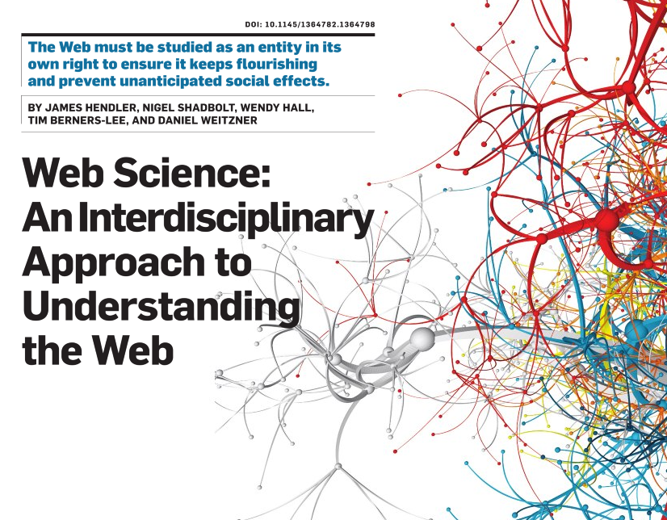
Communications of the ACM
July 2008

Slide 6
“Given the breadth of the Web and its inherently multi-user (social) nature, its science is necessarily interdisciplinary, involving at least mathematics, CS, artificial intelligence, sociology, psychology, biology, and economics. We invite computer scientists to expand the discipline by addressing the challenges following from the widespread adoption of the Web and its profound influence on social structures, political systems, commercial organizations, and educational institutions.”

Slide 7
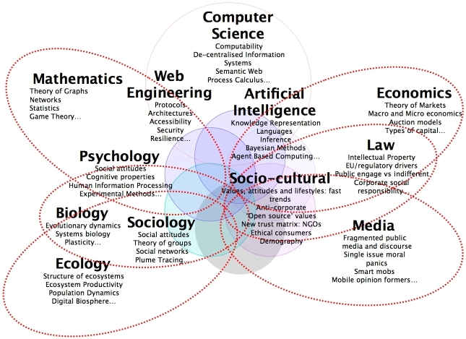
Web Science is Interdisciplinary
O'Hara and Hall, Web Science, ALT Online Newsletter, May 6, 2008

Slide 8
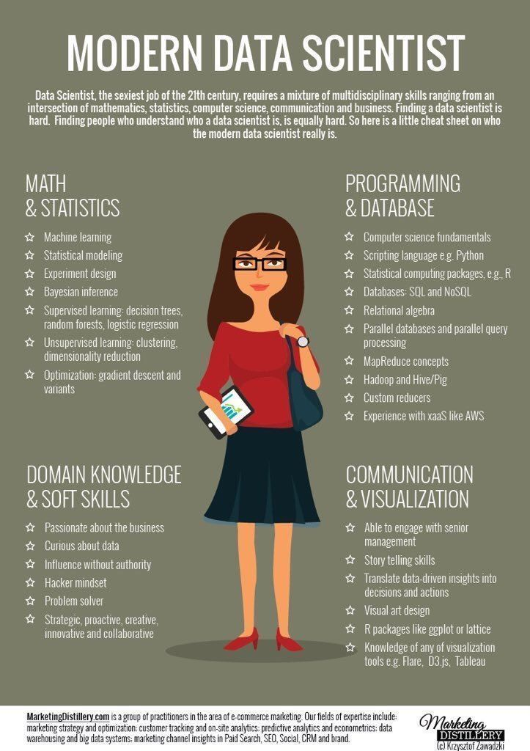
Science by another name?
Web science
Network science
Data science
https://twitter.com/dataiku/status/817435065777012736

Slide 9
Some questions of study:
How is the Web structured? What is its size?
How can unstructured data mined from the Web be combined in meaningful ways?
How does information/misinformation spread on the Web? How can we discover its origin?
How can the Web used to effectively harness the collective intelligence of its users?
How can trust be measured on the Web?
How can privacy be maintained on the Web?
What do events gathered from online social networks tell us about the human condition?
Has the Web changed how humans think?
Why is this important?
Huge implications for web search!

Slide 10
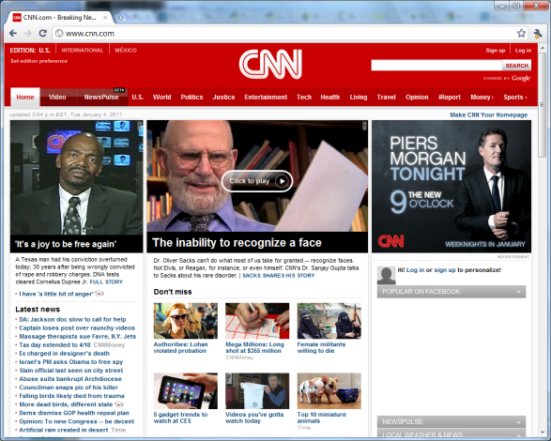

How is the Web structured?
link
Graph Theory: Pages are nodes &
links are directed edges

Slide 11
Web Graph
Normal/Gaussian Distribution
Random Graph
Total
web pages
Num of In-links
Power-law Distribution
Typical Web Graph
Total
web pages
Num of In-links

Slide 12
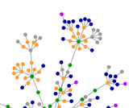
Small World Network
Six degrees of separation
Most pages are not neighbors
but most pages can be reached
from others by a small number
of hops
Many hubs- pages with many inlinks
Robust for random node deletions
Other examples: road maps, networks of brain neurons, voter networks, and social networks

Slide 13
Bow-Tie Structure of the Web
17 Million nodes
Broder et. al (Graph Structure of the Web, 2000)
Examined a large web graph (200M pages, 1.5B links)
Notes:
SCC = Strongly Connected Component

Slide 14
Bow-Tie Structure
75% of pages do not have a direct path from one page to another
Ave distance is 16 clicks when path exists and 7 clicks when undirected path exists
Diameter of SCC is at least 28 (max shortest distance between any two nodes)
Diameter of entire Web is at least 500 (most distant node in IN to OUT)
Broder et al., Graph Structure of the Web, 2000

Slide 15
Web Structure’s Implications
If we want to discover every web page on the Web, it’s impossible since there are many pages that aren’t linked to
Finding popular pages is easy, but finding pages with few in-links (the long tail) is more difficult
How do we know when new pages are added to the Web or removed?
Incoming links could tell us something about the “importance” of a page when searching the Web for information (e.g., PageRank)
Link structure of the Web can be artificially manipulated

Slide 16
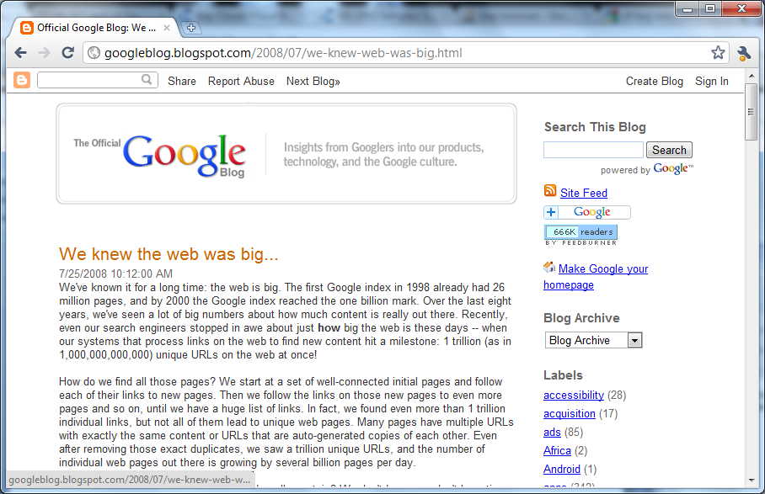
How large is the Web?
1 trillion unique URLs

Slide 17
How did Google discover all these URLs?
By crawling the web

Slide 18
Web Crawler
Web crawlers are used to fetch a page, place all the page’s links in a queue, and continue the process for each URL in the queue
Figure: McCown, Lazy Preservation: Reconstructing Websites from the Web Infrastructure, Dissertation, 2007

Slide 19
Problems with Web Crawling
Slow because crawlers limit how frequently they make requests to the same server (politeness policy)
Many pages are disconnected from the SCC, password-protected, or protected by robots.txt
There are an infinite number of pages (e.g., calendar) so crawlers limit how deeply they crawl
Web pages are continually being added and removed
Deep web: Many pages are only accessible behind a web form (e.g., US patent database). Deep web is magnitudes larger than surface web, and 2006 study¹ shows only 1/3 is indexed by big three search engines
¹He et al., Accessing the deep web, CACM 2007

Slide 20
What Counts?
Many duplicate pages (30% of web pages are duplicates or near-duplicates¹)
  How do we efficiently compare across a large corpus?
Some pages change every time they are requested
  How can we automatically determine what is an insignificant difference?
Many spammy pages (14% of web pages²)
  How can we detect these?
¹Fetterly et al., On the evolution of clusters of near-duplicate web pages, J of Web Eng, 2004
²Ntoulas et al., Detecting spam web pages through content analysis, WWW 2006

Slide 21
Some Observations
Crawling a significant amount of the Web is hard
Different search engines have different pages indexed, but they don’t share these differences with each other (company secret)
So if we wanted to estimate the Web’s size but don’t want to try to crawl the Web ourselves, could we use the search engines themselves to estimate the Web’s size?

Slide 22
Capture-Recapture Method
Statistical method used to estimate population size (originally fish and wildlife populations)
Example: How many fish are in the lake?
  Catch S₁ fish from the lake, tag them, and return them to the lake
  Then catch and put back S₂ fish, noting which are tagged (S_{1∩2})
  S₁/N = S_{1∩2}/S₂ so population N = S₁ × S₂/S_{1∩2}
S_{1∩2}
S₂
N
S₁
Notes:
If you solve for N using the example above, how does the number you got compare with N = 28?
Solved N = 38.5

Slide 23
Estimate Web Population
Lawrence and Giles¹ used capture-recapture method to estimate web page population
  Submitted 575 queries to sets of 2 search engines
  S1 = All pages returned by SE1
  S2 = All pages returned by SE2
  S1∩2 = All pages returned by both SE1 and SE2
  Size of indexable Web (N) = S₁ × S₂/S_{1∩2}
Estimated size of indexable Web in 1998 = 320 million pages
Recent measurements using similar methods find lower bound of 5.2 billion pages²
¹Lawrence & Giles, Searching the World Wide Web, Science, 1998
²http://www.worldwodewebsize.com/

Slide 24
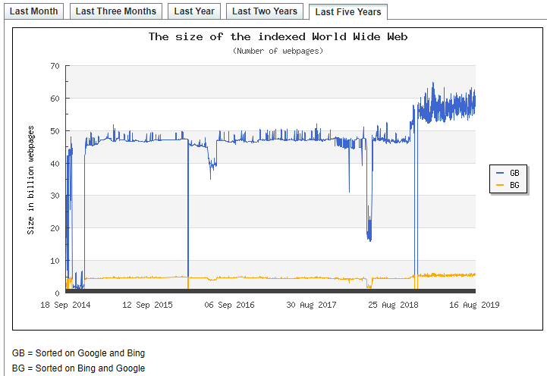
Estimate using Lawrence and Giles method with Google and Bing
At least 5.2 billion
pages in Aug 2019
https://www.worldwidewebsize.com/

Slide 25
This is just a sample of Web Science that we will be examining from a computing perspective.

Slide 26
More Resources
Video: Nigel Shadbolt on Web Science (2008)
http://webscience.org/webscience.html
Slides: “What is Web Science?” by Carr, Pope, Hall, Shadbolt (2008) http://www.slideshare.net/lescarr/what-is-web-science

