Slide 1

Web Architecture
Dr. Frank McCown
Intro to Web Science
Harding University
This work is licensed under a Creative Commons Attribution-NonCommercial-ShareAlike 3.0 Unported License

Slide 2
Internet != Web
File transfer
Web
IM
VoIP
Streaming video
email
The Internet
Notes:
BitTorrent – accounts for about half of all Internet traffic

Slide 3
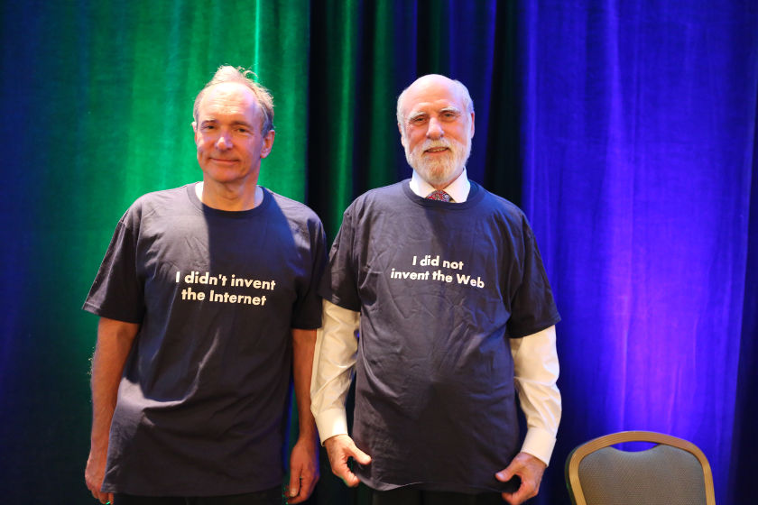
Tim Berners-Lee
Vint Cerf
From: http://www.internethalloffame.org/blog/2014/12/10/internet-hall-fame-news-highlights

Slide 4
“The Internet is a global system of interconnected computer networks that use the standard Internet Protocol Suite (TCP/IP) to serve billions of users worldwide.”
http://en.wikipedia.org/wiki/Internet
Internet
Computer 1
Computer 2
255.254.253.252
1.2.3.4

Slide 5
Internet Protocol Suite
Internet Protocol (IP): directs packets to a specific computer using an IP address
Transmission Control Protocol (TCP): directs packets to a specific application on a computer using a port number.
  Common port numbers:
    22 – ssh
    23 – telnet
    25 – email
    80 – Web

Slide 6
Overview of the Web
Internet
Client – Web Browser
Web Server
255.254.253.252
1.2.3.4
World Wide Web: The system of interlinked hypertext documents accessed over the Internet using the HTTP protocol.

Slide 7
Hypertext Transfer Protocol (HTTP)
HTTP is the set of rules that govern communication between web browsers and web servers.
HTTP Request
GET /fmccown/ HTTP/1.1
Host: cs.harding.edu
HTTP Response
HTTP/1.1 200 OK
Date: Wed, 21 Aug 2019 15:25:37 GMT
Server: Apache/2.4.6 (CentOS)
Last-Modified: Fri, 18 Jan 2013 17:10:33 GMT
ETag: "a9-4d393306dd440"
Accept-Ranges: bytes
Content-Length: 169
Content-Type: text/html; charset=UTF-8
<!DOCTYPE html>
<html lang="en">
Etc…
Example request for http://cs.harding.edu/fmccown/
header
body

Slide 8
Domain Name System (DNS)
DNS is a hierarchical look-up service that converts a given hostname into its equivalent IP address
DNS Server
www.harding.edu
128.82.4.20
www.google.com → 1.4.5.8
www.cnn.com → 4.6.2.8
www.hulu.com → 6.7.8.9
Etc ...
DNS servers contact parent servers for missing entries
Authoritative name servers are responsible for specific domains
Warning: DNS cache poisoning

Slide 9
Example: Web Page Request
DNS
(1) Enter URL
(2) foo.org
(3) 1.2.3.4
http://foo.org/bar.html
(4) HTTP GET bar.html
(5) Locate the resource
(6) HTTP Response
(7) Parse HTML
& display
(8) HTTP GET image1
(N) HTTP GET imageX
Potentially many requests & responses
Client (Web Browser)
Web Server

Slide 10
More Formal Definitions
HTTP defined by Request for Comments (RFCs) 1945, 2068, and 2616
Other RFCs for defining URLs (1736, 1738), URIs (1630, 2396), etc.
Web architecture defined in W3C’s The Architecture of the World Wide Web, Volume One
  http://www.w3.org/TR/webarch/

Slide 11
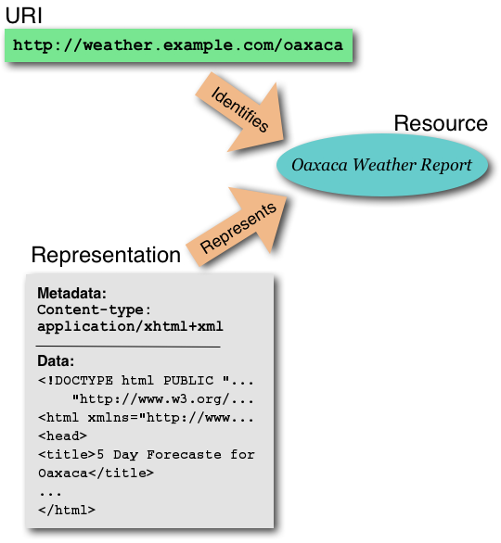
Web Definition
“The World Wide Web (WWW, or simply Web) is an information space in which the items of interest, referred to as resources, are identified by global identifiers called Uniform Resource Identifiers (URI).” – W3C
http://www.w3.org/TR/webarch/

Slide 12
URIs, Resources, and Representations
URIs identify Resources
Representations represent Resources
When URIs are dereferenced, they return representations (not resources)
Different representations may be returned for the same URI (e.g., English vs. French version)
http://www.w3.org/TR/webarch/

Slide 13
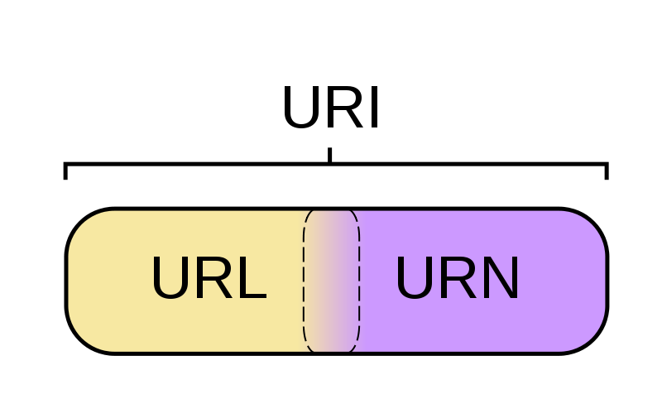
What’s a URx?
URI - String of chars used to identify a name or resource
on the Internet
URL - Where to find a resource
URN - Name of a resource
Figure: http://en.wikipedia.org/wiki/File:URI_Euler_Diagram_no_lone_URIs.svg

Slide 14
URI Components
foo://username:password@example.com:8042/over/there/index.dtb;type=animal?name=ferret#nose
\ / \________________/\_________/ \__/ \___/ \_/ \_________/ \_________/ \__/
| | | | | | | | |
| userinfo hostname port | | parameter query fragment
| \_______________________________/ \_____________|____|____________/
scheme | | | |
| authority |path|
| | |
| path interpretable as filename
| ___________|____________ |
/ \ / \ |
urn:example:animal:ferret:nose interpretable as extension
Other examples:
http://example.org/absolute/path/to/resource.txt
ftp://example.org/resource.txt
urn:issn:1535-3613
Figure: http://en.wikipedia.org/wiki/URI_scheme

Slide 15
HTTP with curl
$ curl -I https://www.harding.edu/
HTTP/1.1 200 OK
Server: nginx/1.10.3 (Ubuntu)
Date: Wed, 21 Aug 2019 15:18:53 GMT
Content-Type: text/html
Content-Length: 31380
Last-Modified: Wed, 21 Aug 2019 05:16:05 GMT
Connection: keep-alive
ETag: "5d5cd395-7a94"
Accept-Ranges: bytes
$ curl https://www.harding.edu/
<!DOCTYPE html>
<head>
<meta charset="utf-8">
<meta http-equiv="X-UA-Compatible" content="IE=edge">
Etc…
curl is a command-line tool for making HTTP requests
https://curl.haxx.se/
Options:
-I : Show header only
-i : Show header and body

Slide 16
See All Headers
$ curl -vs http://cs.harding.edu/fmccown/
* Trying 10.1.154.3...
* TCP_NODELAY set
* Connected to cs.harding.edu (10.1.154.3) port 80 (#0)
> GET /fmccown/ HTTP/1.1
> Host: cs.harding.edu
> User-Agent: curl/7.55.1
> Accept: */*
>
< HTTP/1.1 200 OK
< Date: Wed, 21 Aug 2019 15:38:18 GMT
< Server: Apache/2.4.6 (CentOS) OpenSSL/1.0.2k-fips
< Last-Modified: Wed, 21 Aug 2019 15:29:21 GMT
< ETag: "124-590a23cb2b640"
< Accept-Ranges: bytes
< Content-Length: 292
< Content-Type: text/html; charset=UTF-8
<
<!DOCTYPE html>
<html lang="en">
Etc…
TCP/IP connection
Request header
Response header

Slide 17
POST Example
$ curl -vs -d "name=Bob&age=21" -X POST https://wp.zybooks.com/form-viewer.php
…
> POST /form-viewer.php HTTP/1.1
> Host: wp.zybooks.com
> User-Agent: curl/7.55.1
> Accept: */*
> Content-Length: 15
> Content-Type: application/x-www-form-urlencoded
>
(body is encrypted)
…
< HTTP/1.1 200 OK
< Date: Wed, 21 Aug 2019 15:48:25 GMT
< Content-Type: text/html
< Transfer-Encoding: chunked
< Connection: keep-alive
< Server: nginx/1.4.6 (Ubuntu)
< X-Powered-By: PHP/5.5.9-1ubuntu4.17
<
<!DOCTYPE html>
<html>
…

Slide 18
Response Codes
From section 6.1.1 of RFC 2616
- 1xx: Informational - Request received, continuing process
- 2xx: Success - The action was successfully received,
understood, and accepted
- 3xx: Redirection - Further action must be taken in order to
complete the request
- 4xx: Client Error - The request contains bad syntax or cannot
be fulfilled
- 5xx: Server Error - The server failed to fulfill an apparently
valid request

Slide 19
301 – Moved Permanently
$ curl -i http://www.harding.edu/comp/
HTTP/1.1 301 Moved Permanently
Server: nginx/1.10.3 (Ubuntu)
Date: Wed, 21 Aug 2019 16:04:51 GMT
Content-Type: text/html
Content-Length: 194
Connection: keep-alive
Location: https://www.harding.edu/comp/
<html>
<head><title>301 Moved Permanently</title></head>
<body bgcolor="white">
<center><h1>301 Moved Permanently</h1></center>
<hr><center>nginx/1.10.3 (Ubuntu)</center>
</body>
</html>

Slide 20
404 – Not Found
$ curl -i http://cs.harding.edu/BLAH
HTTP/1.1 404 Not Found
Date: Wed, 21 Aug 2019 16:09:33 GMT
Server: Apache/2.4.6 (CentOS) OpenSSL/1.0.2k-fips PHP/5.4.16 mod_apreq2-20090110/2.8.0 mod_perl/2.0.10 Perl/v5.16.3
Content-Length: 202
Content-Type: text/html; charset=iso-8859-1
<!DOCTYPE HTML PUBLIC "-//IETF//DTD HTML 2.0//EN">
<html><head>
<title>404 Not Found</title>
</head><body>
<h1>Not Found</h1>
<p>The requested URL /BLAH was not found on this server.</p>
</body></html>

Slide 21
501 – Not Implemented
$ curl -X BLAH http://cs.harding.edu/
HTTP/1.1 501 Not Implemented
Date: Wed, 21 Aug 2019 17:27:08 GMT
Server: Apache/2.4.6 (CentOS) OpenSSL/1.0.2k-fips PHP/5.4.16 mod_apreq2-20090110/2.8.0 mod_perl/2.0.10 Perl/v5.16.3
Allow: GET,HEAD,POST,OPTIONS,TRACE
Content-Length: 202
Connection: close
Content-Type: text/html; charset=iso-8859-1
<!DOCTYPE HTML PUBLIC "-//IETF//DTD HTML 2.0//EN">
<html><head>
<title>501 Not Implemented</title>
</head><body>
<h1>Not Implemented</h1>
<p>BLAH to /index.html not supported.<br />
</p>
</body></html>

