Slide 1
Web Archiving
Dr. Frank McCown
Intro to Web Science
Harding University
This work is licensed under a Creative Commons Attribution-NonCommercial-ShareAlike 3.0 Unported License

Slide 2
What is it?
Web archiving is the process of collecting pages from the Web and saving them in an archive
Usually it’s important to save all associated resources (images, style sheets, etc.) to preserve look
Archives are typically produced using web crawlers

Slide 3
The Ephemeral Web
Linkrot is a significant problem
Kahle (‘97) - Average page lifetime is 44 days
Koehler (‘99, ‘04) - 67% URLs lost in 4 years
Lawrence et al. (‘01) - 23%-53% URLs in CiteSeer papers invalid over 5 year span (3% of invalid URLs “unfindable”)
Spinellis (‘03) - 27% URLs in CACM/Computer papers gone in 5 years
Ntoulas et al. (‘04) – predicted only 20% of pages today will be accessible in a year
Even if links don’t disappear, existing content is likely to change over time

Slide 4
Why archive the Web?
If the web isn’t saved, we might loose a significant amount of our digital heritage
The web gives historians and other social scientists significant insight into our society, especially into how technology has effected it
Serves as important resource in many lawsuits
Some organizations want to or are legally obliged to archive their web materials
Someone worked hard on this stuff, why not save it?

Slide 5
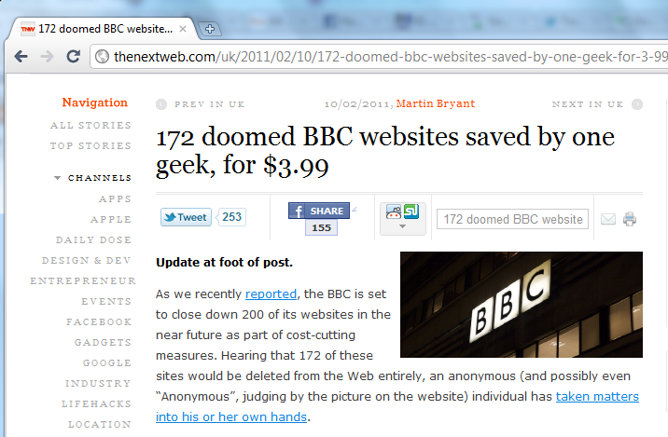
Heroic solo efforts

Slide 6
If you could choose a website to preserve for all time, what would you choose? What websites will people want to look at 50 to 500 years from now?

Slide 7
K12 Web Archiving Program
Program by Internet Archive and Library of Congress
5th to 12th graders get to participate in web archiving activities
As of Oct 2010, students in the program have archived 2,379 websites
Video: http://www.archive.org/details/K12WebArchivingProgramStudents

Slide 8
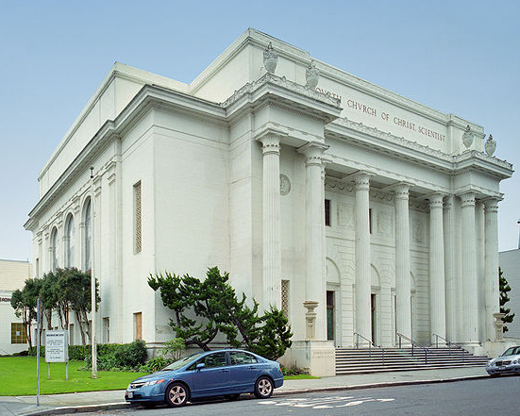
Who is archiving the Web?
Internet Archive
Founded by Brewster Kahle in 1996
Largest web archive in the world (240+ billion pages)
Pages available to public via Wayback Machine
Also collects old recordings, books, video, and other digital works
Images: http://en.wikipedia.org/wiki/Internet_Archive

Slide 9
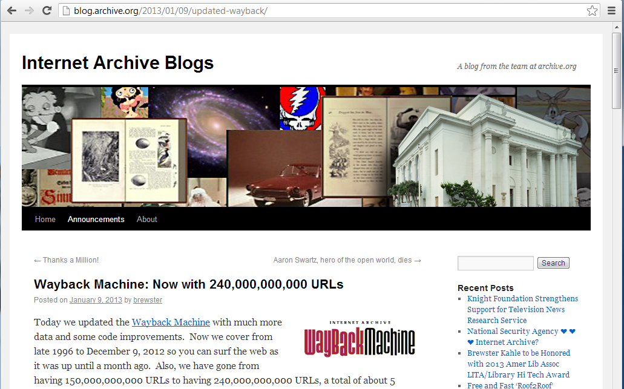

Slide 10
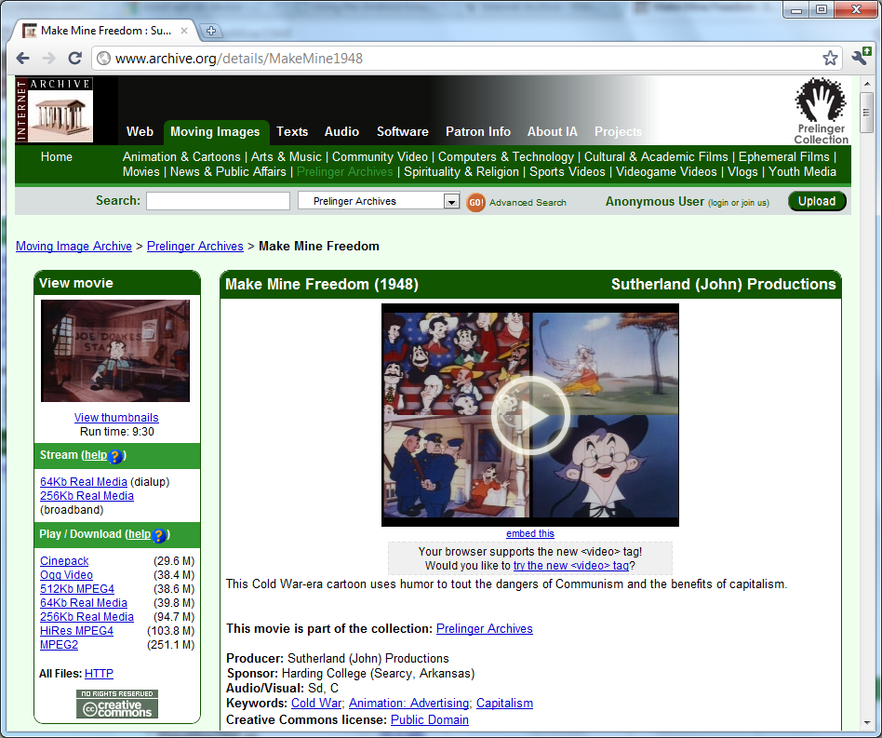

Slide 11
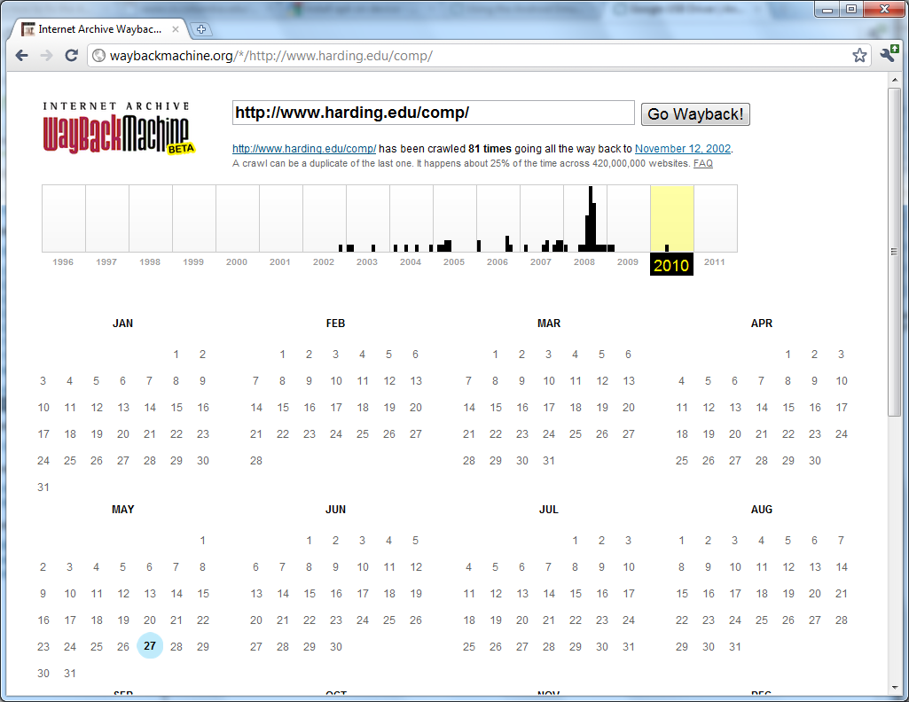

Slide 12
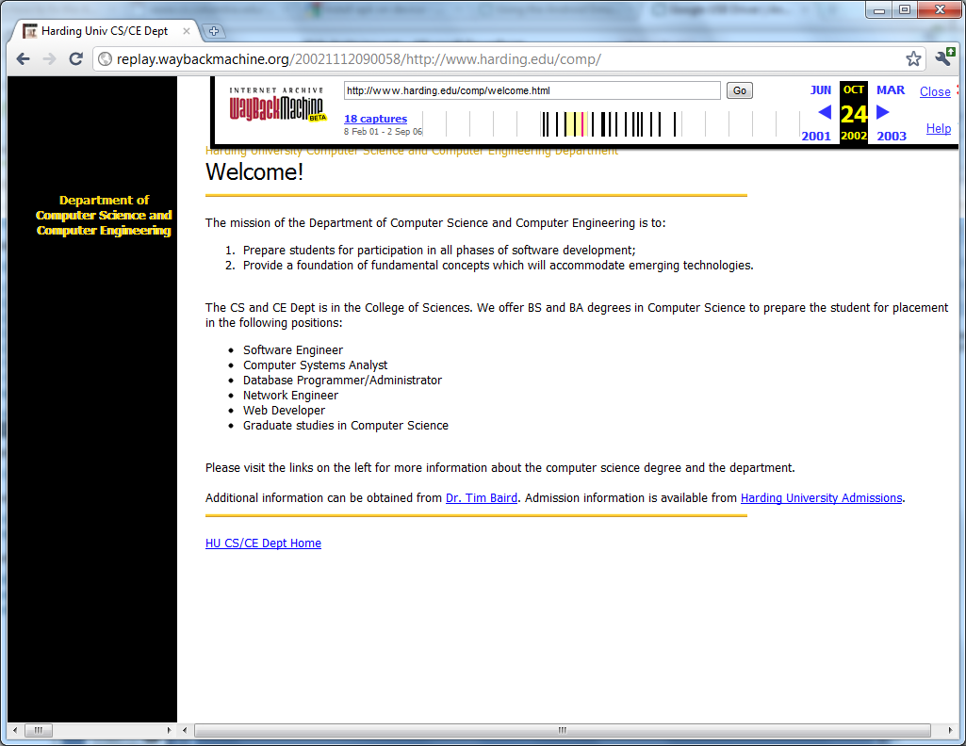
Missing logo
Archived page from Nov 2002

Slide 13
Who is archiving the Web?
National libraries & national archives, usually focusing on culturally significant web collections
US Library of Congress: Minerva
UK Web Archiving Consortium: UK Web Archive
National Library of Australia: PANDORA
Etc.
Commercial organizations
Hanzo Archives: commercial web archiving tools
Nextpoint: archiving service for organizations
Iterasi: for corporate, legal, and govt
Etc.

Slide 14
Other Players
Free on-demand archiving
WebCite: for saving citable web resources
archive.today
www.freezepage.com
Many others…

Slide 15
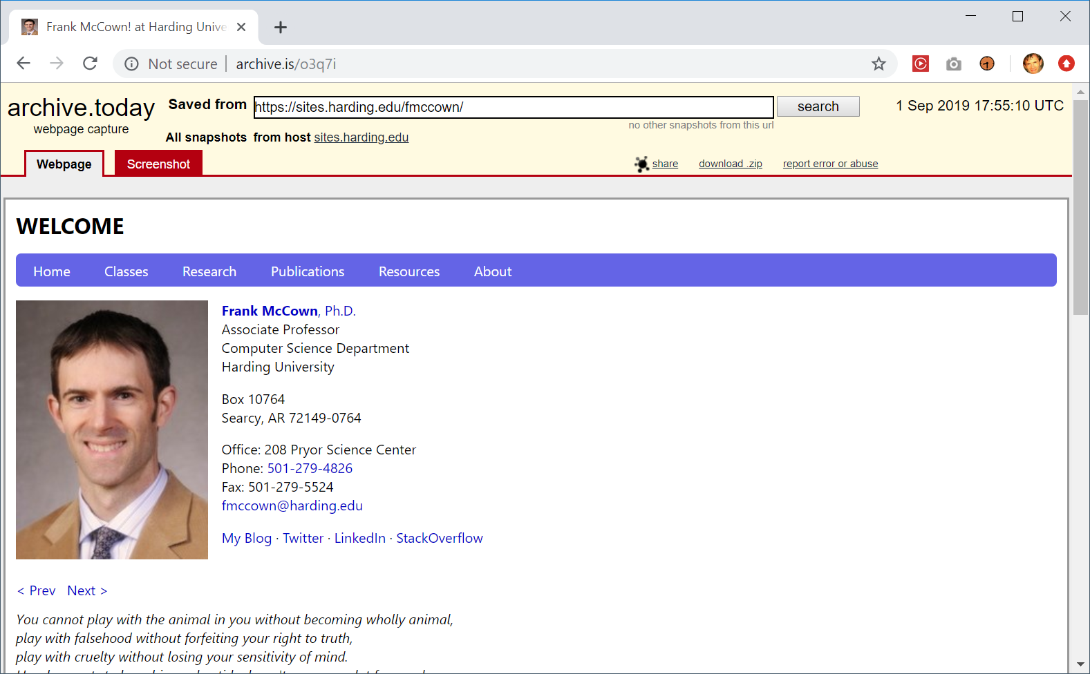
http://archive.is/https://sites.harding.edu/fmccown/

Slide 16
Special Collections
Library of Congress has numerous collections
Twitter archive, 9/11, Iraq War, & much more
Archive-it.org (ran by Internet Archive)
Homeless websites in LA, Virginia Tech shooting, &much more
Stanford WebBase
US Presidential election 2008, Virginia Tech shootings, Hurrikane Ike 2008
Geocities archive
Number of archiving groups: ReoCities, OoCities, and Internet Archive
652 GB torrent also available
ArchiveFacebook
Firefox add-on created to archive individual Facebook pages

Slide 17
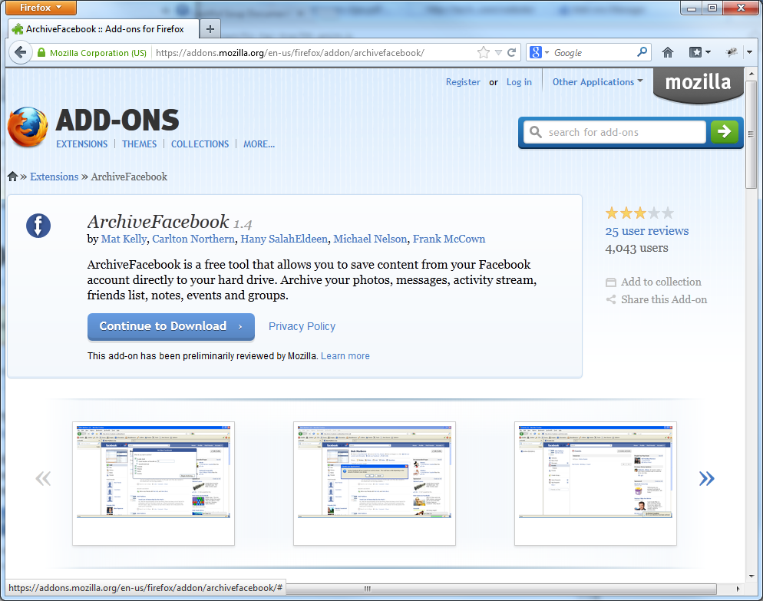

Slide 18
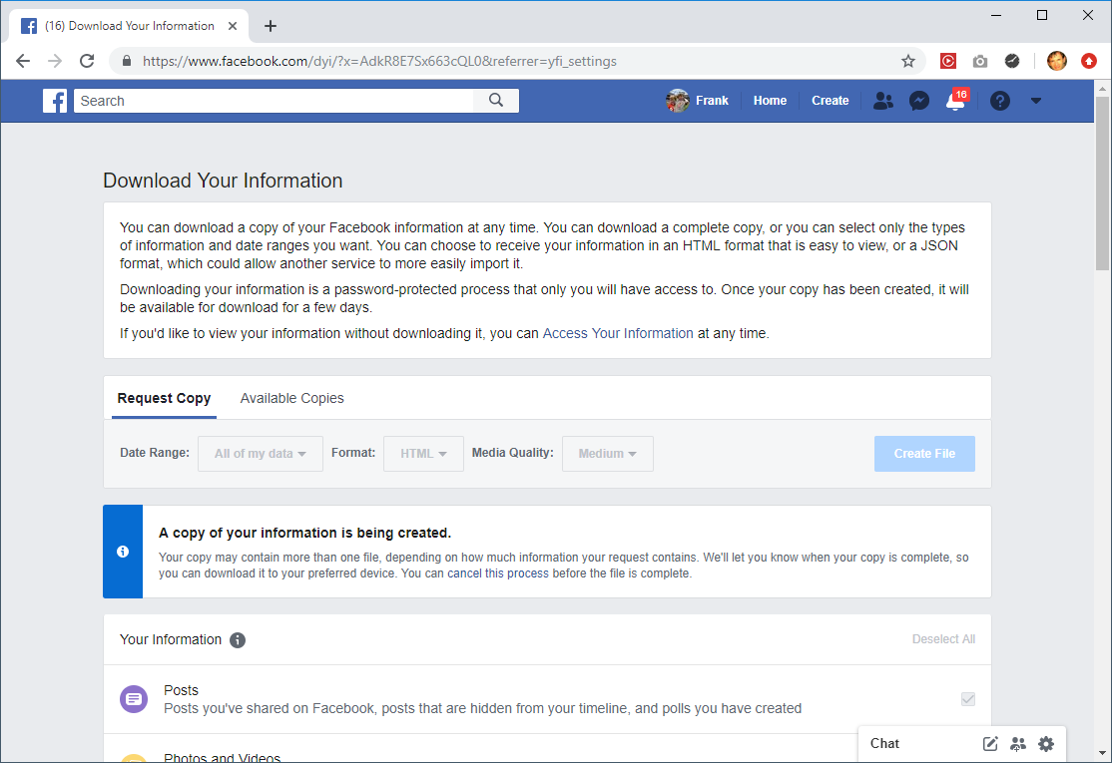

Slide 19
Tools for Web Archiving
Web crawlers
WARC tools
Archive viewer/searcher

Slide 20
Web Crawlers
Wget and HTTrack
Simple tools for mirroring a website
All crawled URLs are converted into a path and file
http://foo.org/test/ saved as foo.org/test/index.html
Not designed for large-scale crawling
Heritrix
Built by Internet Archive and Nordic national libraries for larger web archiving tasks
Archived content stored in Web ARChive file format (WARC)
Uses web interface
Can find links in JavaScript, Flash, etc.

Slide 21
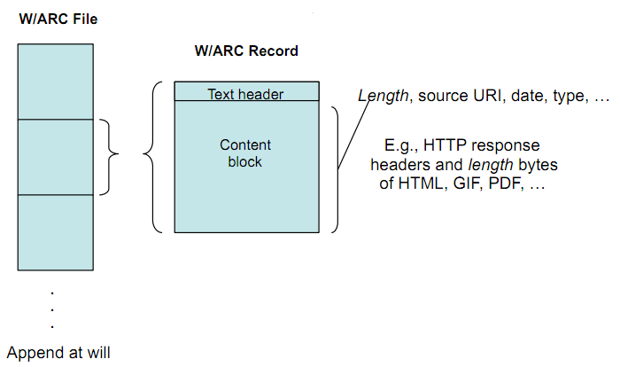
WARC File Organization
Slide from John Kunze at http://www.iwaw.net/05/kunze.pdf

Slide 22
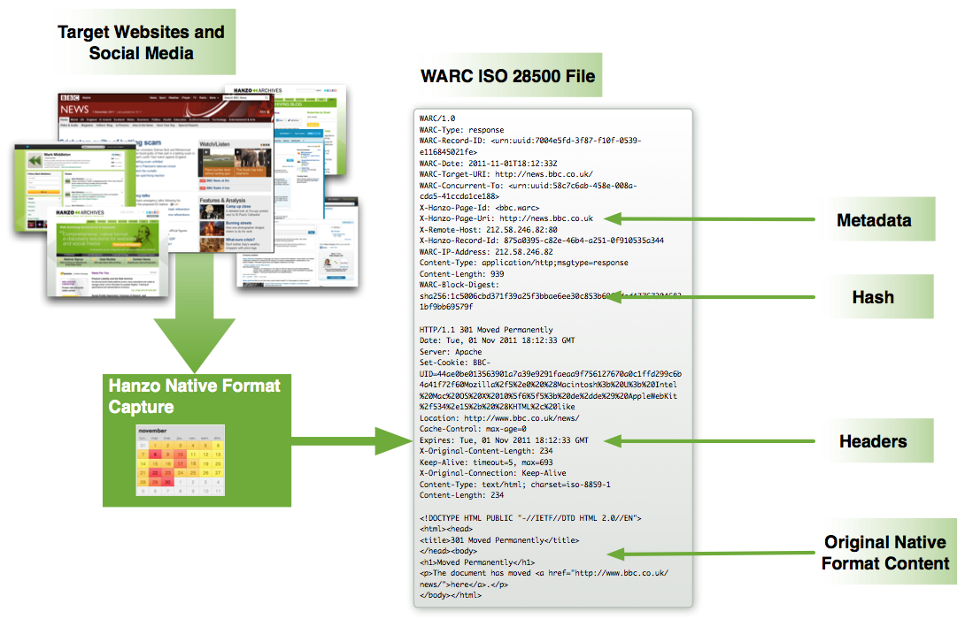
Image from Hanzo: http://www.hanzoarchives.com/learn/faq/iso-28500-warc-faq/

Slide 23
WARC Tools
warc-tools
Python scripts for interacting with WARC files
webrecorder
http://webrecorder.io/
WARCreate & WAIL
http://ws-dl.blogspot.com/2013/07/2013-07-10-warcreate-and-wail-warc.html
http://ws-dl.blogspot.com/2014/07/2014-07-22-archive-what-i-see-now.html

Slide 24
Archive Viewers/Searchers
Wayback
Open source Java implementation of IA’s Wayback Machine
Search by URL
pywb
Python implementation of IA's Wayback Machine
NutchWAX
Full-text search of a web archive
Shine
based on SOLR

Slide 25
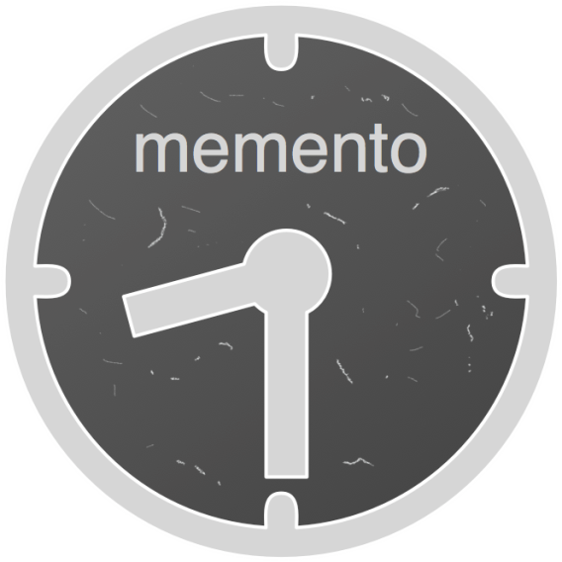
Memento – Date/Time Negotiation
Memento is an addition to HTTP that enables HTTP content negotiation to retrieve older versions (Mementos) of web resources
Agent requests URI with Accept-Datetime set to desired date/time
Server responds with a link to a TimeGate which knows the Mementos available for the URI
Agent makes request to TimeGate and receives response with the URL to the Memento
Learn more: http://mementoweb.org/

Slide 26
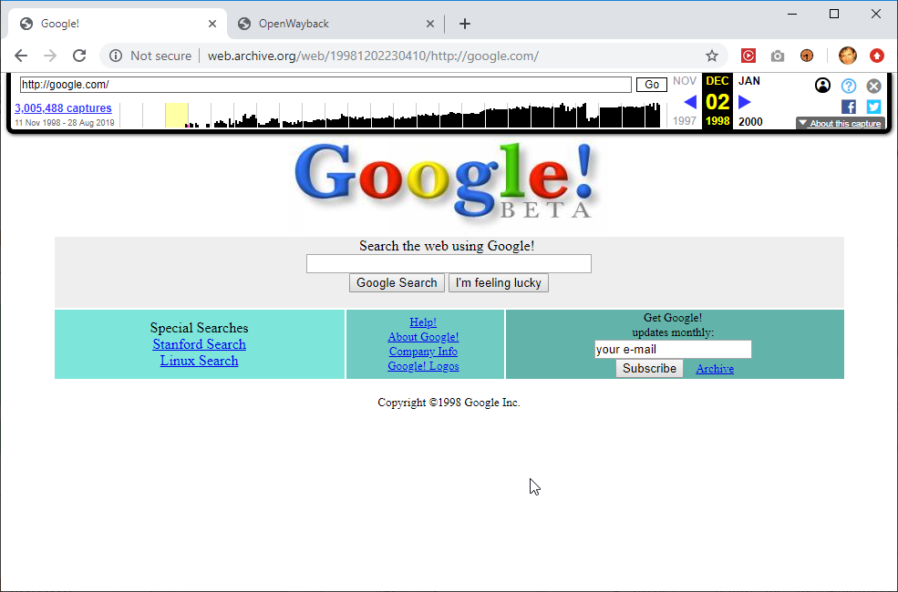
Memento Time Travel Chrome extension
https://chrome.google.com/webstore/detail/memento/jgbfpjledahoajcppakbgilmojkaghgm

Slide 27
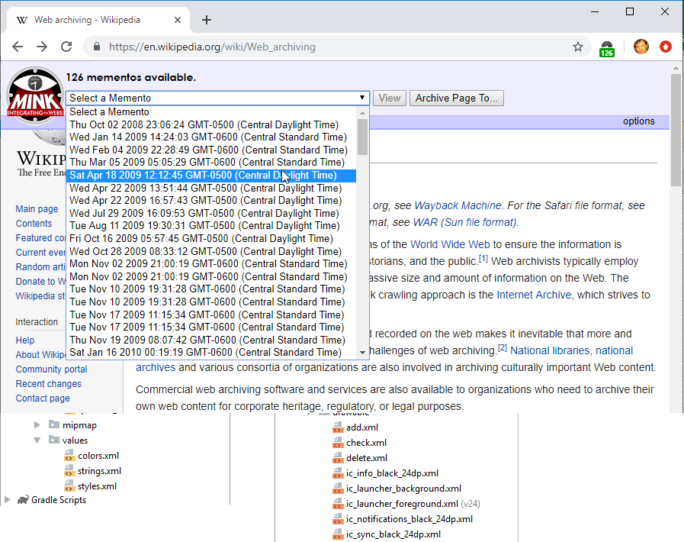
Mink Chrome extension
http://matkelly.com/mink/

Slide 28
Archiving the Deep Web
How are Deep web websites archived when links aren’t available to crawl?
One strategy: Get website owner to release their database (legal deposit)
DeepArc tool
Developed by National Library of France (BnF)
Transforms relational database content into XML for archiving purposes
Xinq tool
Developed by National Library of Australia
Allows online browsing and searching of XML database

Slide 29
How Much of the Web is Archived?
Study by Ainsworth et al. (JCDL 2011)
Sampled URLs from DMOZ, Delicious, Bitly, and search engine indexes
35-90% of URLs have at least one archived copy

Slide 30
Public Archives, ca. Late 2010 / Early 2011
Three categories of archives
Internet Archive
Search engine
Other archives
UK
US
See also: http://arxiv.org/abs/1212.6177

Slide 31
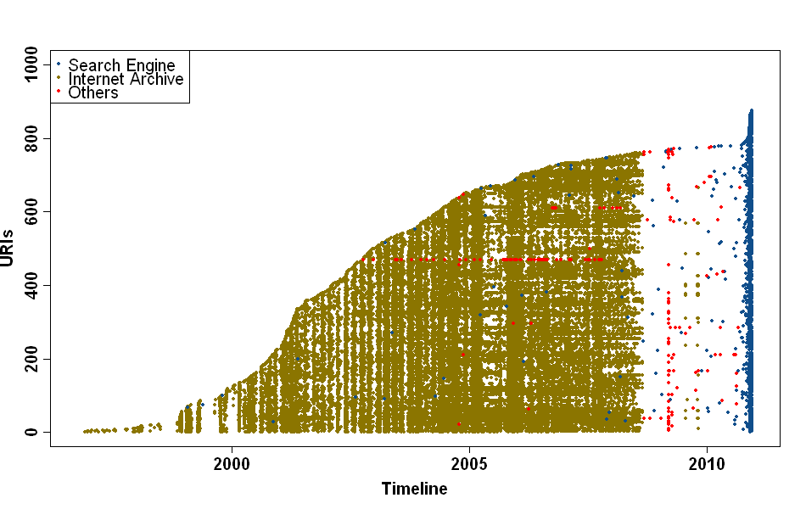
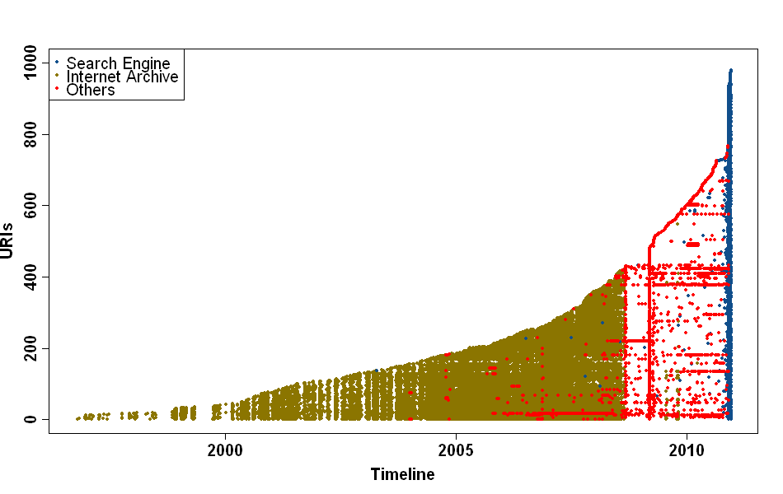
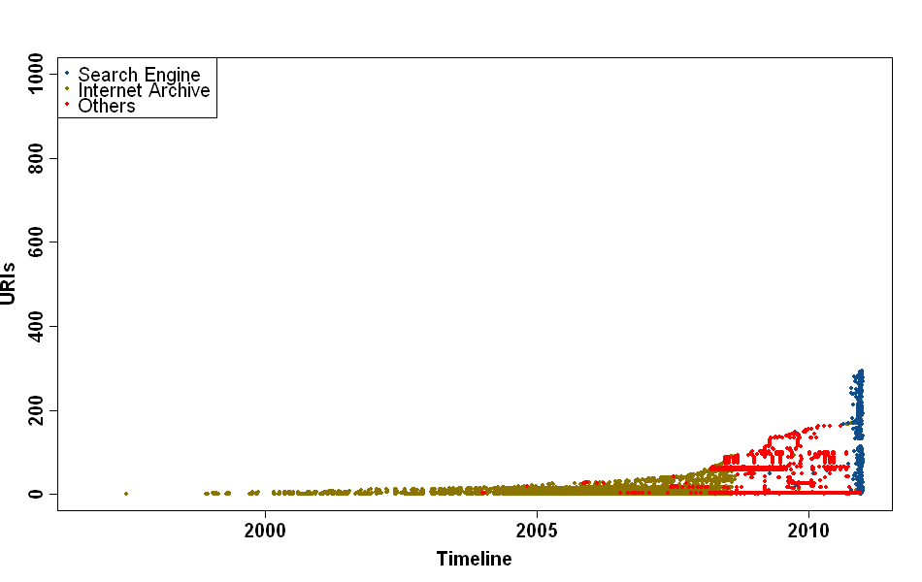
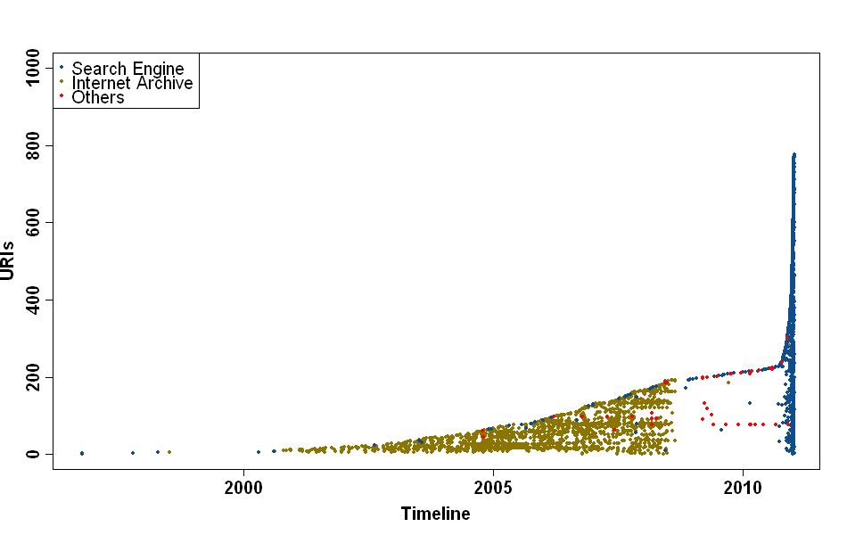

Slide 32
Let’s explore some novel uses of web archives

Slide 33
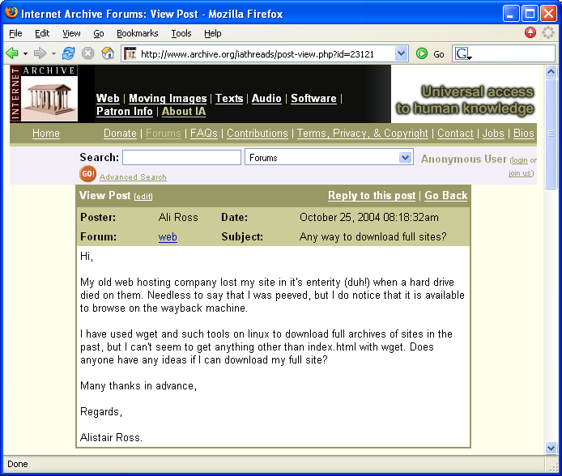
Transactional Archiving
Archive every http transaction between a web browser and web server
Gives evidence that on date D content C was delivered
Often used by organizations that are legally bound to retaining such information
Commercial products:
PageVault, Vignette WebCapture, webEcho

Slide 34
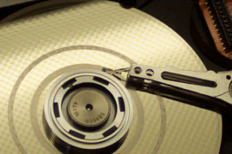
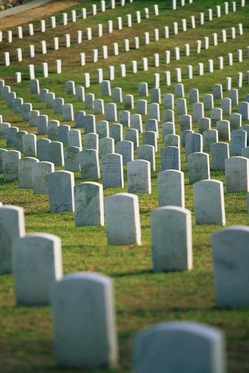
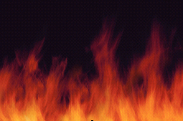
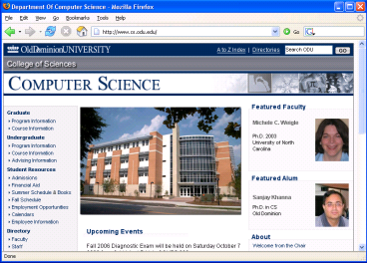
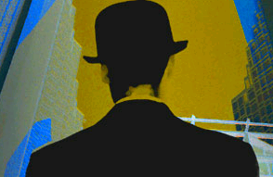
Black hat: http://img.webpronews.com/securitypronews/110705blackhat.jpg Virus image: http://polarboing.com/images/topics/misc/story.computer.virus_1137794805.jpg Hard drive: http://www.datarecoveryspecialist.com/images/head-crash-2.jpg

Slide 35
Web Infrastructure

Slide 36
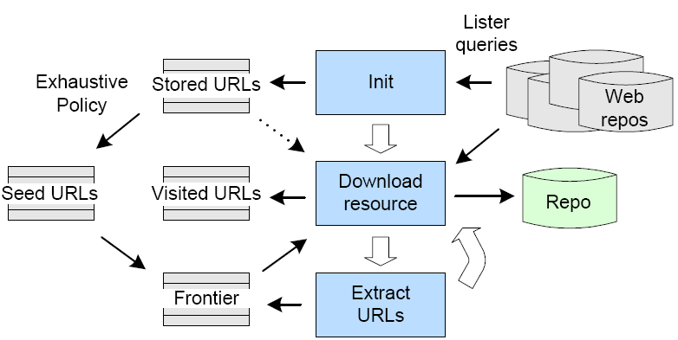
Web Repository Crawling
Warrick developed in 2005 as a web repository crawler
Used to recover thousands of websites from the WI
Available at http://warrick.cs.odu.edu/
Lazy Preservation: Reconstructing Websites by Crawling the Crawlers by McCown et al. (2006)

Slide 37
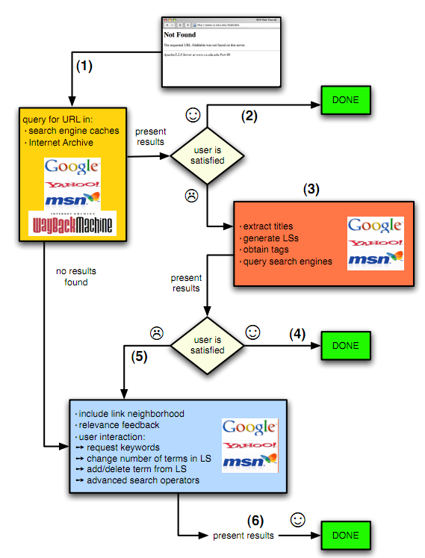
Using the WI to find missing web pages
Klein & Nelson, Evaluating Methods to Rediscover Missing Web Pages
from the Web Infrastructure, JCDL 2010

Slide 38
More Reading
Bleicher (2011), A Memory of Webs Past http://spectrum.ieee.org/telecom/internet/a-memory-of-webs-past/0
Masanès (2006), Web Archiving, Springer
Lyman (2002), Archiving the World Wide Web http://www.clir.org/pubs/reports/pub106/web.html
Leetaru (2017), Why Are Libraries Failing At Web Archiving And Are We Losing Our Digital History? https://www.forbes.com/sites/kalevleetaru/2017/03/27/why-are-libraries-failing-at-web-archiving-and-are-we-losing-our-digital-history/#63548d1e6ecd

