Slide 1
Bystander Intervention
What can I do to combat dating violence, domestic violence, sexual assault, and stalking?

Slide 2


Importance of the Bystander Approach
The bystander approach
offers opportunities to build
communities and a society
that does not allow sexual
violence. It gives everyone in
the community a specific role
in preventing the community’s
problem of sexual violence.
Banyard et al, 2004

Slide 3
The Harding Community
Harding University offers a unique environment in which sexual immorality, sexual violence, and sexual harassment of any kind are not tolerated and are contrary to Biblical teaching. Through our faith in God- students, faculty, and staff are committed to approach our brothers and sisters in Christ with concern, compassion, and also conviction. “Bystander Intervention” is our norm.

Slide 4
Introduction
Regardless of how close to the assault they are, bystanders have the power to stop assaults from occurring and to get help for people who have been victimized.
People in a bystander role often describe feeling scared, alone, and afraid to say or do something in the face of violence.
Bystanders fear making someone angry, possibly misunderstanding the situation, or even triggering further violence.
The bystander intervention approach has recognized that saying or doing something is not necessarily a single event by a single hero.
In many situations, there are a variety of opportunities, and numerous people who can choose to intervene.
People might intervene in less extreme situations, such as saying something at a party when a man is harassing a woman.

Slide 5
Benefits of Bystander Approach
Discourages victim blaming
      With bystanders as active participants, the sense of responsibility shifts away from victims and toward the family, friends and the whole community
Offers the chance to change social norms
      Studies show that social norms can play a significant role in violence prevention, especially in communities such as college campuses
Shifts responsibility to men and women
      The bystander approach shifts the framing of men as perpetrators and women as victims to engage both men and women as equals in prevention

Slide 6
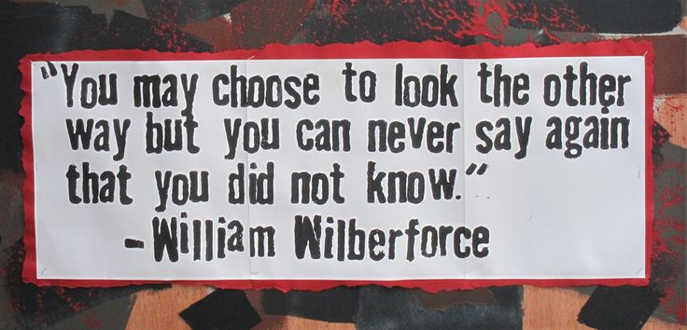
What is a Bystander?
The reality is that everyone is a bystander, every day, in one way or another to a wide range of events that contribute to sexual violence
Everyone has probably witnessed a situation in which someone makes an inappropriate sexual comment or perpetrates sexual harassment.
Sometimes, we say something or do something, but at other times, we choose simply to ignore the situation.

Slide 7
Impact of Sexual Violence
Research has revealed much about the lifelong impact of sexual violence on the lives of many survivors (Feletti et al., 1998).
More recently, researchers have considered the impact of sexual violence on those who come into contact with victims and perpetrators (Bird-Edmunds, 1997).
Friends and family of victims and/or perpetrators of sexual violence are particularly affected, as are the professionals who work with them.
If we accept the premise that all of us are affected in some way by sexual violence, how do we decide whether it makes sense to say or do something as an act of prevention?

Slide 8
Moving Toward Individual Bystander Intervention
There are literally hundreds of little comments, harassments, and other forms of abuse that lead up to what we think of as the sexually violent act.
If we limit our interventions to a culminating “event,” we miss multiple opportunities to do something or say something before someone is harmed.
Instead, think of the “event” as being on a continuum of behaviors that demand specific interventions at each step.
Each situation is an opportunity to intervene by reinforcing positive behaviors BEFORE a behavior moves further towards sexual violence.

Slide 9
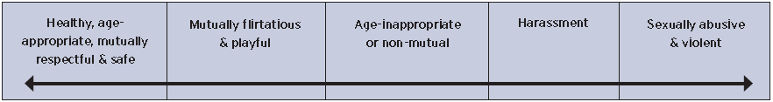
Continuum of Behaviors
When looking at all of the behaviors along this continuum there are a number of ways to either say something or do something in each category. There are many ways to take action and many opportunities to take action with no one right answer.
(Adapted from The Touch Continuum, Anderson, 2000.)

Slide 10
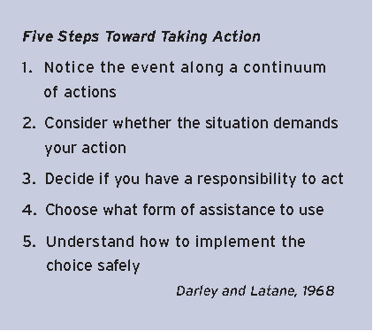
Steps to Intervention

Slide 11
Situational Factors
Research has detailed several situational factors that may affect a person’s willingness to act. They include:
      The presence and number of other victims
      The uncertainty of the situation
      The perceived level of urgency or danger for the victim
      The setting of the event
Some research has shown that people are less likely to act if there are other people around because an individual may feel that someone else is in a better position to say or do something

Slide 12
Characteristics of the Bystander
Characteristics of the bystander that may influence his or her decision to intervene include:
      Relevant skills and experience
      Relationship to the victim and/or the perpetrator
      Feelings and attitudes
      Perception of the personal costs of either intervening or doing nothing
Studies show that the bystander’s relationship with the potential victim has a significant impact on whether they will act

Slide 13
Shifting Social Norms
Programs that promote bystander involvement recognize the importance of shifting existing social norms so that there is social pressure to do or say something instead of nothing (Berkowitz, 2003).
The Harding Community, through our belief and faith in God, stands with each other against sexual violence and to actively promote healthy relationships.
Through His word, God teaches us to be sexually pure:
      1 Thessalonians 4:3- It is God’s will that you should be sanctified: that you should avoid sexual immorality. (NIV Version)
      1 Corinthian 6:18- Flee from sexual immorality. All other sins a person commits are outside the body, but whoever sins sexually, sins against their own body.
God also teaches us to encourage and guide each other in what is right:
      Hebrews 3:13- But encourage one another daily, as long as it is called “Today,” so that none of you may be hardened by sin’s deceitfulness.

Slide 14
Bystander Intervention Strategies
“I” statements
    Three parts: 1. State your feelings, 2. Name the behavior, 3. State how you want the person to respond. This focuses on your feelings rather than criticizing the other person.
    Example: “I feel when you . Please don’t do that anymore.”
Silent Stare
    Remember, you don’t have to speak to communicate.
    Sometimes a disapproving look can be far more powerful than words.
Humor
    Reduces the tension of an intervention and makes it easier for the person to hear you.
    Do not undermine what you say with too much humor. Funny doesn’t mean unimportant.

Slide 15
Bystander Intervention Strategies (Cont.)
Group Intervention
    There is safety and power in numbers.
    Best used with someone who has a clear pattern of inappropriate behavior where many examples can be presented as evidence of his problem.
Bring it Home
    Prevents someone from distancing himself from the impact of his actions.
          Example: “I hope no one ever talks about you like that.”
    Prevents someone from dehumanizing his targets.
          Example: What if someone said your girlfriend deserved to be raped or called your mother a name?”
We’re friends, right….?
    Reframes the intervention as caring and non-critical.

Slide 16

Bystander Intervention Strategies (Cont.)
Distraction
    Snaps someone out of their “sexist comfort zone.”
          Example: Ask a man harassing a woman on the street for directions or the time.
    Allows a potential target to move away and/or to have other friends intervene.
          Example: Interrupt and start a conversation with the person.

Slide 17
Tips for Intervening
Approach everyone as a friend.
Do not be antagonistic.
Avoid using violence.
Be honest and direct whenever possible.
Recruit help if necessary.
Keep yourself safe.
If things get out of hand or become too serious, contact Public Safety at 501-279-5000

Slide 18

Important!
We are not advocating that people risk their own safety in order to be an active bystander. Remember, there is a range of actions that are appropriate, depending on the situation. If you or someone else is in immediate danger, calling 501-279-5000 or 911 is the best action a bystander can take.

Slide 19
How Can Bystanders Make A Difference?
Believe someone who discloses a sexual assault, dating violence, domestic violence, or stalking.
Watch out for your friends and fellow Bisons – if you see someone who looks like they are in trouble, ask if they are okay. If you see a friend doing something shady, say something.
Speak up – if someone says something offensive, derogatory, or abusive, let them know that behavior is wrong and you don’t want to be around it. Don’t laugh at racist, sexist, homophobic jokes. Challenge your peers to be respectful.

Slide 20
We have all been bystanders in our lives, and we will all be in situations where we are bystanders in the future. The choice, then, becomes whether we are going to be active bystanders who speak up and say something, or whether we will be passive bystanders who stand by and say nothing…

Slide 21
References
American Medical Association press release. (1995).
Anderson, C. (2000). The touch continuum: Part of a risk
reduction curriculum. SIECUS Report, 29, 24-27.
Banyard, V.L., Plante, E.G., & Moynihan, M.M. (2004). Bystander
education: Bringing a broader community perspective to
sexual violence prevention. Journal of Community Psychology,
32, 61-79.
Berkowitz, A.D. (2003). The social norms approach: Theory,
research and annotated bibliography. Higher Education Center
for Alcohol and Other Drug Prevention, www.edc.org/hec/
socialnorms/.
Bird-Edmunds, S. (1997). Impact: Working with sexual abusers.
Brandon, VT: Safer Society Press.
Centers for Disease Control and Prevention. (2004). Sexual
violence prevention: beginning the dialogue. Atlanta, GA:
Centers for Disease Control and Prevention.
Christy, C.A., & Voigt, H. (1994). Bystander responses to public
episodes of child abuse. Journal of Applied Social Psychology,
24, 824 – 847.
Crick, N. R., & Dodge, K. A. (1994). A review and reformulation
of social information processing mechanisms in children’s
social adjustment. Psychological Bulletin, 115, 74–101.
Dahlberg, L.L., & Krug, E.G. (2002). Violence – a global public
health problem. In: E.G. Krug, L.L. Dahlberg, J.A. Mercy, A.B.
Zwi, & R. Lozano (Eds.), World Report on Violence and Health
(pp. 3-21). Geneva, Switzerland: World Health Organization.
Darley, J.M., & Latane, B. (1968). Bystander intervention in
emergencies: Diffusion of responsibility. Journal of Personality
and Social Psychology, 8, 377-383.
Davis, R., Fuje Parks, L., & Cohen, L. (2006). Sexual violence
and the spectrum of prevention: Towards a community solution.
Enola, PA: National Sexual Violence Resource Center.

Slide 22
References (Cont.)
Felitti, V.J., Anda, R.F., Nordenberg, D., Williamson, D.F., Spitz,
A.M., Edwards, V., Koss, M.P., et al. (1998). The relationship
of adult health status to childhood abuse and household
dysfunction. American Journal of Preventive Medicine, 14,
245-258.
Foubert, J.D., & Newberry, J.T. (2006). Effects of two versions
of an empathy-based rape prevention program on fraternity
men’s rape survivor empathy, attitudes, and behavioral intent
to commit rape or sexual assault. Journal of College Student
Development, 47, 133-146.
Katz, Jackson. (2006). The macho paradox: Why some men
hurt women. Naperville, IL: Sourcebooks, Inc.
Smedley, B.D. & Syme, S.L. (Eds.). (2000). Promoting health:
Intervention strategies from social and behavioral research.
Washington, DC: National Academy of Sciences Press.
Tabachnick, J. (2000). View from the field. SIECUS Report,
29, 47-49.
Tabachnick, J. (2008). Engaging Bystanders in Sexual Violence Prevention.
Enola, PA: National Sexual Violence Resource Center Press
http://www.stopabuse.vt.edu/bystander.php

